Slide 1

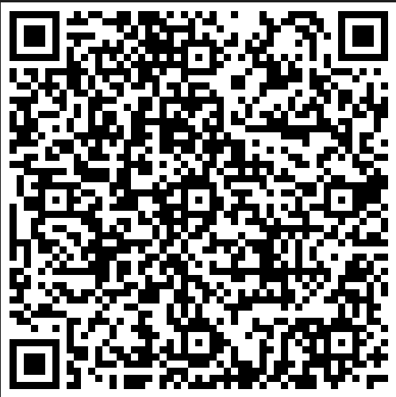
Telling Your Research Story:
Leveraging MSU's Resources for Funding Success and Strategic Visibility
9.6.23
Office of Research & Economic Development

Slide 2

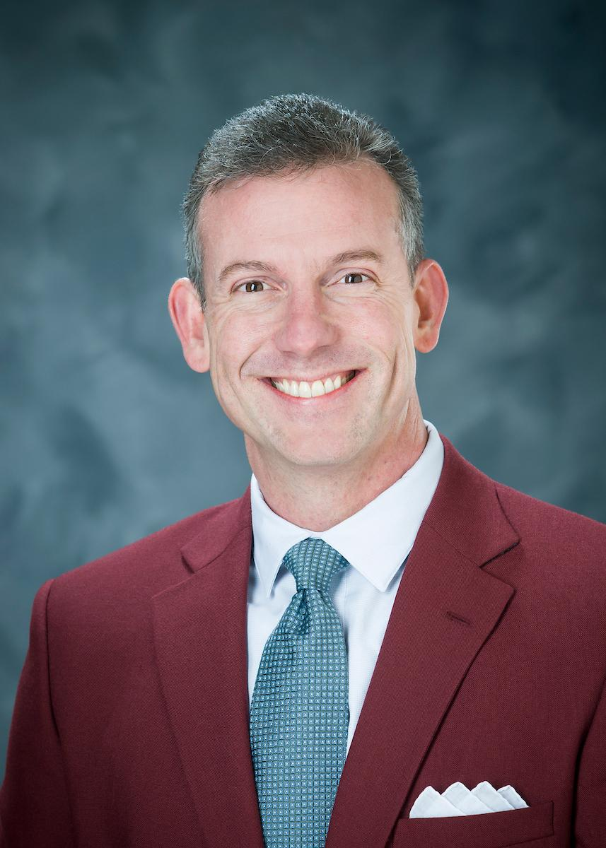
Brent J Fountain, Phd RD
Vice Provost
Extension Professor, Nutrition
Faculty Athletics Representative, SEC & NCAA
bfountain@provost.msstate.edu
Transforming MSU
additional resources

Slide 3
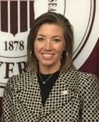
Stephanie Hyche, MS, CRA
Director, Office of Research Development
stephanie@ord.msstate.edu
ord.msstate.edu
Collaborator Identification
Persuasive Proposals
  Quality writing & visuals
  Voice & content for targeted audiences
Broader Impacts
  The impact chain; broadening participation
Dissemination/Deliverables
Telling your story for funding success
additional resources

Slide 4
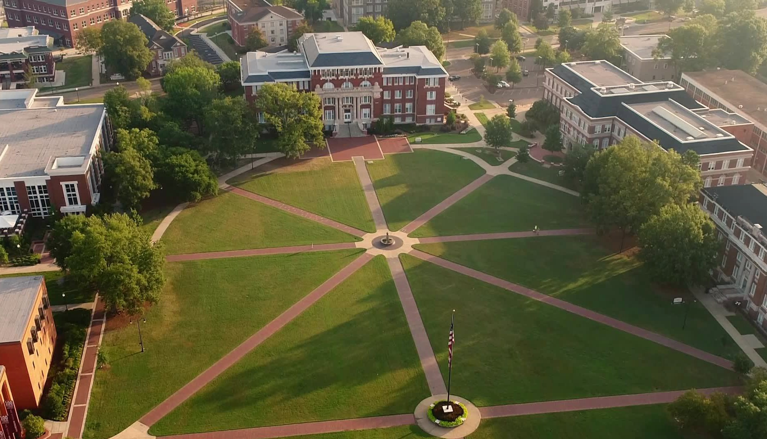

ORED SEMINAR SERIES TELLING YOUR RESEARCH STORY: AMPLIFYING MSU
09.06.2023
Colvard Student Union
Fowlkes Auditorium
2—4 p.m.
AMPLIFYING MSU
  Telling Our Story
  What is a Brand, Anyway?
  Our Purpose and Promise, Video Style
  Integrated Messaging
  Consistency Is Key
  Voice
  Messaging
Notes:
Thanks for being here today and for this chance to speak with you. My name is Chris Bryant, and I’m part of the public affairs team.
Today we want to talk a bit about how we amplify Mississippi State, our branding efforts and how our new approach to voice and messaging fit in.

Slide 5
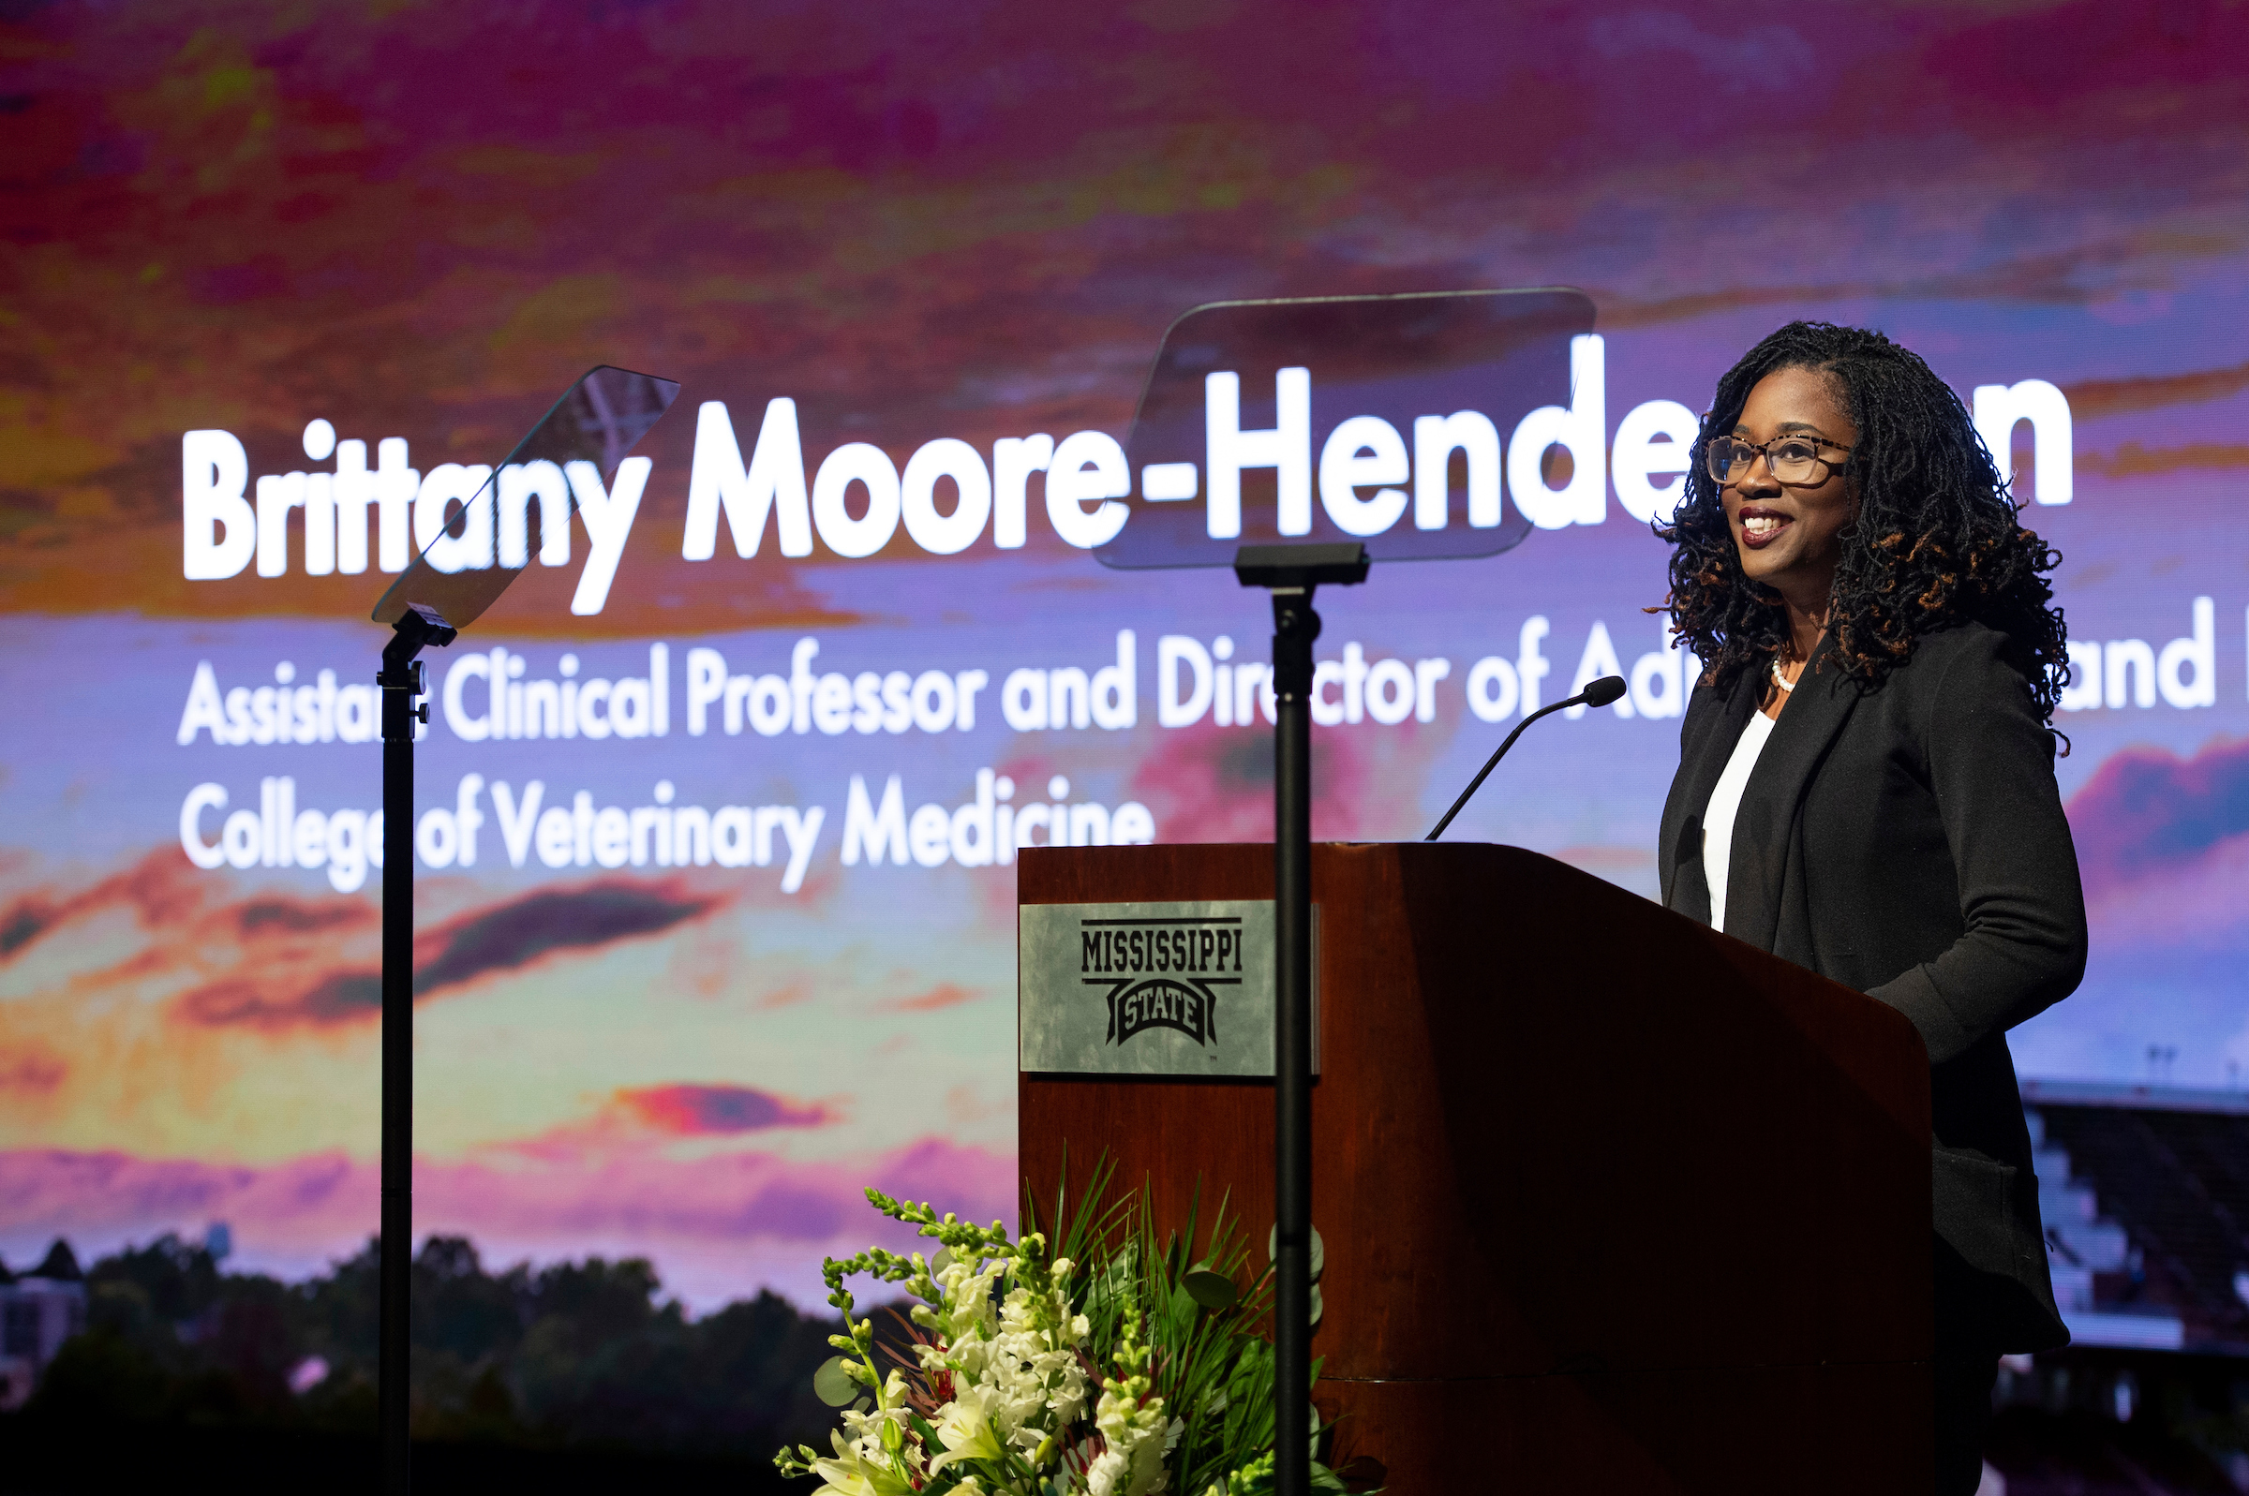

MSU launches new branding campaign during Strategic Plan introduction event on April 11, 2023
Launch emphasizes newest tagline, “Taking Care of What Matters.”
Notes:
Last spring, MSU publicly introduced its new strategic plan, “Transforming MSU.” During that event, we also launched a new branding campaign and emphasized our newest tagline, “Taking Care of What Matters.”

Slide 6
Our Vision and Pillars
At Mississippi State, we’re redefining the role of a land-grant university. We provide an innovative, hands-on learning experience, ​meeting all students where they are and equipping them for a world that needs their talent. We’re working to help our communities prosper while exploring cutting-edge solutions to the world’s biggest challenges.
Together, we’re taking care of what matters in the 21st century – starting in our own backyard.
SERVE THE WHOLE STUDENT
Help students thrive through innovative academic programs and memorable experiences while ensuring a holistic focus on student well-being
STRENGTHEN OUR
BONDS
Grow and nurture relationships that further enhance our vibrant community
IGNITE
INNOVATION
Foster life-changing research and creative endeavors to advance our society
ELEVATE OUR COMMUNITY
Serve our communities with the knowledge and experience that address critical challenges and unique opportunities
TELL OUR
STORY
Grow awareness and shape the perception of MSU by amplifying the stories, impacts and excitement of our community
Notes:
You’ll recall that at the heart of our Strategic Plan is our north star vision for transformation, as you see here. The plan is guided by these five pillars. Each pillar represents an essential focus area.

Slide 7
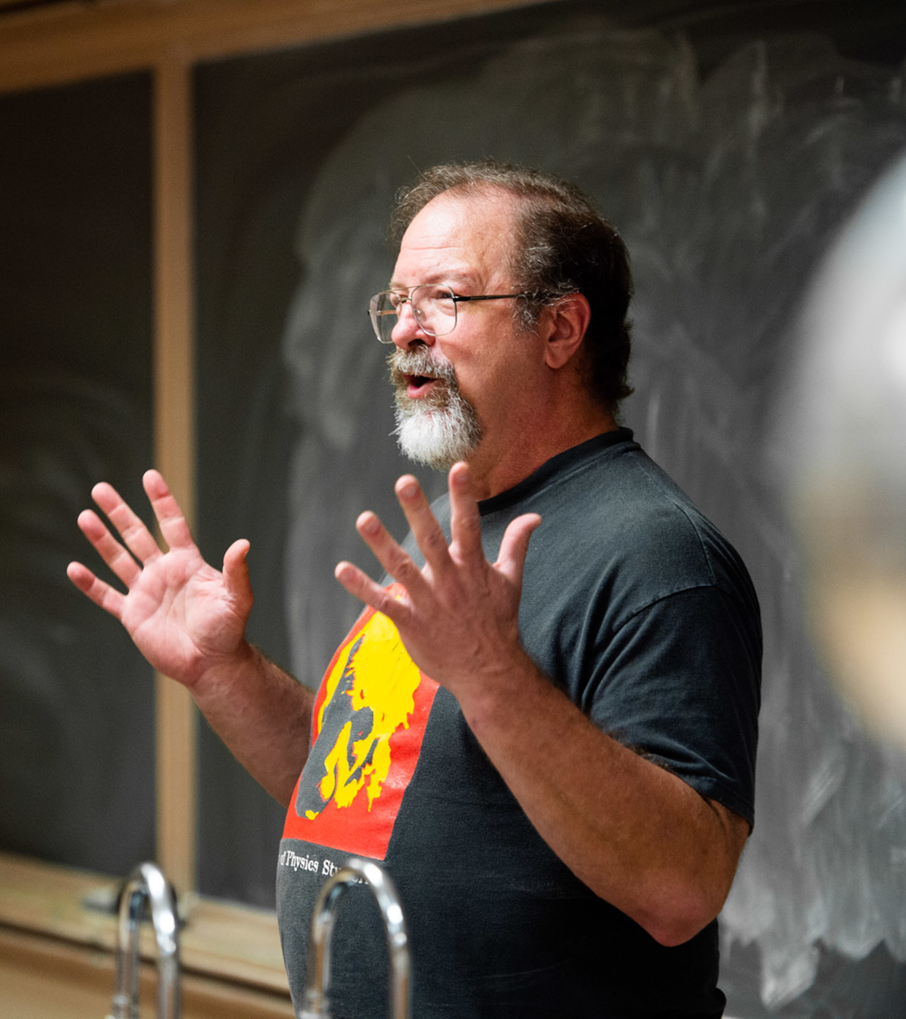
TELL OUR STORY
Grow awareness
and shape the perception
of MSU by amplifying the
stories, impacts and
excitement of our community
Notes:
The pillar we’ll highlight today is “Tell Our Story.” Through the initiatives under development within this pillar, we’ll grow MSU’s brand awareness and increase the positive perceptions of MSU. This will encourage engagement.

Slide 8
Tell Our Story Goals:
Grow MSU’s brand recognition beyond Mississippi and the Southeast
1
Engage more individuals in experiencing MSU’s teaching, research and outreach offerings
2
Celebrate the value of MSU’s efforts within Mississippi and communities like ours.
3
Notes:
What do we mean by engagement? It can mean lots of things, including external recognition, admissions applications, donations, partnerships, faculty recruitment efforts, etc. Our communication efforts don’t directly produce these things, but they can encourage them. More directly, when we tell our story effectively, we increase our brand relevance.

Slide 9
Our Brand Strategy
PURPOSE (why we do what we do)
We believe we must reimagine the role and impact of a national university in solving the world’s most critical challenges, starting in our own backyard.
PROMISE (what we deliver to our audiences)
We apply an innovative, hands-on approach to tackle emerging challenges by coming together to do the hard work and drive meaningful change.
PRINCIPLES (how we uniquely deliver on our promise)
ACADEMICS Applied Experiences | ACCESS Uncommon Opportunities | IMPACT Meaningful Impact | EXPERIENCE Positive Environment
We design academic programs and research with the end in mind, equipping each of our students with the experiences and problem-solving skills they need for success in their careers and beyond. | We eliminate barriers to quality education, connecting students to new opportunities, ideas, and relationships in a safe and collaborative environment—on campus and digitally. | We never stop pursuing a better collective future; we use our tenacity and teamwork to develop solutions with real local, national and global implications. | We provide a dynamic student experience within an inviting campus and college town, where students of diverse interests and backgrounds can explore what excites them and build lasting memories.
Notes:
Let’s pause for a moment and ask ourselves. What is our brand? Our brand is the perception others have of us. Elements in our brand include our purpose and our promise. It incorporates our design standards, our voice, our products, our services, our experiences, our culture. Our brand is us.
This slide describes our brand strategy. This is the backbone, the essence of everything we do at Mississippi State.
Where did this come from?
Well, if you look closely at the purpose and promise, you’ll see that it’s intentionally aligned with our North Star Vision for Transformation.
Where did these principles come from?
These principles were created by us and our MSU colleagues across campus working alongside Prophet, our consultant company, during the last academic year. MSU agreed these were principles that represented us and the things we wanted to emphasize – the most relevant things to be talking about at the university level.

Slide 10


In-house produced brand video
Notes:
They say a picture is worth 1,000 words. So, I thought a two and a half-minute video would be worth at least a million.
This video helps articulate our brand position. It demonstrates why we exist and what we promise our audiences. Let’s watch. That was produced by the Office of Public Affairs’ University Television Center and debuted last spring during our brand launch. It’s appearing on various social media channels and lives on our brand site. It is serving as the inspiration for MSU’s NCAA institutional spot.

Slide 11
We believe an integrated communications strategy is integral to activating the brand and creating clarity for internal and external audiences.
An integrated approach to comms ensures that every interaction a person has with MSU is consistent with the university’s identity and reinforces the same major themes.
This model creates a seamless experience that ensures clarity among all audiences, even when they’re interacting with different areas of the university.
It also equips us with the tools to make work easier, more efficient and more effective.
Notes:
Today, we also want to talk about the importance of integrated communications and the role it plays within our branding efforts and the Tell Our Story pillar.
OPA is far from the only story tellers on campus. We recently asked HR to pull an updated list of everyone on campus who has communication or marketing listed in their job descriptions. There were more than 160 people on the list. There’s about 20 of us in OPA.
It’s a blessing to have people outside of OPA who are directly responsible for communications, and it also creates some opportunities for us to work harder to align on messaging.
Through Prophet’s work with OPA and select communicators across campus, we have developed a new voice and messaging approach for MSU.

Slide 12

An integrated comms strategy creates a thread that infuses a common voice throughout all our communications …
OFFICE OF THE PRESIDENT
OUR COLLEGES
CENTERS & INSTITUTES
ATHLETIC DEPARTMENT
SATELLITE CAMPUS/ONLINE
OUR VISION & IDENTITY
LIBRARIES
STUDENT EXPERIENCES
Notes:
It’s important that MSU have a recognizable and consistent brand … that we speak with one voice, as it were. When we have consistency of messaging and voice, when we’re all singing from the same sheet of music, the message the audience hears will be more pleasant, recognizable and memorable. This is important because, to date, we haven’t often communicated in the most integrated manner. Our aim is to move our communications and our brand identity in a more integrated manner so that across all different channels, across all different pieces of content, we come across as a single university.

Slide 13

… while allowing MSU communicators to be creative and craft messaging for their specific audiences and agendas.
MSU BRAND IDENTITY & PURPOSE
YOUR
SPECIFIC CONTENT
20%
80%
BENEFITS OF THIS APPROACH
Ensures we are all aligned in our verbal and visual identity and presents a cohesive brand to internal and external audiences
Allows for creativity with audience-specific content that communicates your unique vantage point at the university
Creates clarity for audiences and increases brand awareness
Notes:
When we achieve the proper balance between incorporating our brand identity and purpose along with providing enough flexibility for MSU communicators to tell the stories they need to tell, creatively, we can meet both MSU’s overall brand needs and the individual needs of our colleges and units. We believe this 80/20 mix, as you see here, achieves this balance.

Slide 14
Voice is how we say what we say
WHY WE USE IT
Just like you get a sense for a brand through the way it looks, you can also understand a brand through the way it speaks.
Brand voice is a strategic tool that guides the style in which we write and say things.
When used correctly and consistently, our brand voice allows us to create a familiar connection to our audiences.
WHERE WE USE IT
Our voice should be applied across everything we write—from marketing and advertising to customer-service responses and internal communications.
When voice is done right, it’s memorable and dynamic.
Notes:
We don’t want to go too deep in the weeds today, but we did want to provide you with a taste of how this works.
When we talk about writing and MSU’s brand identity … we talk about writing with the appropriate voice and while incorporating the appropriate messaging.
Voice is not the words we use. It’s how we use them. It’s our writing style and the feeling our audience gets when they read our copy. When we use it consistently, it allows us to create a familiar connection with our audience, so they know MSU is speaking with them.

Slide 15
Messaging brings our brand strategy to life.
MESSAGING IS WHAT WE SAY
VOICE IS HOW WE SPEAK
Structure, order and prioritization of ideas
Our messages represent the big ideas we want our audiences to know and remember about MSU. We use our messages to inform, so that our writing maintains consistent themes that reinforce our overall brand.
Expression style: language, syntax, rhythm, etc.
Just like you get a sense for a brand through the way it looks, you can also understand a brand through the way it sounds. Brand voice is a strategic tool that guides our expression. When used consistently, our brand voice allows us to create a familiar connection with our audiences.
Notes:
We’re going to look at some examples that bring this to life a bit more.
But first, we want to a say a bit about messaging and contrast it with voice.
Messaging is what we say … some of the foundational messages as to what MSU is all about. Using messaging allows us to differentiate ourselves from our competitors. It also permits us to build a cohesive strategy to target our various audiences.

Slide 16
Our messaging themes keep us on brand
PURPOSE (why we do what we do)
We believe we must reimagine the role and impact of a national university in solving the world’s most critical challenges, starting in our own backyard.
PROMISE (what we deliver to our audiences)
We apply an innovative, hands-on approach to tackle emerging challenges by coming together to do the hard work and drive meaningful change.
PRINCIPLES (how we uniquely deliver on our promise)
ACADEMICS Applied Experiences | ACCESS Uncommon Opportunities | IMPACT Meaningful Impact | EXPERIENCE Positive Environment
We design academic programs and research with the end in mind, equipping each of our students with the experiences and problem-solving skills they need for success in their careers and beyond. | We eliminate barriers to quality education, connecting students to new opportunities, ideas, and relationships in a safe and collaborative environment—on campus and digitally. | We never stop pursuing a better collective future; we use our tenacity and teamwork to develop solutions with real local, national and global implications. | We provide a dynamic student experience within an inviting campus and college town, where students of diverse interests and backgrounds can explore what excites them and build lasting memories.
Messaging Themes
Develop dynamic skills | Learn without boundaries | Impact every day | Be a Bulldog forever
Notes:
Our messaging themes are linked to our brand strategy. Our brand strategy includes our purpose, our promise and our principles. This is the essence, the backbone of everything we do as Mississippi State. Where did these principles come from?
These principles were created by us and our MSU colleagues across campus working alongside Prophet during the last academic year. MSU agreed these were principles that represented us and the things we wanted to emphasize – the most relevant things to be talking about at the university level.
So, the messaging themes are linked to our brand strategy. Our themes are mapped to our principles so we can communicate our brand strategy to external audiences.
So, we provide applied experiences, so you … with you being our audience … so you can develop dynamic skills. We provide uncommon opportunities, so you can learn without boundaries. We provide meaningful impact, so you can impact every day. We provide a positive environment so you can Be a Bulldog Forever.

Slide 17
Voice in action
Before and after examples in the following sections reflect desired shift in messaging and tone. It's not intended to designate one style as "right" and the other as "wrong.”
Original copy – From a brochure
Your next adventure
Start your next adventure in the College of Agriculture and Life Sciences. As an undergraduate student, you can discover which of the 17 majors and 46 concentrations is right for you. And as a graduate student, you have 17 majors and 40 concentrations to explore. Your degree is only the start of your greatest journey yet.
Our College
The College of Agriculture and Life Sciences presents a broad array of opportunities for the study of life, encompassing eight departments and a school. Together, they offer 17 majors and 46 concentrations for undergraduates and 17 majors and 40 concentrations for graduate degrees.
Copy written with new voice persona
VOICE PRINCIPLES IN ACTION
Lead with curiosity
Connect with credibility
Engage with humanity
Notes:
Let’s now look at specific examples of the ways voice and messaging can be used.
We’ll start with voice. Here’s two pieces of copy. In the first example, we’re communicating without incorporating our voice principles. The second piece has been rewritten to include MSU’s voice principles.
Our voice principles are categorized by name. They are color-coded in this example. There are specific writing techniques associated with each voice principle. The first principle, leading with curiosity, addresses MSU’s inquisitive nature and looks for ways to connect that curiosity with our audience. In many ways, the voice principles taught are just good writing.
In journalism and public relations courses, much time is invested discussing the importance of leads … or the opening sentence of a piece of writing. We need to grab our reader’s attention immediately. So, here, we’re leading with curiosity … start your next adventure.
You see other examples in green of how we can use language to help the reader imagine what could be.
In connect with credibility, shown here in orange, we’re taking ownership of our accomplishments by drawing our audiences in with relevant facts. The original piece did this fairly well, so you’ll see there is not much change in those lines that discuss majors and concentrations.
In the aqua-colored text … is what we call engage with humanity. This technique calls for the use of a warm and familiar tone. One way we accomplish this is through using first and second-person language. So, you’ll see the use of “you” and “your” throughout the copy … to make the reader feel more like they are participants within the conversation.

Slide 18
Messaging themes in action
Original copy – Careers page on College of Veterinary Medicine website
Copy written with our messaging themes
It’s safe to say that most veterinarians don’t pursue their career paths because they want to handle the responsibilities and duties associated with running a practice; most veterinarians are veterinarians because they enjoy science and love caring for animals. Reality is, however, there are a number of business-related skills required to operate a successful veterinary practice and excel in most other career paths in the field of veterinary medicine. To help MSU CVM graduates not only be prepared to handle the business side of their careers, but to excel in them, MSU CVM offers CVM 5692—Veterinary Medicine: The Art of Practice and Business Management. This two-week, elective course for third- and fourth-year DVM students is led by Assistant Dean for Clinical Services and Animal Health Center Director Dr. Joey Burt and is designed specifically to teach new graduates to be comfortable handling subjects outside of the academics and science of veterinary medicine.
At the heart of everything we do as veterinarians, we carry a passion for caring for animals. We advance our education and explore veterinarian science—because it’s how we show up to care. But we know we can aim higher. For our care to have a wider impact, we recognize how invaluable business skills related to running a veterinary practice are. MSU CVM offers the course CVM 5692—Veterinary Medicine: The Art of Practice and Business Management to equip our graduates with the skills they need to excel in their careers. Led by Assistant Dean for Clinical Services and Animal Health Center Director Dr. Joey Burt, this two-week elective course is designed for third- and fourth-year DVM students to gain the business and interpersonal skills needed to lead a successful practice.
Develop dynamic skills
Learn without boundaries
Impact every day
Be a Bulldog forever
Notes:
Now, let’s look at the application of some messaging techniques in our writing.
You’ll note the four messaging themes at the bottom of the slide. They are color-coded. One thing we emphasize in our training sessions with communicators … there’s not a need to work in each of our four messaging themes in every piece of content. The writer lets the content guide them as to which of our messaging themes should be emphasized.
In this example, we’re emphasizing developing dynamic skills and impacting every day. Impacting every day emphasizes how MSU is making a difference. And, you see the direct use of words like “impact.”
We developed key words, key phrases and copy lines that writers can draw from. They’re not prescriptive. We’re not saying writers must use specific key words, phrases and copy lines, but we hope they will inspire writers to create their own phrasing that remains on-brand, and we discuss in our training sessions how you can do this.
For develop dynamic skills, we use phrases like “equip our graduates with the skills they need to excel in their careers” … directly tying the skills they’ll learn at MSU with their success and how those skills will follow them throughout life.

Slide 19
DESIRED RESULTS:
ELEVATE MISSISSIPPI STATE UNIVERSITY
1
HELP MSU ACHIEVE ITS GOALS
2
Notes:
Our brand reflects our commitment to teamwork, discovering solutions and the drive to a better collective future. It presents a strong, unified identity.
MSU needs a consistent brand to tell a compelling story about all that the university has to offer. Through the use of these techniques, we can amplify the amazing work done at MSU and shape the impression of Mississippi State in the hearts and minds of our audiences.

Slide 20
Resources and Avenues for Promoting Your Research

Slide 21
Institutional Objectives when Promoting Research
Raise visibility and awareness
Strengthen strategic partnerships
Position faculty as subject matter experts
Enhance image
Promote academic programs related to area of research

Slide 22
Target Audiences
General Public
Funding Agencies
Potential Students
Lawmakers
Private Companies
Alumni

Slide 23
Who to connect with
Office of Public Affairs (opa.msstate.edu)
Communications specialist for your college (list provided)
University Television Center
Ag Communications

Slide 24
What We Can Do
Social media content generation
Graphic design
Photography
Web articles, news releases and media outreach
Video
Consultation

Slide 25
Where you can promote your research
Social media – personal and institutional
MSU and college/departmental website articles, news releases
The Conversation
EurekAlert!
Alumnus Magazine
Media outreach – specialized lists
E-Mail
Events

Slide 26
When to promote
Study is published with potential broad interest
Significant funding is received
New partnership is launched
Evergreen snapshot of your research

Slide 27
Why?
Promote scientific literacy
Gain visibility among peers and key stakeholders
Continue the land-grant mission
Broaden the impact of your work

Slide 28
Thank you!
jcarskadon@opa.msstate.edu

Slide 29

Research Communication Panel
Sarah Nicholas
Communication Specialist
College of Arts & Sciences

Slide 30
Positioning Research to Reach Broad Audiences
Why does
your research matter?
MSU is a leading research institution
Communication needs have changed –
We need to connect quickly
Branding MSU as a research leader helps faculty
How does it impact me?

Slide 31
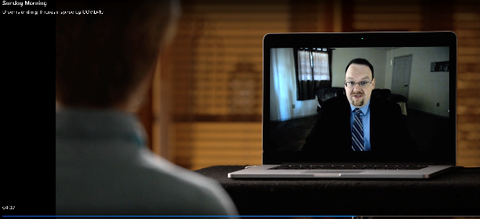
Why Positioning Your Research Matters
Connecting with other researchers for collaborative projects
Connecting with potential donors
Helps students (and parents) recognize your name
Puts MSU’s name in the limelight
The more you publish, the more you can publish…
MSU’s Psychology Professor Michael Nadorff being interviewed on CBS Sunday Morning

Slide 32
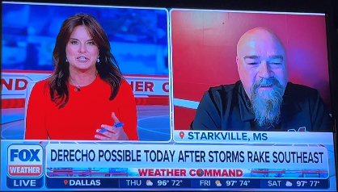
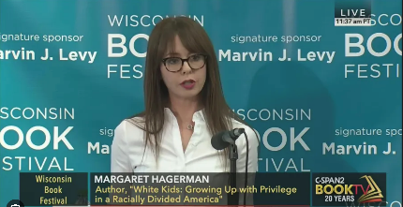
Your Research Serves our Community
  What’s happening in our world that your research addresses?
  Suicide prevention
  Virus replication and bacterial formation
  Hurricanes, droughts, tornado news
  Pet hoarding
  “Hidden History of Mississippi” series

Slide 33
For help, contact:
Karyn Brown
Director of Communication
662-325-6650
kbrown@deanas.msstate.edu
Sarah Nicholas
Communication Specialist
662-325-6650
snicholas@deanas.msstate.edu

Slide 34
Telling Your Research Story:
Leveraging MSU's Resources for Funding Success and Strategic Visibility
9.6.23
Office of Research & Economic Development

