Slide 1
National Science Foundation
Policy and Procedure Updates
& Administrative Topics

Slide 2
Proposal & Award Policies & Procedures Guide (PAPPG)
(NSF-23-1)
The Proposal & Award Policies & Procedures Guide (PAPPG) is the source for information about NSF's proposal and award process.
Each version of the PAPPG applies to all proposals or applications submitted while that version is effective.

Slide 3
Proposal & Award Policies & Procedures Guide (PAPPG)
(NSF-23-1) Effective Dates
PAPPG (NSF 23-1) Overall Effective Date
January 30, 2023
PAPPG – Other Effective Dates
July 31, 2023: Responsible and Ethical Conduct of Research (RECR)
October 23, 2023: Mandatory use of SciENcv for Current and Pending (Other) Support and the Biographical Sketch

Slide 4
PAPPG (NSF 23-1): Guidance and Changes
Proposal and Award Policies & Procedures Guide (PAPPG): https://new.nsf.gov/policies/pappg
Summary of changes to the PAPPG: https://new.nsf.gov/policies/pappg/23-1/summary-changes
If viewing the PAPPG as a pdf or printed version, the changes are the first item in the document.

Slide 5
PAPPG (NSF 23-1): Safe and Inclusive Working
Environments for Off-Campus or Off-Site Research
For each proposal that proposes to conduct research off-campus or off-site, the AOR must complete a certification that the organization has a plan in place for that proposal regarding safe and inclusive working environments
Off-campus or off-site research is defined as data/information/samples being collected off-campus or off-site, such as fieldwork and research activities on vessels and aircraft
The plan itself is not submitted to NSF as part of the proposal
Notes:
NSF awards are among the most prestigious.
NSF v. NIH – NIH funds health and medical via PHS programs. NSF focused on BASIC RESEARCH.

Slide 6
PAPPG (NSF 23-1): Safe and Inclusive Working
Environments for Off-Campus or Off-Site Research
The plan must describe how the following types of behavior will be addressed
Abuse of any person, but not limited to harassment, stalking, bullying or hazing of any kind, whether the behavior is carried out verbally, physically, electronically, or in written form; or
Conduct that is unwelcome, offensive, indecent, obscene, or disorderly
The plan should identify steps the proposing organization will take to nurture an inclusive off-campus or off-site working environments
The plan should consider communications within the team and to the organization
Notes:
MSU’s numbers here… (Steph)

Slide 7
PAPPG (NSF 23-1): Safe and Inclusive Working
Environments for Off-Campus or Off-Site Research:
FAQs
How does NSF define off-campus or off-site?
It is the proposing organization’s responsibility to establish what constitutes an off- campus or off-site location
How do collaborative proposals comply with this requirement?
If more than one collaborating organization proposes to conduct research off- campus or off-site, one joint plan must be developed
Must the plan be in place prior to proposal submission?
Yes, the language contained in the certification was carefully crafted to require that the organization has a plan in place for that proposal that describes how the types of behavior specified in Chapter II.E.9 will be addressed.

Slide 8
PAPPG (NSF 23-1): Safe and Inclusive Working
Environments for Off-Campus or Off-Site Research
How is MSU implementing this guidance?
In the Service Request Portal Ticket, the following comment will be posted:
Does any portion of this proposal involve off-campus or off-site research which is defined as data/information/samples being collected off-campus or off-site, such as fieldwork and research activities on vessels and aircraft? If the answer is yes, OSP will provide you with a form that the PI will need to complete to satisfy a new requirement by NSF. If the answer is no, nothing further is required.
Notes:
Pre- and Post-Award Bible!

Slide 9
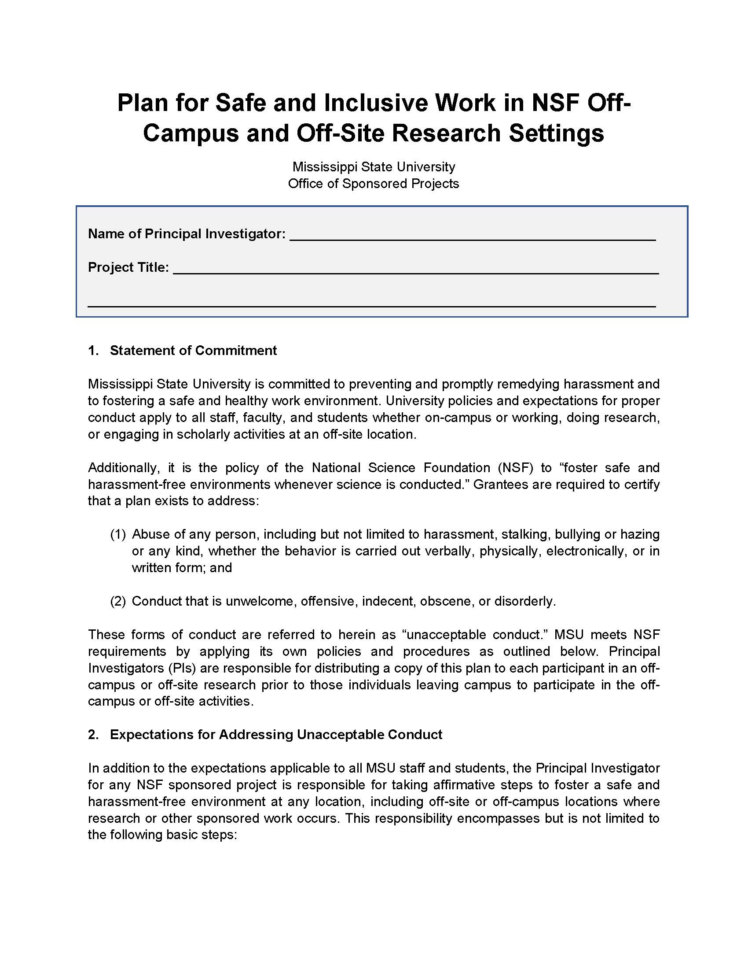
PAPPG (NSF 23-1): Safe and Inclusive Working
Environments for Off-Campus or Off-Site Research
If NO, then nothing further needs to be done.
If YES, then the NSF Workplace Plan form will be posted in the ticket for the PI to complete.
Once completed, the form needs to be posted back in the ticket so that OSP has a record of the information.
Check the box on the NSF Cover Sheet: Off-Campus or Off-Site Research

Slide 10
PAPPG (NSF 23-1): Revisions to the Biographical Sketch and Current and Pending (Other) Support
National Science and Technology Council (The White House) have been working to develop Common Forms for the Biographical Sketch and Current and Pending Support across agencies
Both forms now require that Senior Personnel certify that the information is accurate, current and complete

Slide 11
PAPPG (NSF 23-1): Revisions to the Biographical Sketch and Current and Pending (Other) Support
Senior personnel must certify that the information is accurate, current and complete
In SciENcv the certification is completed upon download of the document
For the fillable formats, the senior personnel must type their name and date on the form. NSF does not allow for certification via DocuSign or other comparable products

Slide 12
PAPPG (NSF 23-1): Revisions to the Biographical Sketch and Current and Pending (Other) Support
Both SciENcv and NSF fillable formats may be used through October 20, 2023
Use of SciENcv only will be mandated for proposals submitted or due on or after October 23, 2023

Slide 13
PAPPG (NSF 23-1): Revisions to the Biographical Sketch and Current and Pending (Other) Support
How do I access SciENcv?
Users can access SciENcv by visiting https://www.ncbi.nlm.nih.gov/sciencv/
SciENcv FAQs
Tutorials, Help Manual, Screenshots

Slide 14
PAPPG (NSF 23-1): Revisions to the Biographical Sketch and Current and Pending (Other) Support: FAQs
What do I do if there have been no changes to my Current and Pending (Other) Support if I’m asked to provide a revised version?
If there have been no changes to the information, senior personnel must download the
existing current and pending (other) support information and recertify with a new date
A project that was listed as “pending” has since been awarded. Do we need to notify NSF that this project has been funded?
After an award has been made, a change in active other support must be reported to NSF as part of the annual or final project report submission

Slide 15
PAPPG (NSF 23-1): Revisions to the Biographical Sketch and Current and Pending (Other) Support: FAQs
If the individual is not requesting salary on the budget, does the proposal still need to be listed in Current and Pending (Other) Support
Person-month information included in current and pending (other) support may differ from the person-months requested on the budget for a given project. For current and pending (other) support, senior personnel are required to provide the number of person-months (or partial person-months) per year to be devoted to the project by the individual.

Slide 16
PAPPG (NSF 23-1): Responsible and Ethical Conduct of Research (RECR)
Requires that the appropriate training and oversight in the responsible and ethical conduct of research be provided to undergraduate students, graduate students, postdoctoral researchers, faculty, and other senior personnel.
Content of the training must address mentor training and mentorship.
Office of Research Compliance provides oversight for these trainings.
https://www.orc.msstate.edu/compliance/rcr

Slide 17
PAPPG (NSF 24-1): Guidance changes to come in 2024
(effective January 30, 2024)
Mentoring plan requirement expanded to include graduate students
Individual development plan requirement for graduate students and postdoctoral researchers
And others…

Slide 18
NSF Broad Agency Announcements (BAA)
The U.S. National Science Foundation has started issuing broad agency announcements, or BAAs, as a new form of funding opportunity.
By using BAAs, NSF is seeking to engage new communities of scientists and engineers, including those who may be working beyond institutions of higher education, such as in industry, nonprofits and other organizations.
NSF can choose to fund proposals as grants, cooperative agreements, contracts or other arrangements; each BAA will specify the award type and who can apply based on their organization.
Submitted through their Broad Agency Announcement Management site https://baam.nsf.gov/s/

Slide 19
Office of Sponsored Projects
OSP ADMINISTRATORS FOR NATIONAL SCIENCE FOUNDATION
Becky Bassett, Senior Grants & Contracts Administrator
bbassett@osp.msstate.edu
KarLee McNeel, Grants & Contracts Administrator
kmcneel@osp.msstate.edu
Asia Sherrod, Grants & Contracts Administrator
asherrod@osp.msstate.edu

