Slide 1
Research Data Flow and Why it Matters
Kendall Blaylock
To change the “University Unit Name Here,”
you must modify the Master Slide. Go to your menu bar – select
the View tab, in the Master Views group, click Slide Master.
You’ll be able to select the text and modify it then. Hit save
and close out of Slide Master

Slide 2
Research Data
Every research project at MSU has some kind data associated with it.
Types of data related to research at MSU.
  Administrative data
  Internal project data
  Experimentation data
  Publication data
  Much more….

Slide 3
Data Flow
Sometimes required as part of a project proposal.
Range from very simple to extremely complex.
Include any regular data information for the project.
  What is the data?
  What is the category of the data?
  Where will the data be stored?
  How will the data be transferred?
  Other?

Slide 4
Data Requirements
When documenting data flow, consider any specialized data requirements.
  Data handling requirements from the sponsor
  Information Security requirements
  Data retention requirements
  Other

Slide 5
Scenario – Data Types
Proposal to create the perfect cowbell
  Expected Project Data Types
    Internal project management data (internal only)
    Design and materials data (CUI)
    Project reports (sensitive – limited dissemination)
      Sponsor and internal team only
    Publications (sensitive and public)

Slide 6
Scenario – Data Storage
  Expected data storage
    Specialized equipment storage
    External USB drive
    MSU network storage
    MSU Team member workstations

Slide 7
Scenario – Data Transfer
  Direct data transfer
    Specialized equipment ←→ USB storage
    USB storage ←→ Team Workstations
  Remote data transfer
    Team Workstation ←→ Team Workstation (via MSU Office 365)
    Team Workstation ←→ MSU network storage
    Team Workstations and MSU storage ←→ Sponsor (via email)
    Team Workstations and MSU storage → Sponsor (via sponsor portal)

Slide 8
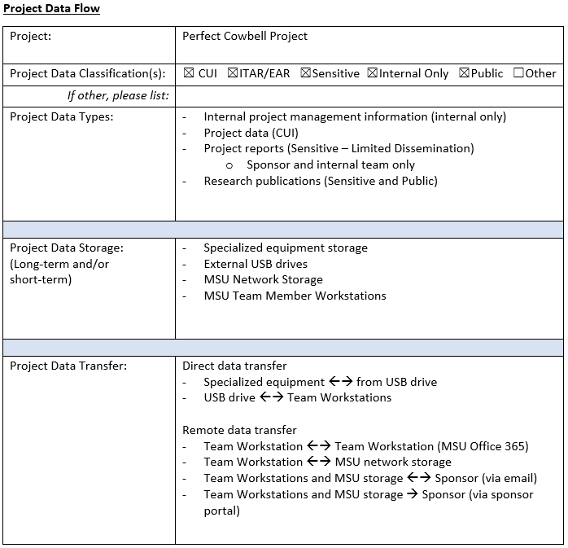

Slide 9








Cowbell Test Robot
MSU Cowbell Lab
More Cowbell Inc.
(Sponsor)
MSU Network Storage

Slide 10



Cowbell Test Robot
MSU Cowbell Lab
More Cowbell Inc.
(Sponsor)
Cowbell Cloud Co.
MSU Network Storage
What if we upgrade to Cowbell Test Robot 2.0?

Slide 11
Benefits
Better project data awareness for all team members.
Consistent data practices across departments.
IT support knowledge of unique technology requirements for a project.
Better strategy for technology implementation based on data flow needs.
Enhanced regulatory compliance awareness, documentation, and processes.
Improved disaster recovery for research at MSU.

Slide 12
Thank You
Kendall Blaylock
kendallb@hpc.msstate.edu

