Slide 1

Cybersecurity Considerations in Agricultural Autonomy
Madison P. Dixon, PMP
Associate Director
MSU Agricultural Autonomy Institute
Pace Building – 650 Stone Blvd.
Mississippi State, MS 39762
9 - 14 - 2023

Slide 2
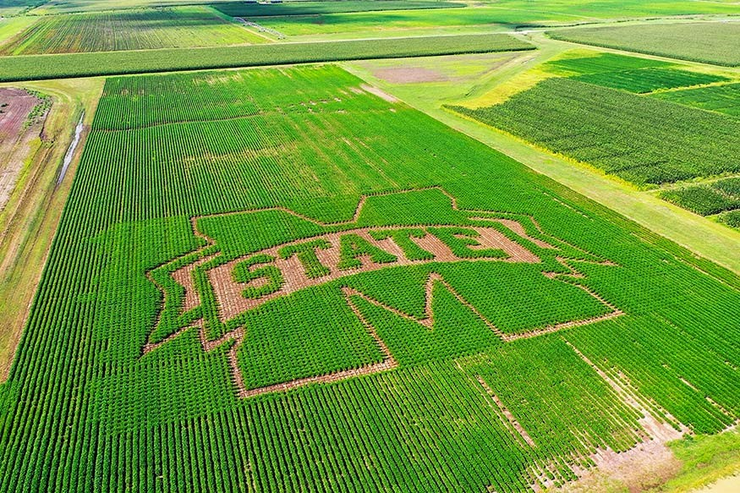
What is Agricultural Autonomy?
Agricultural Autonomy is the automation of traditional agricultural practices through the adoption of multi-domain autonomous vehicle systems such as drones, driverless tractors, and uncrewed maritime vessels.
These autonomous vehicle systems have demonstrated tremendous potential to modernize 21st century agricultural production, processing, and research.

Slide 3
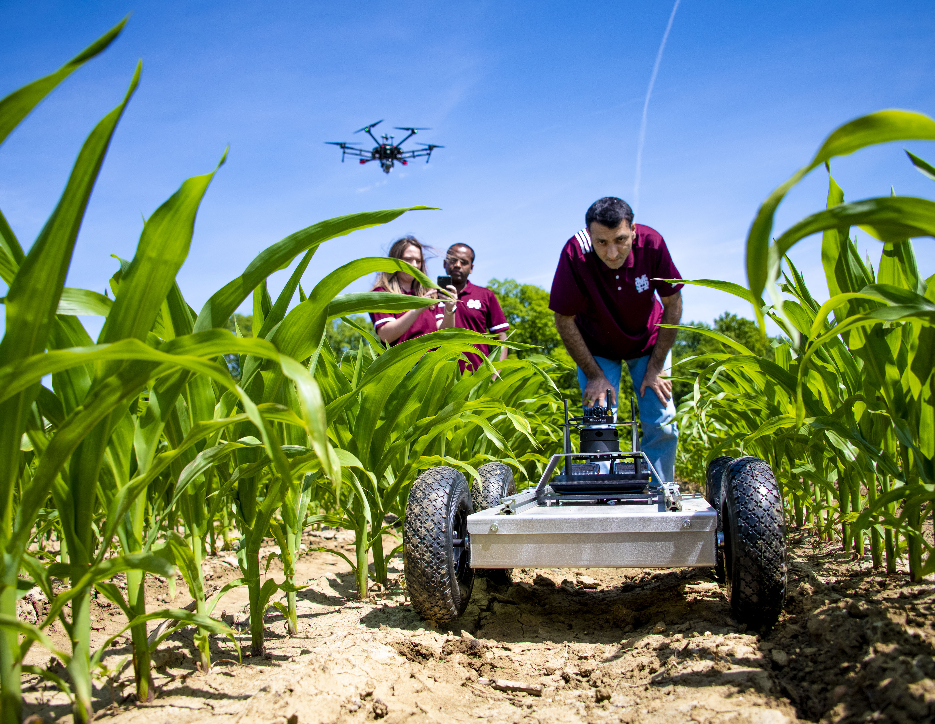
How does Ag Autonomy work?
Autonomous vehicle systems incorporate numerous technologies which can be tailored to automate many of agriculture’s most difficult and labor-intensive tasks.
To do so, these systems typically execute 3 key functions for any given agricultural task:
1. Detect (In situ & Remote Sensing)
2. Decide (AI & Machine Learning)
3. Act (Actuation through Electrical & Mechanical Engineering)

Slide 4
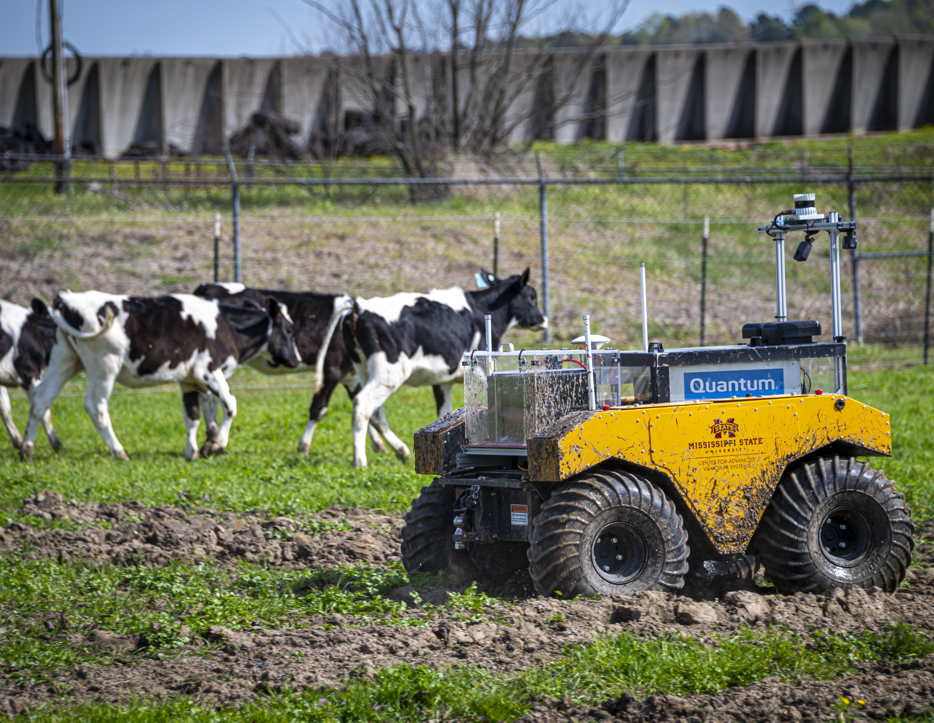
Benefits of Ag Autonomy
Autonomous systems will revolutionize agricultural tasks which are dull, dirty, and/or dangerous. It is these tasks where humans exhibit notoriously poor performance.
Autonomous systems directly and profoundly benefit the safety and efficiency of these tasks and provide a much-needed solution to address current labor shortages and environmental concerns.
Widespread adoption of autonomous systems will aid in combating global food insecurity while promoting global climate and energy security consistent with the U.S. National Security Strategy.

Slide 5
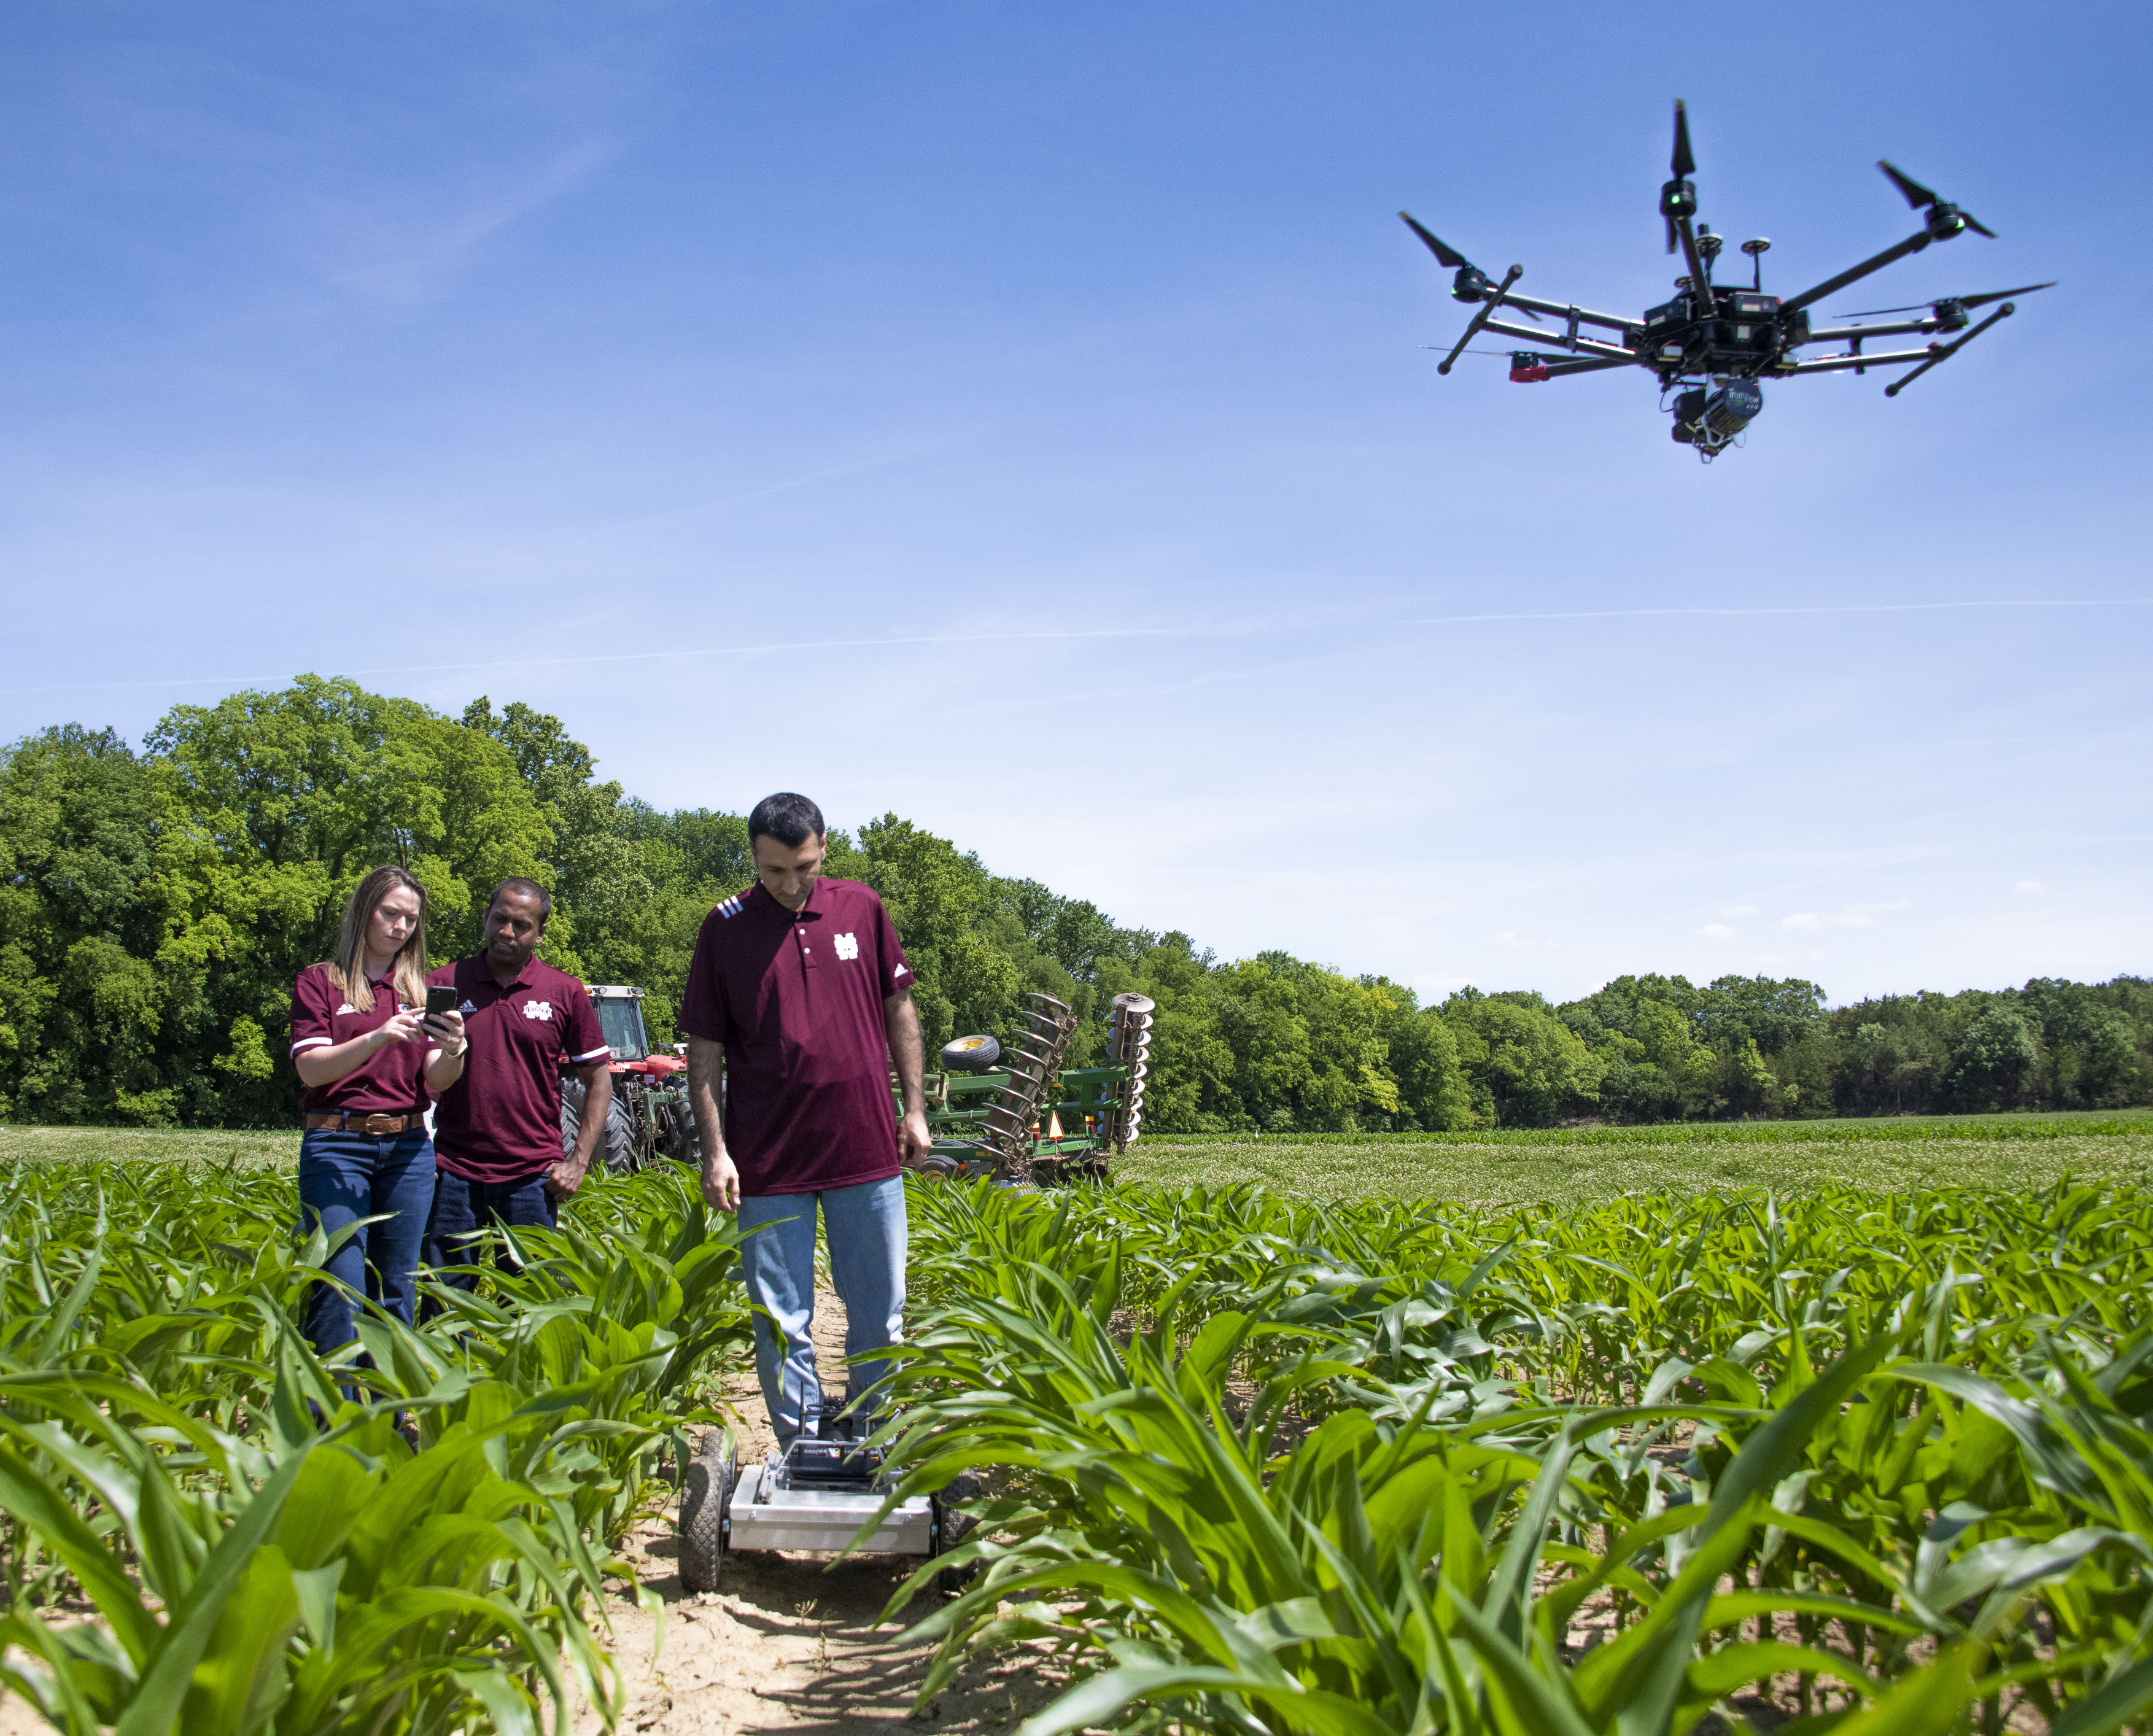
Cybersecurity Considerations
Autonomous vehicles rely on complex, interdependent systems to perform successful operation(s) in all domains.
Critical systems vulnerable to cyber-attacks include:
Command & Control (C2) systems.
Navigation & Orientation systems.
Payload systems.
Each of these critical systems may exhibit vulnerabilities which demand proactive cybersecurity measures to prevent cyber-attacks.

Slide 6
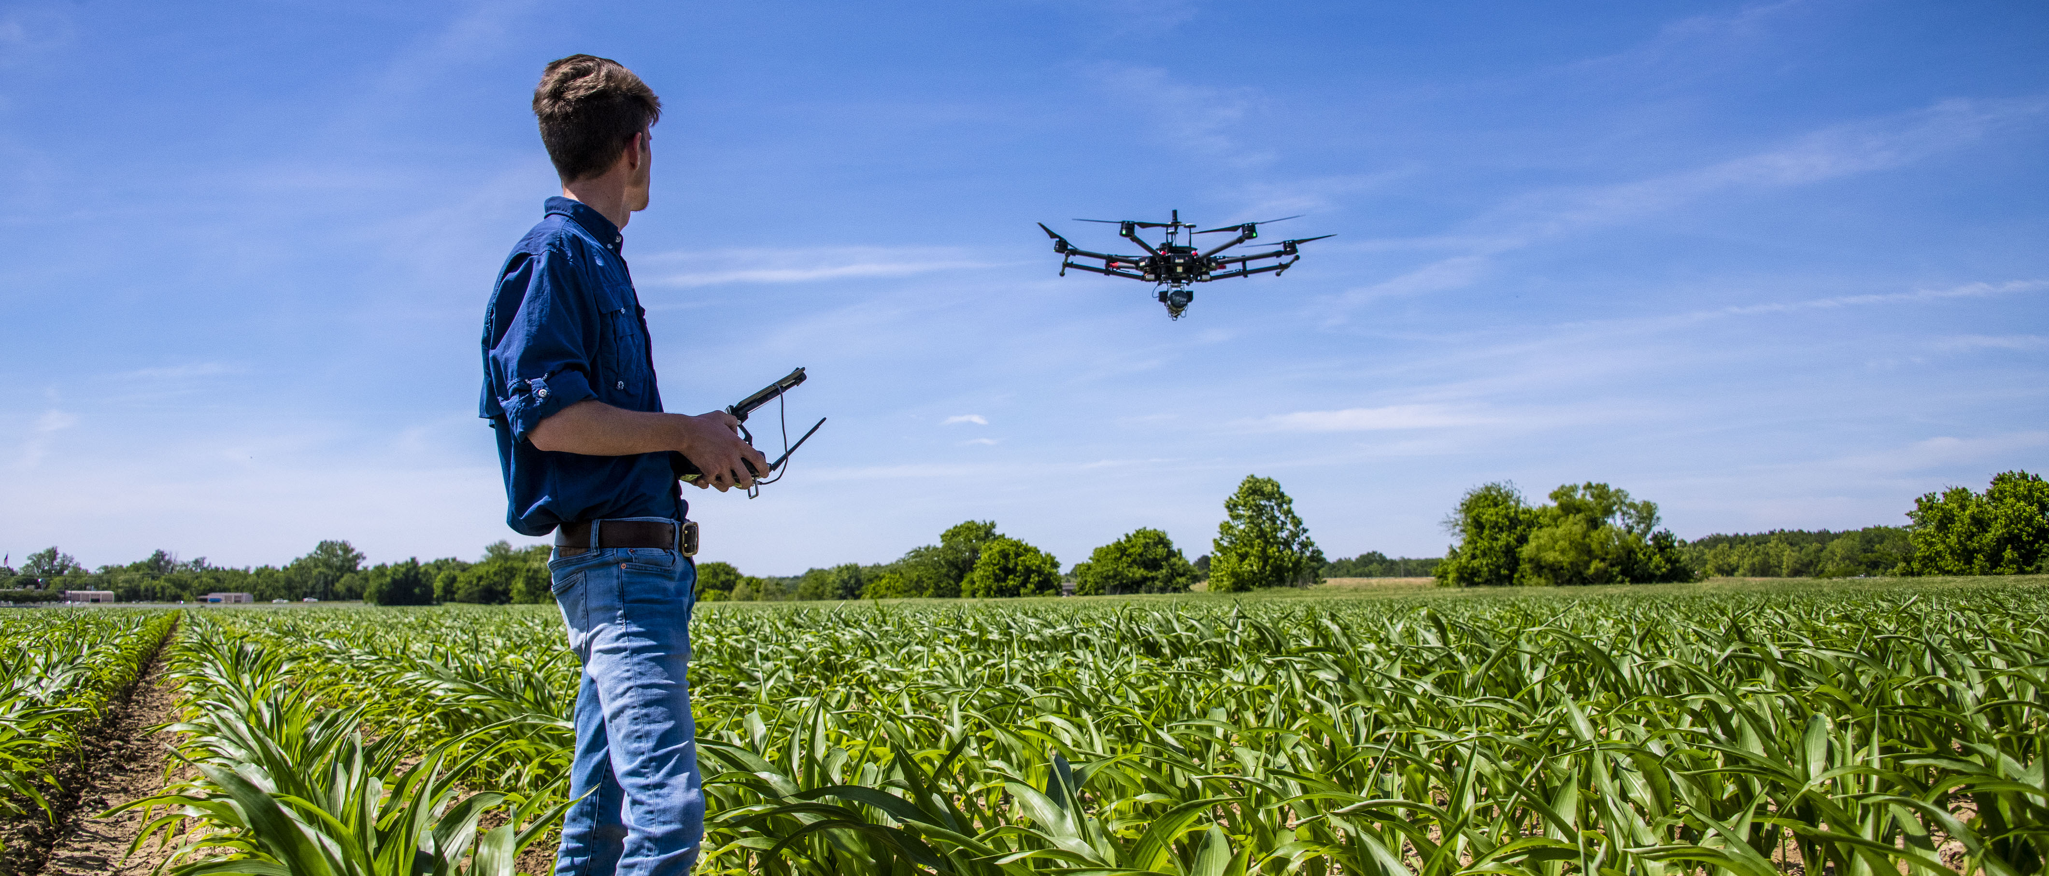
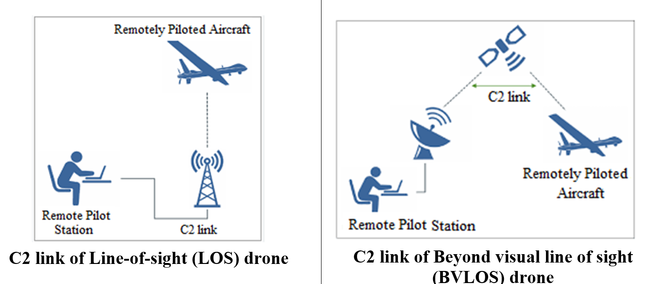
Command & Control (C2) Systems
The Command & Control (C2) system is the master control system of an autonomous vehicle.
The C2 system relies on primary, secondary, and tertiary control links through VHF radios (2.4 GHz, 5.8 GHz, 900 MHz), Satellite Communications (SATCOM), and Internet/WIFI/Cellular data links.
C2 links can be vulnerable to 2 primary forms of cyber-attacks:
Jamming – intentional signal interference resulting in loss of operator control of the vehicle.
Spoofing – intentional signal mimicking whereby a cyber-attack assumes full control of the vehicle.
Image reference: https://www.everythingrf.com/community/what-are-c2-links

Slide 7
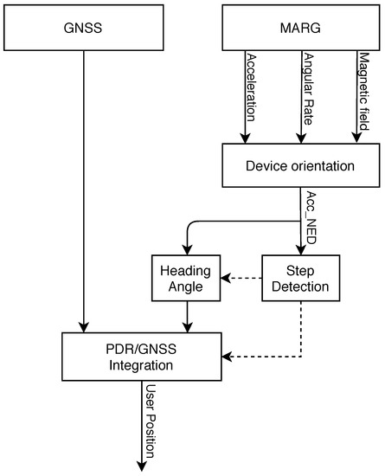
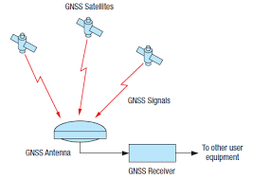
Navigation & Orientation Systems
The Navigation and Orientation system is the primary means of navigation of an autonomous vehicle as the name would suggest.
The Navigation & Orientation system is most commonly a GPS/GNSS antenna and receiver coupled with an Inertial Measurement Unit (IMU) to provide acceleration, deceleration, and magnetic heading information.
The Navigation & Orientation system is vulnerable to same forms of cyber-attacks as the C2 system:
Jamming – intentional signal interference resulting in loss of vehicle navigation/orientation.
Spoofing – intentional signal mimicking whereby a cyber-attack provides false navigation and orientation information to the vehicle during operation.
Additional Navigation & Orientation systems gaining interest recently include optical and LIDAR sensing systems paired with AI/ML algorithms for real-time visual navigation
Image references: http://www.cubesat.org.ua/en/nano-satellites/polyitan-1/adcs
https://www.mdpi.com/2072-4292/13/8/1567

Slide 8
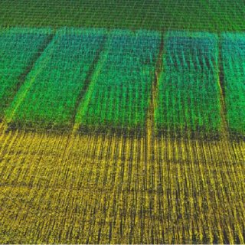
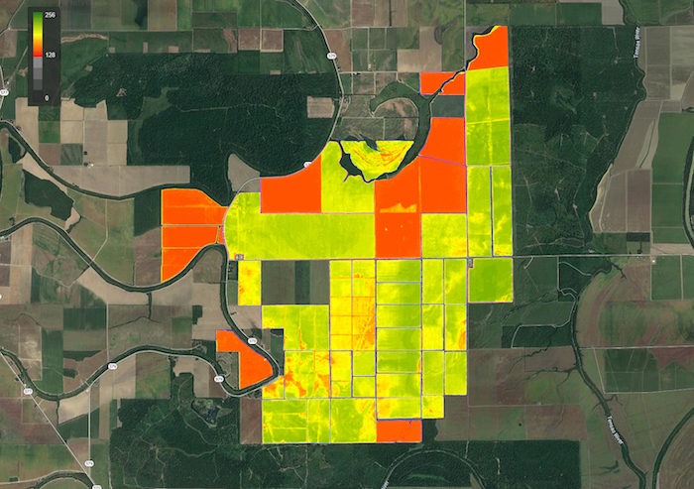
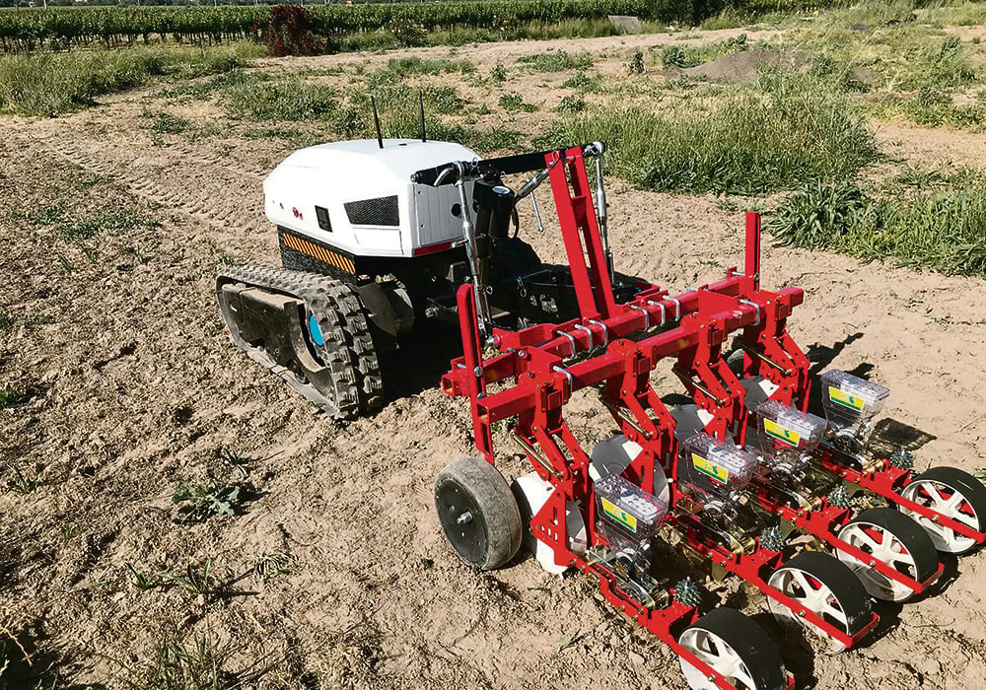
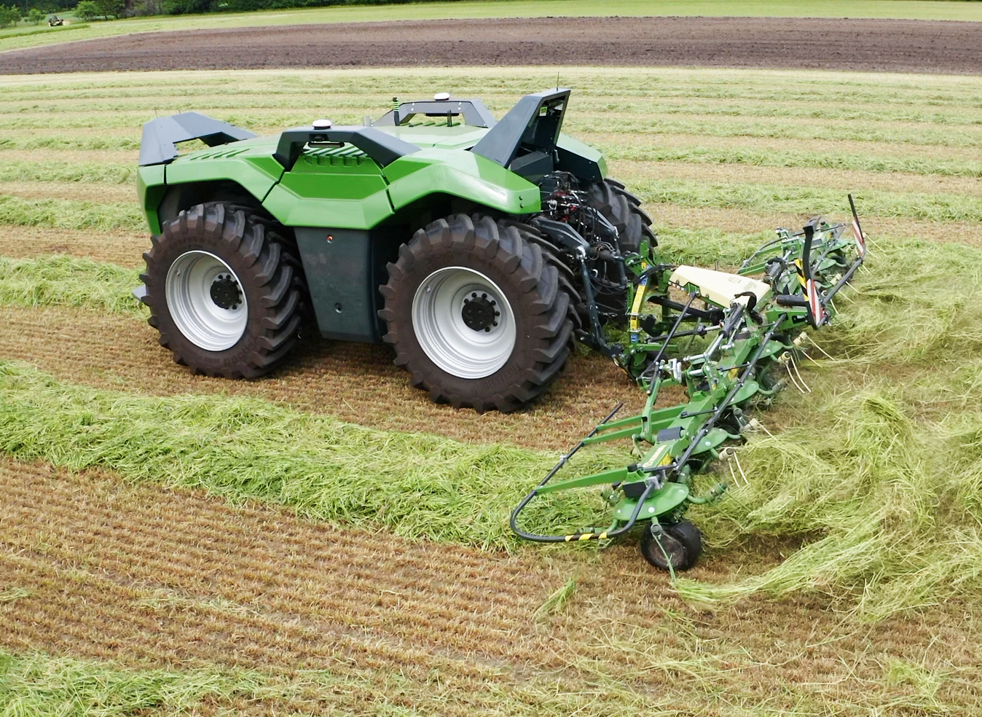
Payload Systems
The Payload system carries out the mission of the autonomous vehicle. This can be done either passively or actively.
Passive payload systems are typically high-fidelity cameras or other specialized sensors with a mission to collect remote sensing data. Even “active” sensor systems (e.g., LIDAR, RADAR, etc.) are considered passive in this context.
Active payload systems carry out a physical task or employ a physical item. For autonomous ground vehicles in agriculture, any implement (e.g., disc, plow, planter) can be an active payload.
For airborne vehicles, aerial application spray systems and granular spreader systems are examples of active payload systems.
Image references: https://www.producer.com/crops/small-electric-autonomous-tractors-build-big-time/
https://www.agriland.co.uk/farming-news/combined-powers-first-demonstration-trials-of-autonomous-tractor/
https://www.researchgate.net/publication/324939344_Ground_vehicle_mapping_of_fields_using_LiDAR_to_enable_prediction_of_crop_biomass
https://www.farm-equipment.com/articles/17277-agdna-ndvi-crop-health-toolkit-with-advanced-cloud-detection

Slide 9
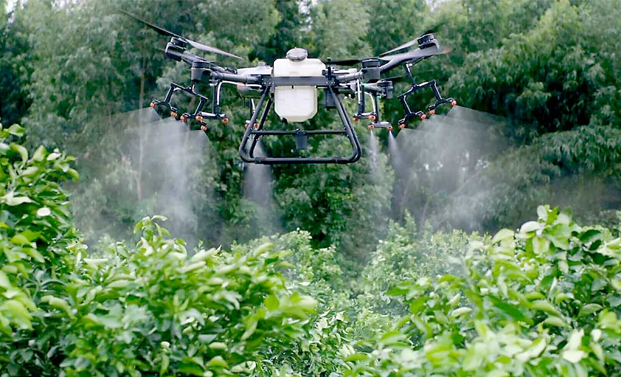
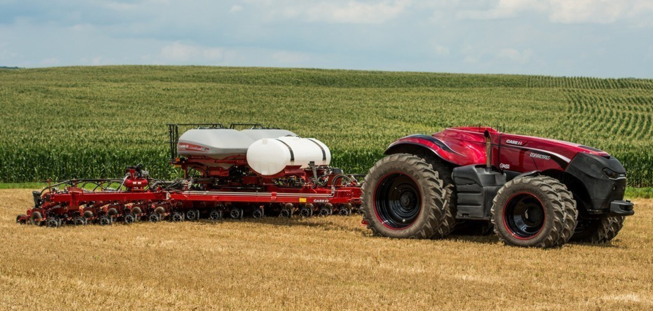
Payload Systems
Both active and passive payload systems typically employ a separate datalink for operation and monitoring of the payload system.
This separate payload link can be vulnerable to targeted “hacking” cyber-attacks which seek to gain access and/or outright control of the payload system.
Cyber-attacks of the payload system for agricultural vehicles can result in uniquely dangerous repercussions:
Data mining
Equipment/Property damage
Environmental damage
Crop destruction
Terroristic Plots
Image references: https://www.goodfruit.com/airblast-from-above/
https://www.prnewswire.com/news-releases/cnh-industrial-brands-reveal-concept-autonomous-tractor-development-driverless-technology-to-boost-precision-and-productivity-300317452.html

Slide 10
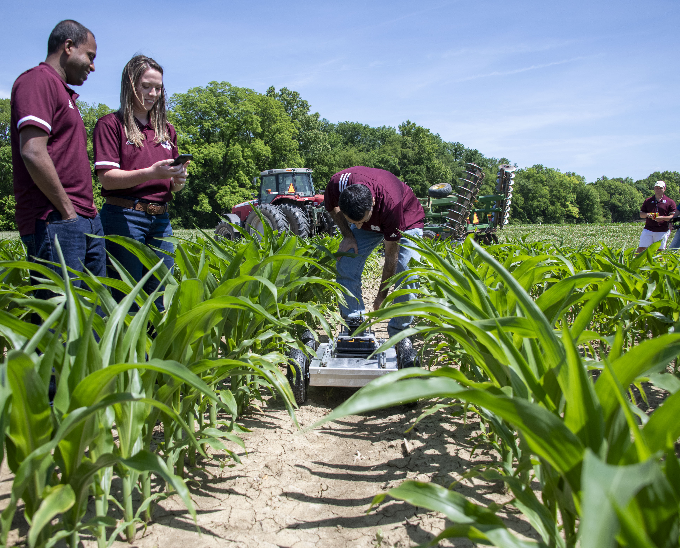
Path Forward
MSU has joined “CyberAG”, a consortium of land-grant universities commitment to promoting cybersecurity in the agriculture domain.
MSU is also engaged with LANDWERX, the newest entity of the DefenseWERX ecosystem, who is keenly focused on agricultural cybersecurity as a means to National Security.
Congress has introduced new legislation specifically focused on cybersecurity in agriculture:
HR.4387 – Cybersecurity in Agriculture Act of 2023 which aims to establish 5 regional Agricultural Cybersecurity Centers across the U.S.
S.2393 – Food and Agriculture Industry Cybersecurity Support Act which aims to establish a national food and agriculture cybersecurity clearinghouse within the National Telecommunications and Information Administration
MSU AAI and CCI are actively engaged in each of these areas to pursue ag-focused cybersecurity R&D opportunities.

Slide 11
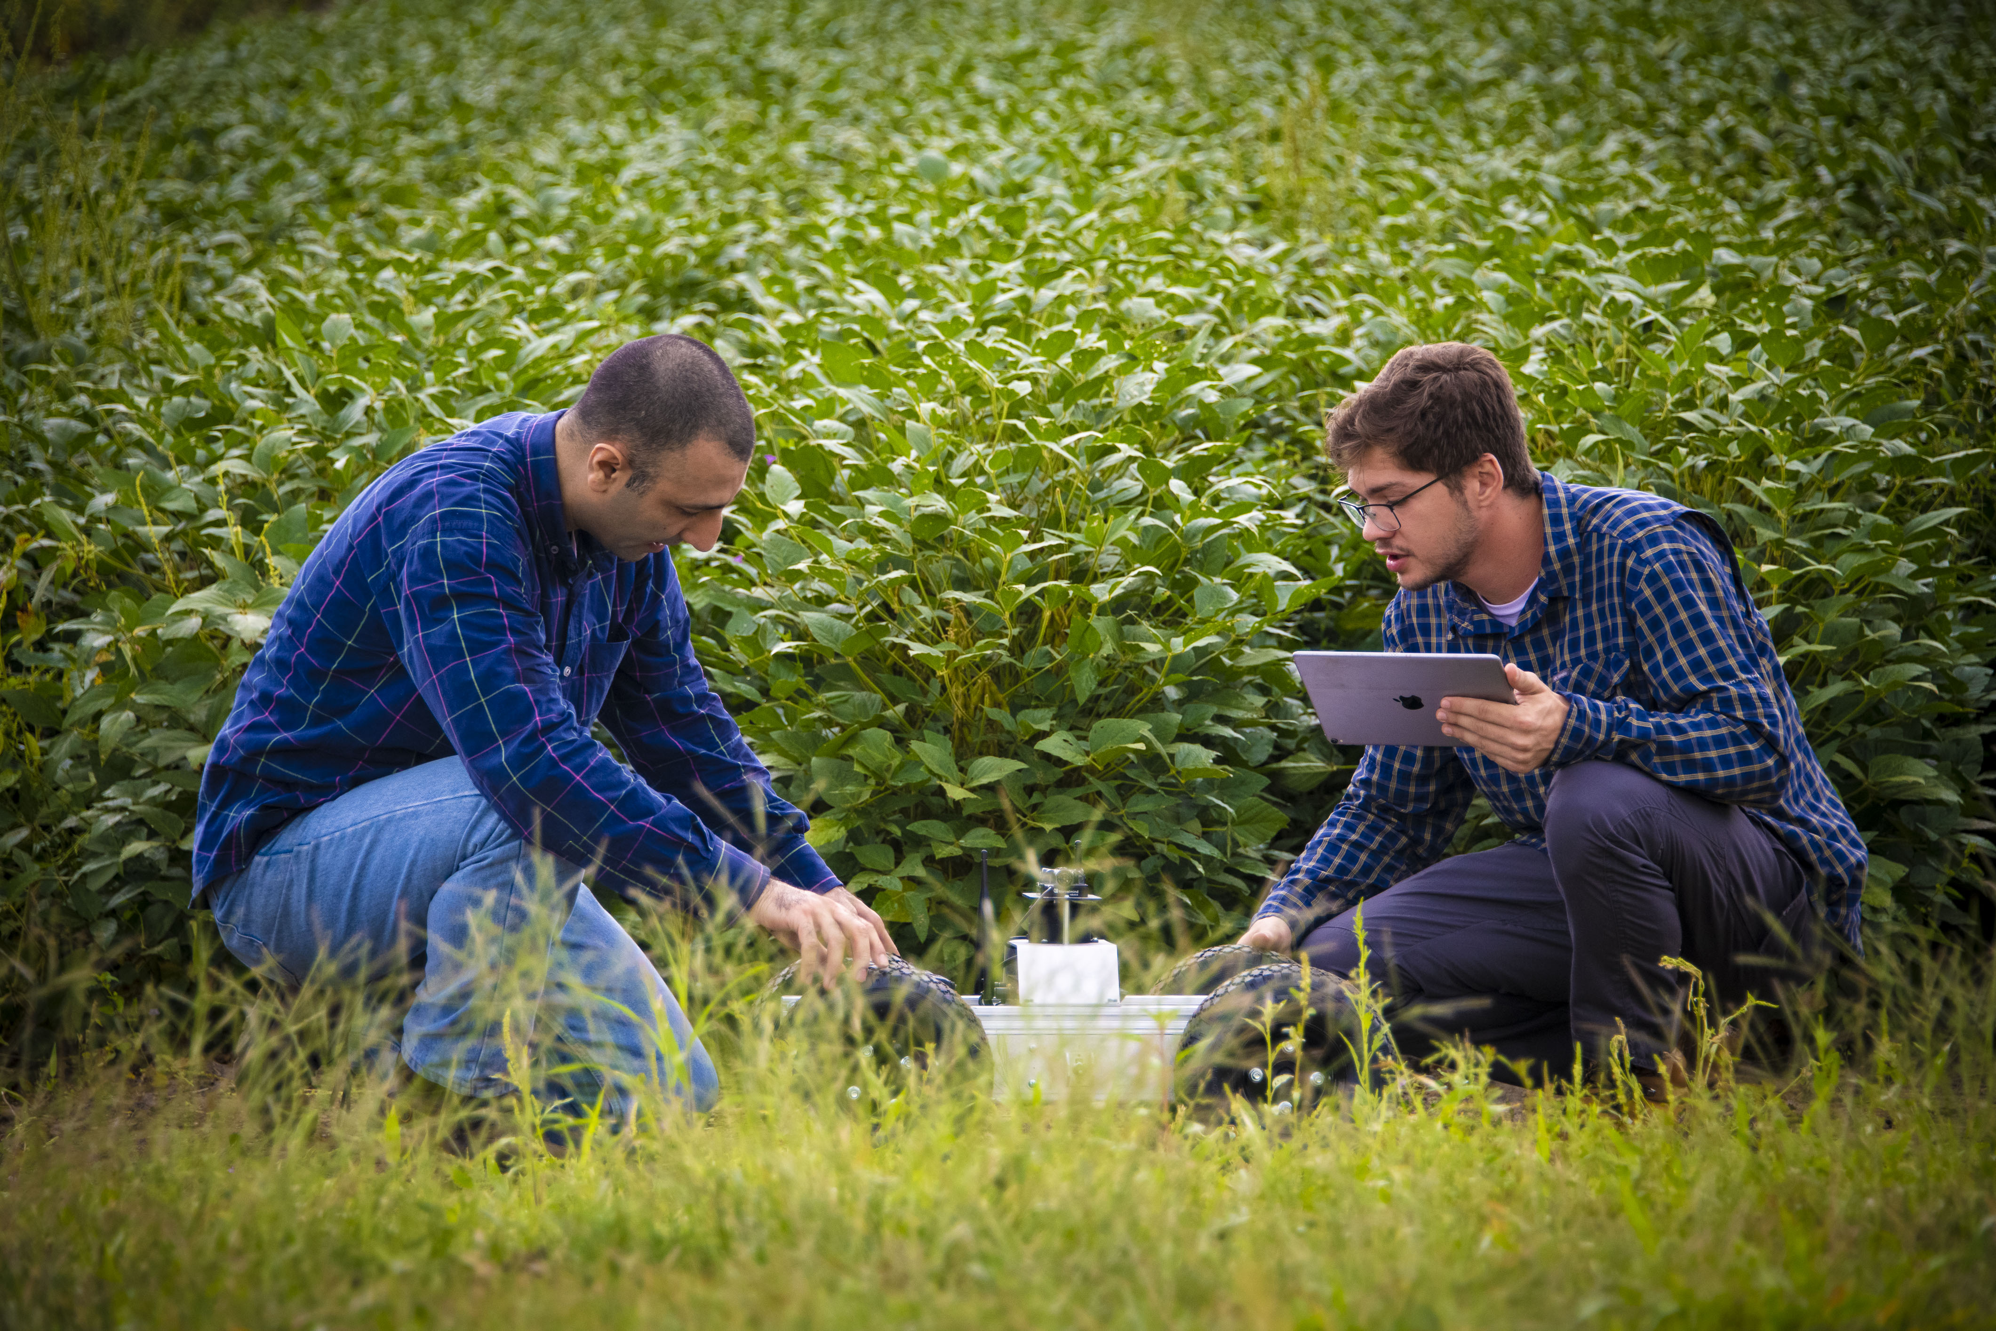
Thank you!
Questions?
AAI Contact Info:
Dr. J. Alex Thomasson
Director
athomasson@abe.msstate.edu
Mr. Madison P. Dixon
Associate Director
mdixon@aai.msstate.edu
Ms. Amber Lynn Moore
Program Manager
amoore@aai.msstate.edu

