Slide 2
MSU Cyber Symposium
William “Greg” Mallette, CISSP
Mississippi Cybersecurity State Coordinator/Advisor, Region 4
Cybersecurity Advisor Program
Cybersecurity and Infrastructure Security Agency
Notes:
Change Presenter’s Name and Date in Slide Master view.

Slide 3
CISA Mission and Vision
MISSION:
  We lead the National effort to understand, manage, and reduce risk to our cyber and physical infrastructure.
  VISION:
  Secure and resilient infrastructure
  for the American people.
3
Notes:
We are one agency with one mission and one vision. This is the mission and vision for every division, branch, and office within CISA. The purpose of every program, service, and tool CISA offers is to support this mission and vision.

Slide 4
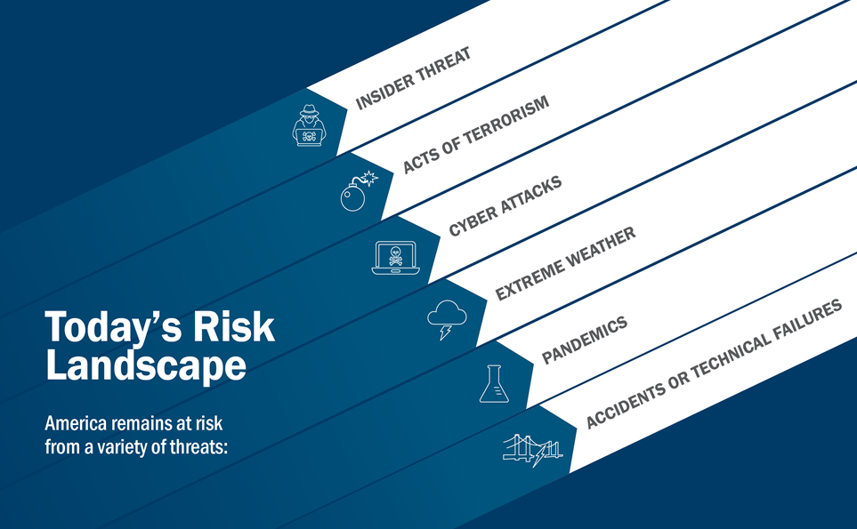
Notes:
At CISA we are often coined as the Nation’s Risk Advisor, We take an all-hazards approach looking across the risk landscape to include risk areas such as insider threat, acts of terrorism, accidents of systemic and/or technical failures that can cause risk to national security, risks of extreme weather, risk of pandemics such as the COVID-19 pandemic we are currently in, and also risk of significant cyber attacks.
Particularly now, it is important to understand that for critical infrastructure, whether with financial services, law enforcement, healthcare providers, retail and virtually any other industry sector, risk of cyber attacks that cause operational impacts have increased.
COVID pandemic had thrust us into a “new normal,” has forced many organizations large and small to move toward a remote working environment in order to maintain operations. (our public school systems are clearest example of this, and may other industries have had to follow suit). Doing so adds new technology as well as added complexity to the operating environment. For instance, we are still trying to figure out the right balance of security and accessibility and business practices for conducting video conferencing sessions. These newly added technologies also increase the attack surface and exposes new mis-configurations - and threat actors know this.
Moving operations remotely also means organizations are now becoming more reliant on that technology for day-to-day operations. Widespread disruptions utilizing this technology means a potentially greater impacts to operations. Additionally, with more of our IT personnel also operating remotely this also means potentially longer response times and potentially an even greater impact to operations and threat actors also know this.
If you are familiar with risk management, what I just described is the basic equation of risk. Probability X Impact = risk. When both increase such as in our current environment, so does the risk.

Slide 5
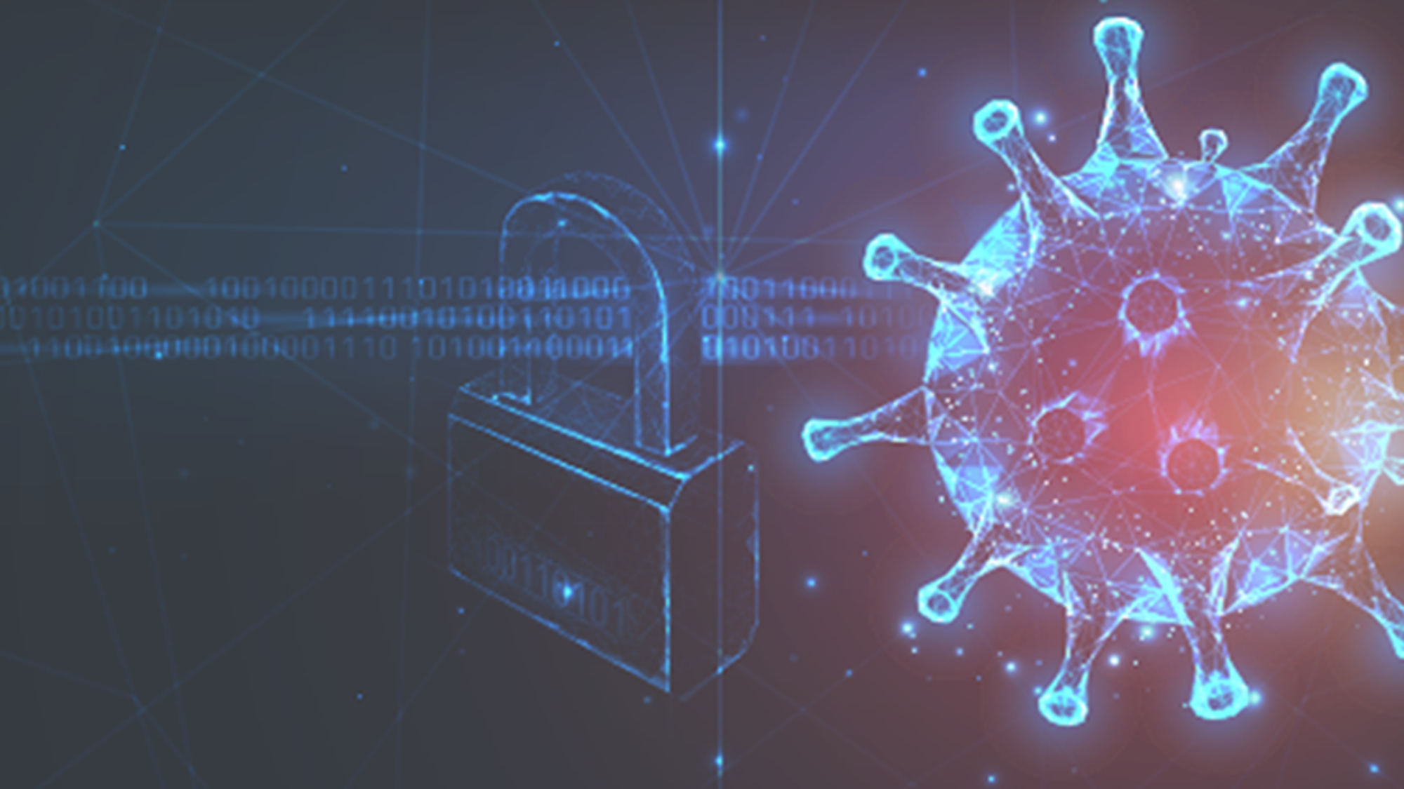



Cyber Threats of Today
    Ransomware
    Petya (2016), WannaCry (2017)
    REvil/ Sodinokibi (targeting MSPs)
    Conti (LE, EM, SLTT)
    Ryuk (targeting healthcare, education, SLTT)
    Black Matter, DarkSide, Babuk, Robinhood, Maze, CovidLock, CryptoLocker, Pysa, Phobos, Egregor, VoidCrypt…
    Lockbit 3.0, Rhysida
    Malware
    [RATs/ banking trojans] Trickbot, Emotet, LokiBot, IcedID
    [wiperware] NotPetya
    [ICS/OT specific] Triton/hatman malware targets Safety Instrumented Systems (SIS)
    [Infosec toolkits] Kali, Metasploit, Cobalt Strike
  Advanced Persistent Threats (APTs)
    Nation state threat actors
    State sponsored threat actors
    Threats to External Dependencies
    3rd party vendors, service providers, infrastructure providers
    Supply chain attacks: SolarWinds, Kaseya, Log4J, etc.
Notes:
Trickbot – Banking trojan with C&C capabilities as well as credential and email harvesting. Uses EternalBlue vulnerability – exploit used with SMB protocol vulnerability
Emotet – Banking trojan with worm-like capabilities and generally spreads through spam email. Often used as a dropper for Trickbot.
LokiBot—also known as Lokibot, Loki PWS, and Loki-bot—employs Trojan malware to steal sensitive information such as usernames, passwords, cryptocurrency wallets, and other credentials.
The malware steals credentials through the use of a keylogger to monitor browser and desktop activity (Credentials from Password Stores [T1555]).
(Credentials from Password Stores: Credentials from Web Browsers [T1555.003])
(Input Capture: Keylogging [T1056.001])
LokiBot can also create a backdoor into infected systems to allow an attacker to install additional payloads (Event Triggered Execution: Accessibility Features [T1546.008]).
Malicious cyber actors typically use LokiBot to target Windows and Android operating systems and distribute the malware via email, malicious websites, text, and other private messages (User Execution: Malicious File [T1204.002]). See figure 1 for enterprise techniques used by LokiBot.
IcedID, also known as BokBot, is a modular banking trojan that targets user financial information and is capable of acting as a dropper for other malware. It uses a man-in-the-browser attack to steal financial information, including login credentials for online banking sessions. Once it successfully completes its initial attack, it uses the stolen information to take over banking accounts and automate fraudulent transactions.
Both considered persistent malware variants

Slide 6
Cyber Actor Capabilities
Damage to Critical Infrastructure
Disruption to Critical Infrastructure
Theft of Intellectual Property/Financial Data
Theft of Sensitive Information (PII)
Establish and Maintain Illicit Presence
Denial of Service (DoS)
Web Defacements
 | State Actors with Greater Capabilities | State Actors with Lesser Capabilities | Cybercriminals | Criminal Hackers | Terrorists
Source: I&A analysis derived from media and USG reporting
Note: Darker color indicates greater capability .

Slide 7

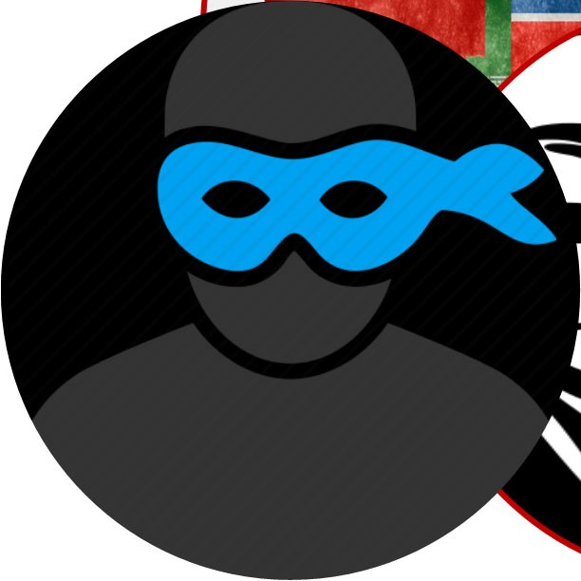
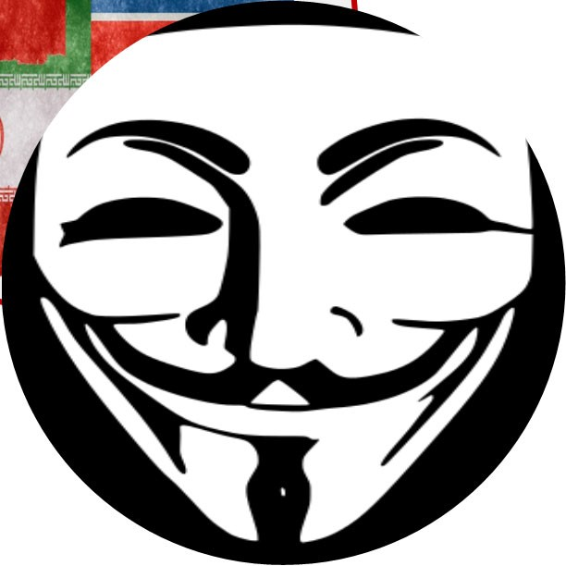
Cyber Criminals
Cybercriminals
  Look for targets of opportunity
  Take the path of least resistance
  Financially motivated
  Personal information and proprietary data: high value, high-demand commodities
Hacking as a service (HaaS) and Ransomware (RaaS)
  Malicious tools readily available for purchase or download.
  Enable less skilled actors to effectively operate
Source: DHS I&A

Slide 8
What are you trying to Protect?
For Official Use Only (FOUO)
Biometric Data
SECRET
Restricted Data
Internal
Financial Data
Personally Identifiable Information (PII)
Company Confidential (CC)
Protected Health Information (PHI)
Law Enforcement Only (LEO)
Intellectual Property (IP)

Slide 9
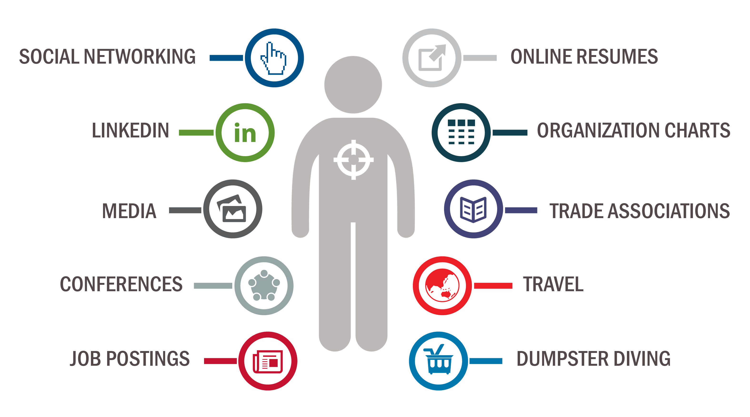
You Are Being Targeted

Slide 10
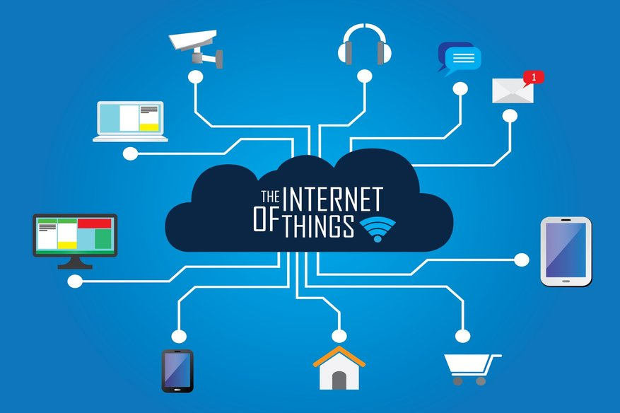
In Your Home
Patching and Updates
Delete Unused Apps
Segment your network
Strong Unique Passwords
Multifactor Authentication
Think Before You Click
Back-up Data

Slide 11
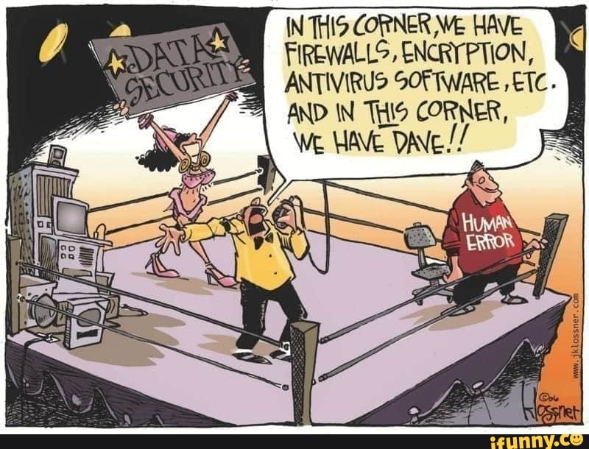
At Work
Phishing
Spear Phishing
Vishing
Social Engineering
Insider Threat
Scammers
Extortion

Slide 12
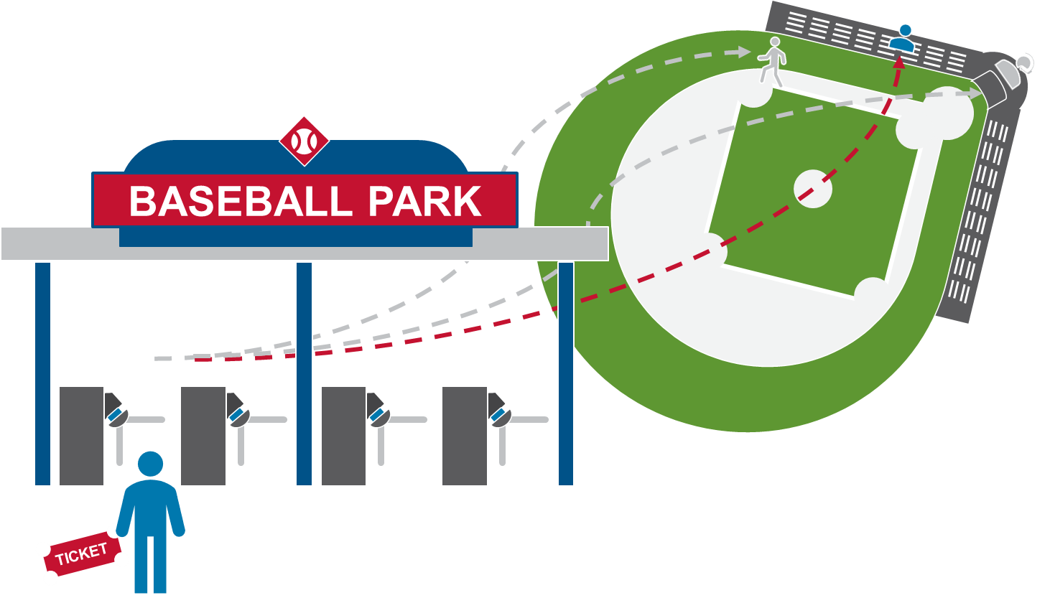
Zero Trust
Zero trust security assumes any user, asset, or resource is untrustworthy and therefore must be verified and continually evaluated.
Several checkpoints throughout the park for validation.
Integrated security.
Trust must be verified.

Slide 13
Mechanics of a Cyber Attack - 1

Slide 14
Mechanics of a Cyber Attack - 2

Slide 15
Think about it
How would law enforcement coordinate with you as an affected organization, in the wake of cyber attacks?
What do you want to know in the first 30 minutes of a disruptive cyber attack?
What are you willing to share within the first 30 minutes of a disruptive cyber attack? Who is allowed to share it?

Slide 16

Resilience Defined
“… the ability to prepare for and adapt to changing conditions and withstand and recover rapidly from disruptions. Resilience includes the ability to withstand and recover from deliberate attacks, accidents, or naturally occurring threats or incidents…”
- Presidential Policy Directive 21
February 12, 2013
Protect (Security) | Sustain (Continuity)
Perform (Capability) | Repeat (Maturity)

Slide 17
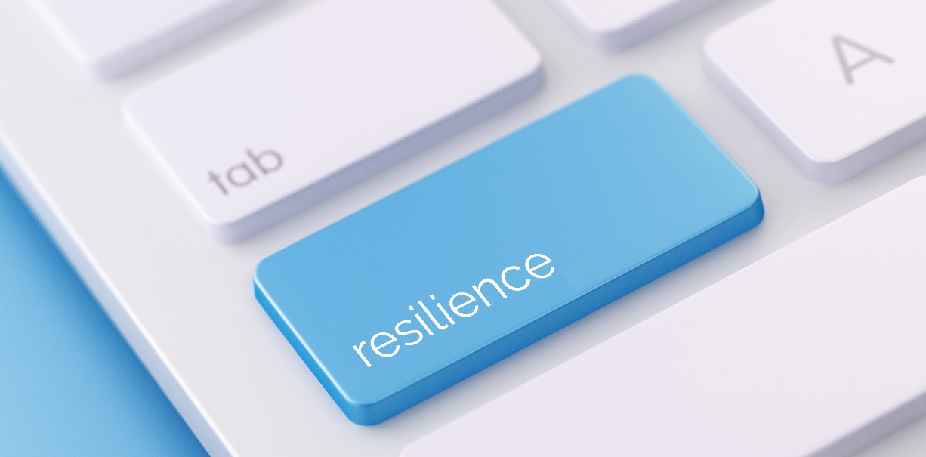
Operational Resilience in Practice
  Operational resilience emerges from what we do, such as:
  Identifying and mitigating risks,
  Planning for and managing vulnerabilities and incidents,
  Performing service-continuity processes and planning,
  Managing IT operations,
  Managing, training, & deploying people,
  Protecting and securing important assets, and
  Working with external partners.

Slide 18
CISA Cyber Essentials (1 of 6)
Essential Practice 1: Drive Strategy, Investment, and Culture
Cyber should be approached as a business risk. (NOT JUST AN IT PROBLEM)
Look into your organizations’ operations to learn how much you are dependent on IT. (IT is woven throughout organizations)
Lead investment into basic cybersecurity.
Leverage sector partners and government agencies to build a network of trusted relationships to better collaborate and quickly access cyber threat information.
https://www.cisa.gov/cyber-essentials

Slide 19
CISA Cyber Essentials (2 of 6)
Essential Practice 2: Develop Security Awareness and Vigilance
Learn what training resources are available through professional associations, academic institutions, private sector and government sources.
Develop a culture of awareness to encourage employees to make better choices online.
Always uphold cybersecurity policies and continuously look for ways to reinforce these policies.
Take advantage of available training resources to educate employees on recognizing and responding to cyber threats.
https://www.cisa.gov/cyber-essentials

Slide 20
CISA Cyber Essentials (3 of 6)
Essential Practice 3: Protect Critical Assets and Applications
Understand what is on your network to create an inventory of all your hardware and software assets.
Safeguard your network by removing unsupported or unauthorized hardware and software from systems.
Implement secure configurations for all hardware and software assets.
Leverage automatic updates for all operating systems and third-party software.
Use email and web browser security settings to protect against spoofed or modified emails, and unsecured webpages.
https://www.cisa.gov/cyber-essentials

Slide 21
CISA Cyber Essentials (4 of 6)
Essential Practice 4: Ensure Only Those Who Belong on Your Network Have Access
Identify who is on your network and create an inventory of all your network connections (user accounts, vendors, business partners, etc.).
Create a culture focused on access and admin permissions based on need-to-know and least privileged.
Foster the development of IT policies and procedures addressing changes in user status (transfers, termination, etc.).
Leverage multiple forms of authentication to gain admin privileges and remote access.
Enforce the use of unique passwords for all user accounts.
https://www.cisa.gov/cyber-essentials

Slide 22
CISA Cyber Essentials (5 of 6)
Essential Practice 5: Make Backups and Avoid Loss of Info Critical to Operations
Learn what information resides on your network. Inventory critical or sensitive information.
Establish regular automated backups and redundancies of key systems.
Be aware of what is happening on your network. Manage network and perimeter components, host and device components, data at rest and in transit, and user behavior and activities.
Understand how your data is protected.
Protect your backups with physical security, encryption and offline copies.
Learn ways in which you can protect yourself from malware.
https://www.cisa.gov/cyber-essentials

Slide 23
CISA Cyber Essentials (6 of 6)
Essential Practice 6: Limit Damage and Quicken Restoration of Normal Operations
Identify who to call for help (e.g., outside partners, vendors, government/industry responders, technical advisors and law enforcement).
Spearhead the development of incident response and disaster recovery plans outlining roles and responsibilities. Test these plans often.
Lead the development of internal reporting structures to detect, communicate, and contain attacks.
Prioritize your resources and identify which systems must be recovered first by conducting business impact assessments.
https://www.cisa.gov/cyber-essentials

Slide 24
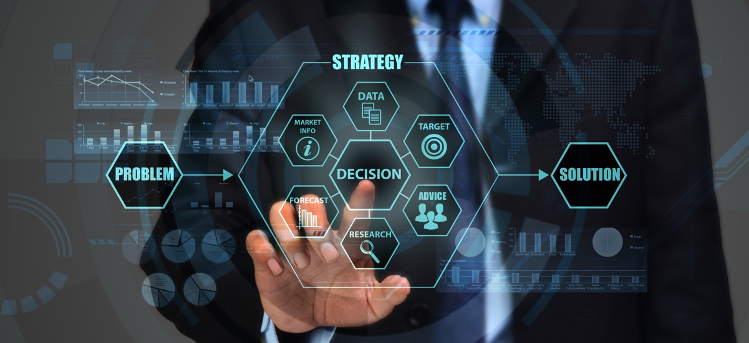
Criticality of Periodic Assessments
Periodic assessments are essential for resilience
Can’t protect if you don’t know what needs protection
Can’t fix if you don’t know what’s wrong
Notes:
Periodic cybersecurity assessments are essential to your serving your customers and constituents. I earlier spoke about operational resilience and the need to create the conditions for resiliency to develop to keep your infrastructure performing as you need it to – assessments are a big part of building resiliency. In a nutshell, assessments . Today, almost all organizations that hold sensitive data are legally bound to have period cyber security assessments.

