Slide 1


The Future of Cyber Insurance
September 2023
THE CYBER SPECTRUM: RESEARCH, INNOVATION, AND IMPACT ACROSS DISCIPLINES
Notes:
Introduction John and Ed

Slide 2


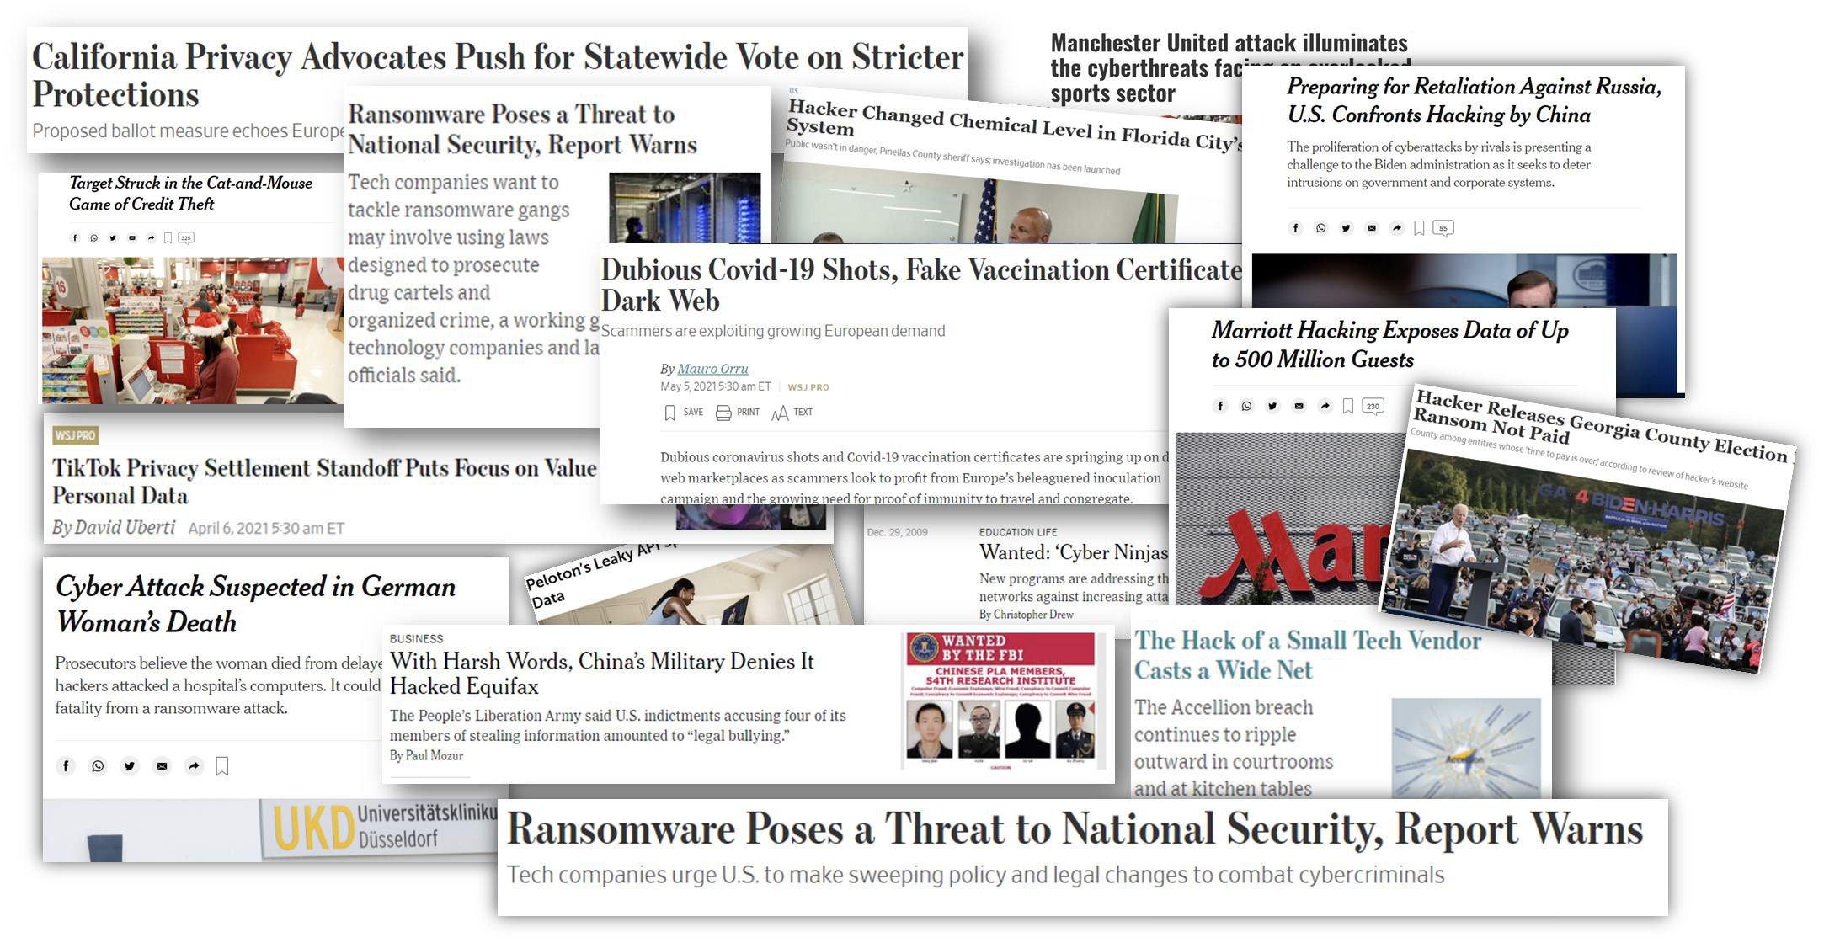
Notes:
Make sure to note that no sever weather is expected this morning.
No Fire Drills are Scheduled for Today
Note where the closet Fire Extinguisher is

Slide 3

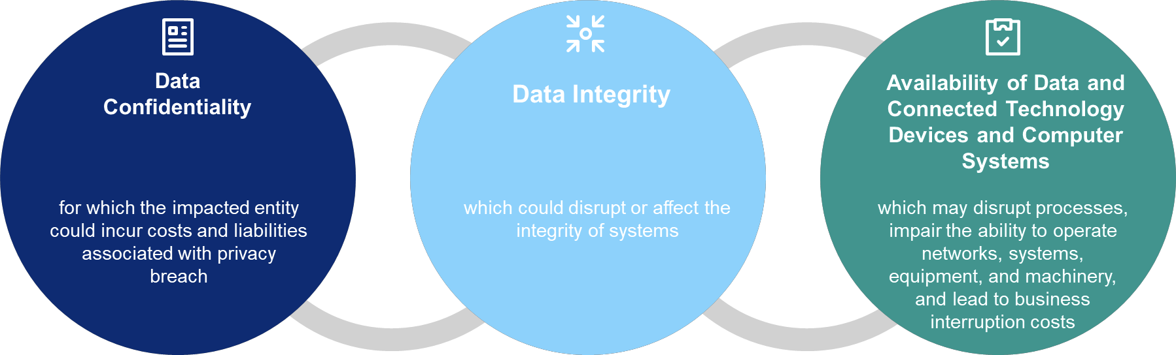
The Role of Cyber Insurance
Cyber insurance does not solve for every aspect of cyber risk, but it was created to address risks that traditional insurance typically does not:
Notes:
Why are we here?

Slide 4
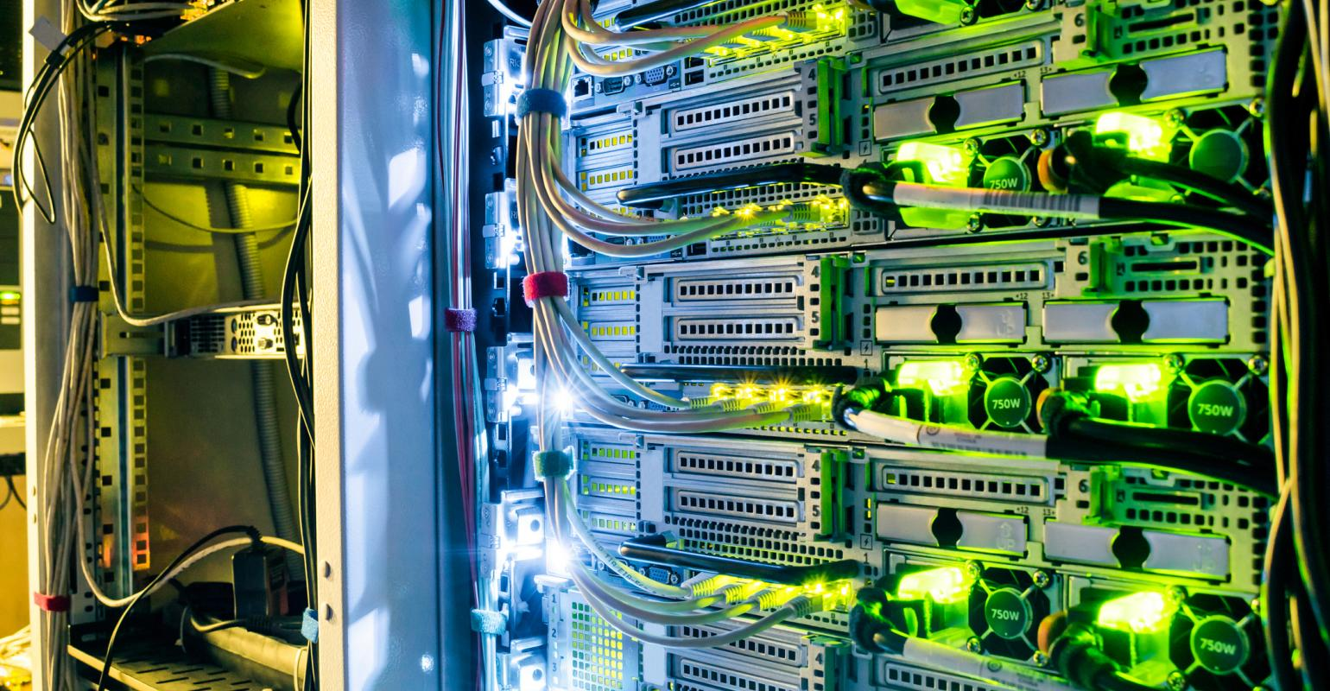
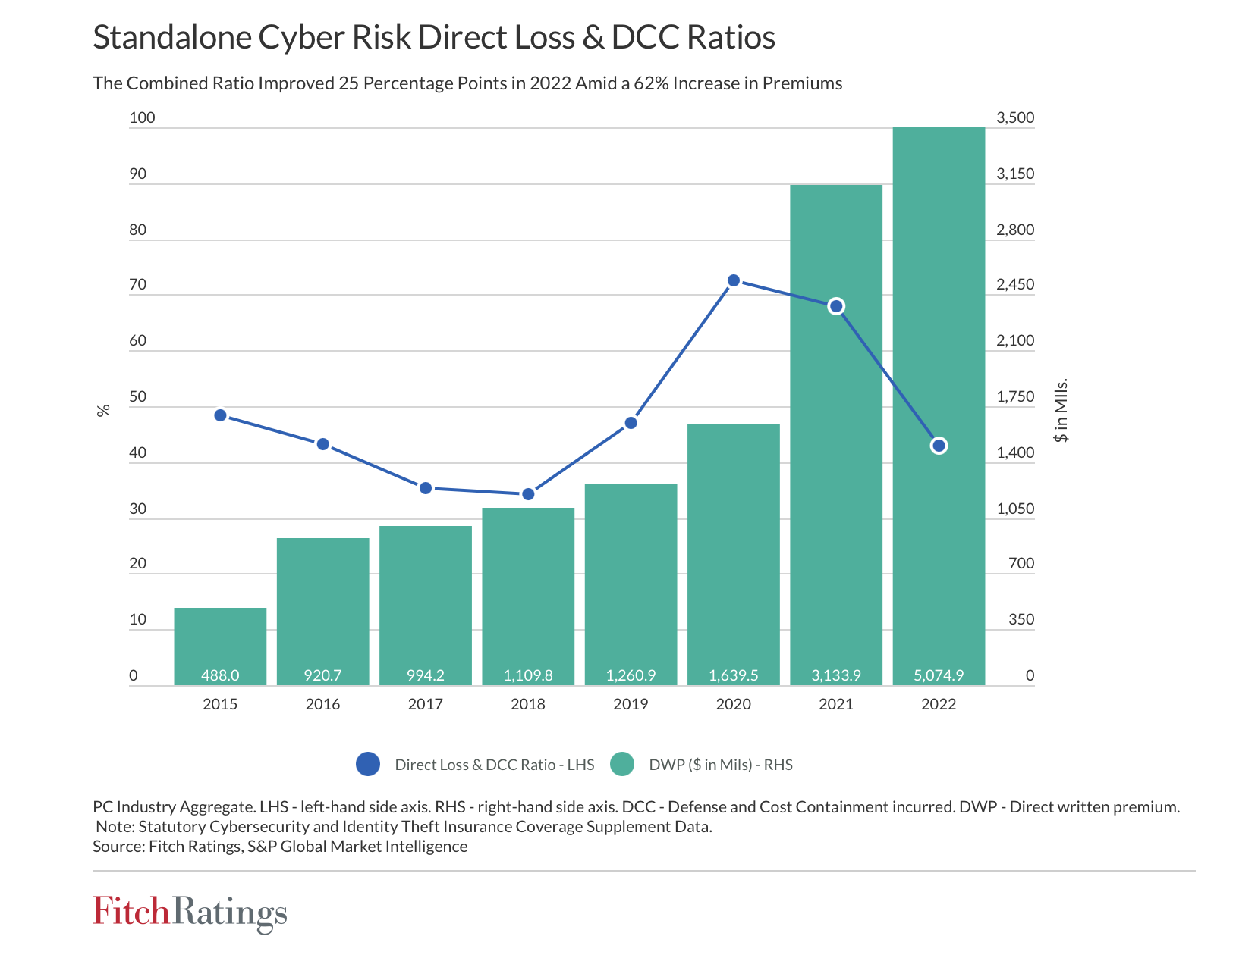
Notes:
Make sure to note that no sever weather is expected this morning.
No Fire Drills are Scheduled for Today
Note where the closet Fire Extinguisher is

Slide 5

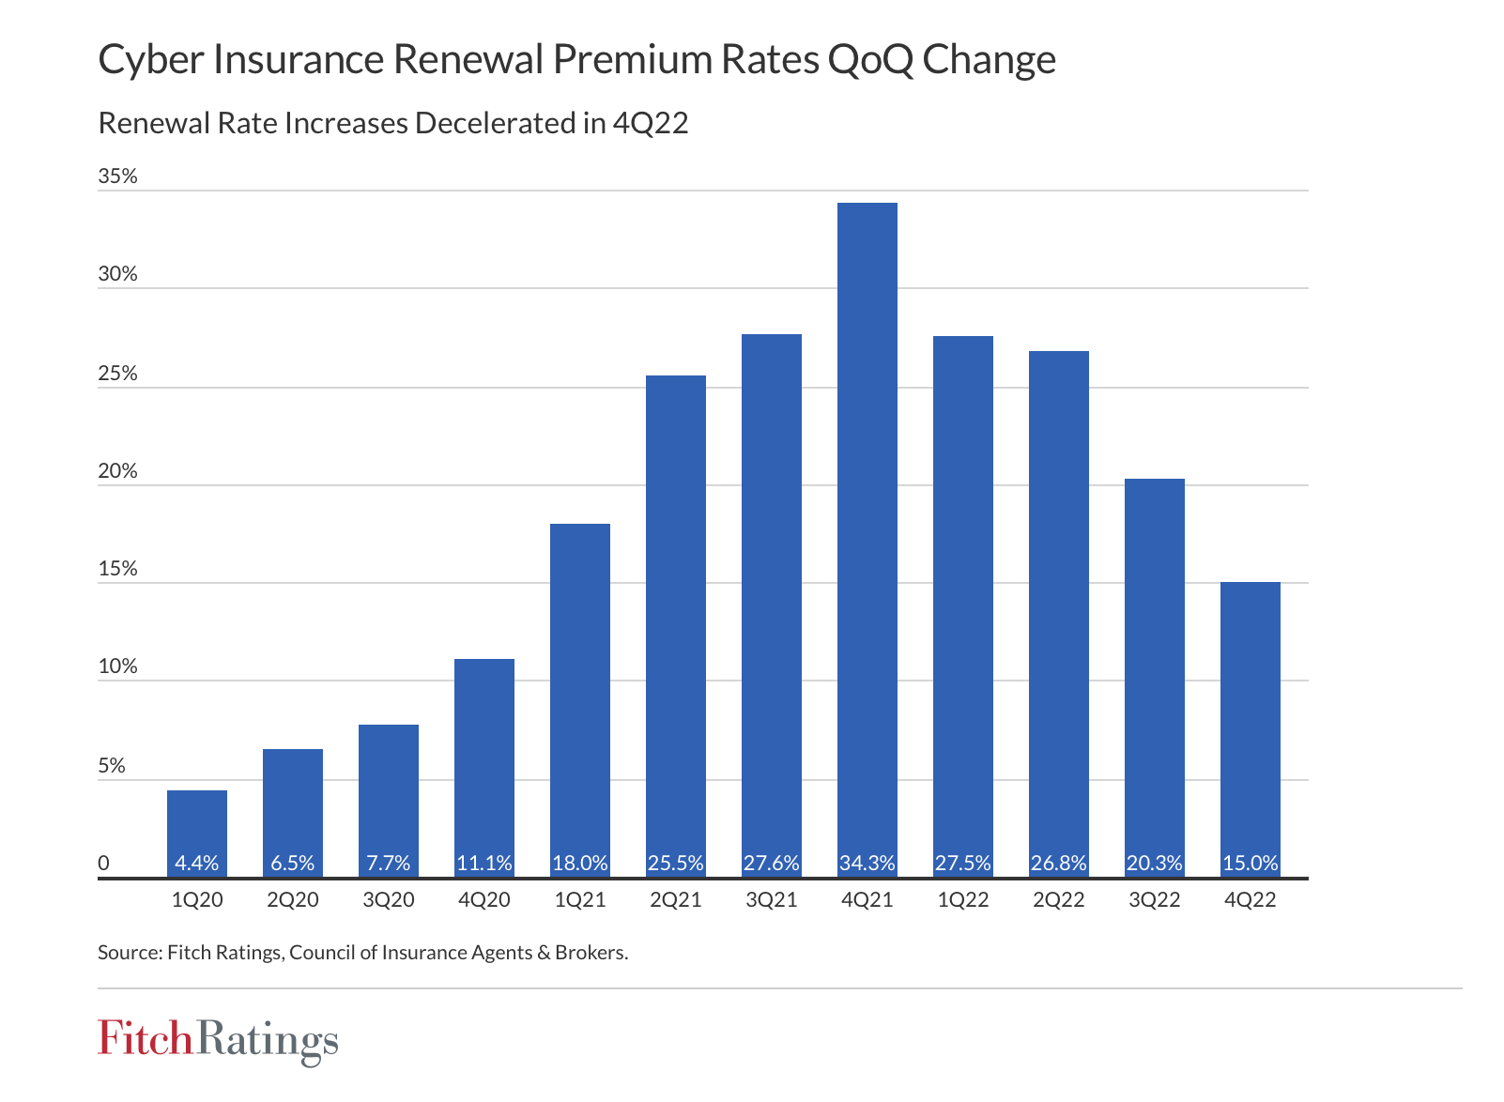
Notes:
Make sure to note that no sever weather is expected this morning.
No Fire Drills are Scheduled for Today
Note where the closet Fire Extinguisher is

Slide 6
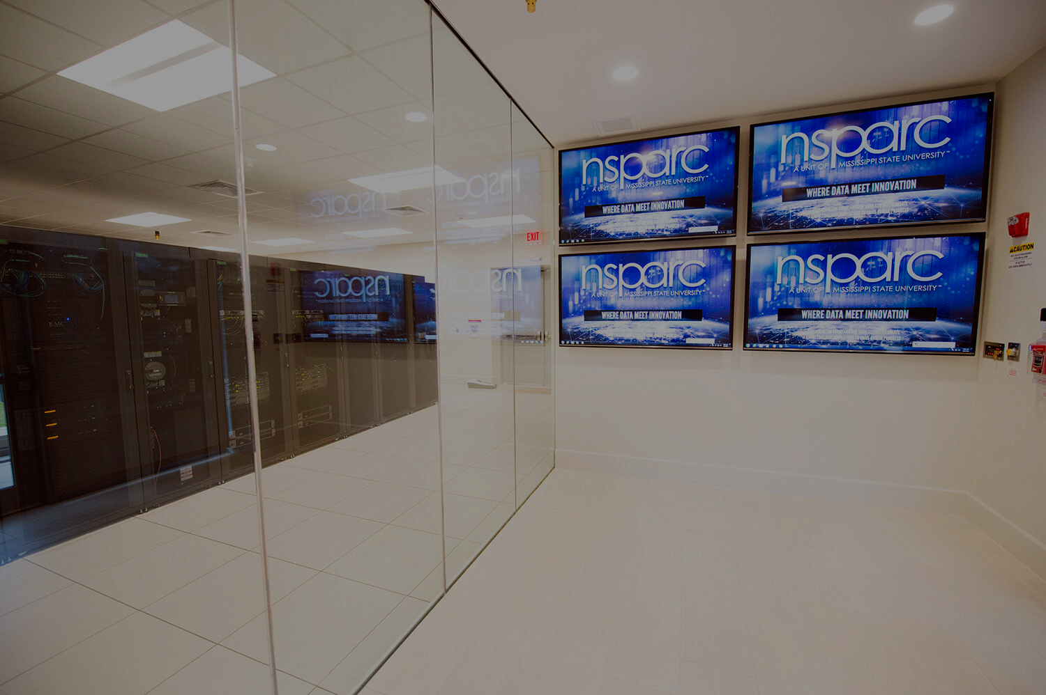
Source: https://content.naic.org/sites/default/files/cmte-c-cyber-supplement-report-2022-for-data-year-2021.pdf

Slide 7
Looking Forward
Market Dynamics: Rate increases are stabilizing; the underwriting process continues to go deep on cybersecurity controls. Coverage scrutiny remains.
Risk Environment: Focus is on catastrophic risk, dynamic privacy regulations, and continued threat of ransomware.
Institution preparation: Demonstrate strong cybersecurity hygiene; align key stakeholders for a smoother process as well as decisions on cyber risk treatment. Complete applications add value to the underwriting process and create an ERM approach to this particular risk area.
Looking Forward: Optimistic about a stabilizing market. As carriers start to see sufficiently priced programs and improved cyber risk profiles, expect minimal increases to become more common
Notes:
Why are we here?

Slide 8

Thank You
Colorado Robertson
Director of Risk Management
colorado.robertson@msstate.edu

