Slide 1
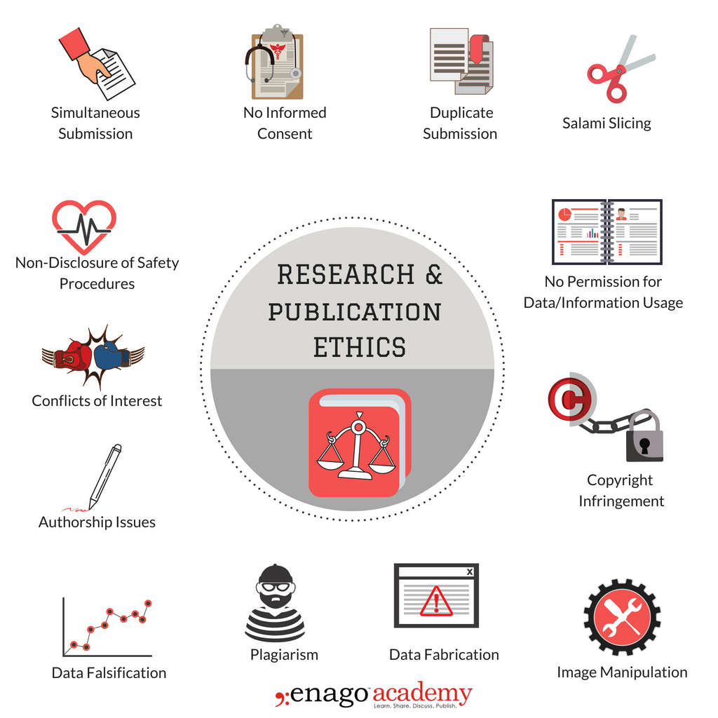
Collaboration & Mentoring: ethics and best Practices
Kari Babski-Reeves, PhD, CPE
Larry G Brown professor and head, Department of industrial and systems engineering
Associate Dean, Bagley College of Engineering

Slide 2
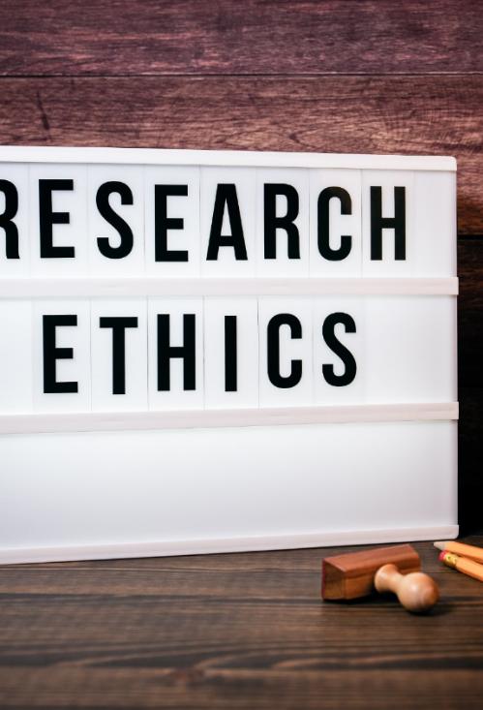
What is ethical behavior
Surprisingly difficult to define
  The application of moral rules and professional codes of conduct to the collection, analysis, reporting, and publication of information … (https://www.encyclopedia.com/social-sciences/dictionaries-thesauruses-pictures-and-press-releases/research-ethics)
  Norms for conduct
    Guidelines for authorship
    Copyright and patent policies
    Data sharing policies
    Confidentiality rules
Notes:
What is appropriate in one discipline may not be in another.
We all know to not fabricate data, but what about using acceptable statistical approaches for filling in missing data, excluding outliers, etc.?
All of us in the room have a gauge for what is ethical so why am I here?

Slide 3
What I’m not going to talk about
Plagiarism/self plagiarism
Fabrication of data
Failure to comply with regulatory requirements
Other categories of research misconduct

Slide 4
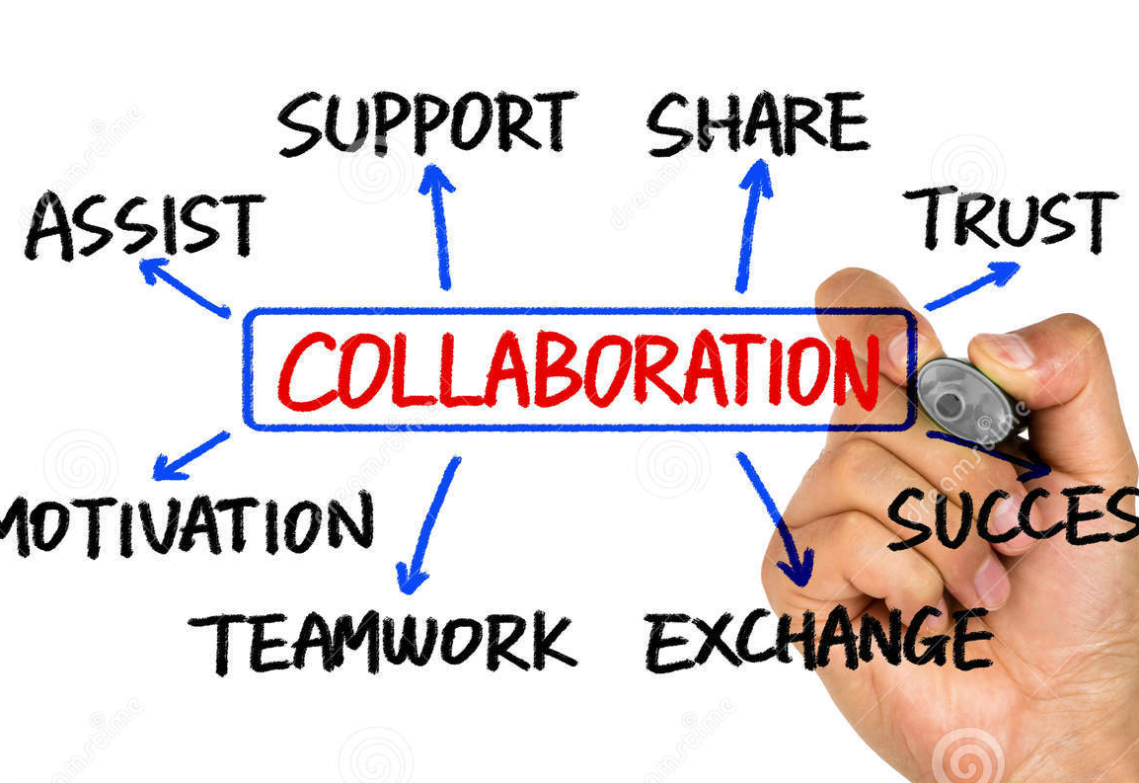
What is research collaboration?
research involving coordination between the researchers, institutions, organizations, and/or communities
can occur at five different levels: within disciplinary, multi-disciplinary, interdisciplinary, trans-disciplinary or national vs international
Bansal, S., Mahendiratta, S., Kumar, S., Sarma, P., Prakash, A., & Medhi, B. (2019). Collaborative research in modern era: Need and challenges. Indian journal of pharmacology, 51(3), 137–139. https://doi.org/10.4103/ijp.IJP_394_19
Notes:
This type of research usually is needed for breakthroughs in the state of the field
Multidisciplinary research takes place when faculty from different disciplines work independently on a common problem or research question. In this approach, faculty share research goals and work on the same problem, but look at it from their own discipline’s perspective.
Interdisciplinary research happens when rather than working independently, with interdisciplinary research disciplines interact and work collaboratively
Transdisciplinary is when new methodologies/techniques/etc are created by the integration of two or more disciplines

Slide 5
Some common issues when participating in collaborative research
Authorship
Data access and use
Work/communication styles and habits
Differences in expectations
Differences in oversight across institutions
Power differentials
Research misconduct

Slide 6
Research collaboration best Practices
Put in the effort early to prevent issues on the back end
Time is critical
Be mindful of others
You need to interact and discuss
Equity can be challenging
Fairly credit researchers for their contributions, regardless of rank, gender, race, title, etc.
Inclusion is key
Intellectual and demographic diversity leads to greater creativity and insight
Establish good communication and trust
Prior history of collaboration typically = increase likelihood of funding
Have clear expectations, roles and responsibilities
Articulate distribution of resources, workload and credit

Slide 7
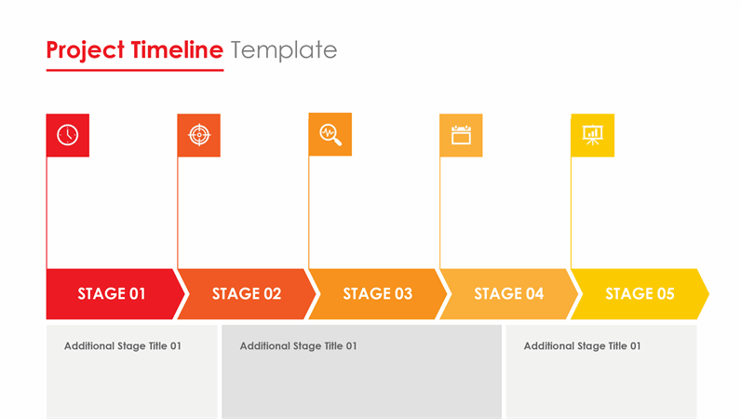
time
Every team member will have different priorities and time constraints
Establish timelines early, adjust as needed
Go to meetings or hold meetings if you are scheduling them
Notes:
Priorities are variable throughout the life of the project

Slide 8
communication
Aligning expectations early in the collaboration ensure there are no misunderstandings
Keep a written record
Use formal MOUs when applicable
Clearly divide and establish who’s responsible for what
Determine authorship early, revise as the direction of the project changes if necessary
Do not assume no news is good news

Slide 9
authorship
Honorary authorship is never acceptable
“Significant contribution”
Author vs acknowledgement
Everyone should contribute to the publications
Data analysis and conclusions
Edits and revisions
Authorize submission
Notes:
We over value our contributions to projects
One department at a university has a proposal process for reviewing and discussing authorship issues as early as possible.

Slide 10

Data management and ownership
Immediate access to all collaborators in a form that is useful
Sufficient detail in research records to address honest errors or misinterpretation
Consistent data organization, file structure and stable electronic file formats
Understand dissemination priorities (e.g., industry vs academia)
Retain your research data for an appropriate period of time
Notes:
Differences in data use/dissemen

Slide 11
What should faculty consider before joining collaborations?
How does the opportunity move their specific research agenda forward?
How does the opportunity fit in with their professional goals?
What resources are needed?
What level of input will you have?
Notes:
Does this help with establishing connections, does this fit within your research/development goals, does this gain you additional expertise in some techniques or methodologies, does this gain you a new focus area for research expansion…
Pre-tenure faculty should be selective, is it time to engage in this, will it fit specifically within the goal of you establishing a reputation and fit within your research narrative. How is this work counted towards P &/or T?
Are you the lead? Do you need a reduction in responsibility? Is there a resource (editors, staff support, etc.) that is needed and can it be obtained.
Will your voice be heard? What are the collaborators track record with others? Does this collaboration have to look like previous collaborations by others within the group?

Slide 12
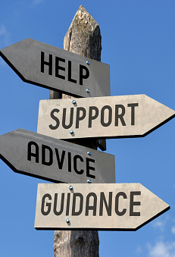
What do I do if my collaboration is not working out?
Speak
Speak with your collaborators
Speak
Speak with your mentors/supervisors
Speak
Speak with ethics officers
Notes:
Follow the chain of command!!

Slide 13

Remember, collaborations are relationships
And keep in mind the 4 pillars
  Time
  Equity
  Inclusion
  Communication

Slide 14

Mentoring
What is mentoring?
  Voluntary
  Partnership
  Reciprocal and collaborative
  Sharing of knowledge
  Supportive of personal and professional development
Notes:
Mentoring is a developmental partnership in which a person with relevant knowledge and experience (a mentor) shares knowledge and skills in order to support other people (a mentee) in their personal and professional development.
Just because I am a senior member of the faculty, or even a faculty member, doesn’t mean that I will make a good mentor. We will talk about the skills of a good mentor, but keep in mind, good mentors take time to develop and each mentee/mentor relationship is different.

Slide 15
3 C’s of Mentorship
Communication
Clarity
Commitment
Notes:
Clarify of purpose of the mentoring program is vital.
Faculty mentoring—how to successfully navigate the university system, earn promotion and/or tenure, grow research program, become a prolific teacher, etc.
Student mentoring—becoming an independent and effective researcher, developing instructional skills, effective mentoring of UG and G researchers, negotiation job searches, etc.
Communication—what is expected of both the mentee and the mentor.
Commitment—time and effort on the part of both the mentee and mentor, resources to help develop strong mentors

Slide 16
University of IOWA has 9 ethical principals for mentoring: junior faculty and students
Beneficence--facilitate growth based on the unique needs
Nonmaleficence--avoid harming, exploiting, neglecting, etc.
Autonomy—bolster knowledge, independence, self-sufficiency, and maturity
Fidelity—provide mentees with attention, support, and honest evaluation
Justice--treat all mentees (and potential mentees) equitably
Transparency—keep the lines of communication open and allow mentees to make informed decisions
Boundaries and Multiple Relationship--honor the boundaries of the mentoring relationship
Privacy--keep private information private.
Competence—seek to expand their competence in the mentor role
Notes:
Beneficence—Mentors strive to facilitate the professional, academic, and/or personal growth of their mentees, acting to understand their unique needs and demonstrating diligence in providing wisdom, support and feedback.
Nonmaleficence—mentors intentionally work to avoid harming, exploiting, neglecting or otherwise disrespecting their mentees
Autonomy—mentors endeavor to bolster mentees knowledge, independence, self-sufficiency and maturity, facilitating the autonomy and creativity of their mentees.
Fidelity—mentors keep promises and remain loyal to those they mentor in terms of attention, support and honest evaluation. If the relationship requires renegotiation on the mentor’s part, the mentor will initiate that conversation.
Justice—mentors treat all mentees and potential mentees equitably regardless of any characteristic
Transparency—mentors provide mentees the information necessary to make an informed decision about entering into a mentoring relationship and encourage good communication about mutual expectations moving forward.
Boundaries and multiple relationships—mentors honor the professional boundaries of the mentoring relationship and seek to protect the integrity of this bond.
Privacy—mentors keep private information shared in confidence by the mentees, however there are circumstances where your mentor may be mandated to report information you shared with them.
Competence—mentors continually work to evaluate and expand their competence in the mentor role, participating in activities such as training, formal educational opportunities and consultation with colleagues. If there is an issue, the mentoring relationship should be renegotiated or terminated.

Slide 17
Nature’s 5th Biennial PhD survey
1 out of 4 graduate students said they’d change their supervisor if they could (Nature’s 5th biennial PhD survey
49% of students said they had less than 1 hr/week 1-1 with their mentor
1/3 satisfied with career guidance
21% reporting bullying or harassment, with 48% of these cases attributed to the advisor

Slide 18

skills of a good mentor
Building rapport and trust
  Most mentor/mentee relationships are built upon similarities
Effective listening
  What challenges is your mentee facing?
Questioning
  Your questions should provoke thought
Providing feedback
  Inspirational and compels the mentee to action
Notes:
Listening—listen to the entire message with your ears (what is being said and what is the tone), with your eyes (what are they doing with their body), with your instincts (are they holding something back that is important), with your heart (what is the other person feeling)
Your questions will dictate the quality of the answers received, and if thought provoking can help you to develop better support measures
Feedback
--inform—break through limitations
--champion—recognize and motivate
--challenge—increase performance
--have the difficult conversation
ALL AT THE SAME TIME

Slide 19
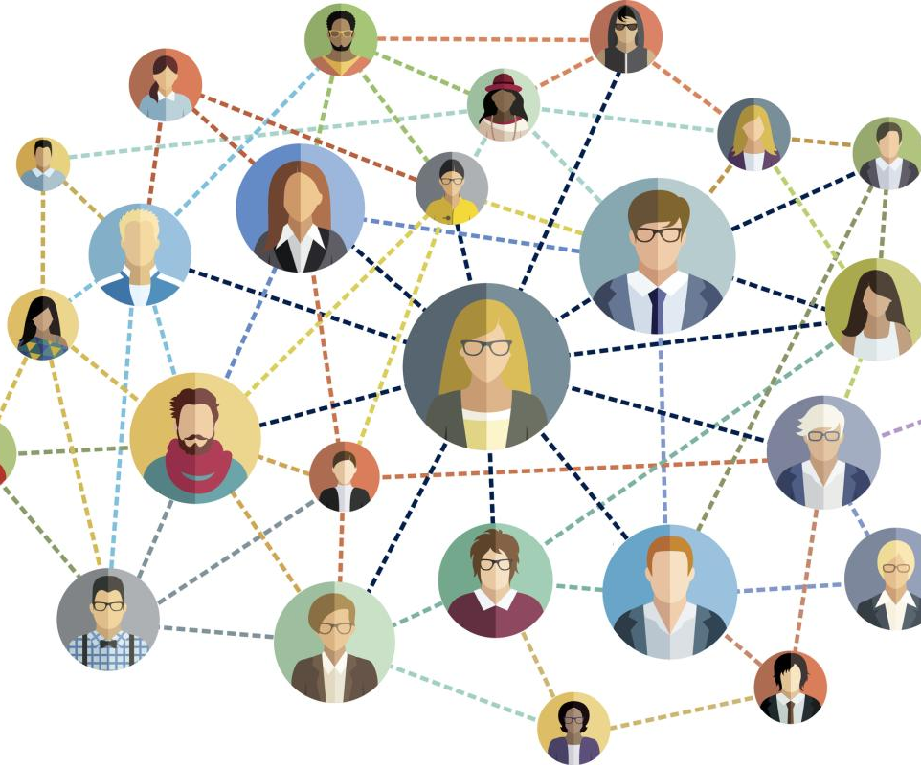
Seek out multiple mentors!

Slide 20

Questions

