Slide 1



MSU @ MCITy- Vicksburg
Tasha Bibb
Senior Program Manager
Office of Technology Management

Slide 2





About Us
Office of Technology Management (OTM)
  Identify opportunities for researchers to work with DOD, ERDCWERX, and others.
Notes:
MSU E-Center
Headquarters vs Vicksburg
OTM
Headquarters vs. Vicksburg
Big picture
Connect our university to more opportunities to work with DOD. Being close to ERDCWERX helps us keep our ear to the ground for more opportunities to do so. We are also able to interface with other ERDCWERX's sister organizations for more opportunties.

Slide 3
SBIR/STTR
Small Business Technology Transfer Research Program (STTR) grant
  Set aside program for Small Businesses requires Small Business to have a non-profit research partner (usually university) to stimulate technological innovation.
  0.45% of extramural budget for agencies with R&D Budget over $1B per year
  5 agencies participating
Small Business Innovative Research (SBIR) grants
  Set aside program for Small Businesses to participate in Federal R&D with the potential for commercialization.
  For agencies with a total R&D budget of over $100M per year, 3.2 % of extramural R&D budget is allocated
  11 agencies participating
Notes:
DOD
Pitch Competitions
Working with ERDCWERX
-opportunities to collaborate on research
& tech challenges
SBIR/University projects

Slide 4
Three Phases
Phase 1
Technical Merit/Feasibility
$50K-$250K
Phase 2
Prototype Development
$750K- $1M
Phase 3
Commercialization
No Federal funding
Commercial sales or federal procurement

Slide 5
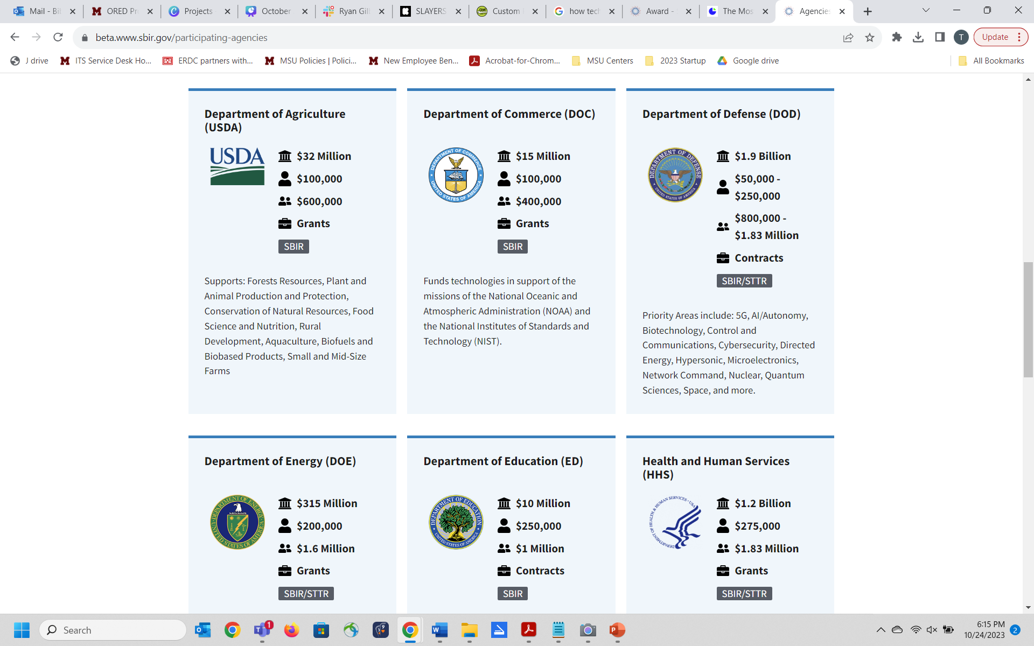
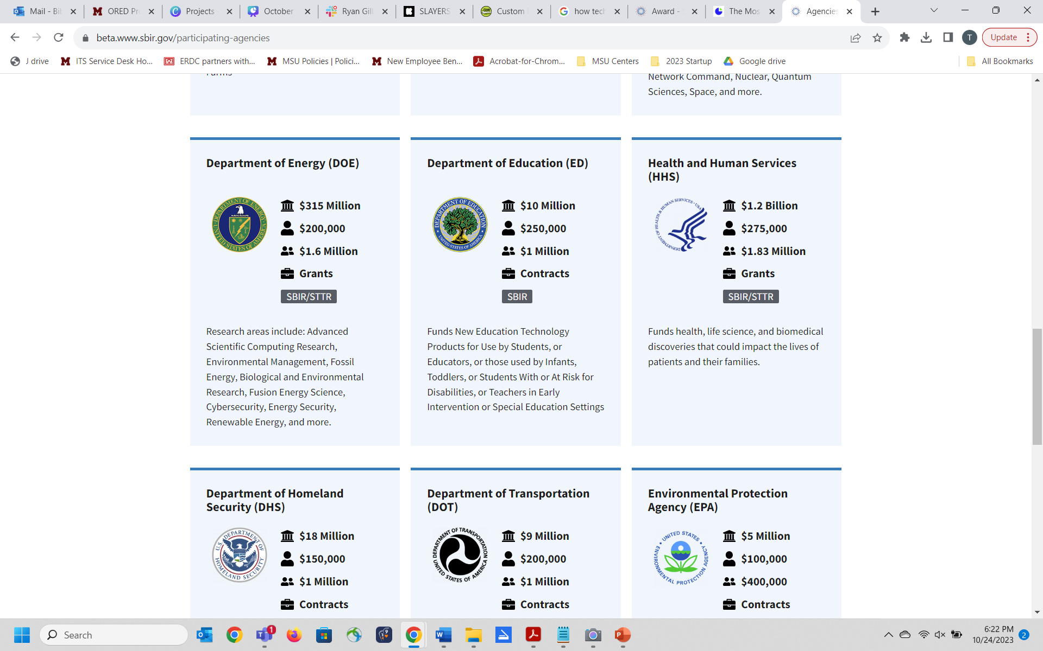
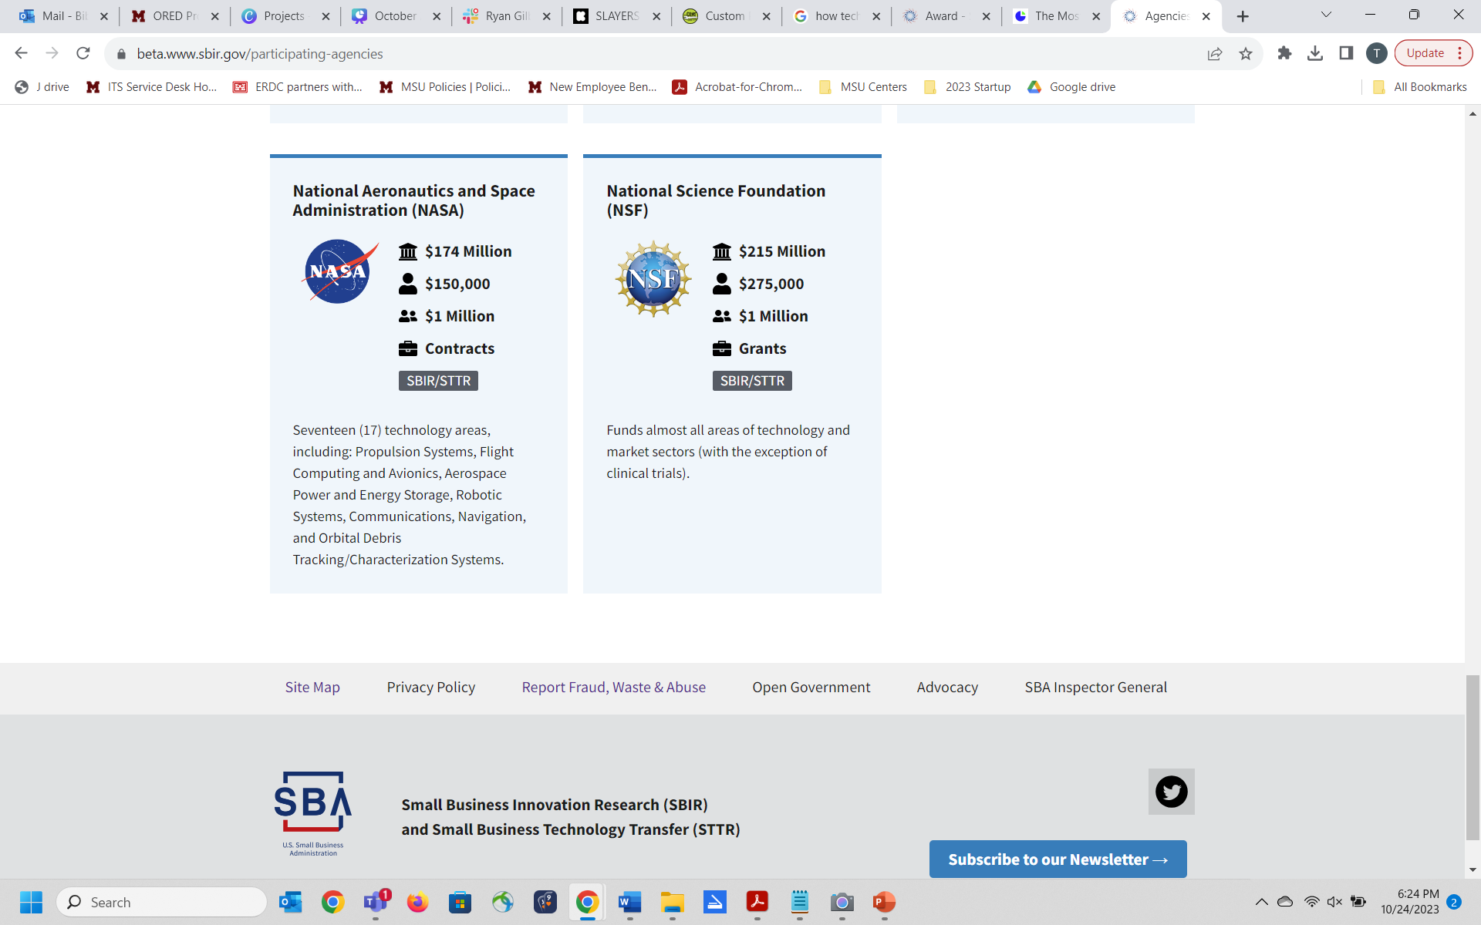
Where are the opportunities??

Slide 6

SBIR- University Partnerships
  SBIR companies and university IP
  SBIR Companies and university Talent
  SBIR companies contracting research services
Notes:
SBIR companies and university IP. Some SBIR projects are built around university IP that was either developed by a faculty member or researcher who ultimately joined the project or licensed from the university to the company. According to the NASEM studies, the former is somewhat more common than the latter. Less than 10 percent of SBIR projects at Defense, Energy and NASA involve university IP; at NIH and NSF this was much more common, with 17 and 19 percent, respectively, using university technology developed by a team member, and 14 and 13 percent licensing university technology.
SBIR companies and university talent. Many companies recruit faculty or graduate students to participate in the SBIR project. This type of arrangement can provide the SBIR company with access to talent that has a uniquely-sophisticated understanding of the technology to be developed by the project. The frequency of this activity ranges from about 15 percent (NASA) to 38 percent (NIH), according to NASEM’s survey respondents. Across all five agencies studied by NASEM, companies worked with faculty more often than with graduate students. SBIR.gov’s tutorial on university partnerships provides advice on this type of relationship.
SBIR companies contracting research services. Beyond hiring faculty to participate in the project, many SBIR awardees contract research assistance or facility access from universities. NASEM respondents reporting this activity ranged from about 20 percent (NASA and Defense) to 37 percent (NIH).
Universities as funders of SBIR companies. Many universities now provide grants, loans or investments to companies with a relationship to the school’s faculty or IP, and NASEM’s surveys suggest that SBIR companies have benefited from these funds. Follow-on funding was reported as rarer for SBIR awardees from Defense (2 percent) and NASA (0 percent) than at Energy (8 percent), NSF (9 percent) or NIH (9 percent). The Ohio State University’s pre-seed fund(link is external) with Rev1 Ventures is just one example of this type of funding.
Universities as providers of application assistance. Many universities also serve as a source of pre-application/Phase 0 support for companies. For example, 10 universities are currently funded by the U.S. Small Business Administration’s Federal and State Technology Partnership (FAST) program to assist companies in understanding and applying for SBIR awards. Assistance is common at non-FAST universities as well, such as grant-writing assistance and commercialization grants that have been offered by the University of Washington, as described by their former vice provost, Linden Rhoads in recent congressional testimony.

Slide 7
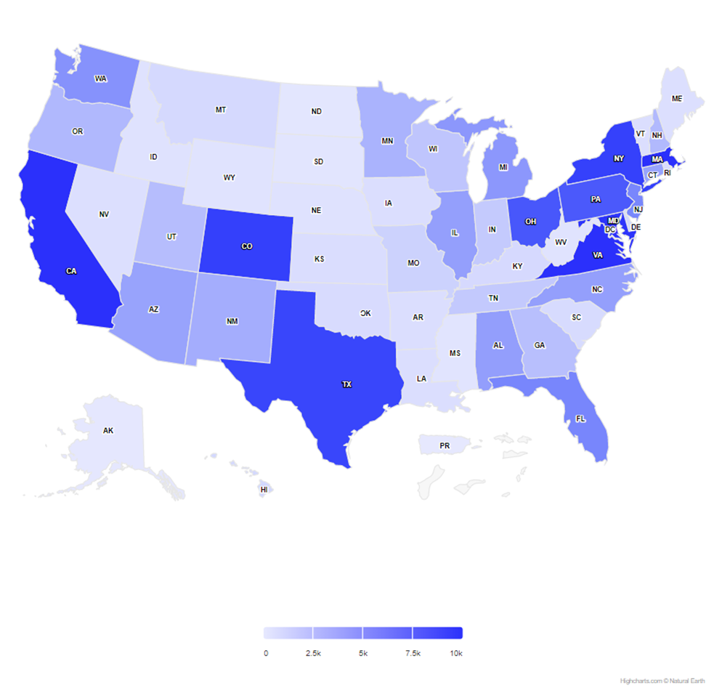
SBIR/STTR
Since 2018...
Nationwide: Nearly 27,000
Alabama: 643
Louisiana: 145
Arkansas: 91
Mississippi: 20

Slide 8
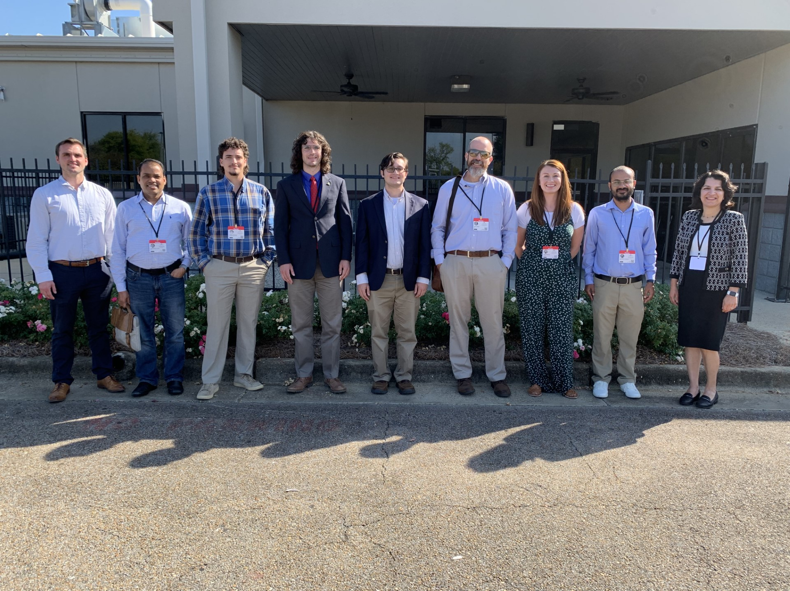
SBIR Pitch Competitions
  Each quarter
  Pitch your SBIR project
  Win $2,000
Opportunities

Slide 9
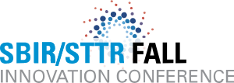
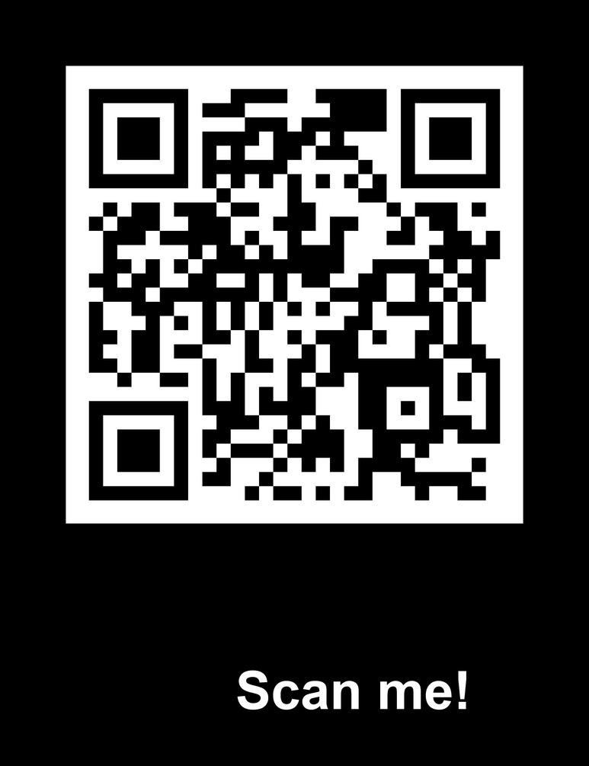
SBIR/STTR Innovation Conference
  Spring/Fall
  November 27-29
  Speak one-on-one with agencies
Opportunities

Slide 10

MS-FAST
  Technical Assistance
  $3,000 award
  Pre-proposal activities
More info: www.mistcluster.org/ms-fast
www.innovate.ms
Opportunities
Notes:
Approved expenses include travel, legal, proposal writing, sample prep & testing, student labor, supplies, etc

Slide 11

SBIR/STTR Consortium
  Network of Small Businesses
  Statewide
  Matchmaking opportunities
Opportunities

Slide 12




Contact Us!
Questions about tech entrepreneurship?
Found and SBIR/STTR opportunity to pursue?
Just want to stay connected?
otm.msstate.edu
tasha.bibb@msstate.edu
662.325.0485
1622 Washington Street, Vicksburg, MS

Slide 13
Thank You

