Slide 1
Department of defense risk matrix
Chris Jenkins
Research Security Officer, Assistant Director
cjenkins@ors.msstate.edu
662-325-0400

Slide 2
Bottom Line Up Front
DoD is acting to counter unwanted foreign influence in fundamental research through their June 2023 memo: “Countering Unwanted Foreign Influence in Department-Funded Research at Institutions of Higher Education.”
DoD will analyze risk of each proposal through four key factors:
Participation in Malign Foreign Government Talent Recruitment Programs (MFGTRPs),
funding sources,
patents, and
entity lists.
After August 9, 2024, researcher associations with malign foreign talent recruitment programs and institutional failure to have a policy prohibiting these associations will be considered a prohibited factor and the project will not be funded.

Slide 3
Risk Factors
Malign Foreign Government Talent Recruitment Programs (MFGTRPs)
Indicators the covered individual is participating in a MFGTRP as defined in the Chips and Science Act.
Funding Sources
Indicators the covered individual is receiving funding from a foreign country of concern (FCOC) or a FCOC-connected entity.
Funding is going to be the most complicated to figure out regarding DoD policy. There are many ways to be a FCOC-connected entity and there has been no guidance on what exactly that phrase means.
Patents
Patent application(s) or patent(s) resulting from USG-funded research that were filed in a FCOC prior to filing in the U.S. or filed on behalf of a FCOC-connected entity.
Entity Lists
Indicators the covered individual association with an entity or person on U.S. Department of Commerce Entity List, EO 14032 or superseding EOs, Section 1260H of the 2021 NDAA, or Section 1286 of 2019 NDAA.

Slide 4
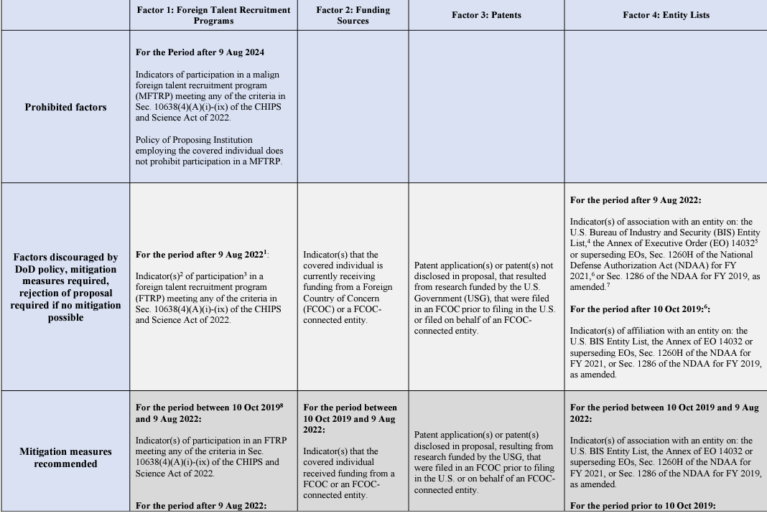
DoD Risk Matrix (partial)
The four main time frames under consideration are:
Prior to 10 October 2019
10 October 2019-9 August 2022
After 9 August 2022
After 9 August 2024
Activities and associations prior to 10 October 2019, mitigation is suggested.
Between 10 October 2019 and 9 August 2022, mitigation is recommended.
After 9 August 2022, mitigation is required to avoid proposal rejection.
If there are associations/activities with MFGTRPs after 9 August 2024, the proposal will be rejected.

Slide 5
Risks to U.S. National Security, per DoD
Universities (China)
Academy of Military Science
Beijing Aeronautical Manufacturing Technology Research Institute
Beijing Computational Science Research Center
Beijing Institute of Technology
Beihang University
Beijing University of Posts and Telecommunications
Center for High Pressure Science and Technology Advanced Research
Chinese Academy of Sciences
Harbin Engineering University
Harbin Institute of Technology
Hefei National Laboratory for Physical Sciences at the Microscale
Nanjing University of Aeronautics and Astronautics
Nanjing University of Science and Technology
National University of Defense Technology
Northwestern Polytechnical University
Ocean University of China
Sichuan University
Sun Yat-Sen University
Tianjin University
University of Electronic Science and Technology of China
Malign Foreign Talent Plans
Changjiang Scholar Distinguished Professorship
Hundred Talents Plan
Pearl River Talents Plan
Project 5-100
River Talents Plan
Thousand Talents Plan OR
Any program that is sponsored by China, Russia, Iran, or North Korea AND requires an individual to take on one or more of the following:
Unauthorized transfer of intellectual property or other nonpublic information
Recruit trainees or researchers to enroll in such program
Establishing a laboratory/appointment in a foreign country in violation of terms and conditions of a Federal research award
Inability to terminate
Overcapacity/overlap/duplication
Mandatory to obtain research funding from the foreign government’s entities
Omitting acknowledgement of US home institution/funding agency
Not disclosing program participation
Conflict of interest/commitment
Sponsored by a country of concern (listed above)

Slide 6
New Actions Moving Forward
DoD
DoD Components will review at least three sets of information
Researcher disclosures and Standard Form 424 submitted for all “Covered Individuals”
Publicly available information
Information in Research Performance Progress Reports for funded projects.
They reserve the right to review any other information as deemed necessary.
DoD Components will conduct periodic spot checks of Covered Individuals on samples of FRPPs to identify any missed research security issues.
MSU
P.I.s must be tracking their publicly available profiles. Know who you are connected to and who your connections are connected to.
Disclose “public” relationships on the SF 424.
If DoD determines there is a high enough risk, the MSU P.I. will have to work with the Research Security Office to create a mitigation plan.
Be prepared to respond:

Slide 7
Takeaways
Fundamental research is being increasingly scrutinized by DoD.
DoD will conduct risk assessments on all fundamental research proposals AFTER they have been selected to be awarded
Association/activities risk levels increase the more recent they occur. Know what your open source profile say about you.
After August 9, 2024, MSU must have a policy that prohibits participation in Malign Talent Plans

Slide 8
Questions
Chris Jenkins
Research Security Officer, Assistant Director
cjenkins@ors.msstate.edu
662-325-0400

