Slide 1

Financial Management for DoD/DoD Related Agencies
Speaker: Kim Lewis, Senior Accountant, Sponsored Programs Accounting

Slide 2
Agenda:
-Invoicing/Financial Reporting
-Invoice/Financial Report Submission
-Audit Standards/Requirements

Slide 3
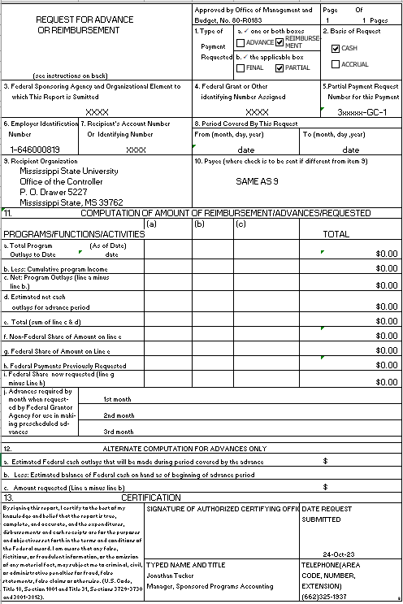
-SF-270 (Invoice)

Slide 4
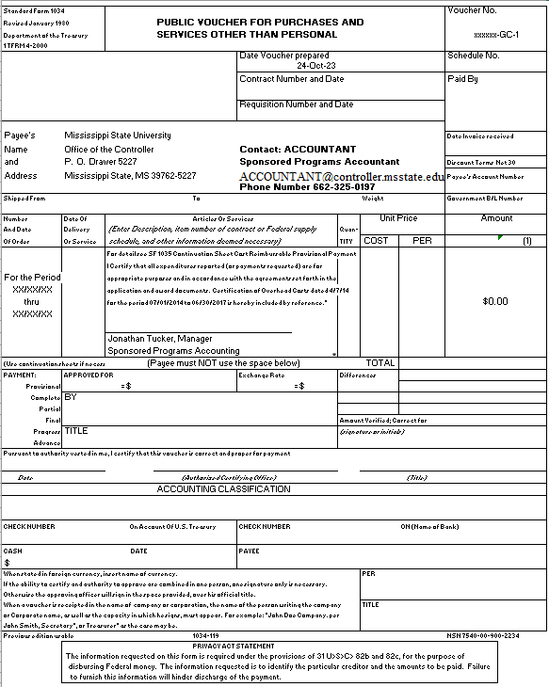
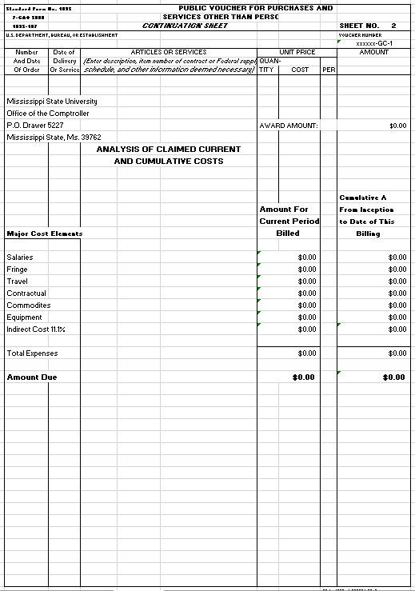
-SF-1034 (Public/Cost Voucher)

Slide 5
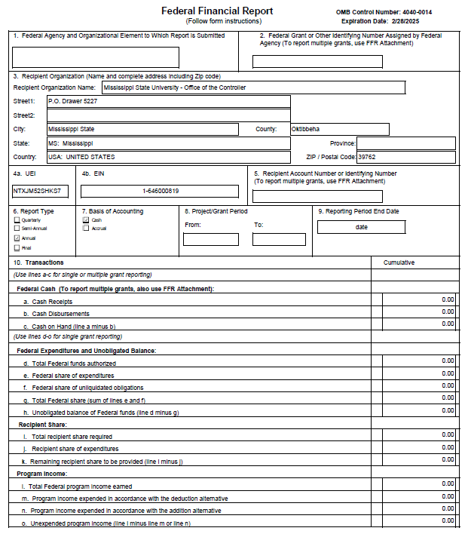
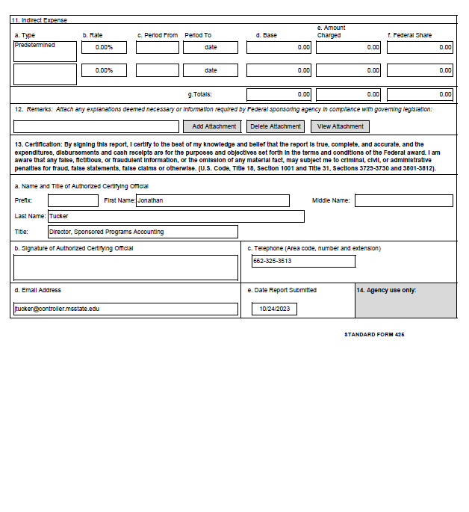
-SF-425 (Financial Report)

Slide 6
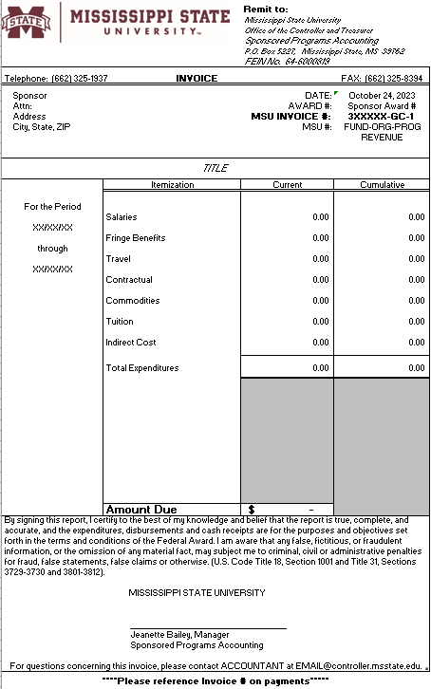
-Standard Invoice (Flow-Through)

Slide 7
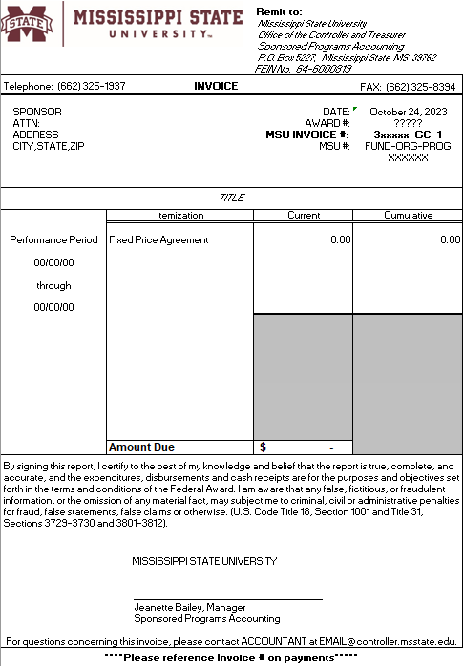
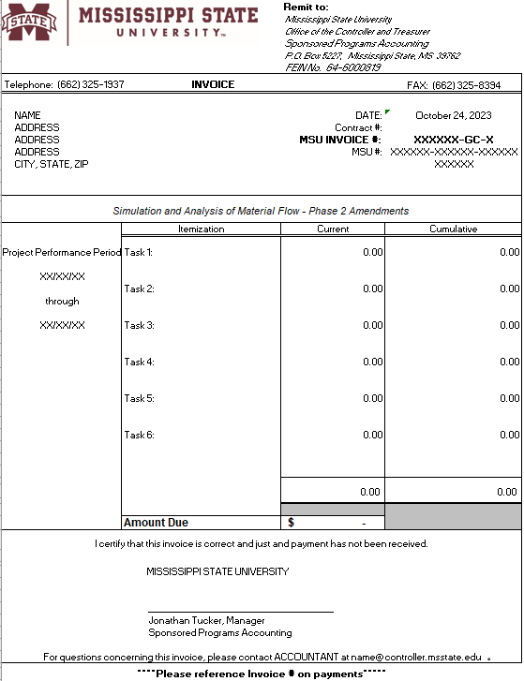
-Installments (Fixed Price/Task Driven)

Slide 8


Invoice/Financial Report Submission:
-PIEE (Formerly referred to as WAWF)
-eBRAP (Financial Reports)
-Email/Mail

Slide 9
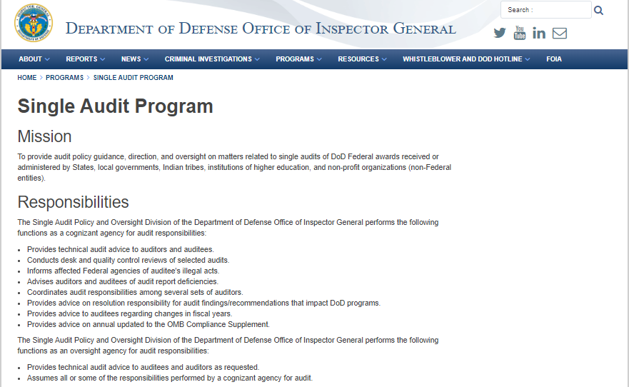
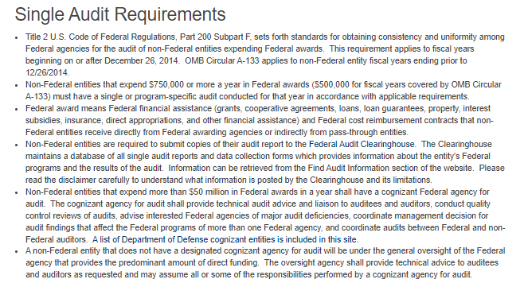
Audit Standards/Requirements:

Slide 10
Thank you!!!

