Slide 1
Lessons Learned Working with DoD Research and Development Programs

Slide 2
BLUF: Lessons Learned
Relationships – Most Important – Face time
  Internships – students & faculty
  Conferences
  Site Visits – University & DoD locations
Contracting Vehicles – SAMS.GOV and GRANTS.GOV
  Broad Agency Announcements (BAA)
  Broad Other Transaction Authority (BOTA)
  Indefinite Delivery Indefinite Quantity (IDIQ)
  Collaboration – Prime Contractor, Subcontractor, HBCU, etc.
Contract Interactions
  Contracting Officer’s Representative (COR)
  Technical Point of Contacts (TPOC)
  Contract Deliverables

Slide 3
DoD Organizational Structure
C:\dod-face-chart-20230306.pdf

Slide 4
National Defense Strategy
On October 27, 2022, the Department of Defense publicly released our unclassified National Defense Strategy (NDS), a Congressionally-mandated review. This strategy sets the strategic direction of the Department to support U.S. national security priorities, and flows directly from President Biden's National Security Strategy.
https://media.defense.gov/2022/Oct/27/2003103845/-1/-1/1/2022-NATIONAL-DEFENSE-STRATEGY-NPR-MDR.PDF

Slide 5
Appropriation Categories
Research, Development, Test and Evaluation (RDT&E) appropriations fund the efforts performed by contractors and government activities required for the Research and Development (R&D) of equipment, material, computer application software, and its Test and Evaluation (T&E) to include Initial Operational Test and Evaluation (IOT&E) and Live Fire Test and Evaluation (LFT&E). RDT&E also funds the operation of dedicated R&D installations activities for the conduct of R&D programs.
Procurement appropriations fund those acquisition programs that have been approved for production (to include Low Rate Initial Production (LRIP) of acquisition objective quantities), and all costs integral and necessary to deliver a useful end item intended for operational use or inventory upon delivery.
Operation and Maintenance (O&M) appropriations fund expenses such as civilian salaries, travel, minor construction projects, operating military forces, training and education, depot maintenance, stock funds, and base operations support.
Military Personnel (MILPERS) appropriations fund costs of salaries and other compensation for active and retired military personnel and reserve forces based on end strength.
Military Construction (MILCON) appropriations fund major projects such as bases, schools, missile storage facilities, maintenance facilities, medical/dental clinics, libraries, and military family housing.

Slide 6
Critical Technology Areas
Seed Areas of Emerging Opportunity
Biotechnology
Quantum Science
Future Generation Wireless Technology (FutureG)
Advanced Materials

Slide 7
Critical Technology Areas
Effective Adoption Areas
Trusted AI and Autonomy
Integrated Network Systems-of-Systems
Microelectronics
Space Technology
Advanced Computing and Software
Human-Machine Interfaces
Renewable Energy Generation and Storage

Slide 8
Critical Technology Areas
Defense-Specific Areas
Directed Energy
Hypersonics
Integrated Sensing and Cyber

Slide 9
DOD RDT&E Budget Activity Codes and Descriptions
Budget Activity Code | Description
6.1 | Basic Research
6.2 | Applied Research
6.3 | Advanced Technology Development
6.4 | Advanced Component Development and Prototypes
6.5 | System Development and Demonstration
6.6 | RDT&E Management Support
6.7 | Operational Systems Development

Slide 10
FY2022 Total DOD RDT&E

Slide 11
RDT&E by Character of Work, FY 2022
(Total obligational authority, in billions of current dollars)

Slide 12
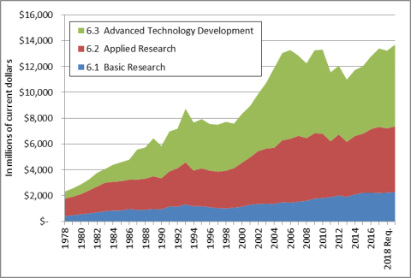
Defense S&T Funding, by Budget Activity,
FY1978-FY2019
(In millions of current dollars)

Slide 13
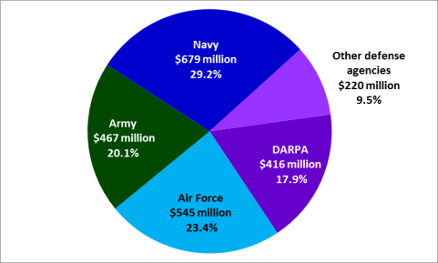
Basic Research Funding of DOD Services and Agencies

Slide 14
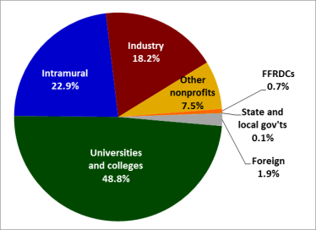
DOD Basic Research Obligations by Performing Sector

Slide 15
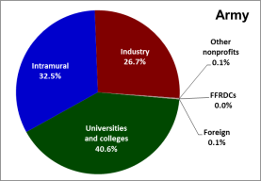
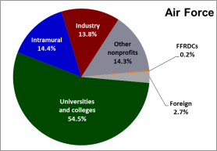
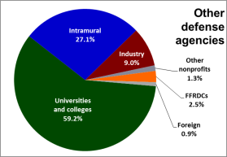
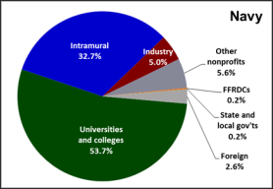
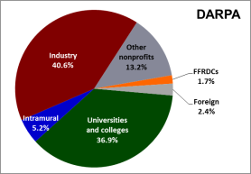
Share of DOD Components' Basic Research

Slide 16
Basic Research Program Elements, Services and D-W Agencies, FY2017
Dollars in millions
 | Army |  | Navy |  | Air Force |  | Defense-Wide
Program Element | Dollars | Share of Army 6.1 | Dollars | Share of Navy 6.1 | Dollars | Share of Air Force 6.1 | Dollars | Share of D-W 6.1 | Total
Defense Research Sciences | $286.1 | 60.5% | $413.8 | 75.3% | $370.6 | 71.1% | $432.3 | 62.0% | 1,502.9
University Research Initiatives | 66.5 | 14.1% | 117.3 | 21.4% | 137.8 | 26.4% |  |  | 321.6
In-House Laboratory Indep. Research | 11.9 | 2.5% | 18.2 | 3.3% |  |  |  |  | 30.2
Univ. and Industry Research Centers | 108.7 | 23.0% |  |  |  |  |  |  | 108.7
High Energy Laser Research Initiatives |  |  |  |  | 13.2 | 2.5% |  |  | 13.2
National Defense Education Program |  |  |  |  |  |  | 74.3 | 10.7% | 74.3
Basic Research Initiatives |  |  |  |  |  |  | 40.6 | 5.8% | 40.6
Basic Operational Medical Research Science |  |  |  |  |  |  | 43.1 | 6.2% | 43.1
Chemical and Biological Defense Program |  |  |  |  |  |  | 43.9 | 6.3% | 43.9
Defense Threat Reduction Agency Univ. Strategic Partnership Basic Res. |  |  |  |  |  |  | 37.2 | 5.3% | 37.2
Historically Black Colleges and Universities |  |  |  |  |  |  | 25.9 | 3.7% | 25.9
Total | $473.2 | 100.0% | $549.4 | 100.0% | $521.6 | 100.0% | $697.3 | 100.0% | 2,241.5

Slide 21
DoD Funding Agencies

Slide 29
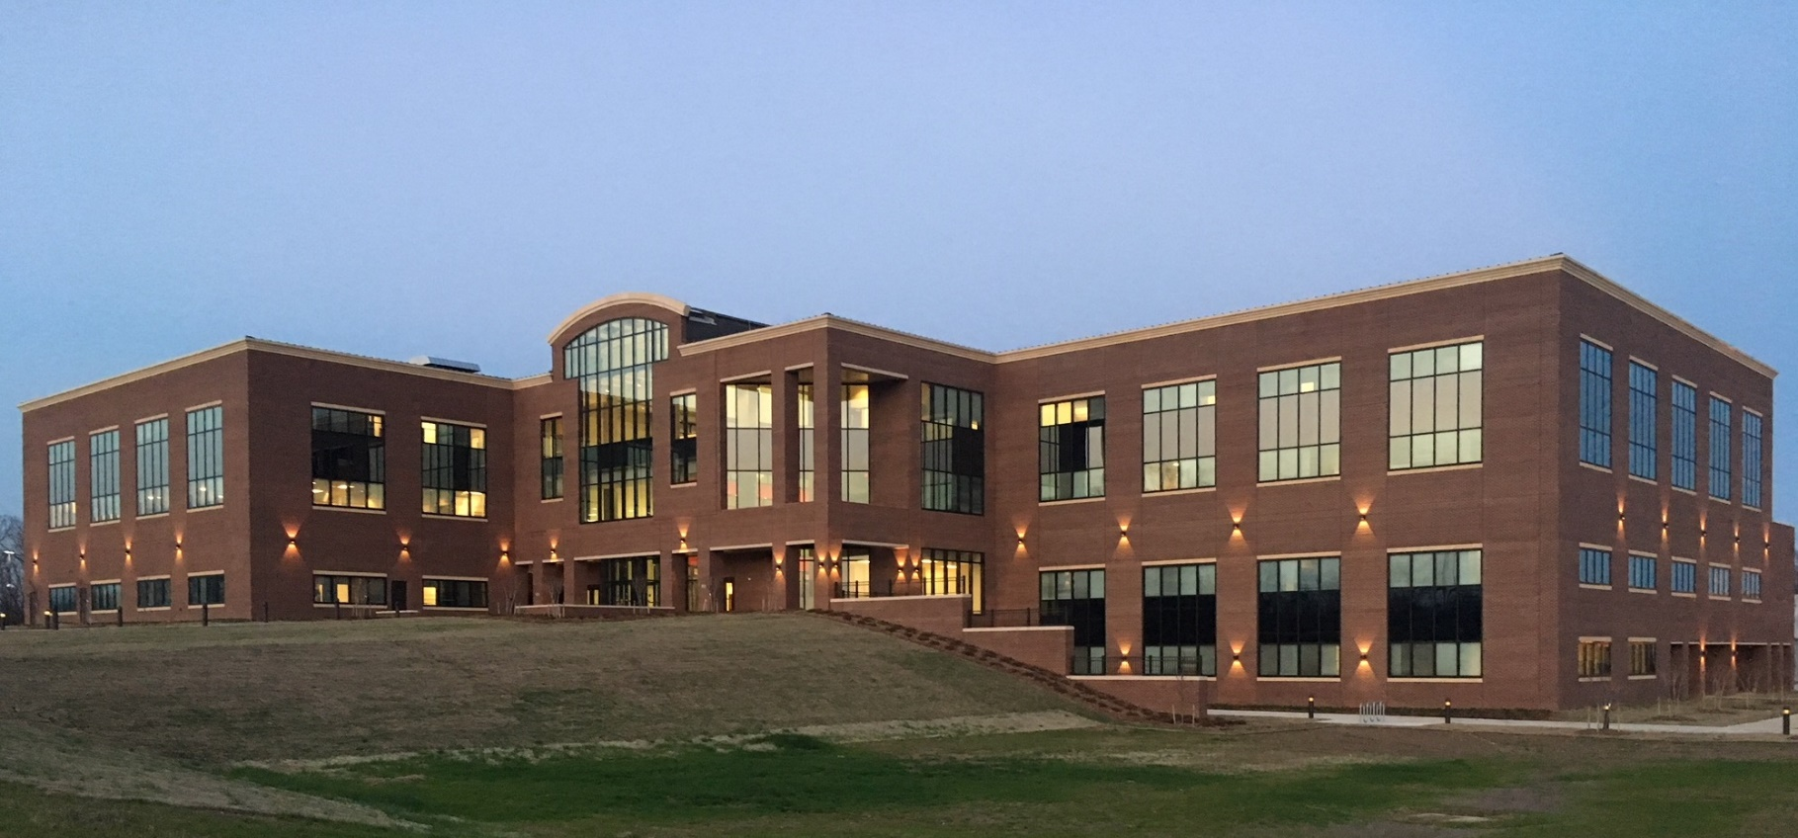
THE POWER OF ERDC
Solving the Nation’s Toughest
Engineering and Science Problems

Slide 30


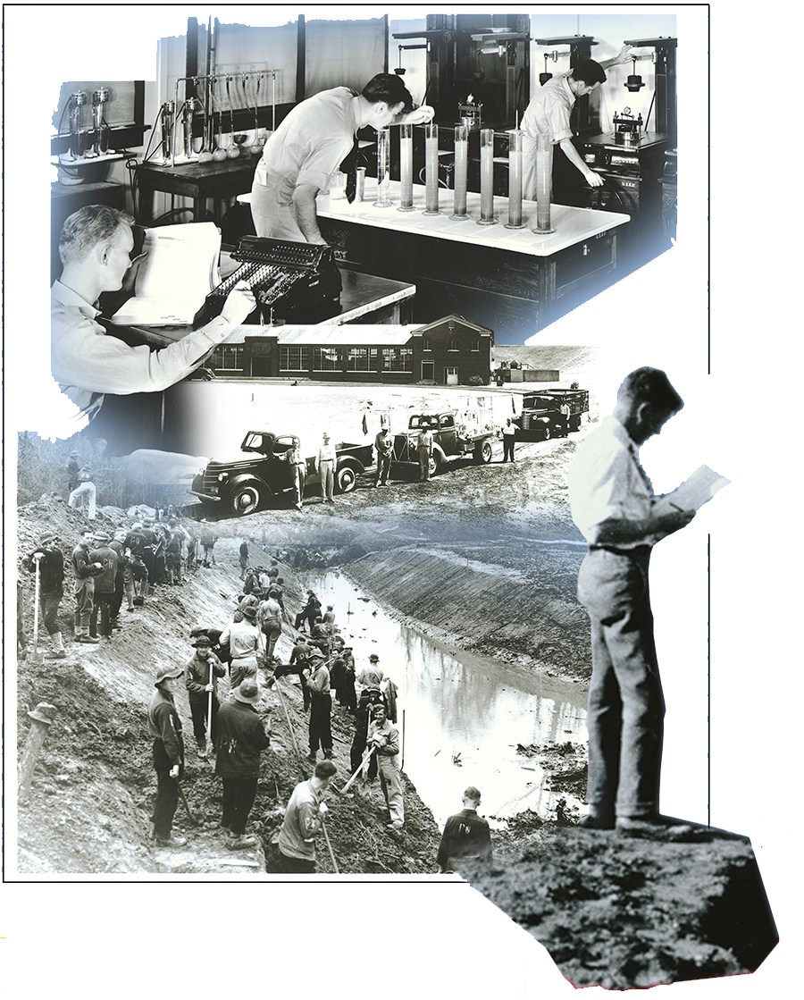
’s History
1929 Waterways Experiment Station (WES) established as hydraulics laboratory in Vicksburg, Mississippi
1939 Soils Division formed at WES
1946 Corps of Engineers’ concrete laboratory relocated from New York to WES
1960 Geodesy, Intelligence, and Mapping Research and Development Agency, forerunner to be the Topographic Engineering Center (TEC), created at Fort Belvoir, Virginia
1961 Cold Regions Research and Engineering Laboratory (CRREL) established in Hanover, New Hampshire
1968 Construction Engineering Research Laboratory (CERL) established in Champaign, Illinois
1974 Environmental Laboratory (EL) established at WES

Slide 31
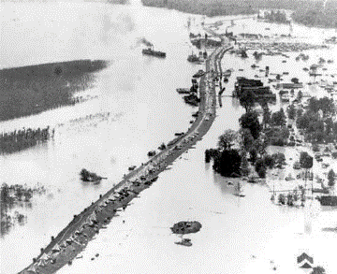
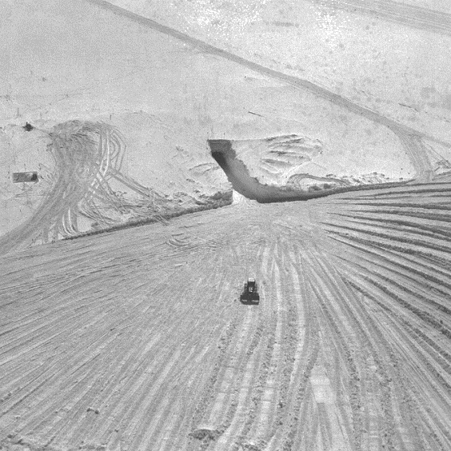
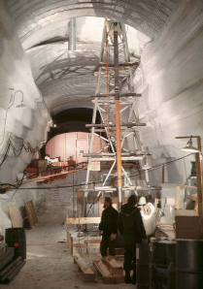

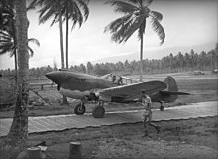
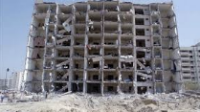
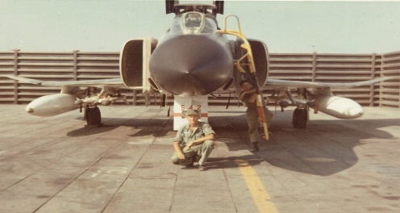

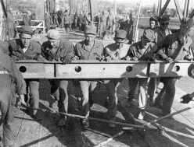
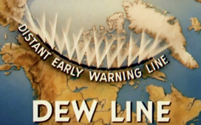

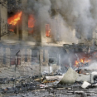

’s History
1980s
1920s
1960s
1940s
Marston Mat
(1942)
Caisson Model
D-Day Tests
First Supercomputers
Mississippi River
Great Flood of 1927
WWII
1990s
Arctic
Camp Century Entrance and Coring Rig (1964)
1929- Corps Established Waterways Experiment Station (WES)
1930s
Pontoon Bridge Model
1950s
Vietnam, AM-2, (1966)
1970s
2000s
9-11
First Outdoor River Model Carved in Soil at WES (1931)
Engineers in Korea
Cold War /
Korean War

Slide 32
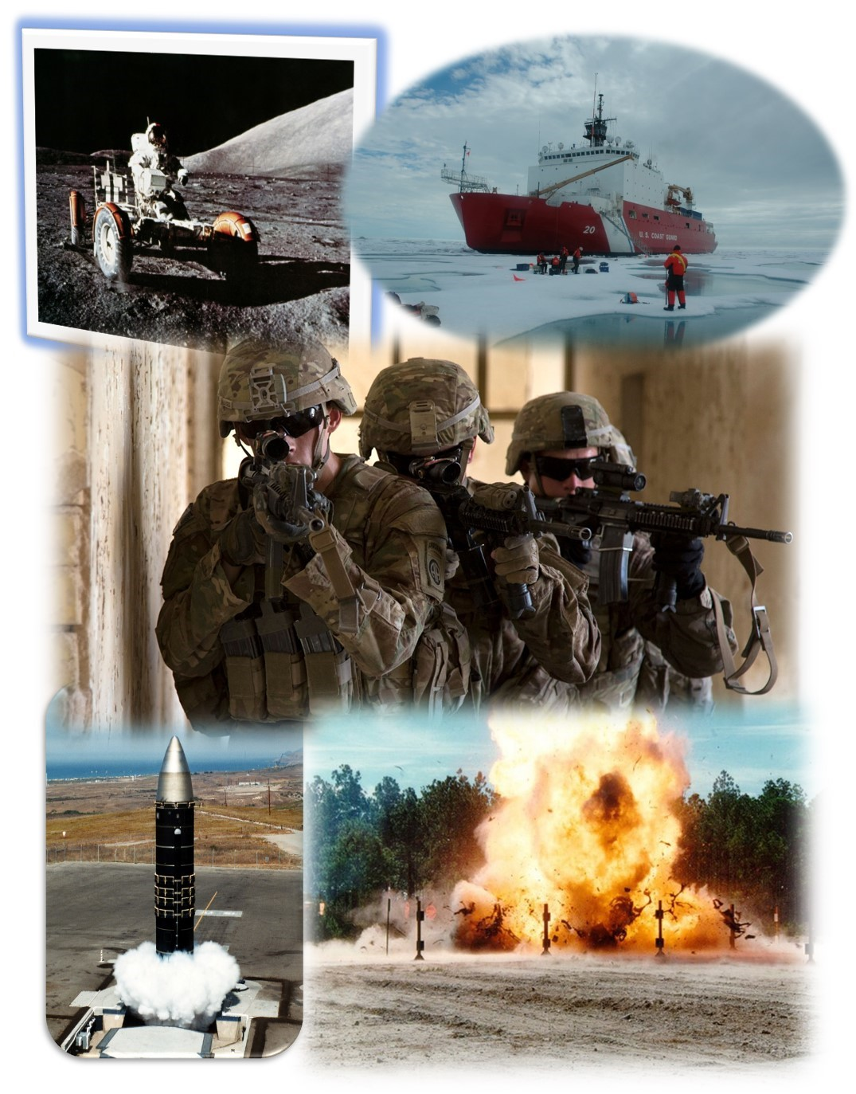

’s History
1978 Geotechnical Laboratory (GL) formed by merger of Soils and Pavements Laboratory and Mobility and Environmental Systems Laboratory, Structures Laboratory (SL) for by merger of Concrete and Weapons Effects Laboratories with Soil Dynamics Division.
1983 Coastal Engineering Research Center (CERC, formed 1963, relocated to WES from Fort Belvoir
1986 Information Technology Laboratory (ITL) established at WES
1996 Hydraulics Laboratory and CERC merged to form Coastal and Hydraulics Laboratory (CHL) at WES
1998 Corps of Engineers approves “re-engineering” plan to consolidate Corps laboratories under single organization structure
1999 Engineer Research and Development Center (ERDC), headquartered at WES established by merging WES laboratories (CHL, GL, SL, EL, and ITL) with TEC, CRREL, and CERL
2000 GL and SL merged to form Geotechnical and Structures Laboratory (GSL)

Slide 33
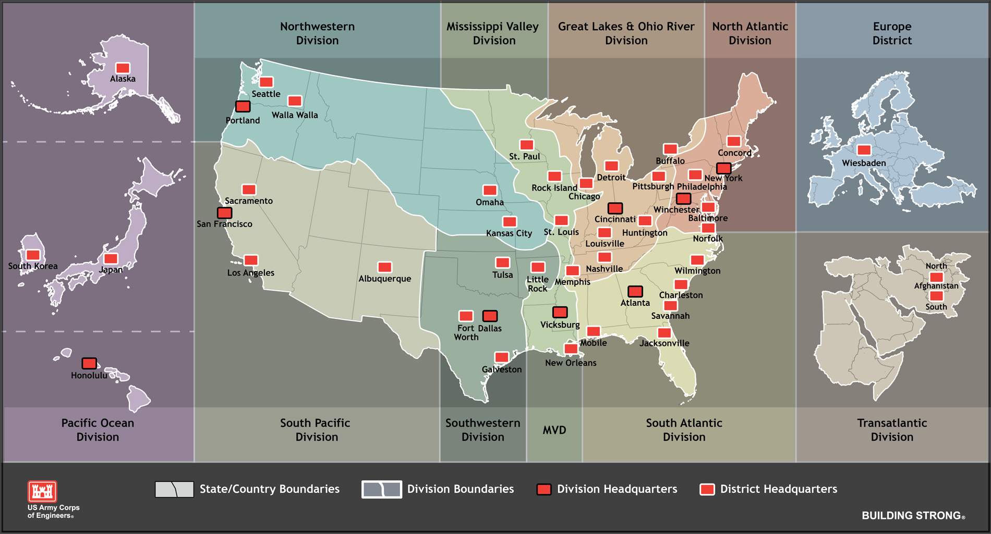
Border

Slide 34
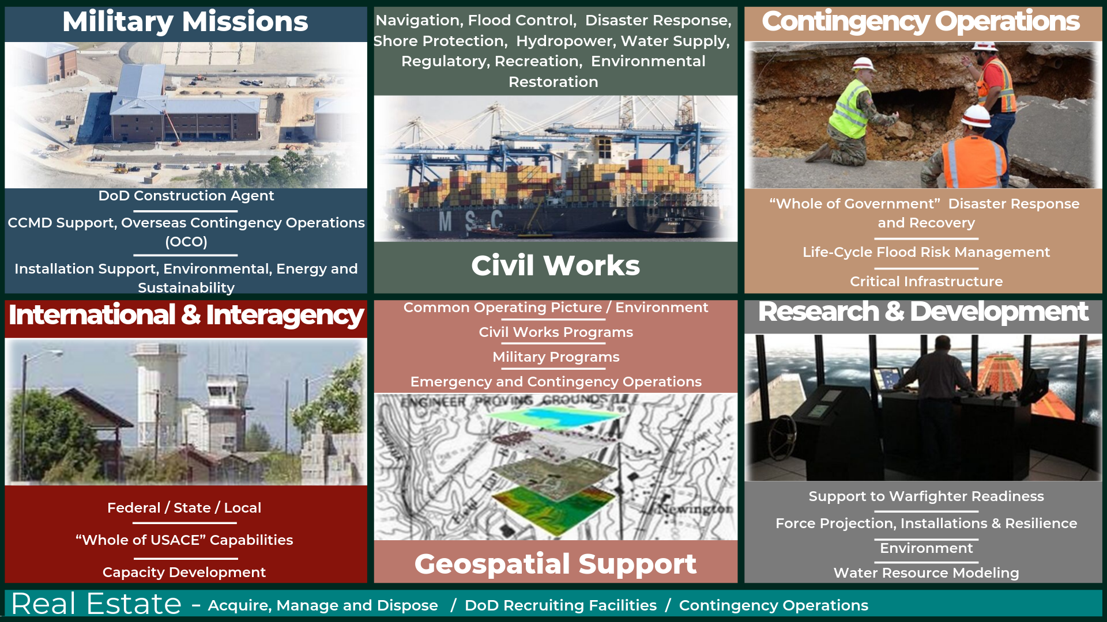
US Army Corps of Engineers and its Missions
ARMY BLACK | ARMY GOLD | WHITE | ARMY GREEN | TAN | FIELD 01 | FIELD 02 | GRAY 01 | GRAY 02

Slide 35

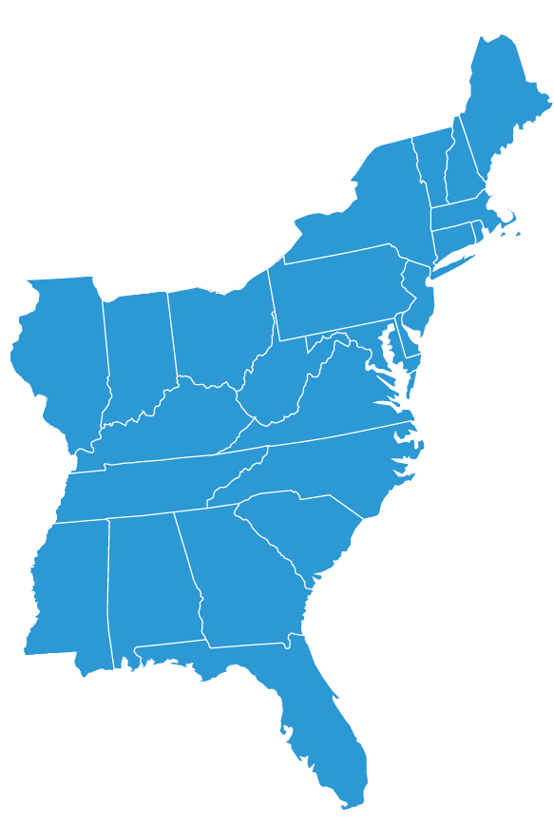
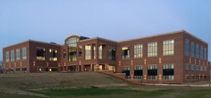
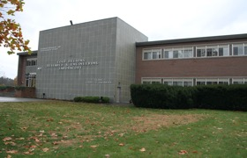
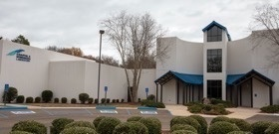
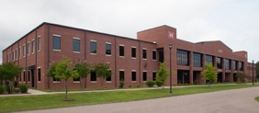
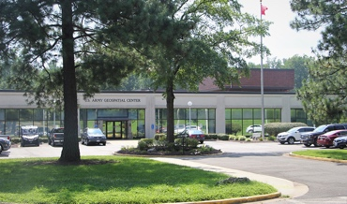
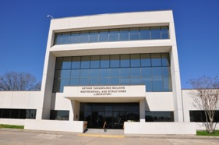

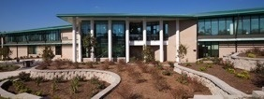
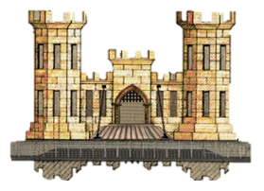
Locations
SEVEN LABORATORIES MAKING AN IMPACT ON THE NATION AND WARFIGHTERS
ERDC Headquarters
Vicksburg,
Mississippi
ERDC
Laboratories
Field Offices
Permafrost Tunnel Research Facility
Fox, Alaska
Alaska Research Office
Fairbanks, Alaska
Lewisville Aquatic Ecosystem Research Facility
Lewisville, Texas
Contingency Base Integration Technology Evaluation Center (CBITEC)
Fort Leonard Wood, Missouri
Field Research Facility
Duck, North Carolina
Corbin Field Station
Woodford, Virginia
Extreme Exposure Station
Treat Island, Maine
ERDC International Research Office
London, England
Coastal and Hydraulics Laboratory (CHL)
Cold Regions Research and Engineering Laboratory (CRREL)
Hanover, New Hampshire
Environmental
Laboratory
(EL)
Geospatial Research Laboratory
(GRL)
Alexandria, Virginia
Geotechnical and Structures
Laboratory (GSL)
Construction
Engineering
Research
Laboratory
(CERL)
Champaign, Illinois
Information
Technology
Laboratory (ITL)

Slide 36



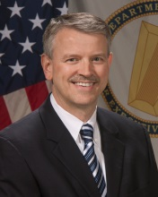
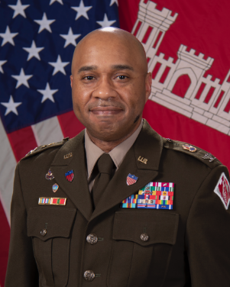

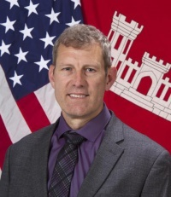

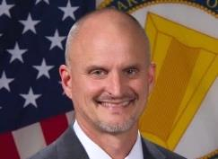

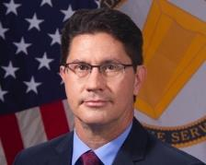



Leadership Team
Deputy Director
Acting Chief,
Integration & Operations
Ms. Patricia Sullivan
Mr. Paul McDonald
Deputy
Commander
Commander
Director
COL
Christian Patterson
Dr. David W. Pittman
MAJ Mark Pollak & MAJ Joseph Henderson
Acting Associate Director
Chief of Staff
Dr. Lucy Priddy
Mr. Jeff Eckstein
LAB DIRECTORS
NWD
MVD
LRD
POD
HNC
SAD
NAD
SWD
TAD
SPD
DR. ANDY NELSON
Construction Engineering
Research Laboratory
DR. TY WAMSLEY
Coastal and Hydraulics Laboratory
DR. JOE CORRIVEAU
Cold Regions Research and Engineering Laboratory
DR. EDMOND RUSSO
Environmental
Laboratory
MR.DAVID HIBNER
Geospatial Research
Laboratory
MR. BART DURST
Geotechnical and Structures Laboratory
DR. DAVID HORNER
Information Technology Laboratory

Slide 37
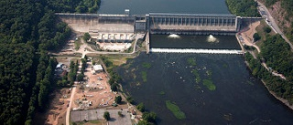
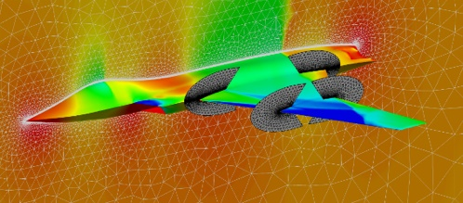
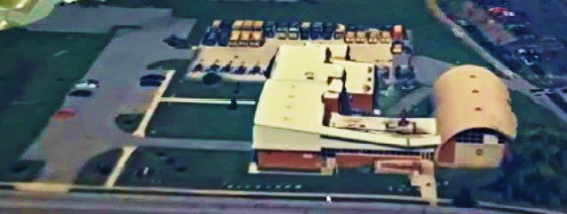
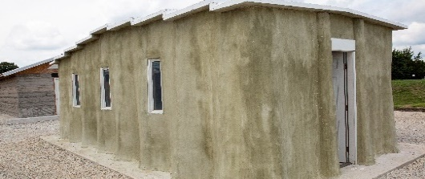
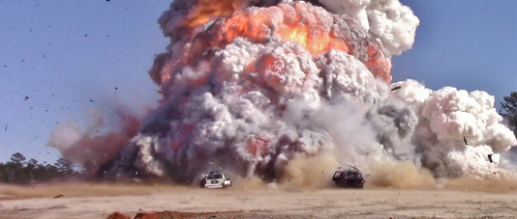


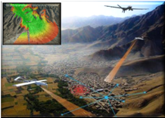
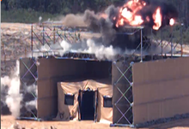
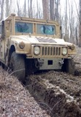

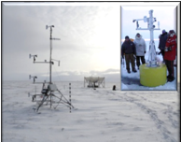
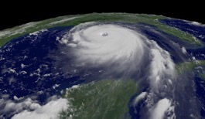
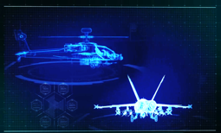
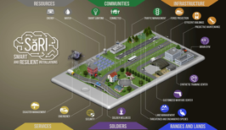
Delivering solutions
ERDC’s Research And Development Areas (RDAs)
RESEARCH & DEVELOPMENT AREAS
CIVIL WORKS
ENGINEERED
RESILIENT SYSTEMS
GEOSPATIAL
RESEARCH AND ENGINEERING
INSTALLATION
AND OPERATIONAL ENVIRONMENTS
MILITARY ENGINEERING
CORE COMPETENCIES
SPECIALIZED ERDC KNOWLEDGE THAT ENABLES OUR RESEARCH AND DEVELOPMENT AREAS
BATTLESPACE TERRAIN MAPPING AND
CHARACTERIZATION
BLAST AND WEAPONS EFFECTS
ON STRUCTURES AND
GEO-MATERIALS
CIVIL AND MILITARY
ENGINEERING
COLD REGIONS SCIENCE
AND ENGINEERING
COASTAL, RIVER AND ENVIRONMENTAL ENGINEERING
COMPUTATIONAL PROTOTYPING OF MILITARY PLATFORMS
MILITARY INSTALLATIONS
AND INFRASTRUCTURE
Notes:
ERDC operates as a matrix organization, executing research programs by leveraging competencies across our laboratories to ensure the best possible solutions are discovered, developed and delivered to our partners and stakeholders. ERDC’s research and development priorities require multidisciplinary approaches; therefore, enterprise collaboration is crucial to mission success.
ERDC manages and executes major R&D programs through five Research and Development Areas (RDAs), which intersect the organizational structure of ERDC’s seven laboratories. RDAs ensure enterprise collaboration and pool multi-laboratory expertise to address specific problems and stakeholder communities. RDAs have an important responsibility for development, management and execution of ERDC’s direct (Army HQ-funded) programs, but the RDAs also may assist in development and oversight of reimbursable (partner-funded) programs and projects.
The five ERDC RDAs are Military Engineering, Civil Works, Installations and Operational Environments, Geospatial Research and Engineering and Engineered Resilient Systems. Each RDA is led by an ERDC Laboratory Director, supported by a Lead Technical Director, other technical directors and their staffs. Each RDA is described on Page 14 and 15.
RESEARCH AND DEVELOPMENT AREAS (RDAs)
Military Engineering
The Military Engineering (ME) RDA provides solutions, technology and capabilities to the warfighter, enabling force protection, projection, maneuver, and maneuver support for Multi-Domain Operations (MDO). The ME RDA is the leader in developing novel, lightweight, rapidly constructed force protection and projection systems that can be expediently deployed in remote locations. Research in this field leverages expertise in blast and weapons effects to help develop more powerful weapons and to protect structures and fixed facilities from a range of manmade threats. Research and development of innovative protection systems has produced survivability decision aids that allow rapid assessment of current protection postures and provide enhanced designs to increase defense against attacks.
Civil Works
The Civil Works (CW) RDA provides methods, tools and technologies that allow the USACE to be innovative and efficient in its water resource missions. The CW RDA serves primary water resource missions of navigation, flood-risk management and environmental sustainability and supports missions including hydropower, water supply, recreation and regulatory. The CW RDA’s state-of-the-art technologies address life-cycle planning, engineering, design and maintenance requirements to reduce risk, improve ecosystems, ensure community resilience and deliver national economic benefits, all enabled through a holistic approach that leverages partnering. In the face of climate change, invasive and nuisance species, demographic shifts and aging infrastructure, ERDC R&D helps the USACE and its partners anticipate and plan for rapid decision-making to meet the water resources needs of future generations.
Installations and Operational Environments
The Installations and Operational Environments (IOE) RDA provides cutting-edge solutions for Army installations, training ranges and contingency basing, as well as applies its knowledge to the warfighter’s environment in theater. The IOE RDA is focused on environmental and energy sustainability, resilience, and security. Additionally, IOE generates new capabilities for smart installation infrastructure. Research conducted by the RDA includes understanding the environment for the warfighter; detecting hazards before they can harm our soldiers; and mitigating negative impacts on soldiers and operations in urban landscapes, industrial complexes and subterranean spaces.
Geospatial Research and Engineering
The Geospatial Research and Engineering (GRE) RDA develops and demonstrates mapping, geospatial analysis and mission-planning technologies to ensure superior situational awareness of the operational environment for the warfighter and to enable Mission Command. GRE research enhances unit and individual soldier performance with greater situational awareness, mission-planning courses of action, options for movement and maneuver, and protection. To support MDO, GRE research focuses on activities that merge intelligence preparation of the operational environment with geospatial mapping and analysis and map-based mission planning, all paced with the convergence and transformation of the Army’s Mission Command systems.
Engineered Resilient Systems
The Engineered Resilient Systems (ERS) RDA combines advanced engineering techniques with the DoD’s high-performance computing capabilities to develop concepts and tools that significantly amplify design options examined during the early stages of the DoD weapons system acquisition process. The ERS RDA efforts span all four DoD services, and methods have been effectively applied to analyses of fixed-wing planes, rotorcraft, ground vehicles and ships. Innovative research includes advanced tradespace analytics tools that can compare millions of potential design options and associated performance characteristics in hours rather than months. The speed of comparison enables more robust designs to be considered in the engineering phase than traditional methods have allowed. Through these technologies and many other advancements in high-performance computing and data analytics, the ERS RDA enables physics-based assessments much more rapidly than ever .
The ERDC Core Competencies are those key technical competencies that the Army and DOD recognize as ERDC leadership roles for the department. ERDC Core Competencies are critical technology enablers not commonly found in the private sector or academia that represent a critical and unique need for the Army and DOD and should be maintained as critical enablers for the Army and DOD.
CORE COMPETENCIES
The ERDC Core Competencies are those key technical competencies that the Army and DOD recognize as ERDC leadership roles for the department. ERDC Core Competencies are critical technology enablers not commonly found in the private sector or academia that represent a critical and unique need for the Army and DOD, and should be maintained as critical enablers for the Army and DOD
Battlespace Terrain Mapping and Characterization
As the U.S Army’s lead in geospatial engineering science and technology, ERDC supports Army Warfighters, U.S Marines, USACE Divisions and Districts, the National Geospatial Intelligence Agency, and the DOD Intelligence Community. This core competency focuses on geospatial understanding of the operational environment ranging from development of innovative mapping technologies, data management and analytics, and spatial and temporal applications enabling mission command. Understanding the operational environment is a foundation element of mission planning and informs all warfighting functions.
Geospatial Research and Engineering
Geospatial Research and Engineering addresses capacities identified in Multi-Domain Operations addressing the complexities of armed conflict in megacities, particularly the problematic issues of dense urban areas involving diverse, interconnected human and physical networks, three-dimensional engagement areas, and terrain and infrastructure that provide varying levels of ready-made cover and concealment. The physical characteristics constrain maneuver, limit situational understanding, and create unique problems for targeting and delivering effects against enemy positions. Understanding and mapping the urban environment including infrastructure interiors, subterranean spaces, overhangs and underpasses in a three-dimensional framework that allows for true 3D analytics for understanding and planning movement and maneuver, fires, protection, and immediate situational awareness.
ERDC leverages this competency to develop a geospatially enabled, integrated, and automated map-based mission planning and intelligence analysis capability that will create a collaborative environment for planning and operational support across echelons and the Joint Services. ERDC’s objective for this core competency will be to understand the operational environment at the point of need to enable mission planning and mission command.
Blast and Weapons Effects
This ERDC core competency is key to achieving the Army operational capability of survivability by enabling the Warfighter to understand and predict weapons effects on surface and underground structures, and to shape offensive and defensive solutions that counter and neutralize our adversary’s energetic weapons. ERDC’s expertise includes testing and analytic/modeling and simulation capabilities in the areas of nuclear and conventional weapons and IEDs – knowledge critical in developing buildings, bridges, protective structures, and bunkers that can withstand required blast loads or defeat certain weapons and defining the protection level of existing structures. These capabilities also help weapons developers predict weapons’ effects for design purposes, and aid mission planners in pre-attack prediction and post-attack lethality assessments.
ERDC’s expertise has been used to address hardened structural designs, such as protective structures and nuclear weapon silos; the design, development and fielding of overhead cover systems and modular protective systems for rapid protection of critical assets in theater and from terrorist threats to critical infrastructure; and the design of test standards and the estimation of the underbelly blast loads resulting from IED detonation under vehicles for protective design and acquisition testing and evaluation. ERDC’s objective for this core competency will be to predict weapons’ effects against specific targets, and to help design weapons to defeat any structural target above or below the ground.
Civil and Military Engineering
ERDC maintains civil and military engineering technology leadership necessary for force protection, force projection, and sustainment, and civil works missions including navigation, flood and coastal risk management, environmental sustainability, as well as hydropower and water supply. Military engineering includes logistics planning, amphibious assault and rapid port enhancement; base and in-theater planning and design, infrastructure optimization and management; and force protection on the battlefield and at installations and bases with an emphasis on expedient protection systems. ERDC’s civil engineering competency includes specialties in structural, geotechnical, water resources, environmental quality, transportation and construction. This competency also includes significant capabilities in computational engineering, installation support and military engineering. Military engineering focuses on developing technologies to support combat engineering, including mobility, countermobility, survivability, route clearance, defense structures, explosive materials handling, and general engineering.
ERDC leverages capabilities in high-performance computing, geo-environmental physics modeling and simulation, Engineered Resilient Systems, and a complete range of testing capabilities in this competency area. ERDC technologies enable rapid repair, upgrade and construction of transportation infrastructure to enable maneuver into and across the battlespace and/or create obstacles to prevent such maneuver. Technologies for Civil Works applications provide engineering technologies for safe and effective navigation, flood and coastal risk management, environmental sustainability, and ecosystem restoration. ERDC maintains leadership in DOD and NATO in vehicle-terrain interaction research to generate cutting-edge ground vehicle mobility modeling and simulation tools.
As the Tri-Service lead for airfields and pavements R&D, ERDC supports the DOD doctrine of global force projection by developing models for improved predictions of airfield performance and deterioration rates. Using its expertise in geo-environmental effects on sensor performance and expedient structural design, ERDC develops innovative solutions that increase the survivability of critical national assets. ERDC’s objective for this core competency will be to evaluate and assess the capacity of strategic transportation infrastructure to accommodate tactical and strategic maneuver and logistical throughput.
Cold Regions Science and Engineering
ERDC has led the Army’s mission in understanding cold regions and its impact on military and civil works missions as the national resource for cold regions science and engineering. Successful and superior operations will demand a fundamental understanding of cold regions processes, such as those governing snow, ice, ice flow/jams, and ground conditions. This core competency focuses on understanding and managing the challenges of operations in cold regions and is key to achieving Army and Civil Works operational capabilities of enhanced mission command, particularly situational awareness, mobility and maneuver, navigation, and flood risk management in arctic regions and mid- to high-latitudes and high elevations.
Cold, ice and snow can have adverse effects on Army and Civil Works systems and components performance. Accordingly, this competency supports a variety of product lines and technologies, from improving situational awareness, to informing materiel designs, to engineering operations, all to enhance the enduring ability of U.S. forces to plan and operate effectively in extreme environments.
Coastal, River and Environmental Engineering
ERDC’s core competency in Coastal, River, and Environmental Engineering form the basis for its support to the USACE Civil Works water resources management mission area, including the navigation, flood and coastal risk reduction, and environmental business lines. ERDC has a long history of leading the engineering profession in coastal, river, and environmental engineering, and related sciences. From understanding the complex hydrodynamic interactions between flowing water and terrain features, to estimating storm surges in coastal areas and inland waterways, to developing new approaches to foster sustainable ecosystems, to understanding and managing sediments in our waterways, ports, and coastal areas – much of what is known today was developed in the 91-year history of ERDC. There is much more to learn and understand, as the nation is challenged to find more sustainable and resilient means of reducing risk to life and property from storms and floods, while enabling safe and reliable navigation on our waterways, and supporting $5T in economic activity in our ports alone.
This core competency has also enabled our military missions as well, particularly in maneuver support and mission command. ERDC’s capability in military hydrology was born from our understanding of floods and impacts of breaching dams and levees and has supported many military operational missions. Our coastal engineering capability supported the planning for the D-Day invasion at Normandy, and today helps our military understand how to design and operate new watercraft for force projection applications. Our understanding of the environment supports mission command by enabling better situational awareness of the battlespace, such as route planning, improved landing site and base site selection, novel sensing modalities and capabilities, and prediction of potential impacts to soldiers from natural or unintended exposure to environmental contaminants. Such knowledge can protect the health of our Warfighters and enable mission success.
Military Installations and Infrastructure
This ERDC core competency supports the USACE mission in military construction, installation support, and support to warfighter operations overseas and in the battlespace to ensure that facilities, infrastructure and installation services are resilient, ready and efficient. Our military installations serve as force projection platforms in support of MDO, as the primary training grounds for our soldiers, as critical nodes in the network of military support operations, as home to many military families and supporting services, and as key members of communities around the nation and in many countries overseas. Most serve a mini-cities in and of themselves, with all of the critical infrastructure – roads, bridges, airfields, rail, buildings, housing, water, sewer, gas, electrical, networks, parks – that any large community might have, with the additional infrastructure required to support the military mission, like training ranges, secure communications, perimeter security, hangars, motor pools, military supply storage and logistics, to name a few. These enclaves are unique in that they are critical to national security, and are where all military operations begin, but similar to any other community in the many services they must provide to their inhabitants.
Computational Prototyping of Military Platforms
DOD success relies on the ability to develop and sustain combat systems that are effective in an ever-widening range of military operations. ERDC’s Computational Prototyping for Military Platforms competency plays a major role in that mission by enabling high-quality and rigorous acquisition decisions. This core competency provides advanced engineering tools and techniques, combined with high-performance computing, to significantly amplify and accelerate design operations during early stages of the acquisition process. ERDC’s competency enables rapid and robust modification of designs to meet mission needs and requirements at lower cost and higher fidelity than traditional methods. It includes virtual prototyping methods, tradespace analytics, and a computational proving ground to decrease time and cost for Army Acquisition. These methods have been effectively applied to analyses of platforms across all services, including fixed-wing aircraft, rotorcraft, ground vehicles and ships.
Additionally, ERDC manages the DOD’s High Performance Computing Modernization Program (HPCMP), which provides infrastructure, software, networking, and support for high performance computing (HPC). This includes computational modeling, data analytics, and decision support tools optimized for HPC. These tools provide high-fidelity, physics-based engineering analysis integrated into complex workflows to assess technology and system performance in operationally relevant environments. Civil Works R&D and reimbursable studies leverage the HPC, artificial intelligence, and data analytics expertise to streamline decision-support and rapidly converge on solutions.

Slide 38
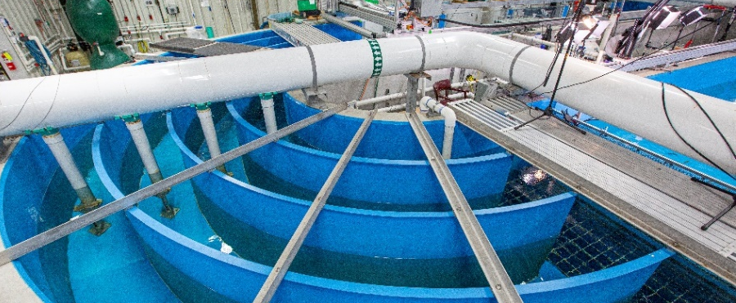
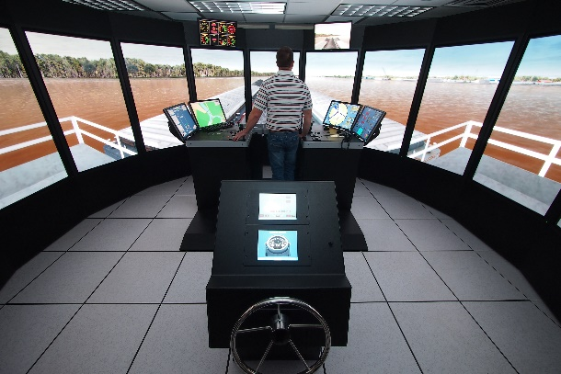






ERDC’s Premier R&D Facilities
Approximately $2 Billion in Infrastructure
Cognitive Ecology & Ecohydraulics Research Facility / EL
Climatic Cold Chamber / CRREL
Ship Simulator / CHL
DoD Supercomputer Resource Center / ITL
Robotics Research Facility / CERL
Heavy Vehicle Simulator “The Titan” / GSL
Advanced Blast Load Simulator / GSL
Physical Models / CHL
Notes:
In order to be a world-class research and development organization, you need the facilities required to provide such innovative solutions. ERDC proudly boasts more than $2 billion in state-of-the art facilities across its laboratories. Recent additions to our facilities have included:
A new climatic cold chamber at CRREL was added in June 2022: The new Climatic Cold Chamber Building is used utilize for the testing of materiel used by the Warfighter in extreme cold environments. This facility will go down to minus 54. degrees. The chamber is a critical research tool used to evaluate new materials, design methods and construction techniques that can help optimize new infrastructure facilities. The insights gained from the research performed in this new climatic chamber will not only ensure our military is prepared to operate in some of the planet's harshest environments but will also benefit everyday Americans by improving our roads and other infrastructure systems. The new chamber is the ERDC’s only cold facility that can house a running vehicle inside. This facility was designed to be modular from the beginning, with the possibility to install a second larger vehicle-testing chamber of a similar model.
A new DoD Supercomputing Resource Center at ITL: ITL held a ribbon cutting for two new, state-of-the-art Supercomputing Research Center (SRC) facilities in Vicksburg, Mississippi in January 2022. The Supercomputing Resource Center (SRC) provides world-class high-performance computing (HPC) to help the Department of Defense (DoD) solve its most challenging and complex problems. The SRC also supplies a complete HPC ecosystem that includes hardware, software, data storage, scientific visualization, training and expertise.
CHL’s Ship Simulator: Modeling technology on the ERDC Ship/Tow Simulator accurately portrays currents, wind and wave conditions, shallow water effects, bank forces, ship handling, ship to ship interaction, fender forces, anchor forces and tug assistance. The three ship-bridge mockups help users evaluate navigation channel designs, modifications and safety issues in a virtual environment. The computerized simulator of navigational conditions are in real-time, meaning that the events require the same amount of time on the simulator as they do in real life. Realistic sights, sounds and conditions for maneuvering ships and tows help make the pilots more at ease and comfortable as if they are in their actual surroundings.
Advanced Blast Load Simulator added in 2023: The ERDC has a lead role in research using experiments and computations to develop new blast design concepts for structural components and retrofits. In the past, the ERDC relied heavily on full-scale field trials to experimentally investigate blast response problems; however, it is very expensive to conduct these large experiments, primarily due to the risk of collateral damage or potential disturbance of neighbors, which dictates a remote test site. The Blast Load Simulator Facility allows blast effects research to be performed at the ERDC-Vicksburg site to replace or support current field trials. The full-scale combustible gas driven Advanced Blast Load Simulator (ABLS) allows blast effects research to be conducted on 12-ft x 12-ft or smaller targets. The full-scale ABLS will reduce the degree of conservatism in current design programs by returning more data for a given budget. The ABLS will allow the rapid evaluation of the complete structure by examining the full-scale building components, such as the walls, windows, doors, window/wall systems, wall/door systems and structural retrofit systems.
Robotics Research Facility: CERL’s Robotic Research Facility is a 16,000-sq-ft temporary structure with a 45-feet tall ceiling that serves as the primary development, integration, and testing venue for ground robotics capabilities developed by ERDC. The facility houses multiple 2-story modular and reconfigurable structures, which allow ERDC researchers to form product development teams around active projects with all the tools, hardware, clean work surfaces immediately available in a single location. The facility is accompanied by a 2-acre outdoor testing area referred to as the ERDC sand box, enabling researchers to test autonomy algorithms for terrain shaping, as well as off-road localization and navigation.
Heavy Vehicle Simulator “The Titan”: GSL completed assembly on the world’s largest heavy vehicle simulator (HVS), the “Titan,” at the end of January 2022. The HVS is a critical research tool used to evaluate new materials, design methods and construction techniques that can help optimize new infrastructure facilities. This new accelerated pavement testing capability will keep ERDC at the forefront of transportation infrastructure research for the foreseeable future and equip the ERDC with the required tools to provide effective sustainable infrastructure to the Army, the Department of Defense and the Nation. The Titan is the world's largest HVS and has the unique capacity to simulate ground vehicles, aircraft and rail traffic up to 120,000 pounds. It was developed in partnership with Dynatest. This new capability expands ERDC's ability to support a wide range of unique military vehicles to help develop better transportation infrastructure solutions.
Cognitive Ecology and Ecohydraulics Research Facility: USACE and our partners research and implement projects across rivers, bays and coastal aquatic ecosystems and consequently, influence aquatic animals of all types and sizes. From the Pacific Northwest salmon to invasive warm-water fishes of south Florida, and coastal and estuarine species associated with navigation channels, surge barriers and beach reconstruction, the Cognitive Ecology and Ecohydraulic Research Facility (CEERF) develops solutions to protect the nation’s environment and enhance quality of life. The CEERF is designed to allow for a broad range of fish and invertebrates species, sizes, and associated habitats to be studied in-house to support dredging activities, floodplain design, levee mitigation, attraction and deterrence, restoration and dam removal.

Slide 39


How does the ERDC fit into this bigger picture?
DoD S&T Enterprise
How does ERDC fit into the Army and the DoD?
ERDC Performs Enabling Work Across 17 COIs

Slide 40



ERDC’s work is primarily in coordinated, specific niche areas. We often perform our “niche work” in support of the other labs.

Slide 41

HQDA Organization
The
Inspector
General
Chief of
Legislative
Liaison
The
Army
Auditor
General
Director
Small
Business
Programs
Admin
Assistant
Chief of
Public
Affairs
Army Secretariat
General
Counsel
Chief
National
Guard
Bureau
ASA
Manpower
&
Reserve
Affairs
ASA
Install’s
and
Environ
ASA
Civil
Works
ASA**
Acquis,
Log
& Tech
[Mil Dep
Acq]
ASA
Financial
Mgmt &
Comptroller
[Mil Dep
Budget]
Chief
Info
Officer/
G-6
SECARMY
USA(CMO)
Director
Army Staff
CSA
VCSA
Chief
of
Chaplains
Dir
ARNG
The
Surgeon
General
G-1*
ACS*
Install’n
Mgmt
Chief
Of
Engrs
G-4*
G-8*
D,PA&E
G-3/5/7
G-2
(OGC oversight)
The
Judge
Advocate
General
Sergeant
Major
of the
Army
Provost
Marshal
General
Army Staff
Chief
Army
Reserve
* Responsible to ASA for advice and assistance within functional area
** Army Acquisition Executive
Defined responsibilities to ASAs
Oversight

Slide 42


Army Command Structure
https://www.army.mil/organization/
05 AUG 2022
U.S. ARMY CORPS OF ENGINEERS (USACE) I WASHINGTON, D.C.
USACE is designated as a Direct Reporting Unit (DRU) by the Secretary of the Army. The USACE provides engineering services and capabilities in support of National interests.

Slide 43





ARMY S&T Enterprise
Policy, Budget and Oversight
Secretary of the Army
How does ERDC fit into the Corps and the Army?
Under Secretary of the Army
“ASAALT”
Assistant to the Secretary of the Army for Acquisition, Logistics and Technology
Deputy Assistant Secretary of the Army for Research & Technology
Operational and Program Execution
Army
Futures Command (AFC)
3%
U.S. Army
Space and Missile Defense Command (SMDC)
U.S.
Army Corps of Engineers (USACE)
Headquarters, Department of the Army (HQDA)
G-1, Personnel
Combat Capabilities Development Command (CCDC)
Army Medical Research and Development Command (MRDC)
Space & Missile Defense Command Technical Center (SMDC TC)
Engineer Research and Development Center
U.S. Army Research Institute for the Behavioral and Social Sciences (ARI)
U.S. Army Rapid Capabilities & Critical Technologies Office (RCCTO)
70%
9%
2%
13%
2%
3%

