Slide 2
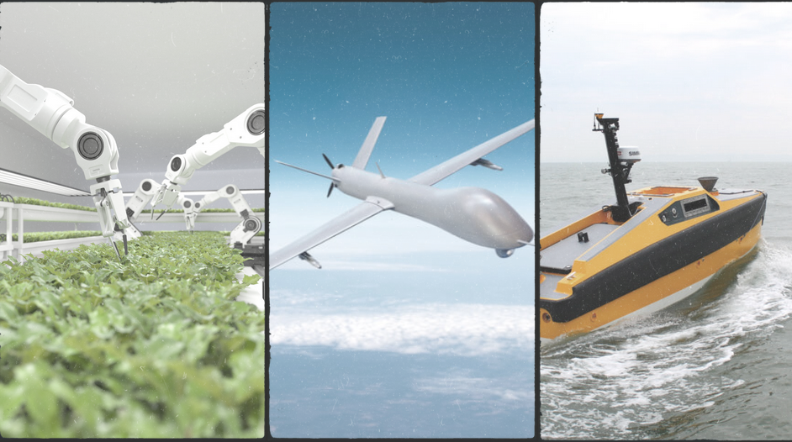
AUTONOMOUS SYSTEMS
MSU Office of Research & Economic Development
November 14, 2023
Inspiring innovation across air, land & sea

