Slide 1

You Have All This DATA! Now What?
Research Computing & Data Management
Lauren Geiger
Carolina M. Siniscalchi
Michael Navicky

Slide 2
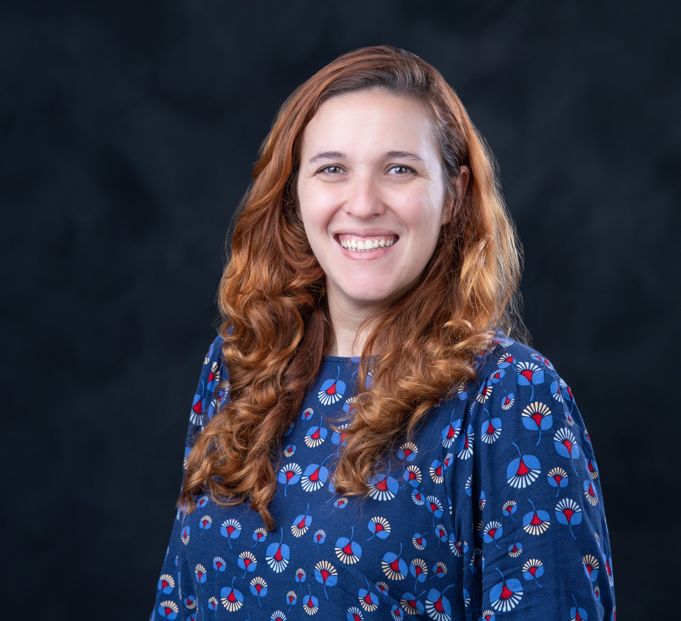
Carolina Siniscalchi
Data Sciences Coordinator
Mississippi State University Libraries
Plant biologist turned data scientist,
experience in managing projects with
large datasets from different sources.

Slide 3
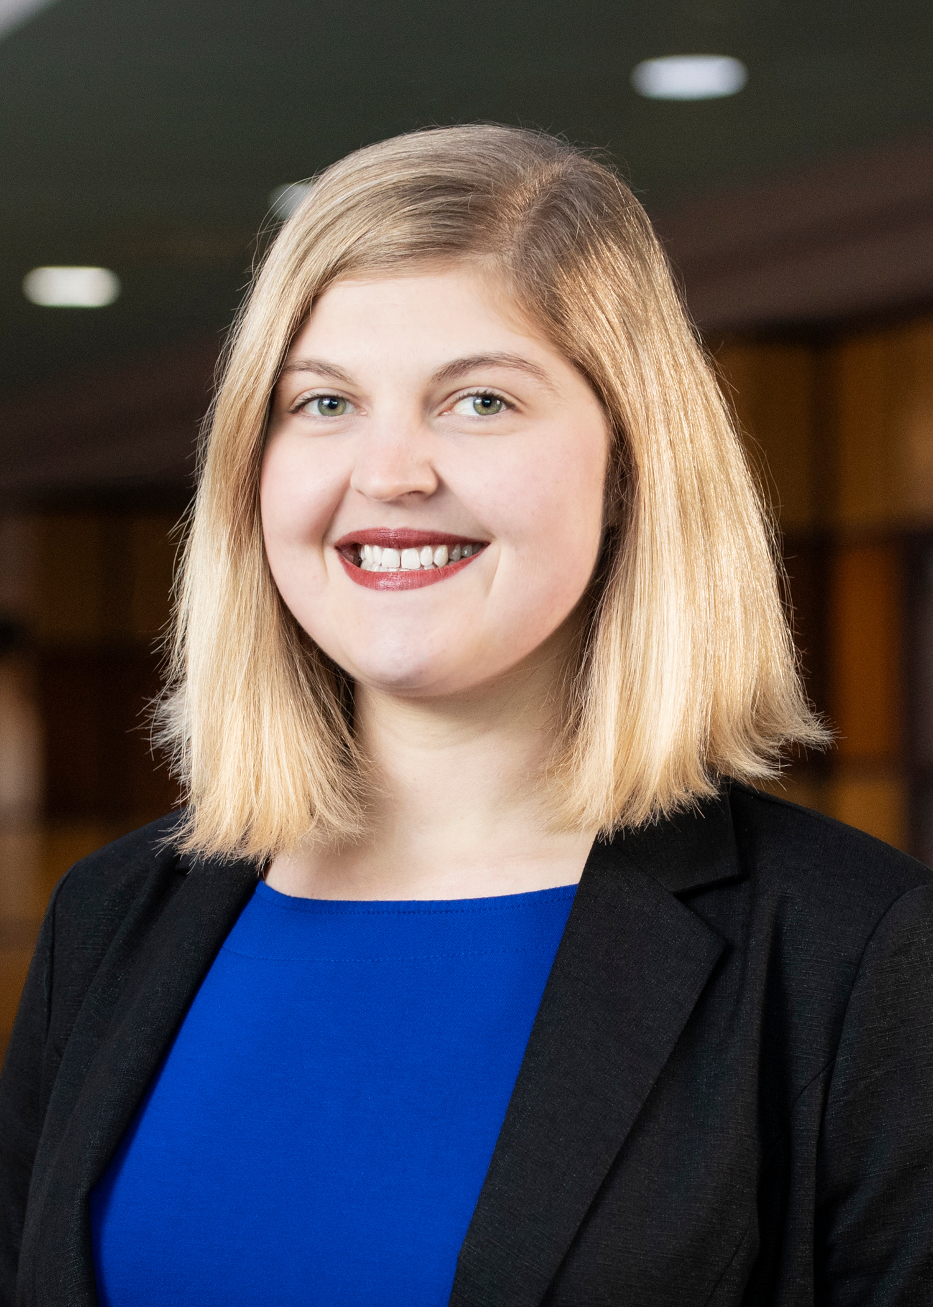
Lauren Geiger
Digital Archivist
Mississippi State University Libraries
Librarian with a background in metadata, linked data, ADA accessibility, and data storage practices.

Slide 4
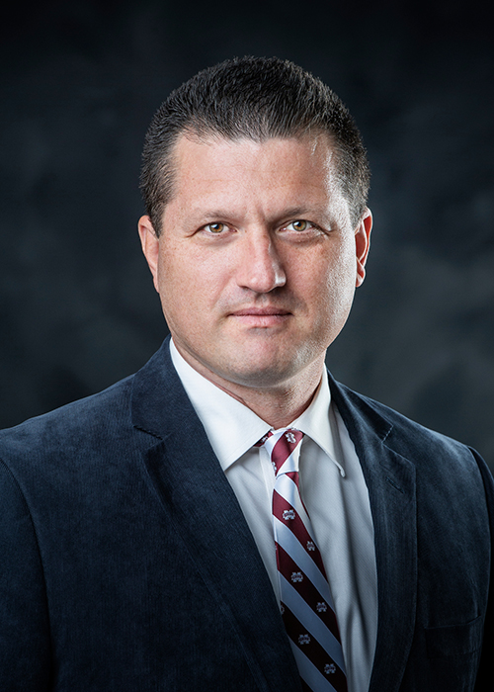
Mike Navicky
Director of High Performance Computing
High Performance Computer Collaboratory
Retired U.S. Air Force officer turned research computing director with an interest in full spectrum research computing and data capabilities.

Slide 5
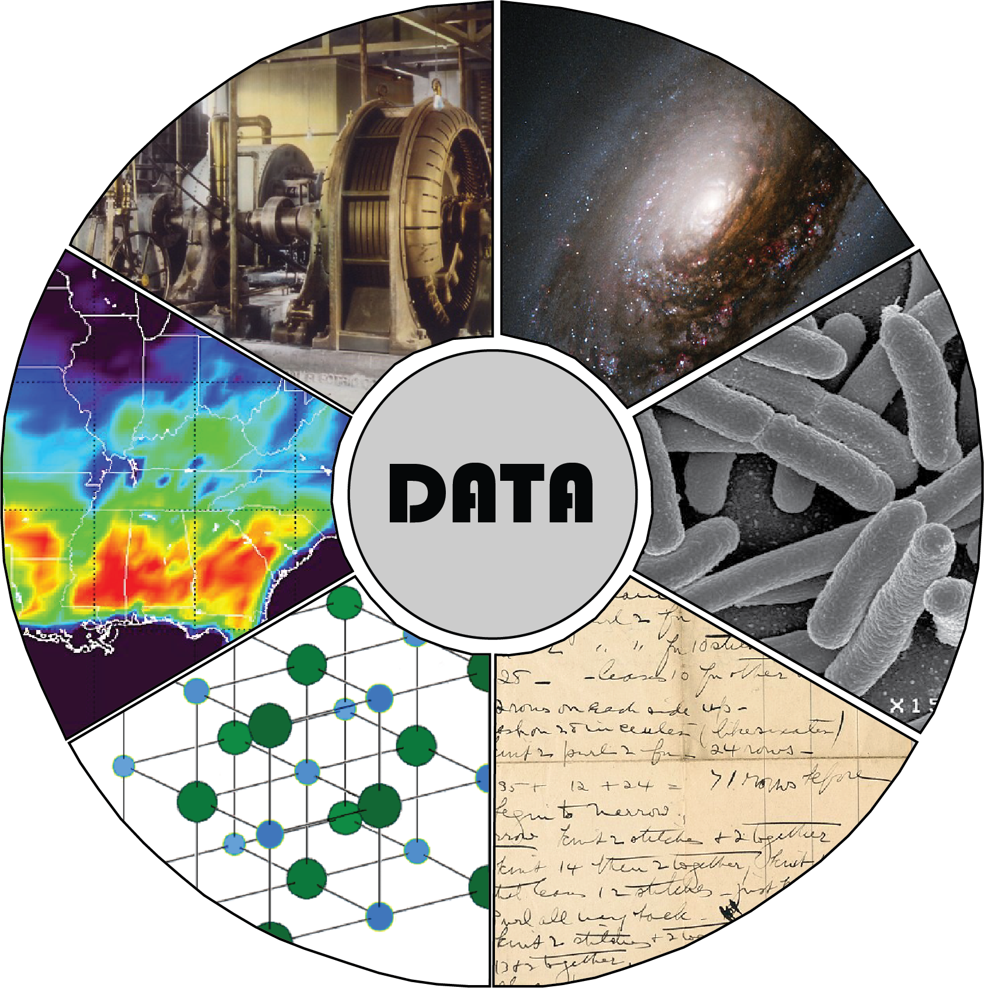
Data is everywhere!
Everything is (or can be) data!
All public domain images from Wikimedia Commons

Slide 6
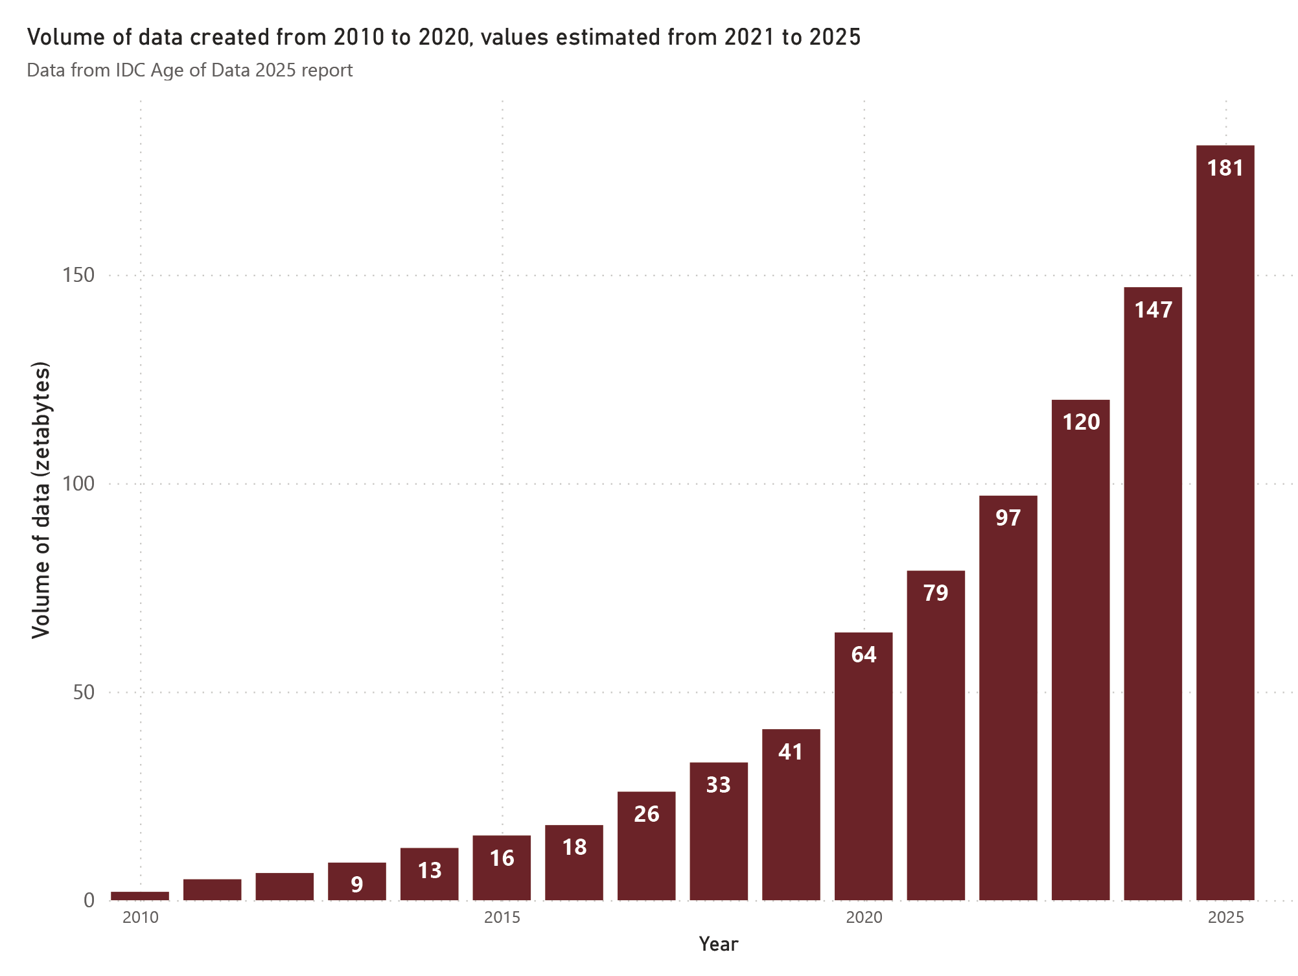
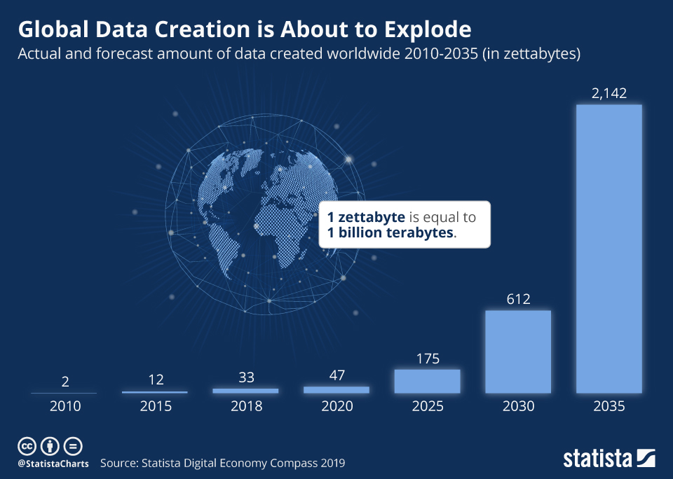
An explosion of data

Slide 7
An explosion of data
With big data comes big responsibility
Large amounts of data require more carefully planned management
These issues are being faced all over, not only in the scientific realm
Where do we keep all this data? For how long? Who should access it? Who owns it?

Slide 8
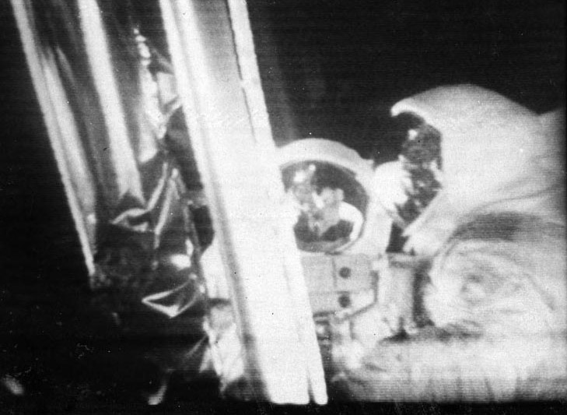
Data permanence
Scientific data gets lost all the time
The tapes that contained the original moon landing records were erased by NASA for reuse during the 1970s
Only low-quality broadcasted material of the live transmission remain
Public domain images from Wikimedia Commons

Slide 9
Data permanence
Some empirical studies have shown that the odds of the data still existing after publication decreases 17% per year (Vines et al. 2014)
The odds of finding data from a scientific paper online are 974 times higher if the journal has a mandatory archiving policy (Vines et al. 2013)

Slide 10
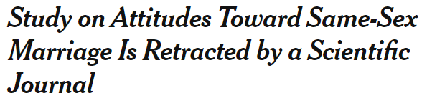
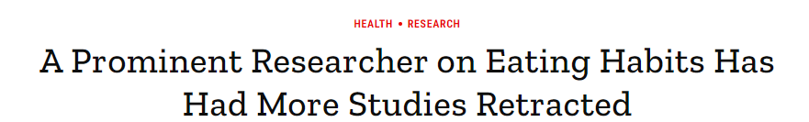
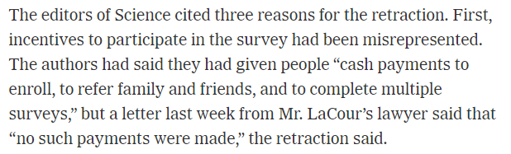
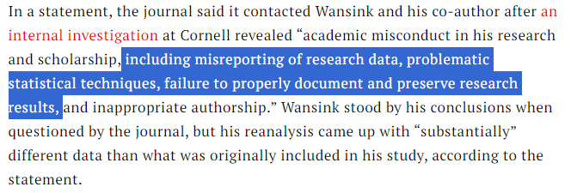
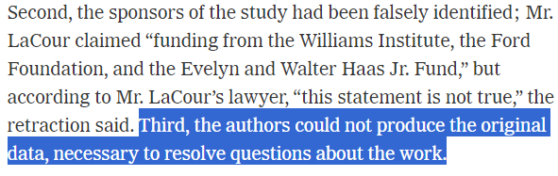
Data permanence
Disappeared data can have dire circumstances for scientists
TIME magazine, Sep 21, 2018
The New York Times, May 28, 2015

Slide 11
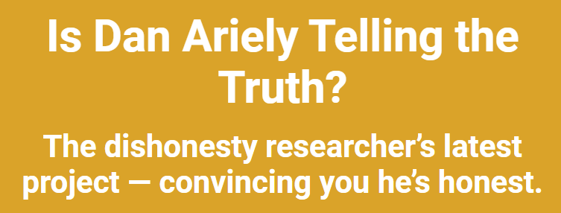

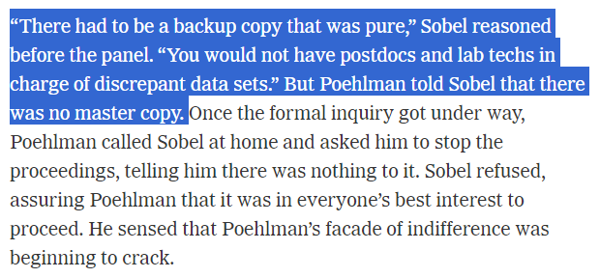
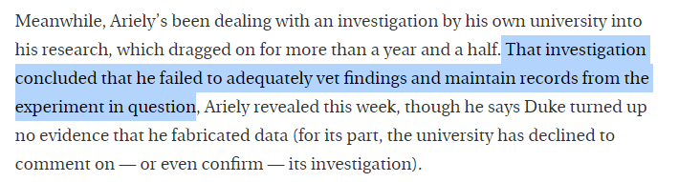
Data permanence
Disappeared data can have dire circumstances for scientists
Chronicle of Higher Education, Jan 18, 2024
The New York Times Magazine, Oct 22, 2006

Slide 12
Data permanence and Management Practices
Bad research data management practices can lead to data loss and worse
Losing data or having inaccessible data can delay scientific progress:
  Lack of community oversight
  Impact on replicability of findings
  Put important findings into questioning
  Erosion of the public's trust on science
“Transparency doesn’t guarantee credibility; transparency and scrutiny together guarantee that research gets the credibility it deserves". (Vazire, 2019)

Slide 13
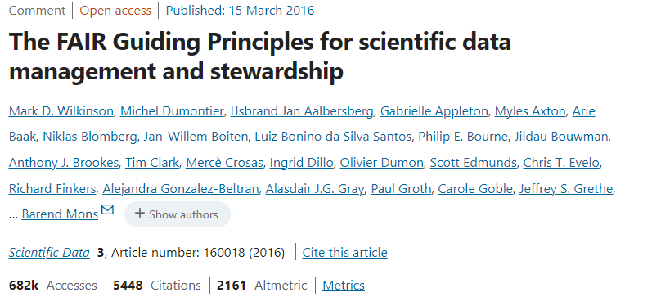

Open data and FAIR principles
The idea of Open Data has been around since the 1960s
FAIR = Findable, Accessible, Interoperable, Reusable
FAIR emerged as a set of guidelines to improve reusability of data
Is embedded in many data sharing guidelines
By SangyaPundir - Own work, CC BY-SA 4.0,
https://commons.wikimedia.org/w/index.php?curid=53414062

Slide 14

OSTP Nelson Memorandum
Office of Science and Technology Policy (OSTP)
Published in August 2022
Update the 2013 Holdren Public Access Memo
"Ensuring Free, Immediate, and Equitable Access to Federally Funded Research"
Removes funding threshold for agencies providing public access = 400+ agencies are now included
Outlines new requirements affecting researchers that conduct federally-funded projects
Access the memo here

Slide 15
OSTP Nelson Memorandum
Key points:
Applies to peer reviewed publications and underlying scientific data
Removes embargo times to release this products > immediate free and public release
Applies to all federal agencies, including those funding Humanities and Social Sciences
Requires persistent identifiers for research products (e.g., DOI) and researchers (e.g., ORCID)
Access the memo here
Key dates:
Dec 31, 2024: deadline for agencies to publish their new requirements
Dec 31, 2025: last date for policies to become effective

Slide 16
OSTP Nelson Memorandum
NIH has already changed their requirements
  Effective in Jan 2023
  Very detailed
  Allows specific budgeting for data management/sharing
  Data should be shared upon publication of research article or before end of funding
  https://sharing.nih.gov/
NSF, USDA and other agencies will release new data sharing requirements!

Slide 17
OSTP Nelson Memorandum
Based on the NIH policy, these are NOT considered data:
  Lab notebooks,
  Preliminary analyses,
  Drafts of scientific articles,
  Plans for future research,
  Peer reviews,
  Communication with colleagues or research team,
  Data not necessary for or of sufficient quality to validate and replicate findings.
From the "Understanding the New NIH Data Management and Sharing Policy webinar (https://www.youtube.com/watch?v=CgUpwkngj3g)

Slide 18
How do we ensure our data lives a long, happy life?
How to make data management practices part of the overall research process?
Who can support researchers at MSU in this process?

Slide 19
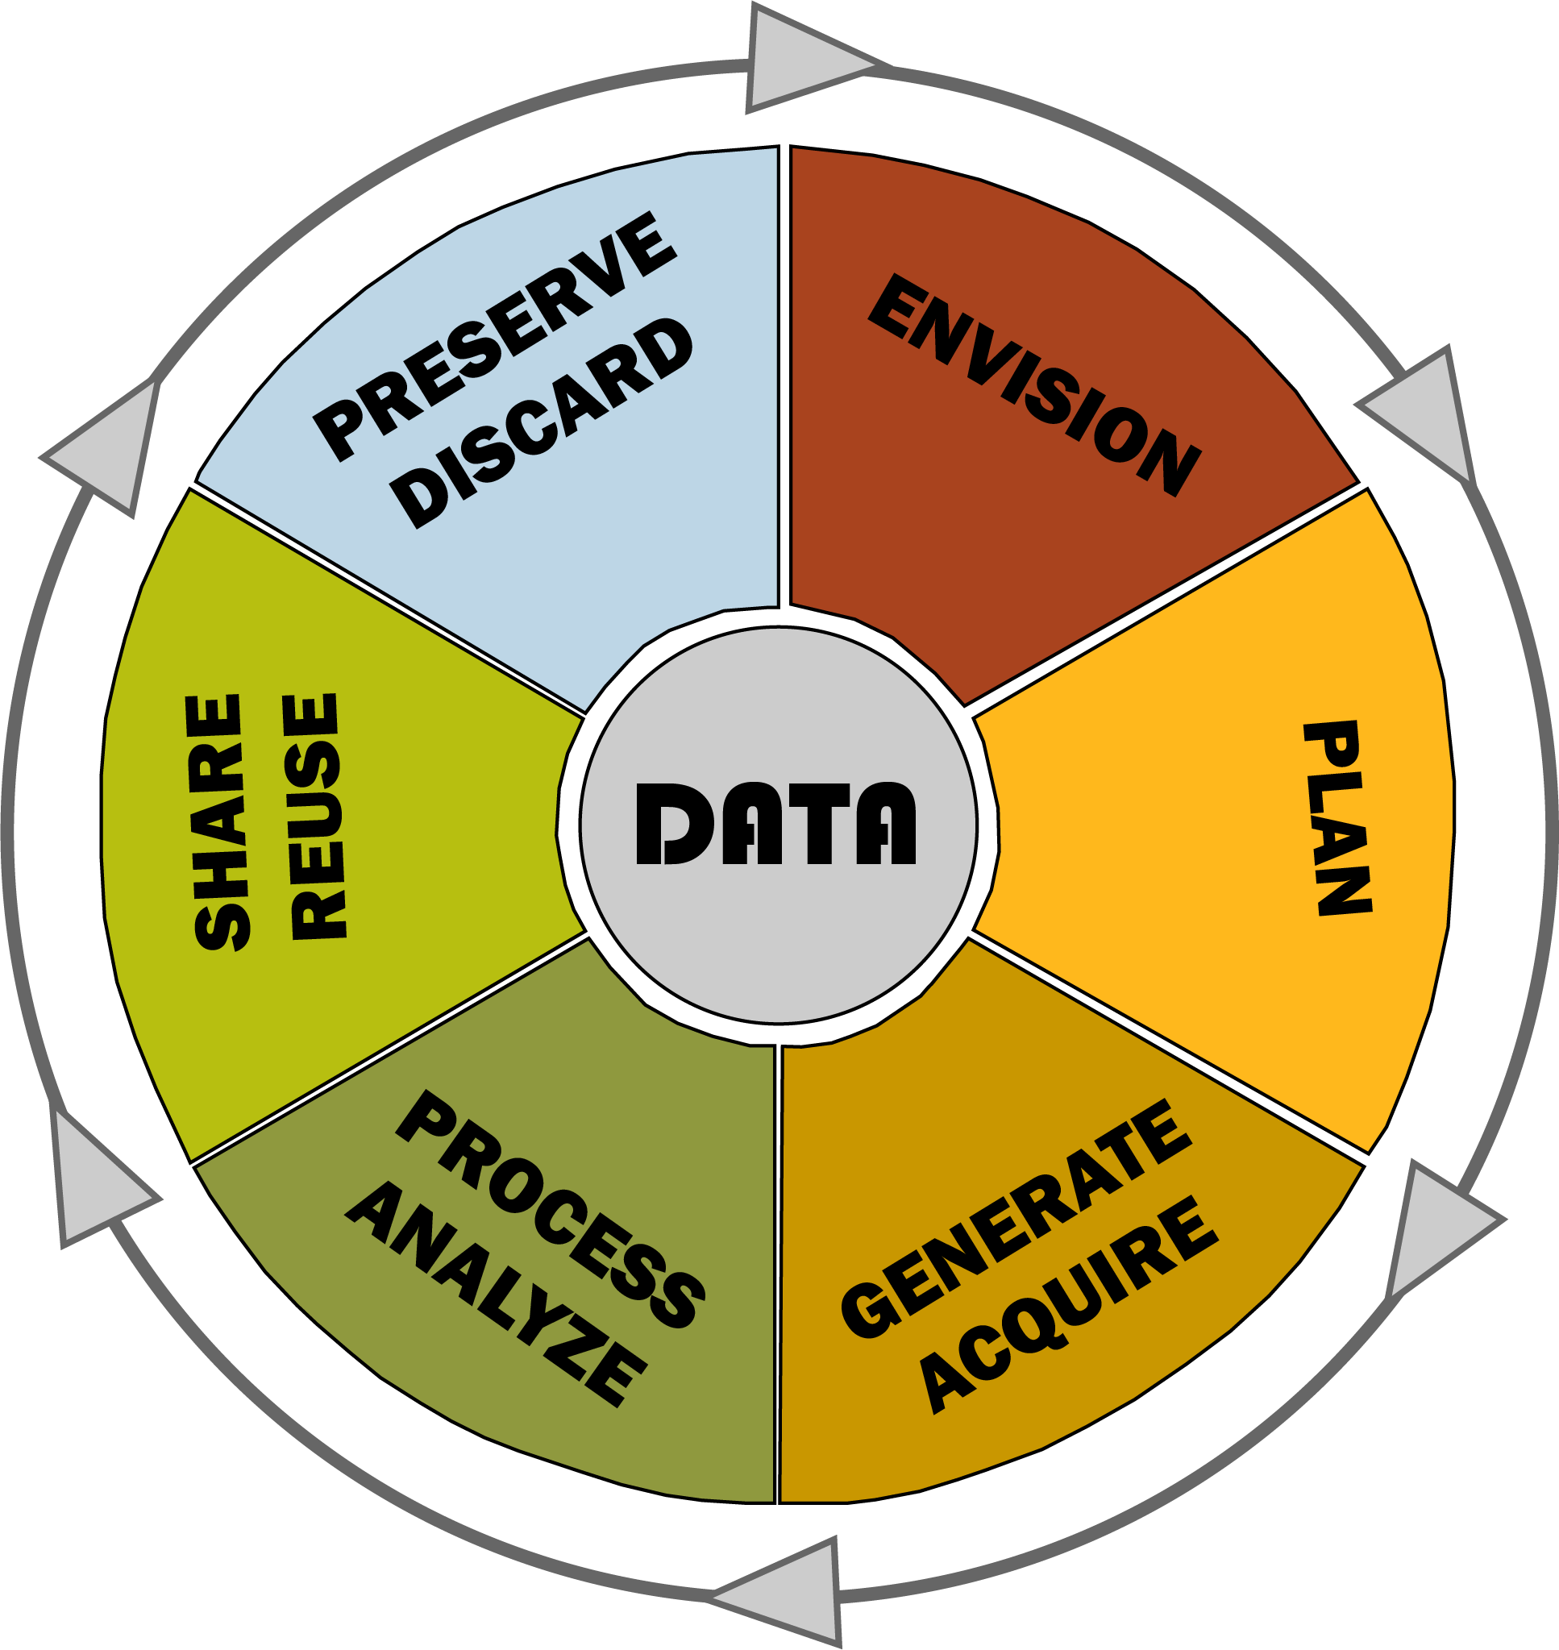
Research Data Lifecycle
A plan for project data that goes beyond the timeline of the project itself.​
Can assist in organizing and managing the project itself.​
Documentation for the group and others who wish to replicate or expand the project.
Adapted from NIST RDaF materials

Slide 20
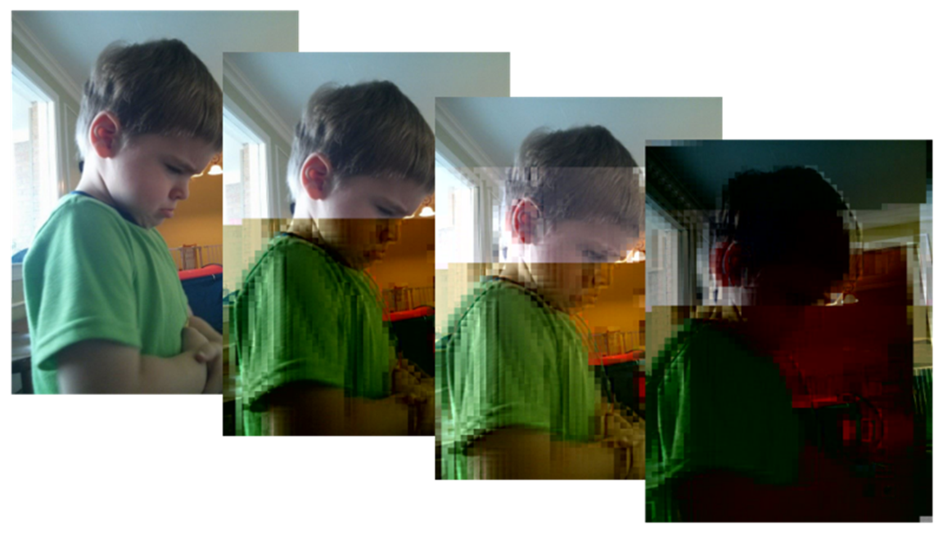





Data Lifecycle and Bit Rot
Salter, J. (2016). Bitrot Cascade [Online Image]. Wikimedia Commons. https://commons.wikimedia.org/wiki/File:Bitrot_cascade.png

Slide 21
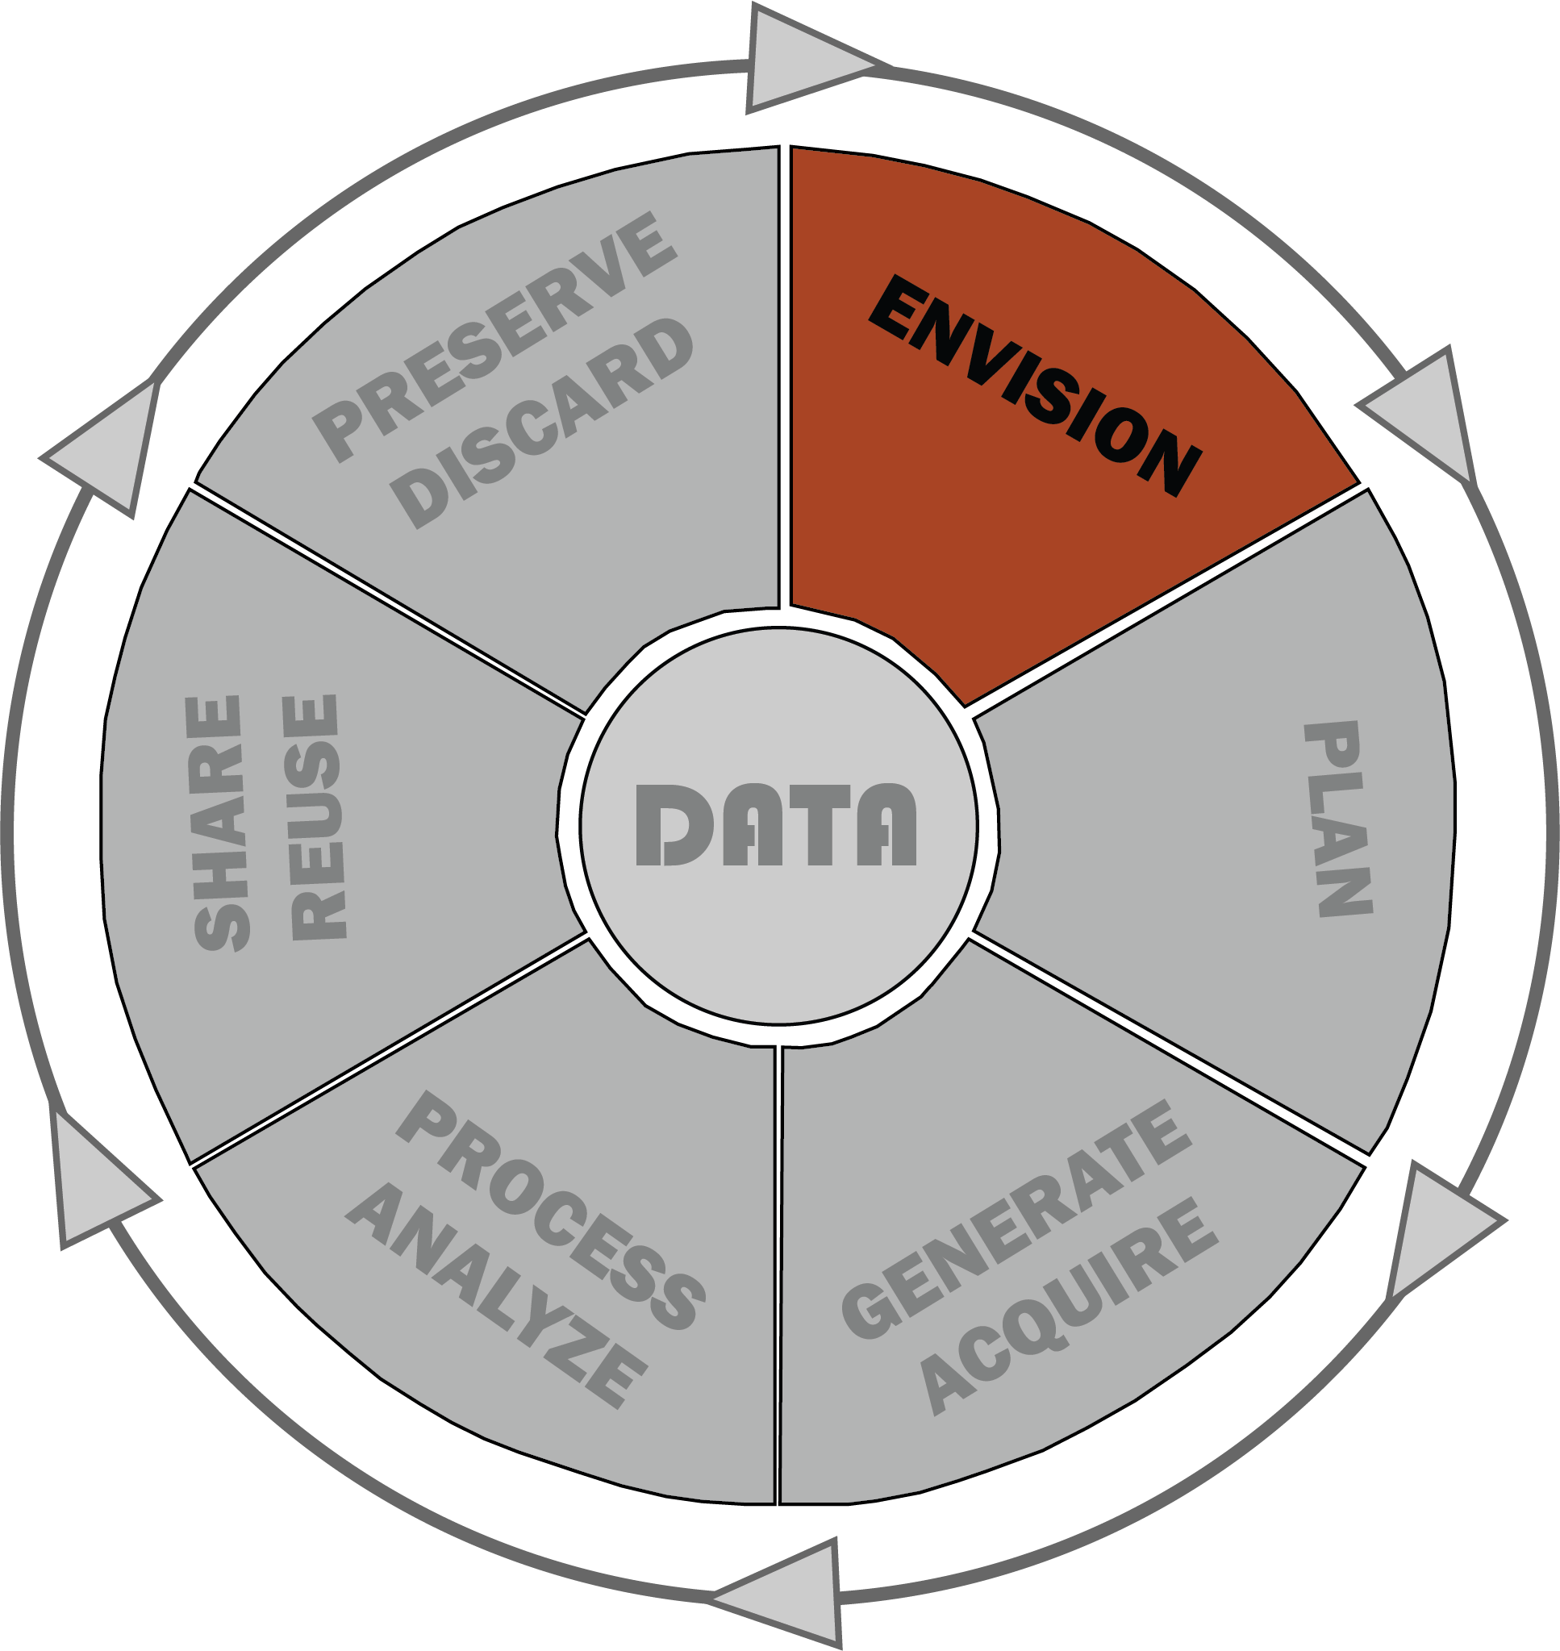
Envision
A more formalized version of ‘brainstorming’
  Creating a storage plan and area.
High-level organization of the project
  Organizational goals and values
  Broad conversation of the research project
Planning:
  Copyright, licensing options
  Ethical and privacy concerns
  Data archiving and storage
Adapted from NIST RDaF materials​

Slide 22
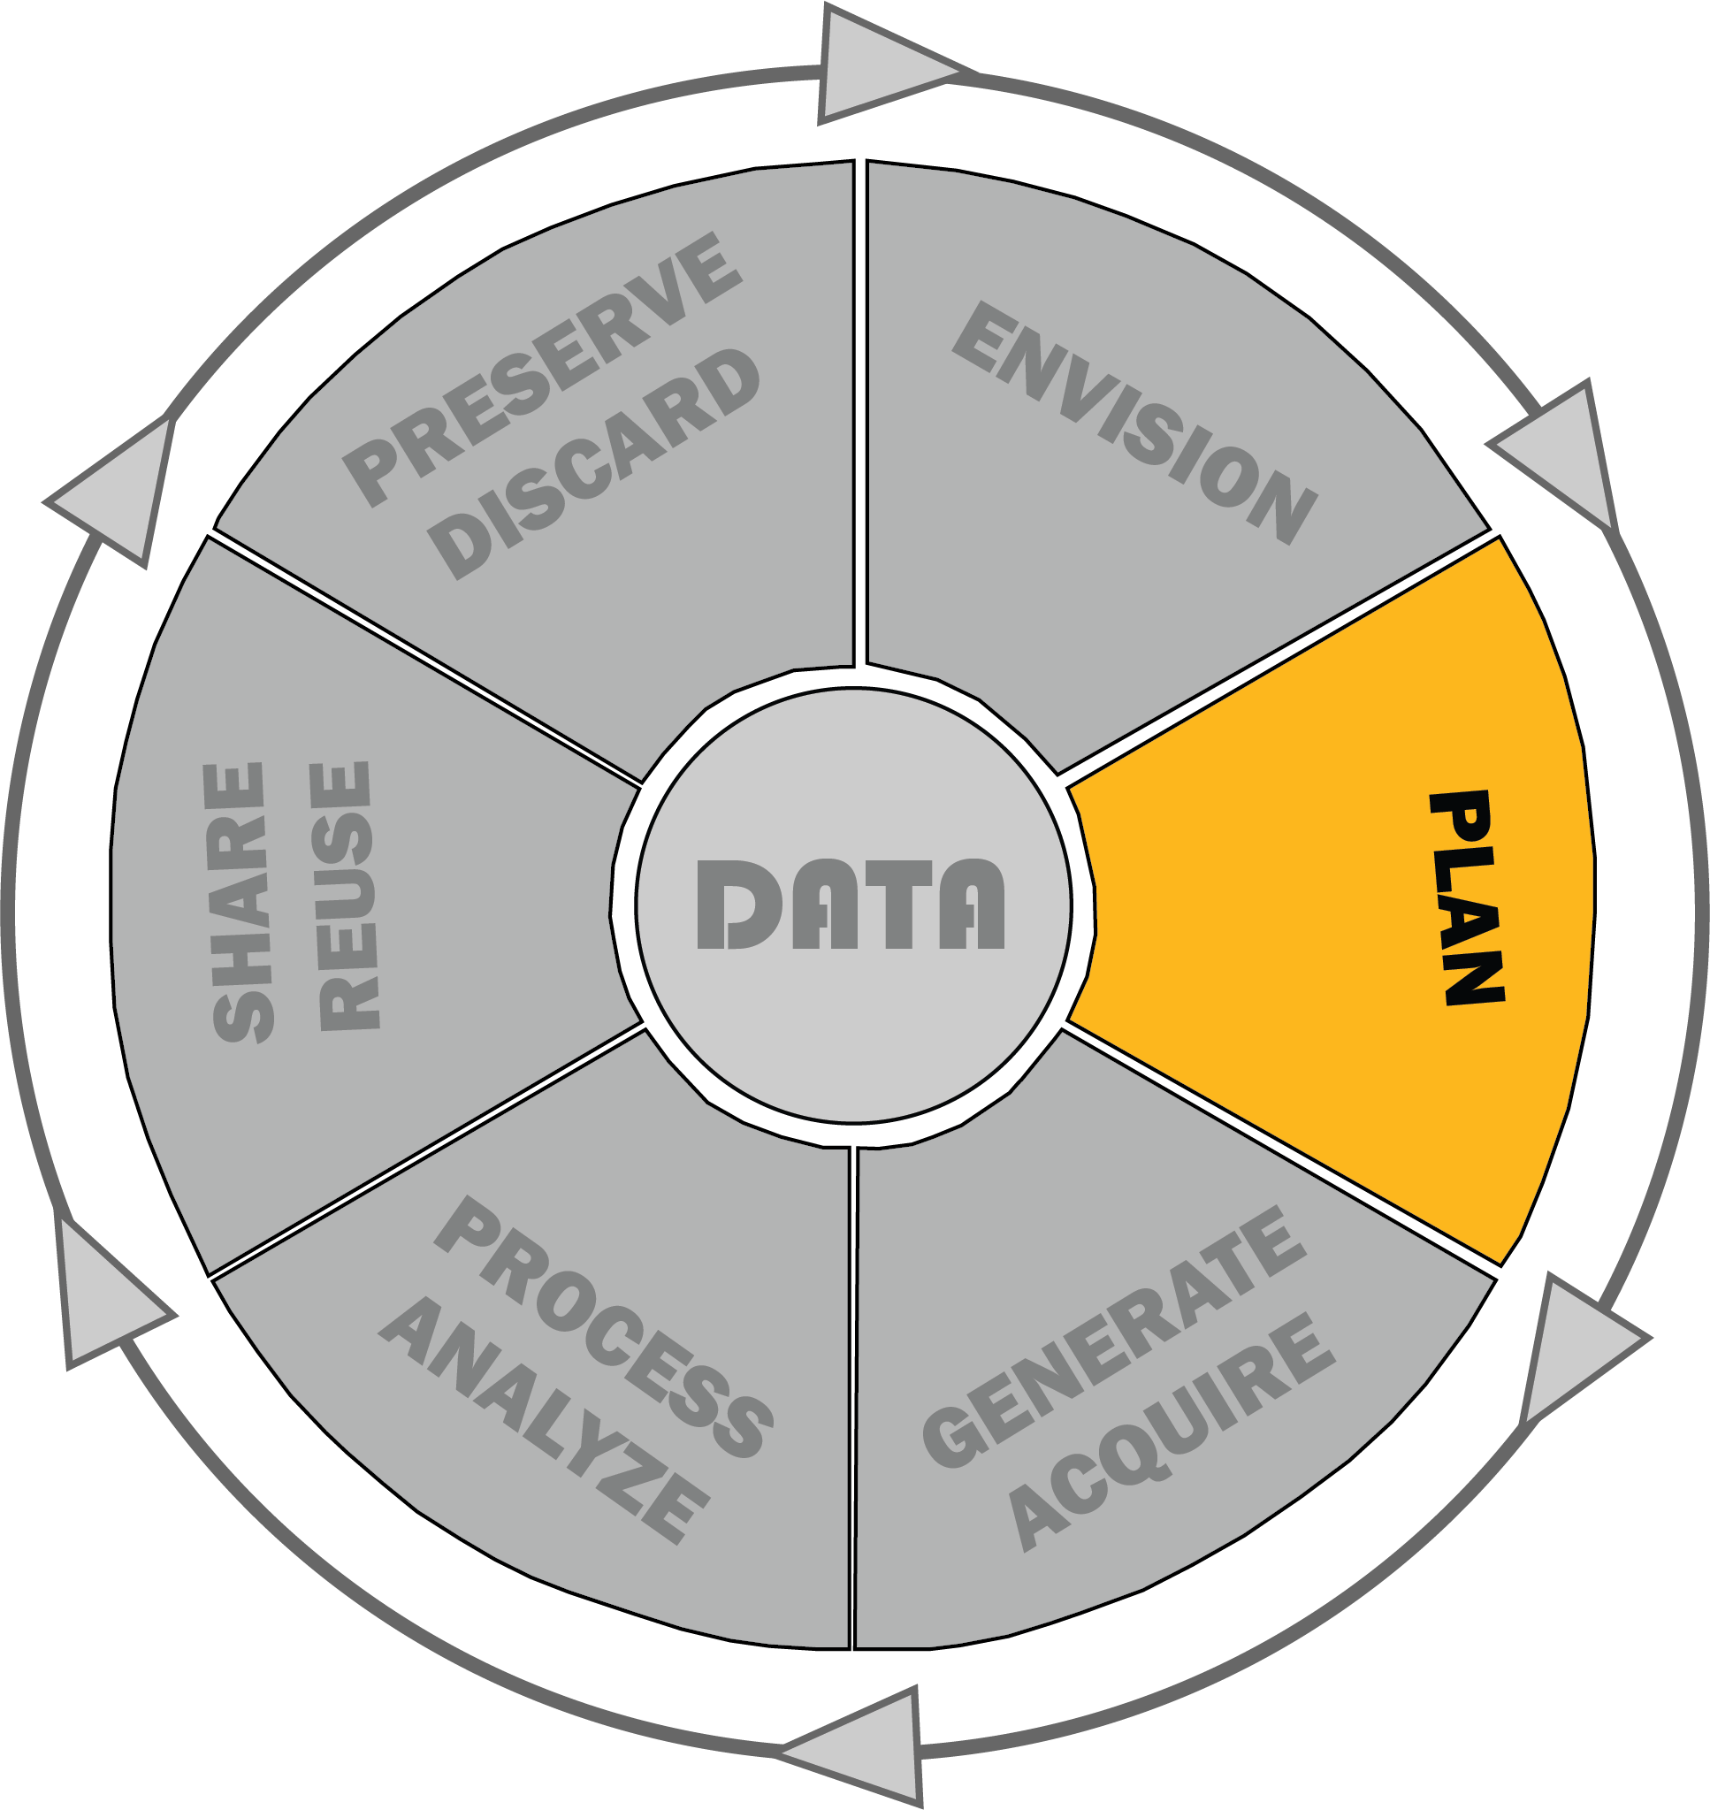
Plan
Selecting a Project Manager
  Organize the project and all materials associated with it.
  Communicates with partners and can identify resources to assist project
Creating data management plan
  Data acquisition strategies and desired formats
  Identifying all forms of data
  Identifying where the data will live during the project and who will have access to it
  Budget for storage needs and open access publication
Adapted from NIST RDaF materials​

Slide 23
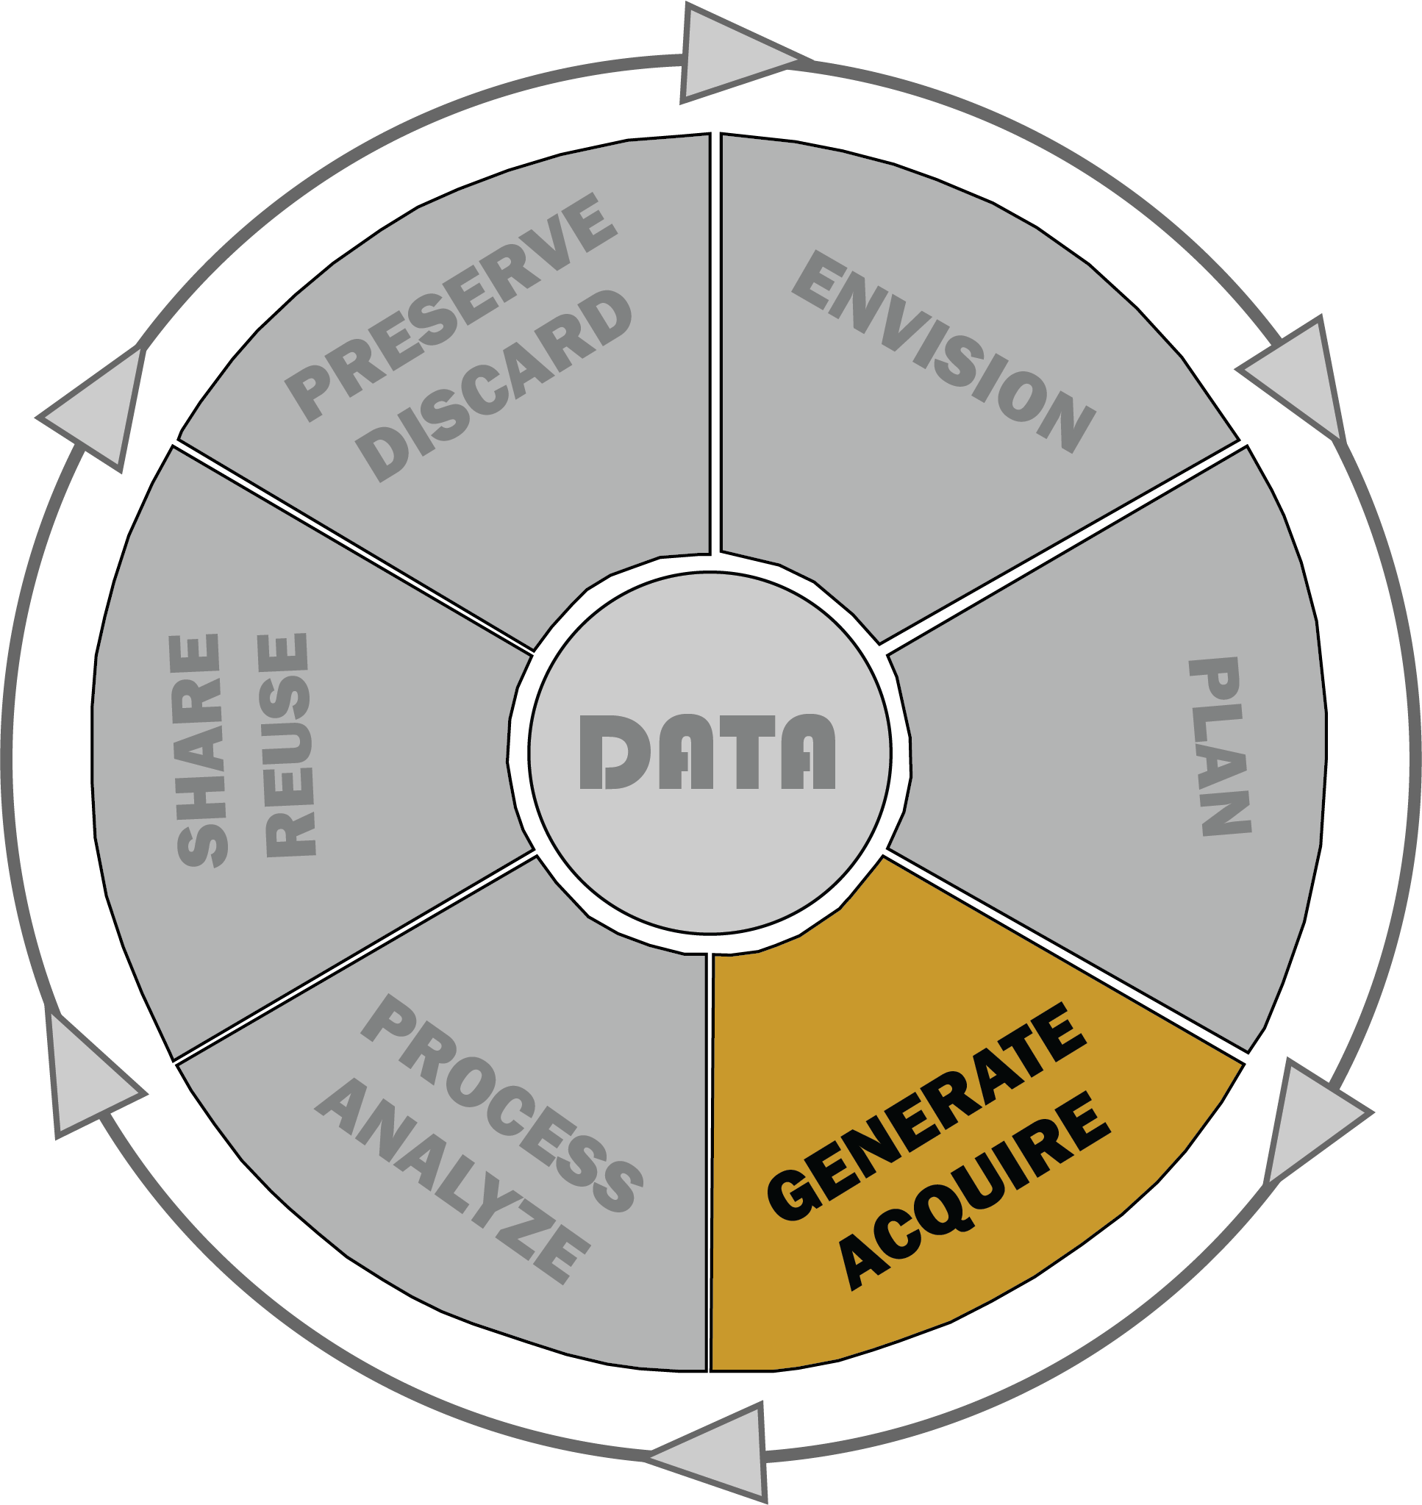
Generate / Acquire
Collecting raw data
  What kinds of data?
  How much?
  What metadata will you collect from subjects?
Purchasing data sets / Reusing open access data sets
  From where?
  What are the rights you have to the data?
  What work has been done to them?
  What metadata do they come with?

Slide 24
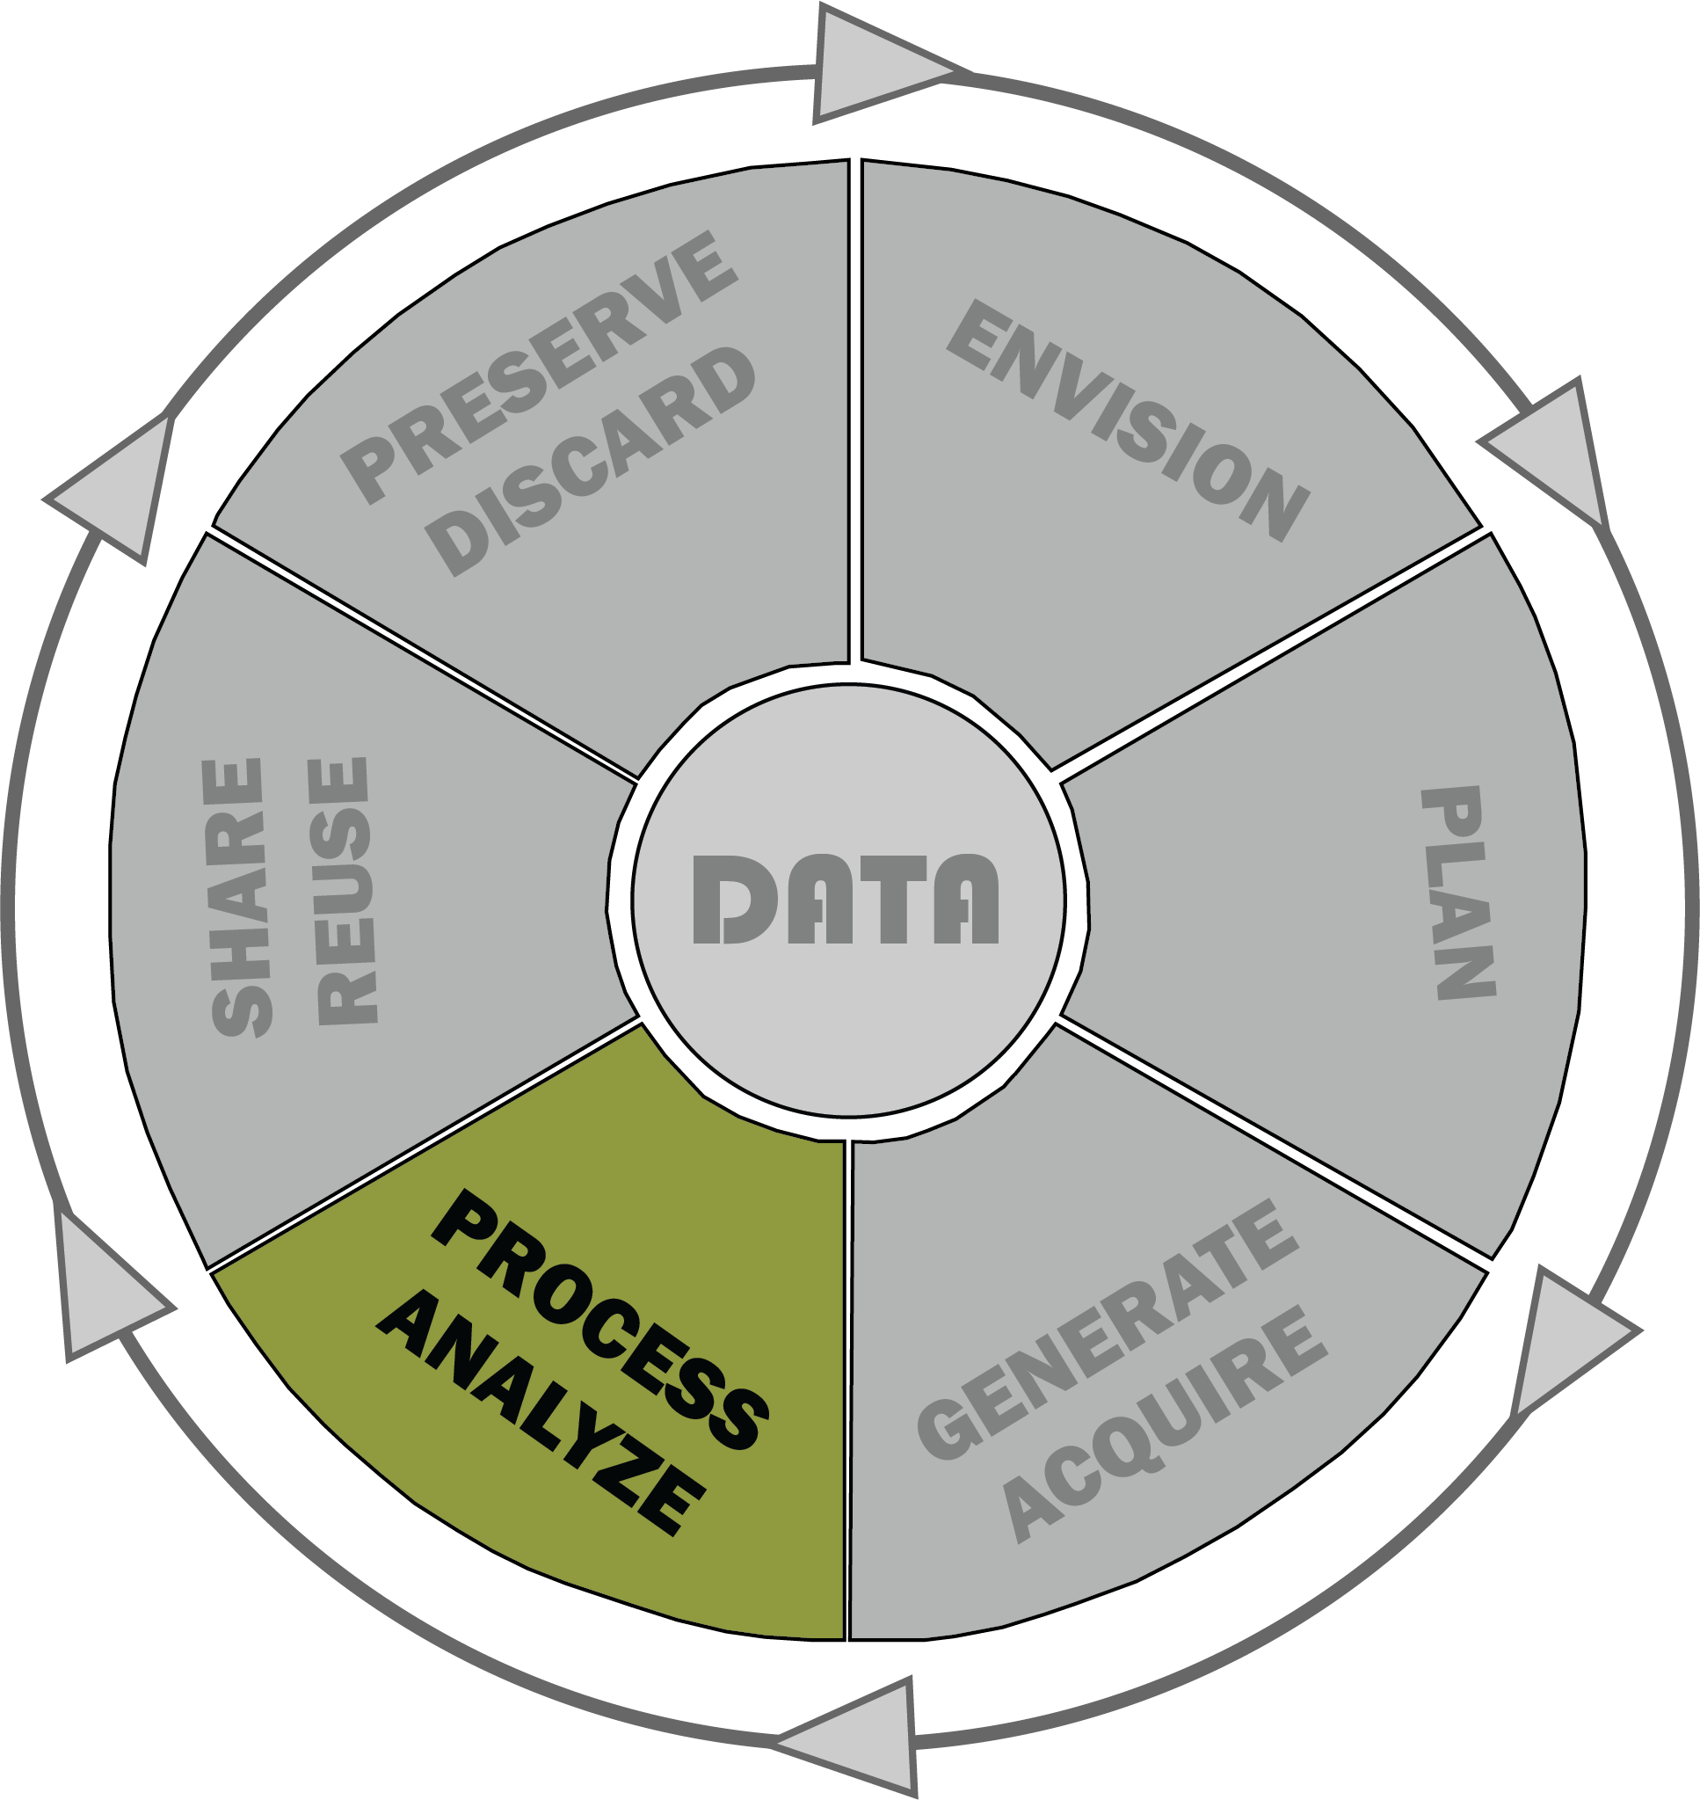
Process / Analyze
Organizing and cleaning data
Playing with your data
  Is it in the right format?
  Do you have the correct software?
  Storage capacity?
  Do you need computational support?
Finalizing file formats and sizes
  What restrictions do your final repositories have?
  What restrictions does the software you have available have?
Adapted from NIST RDaF materials​

Slide 25
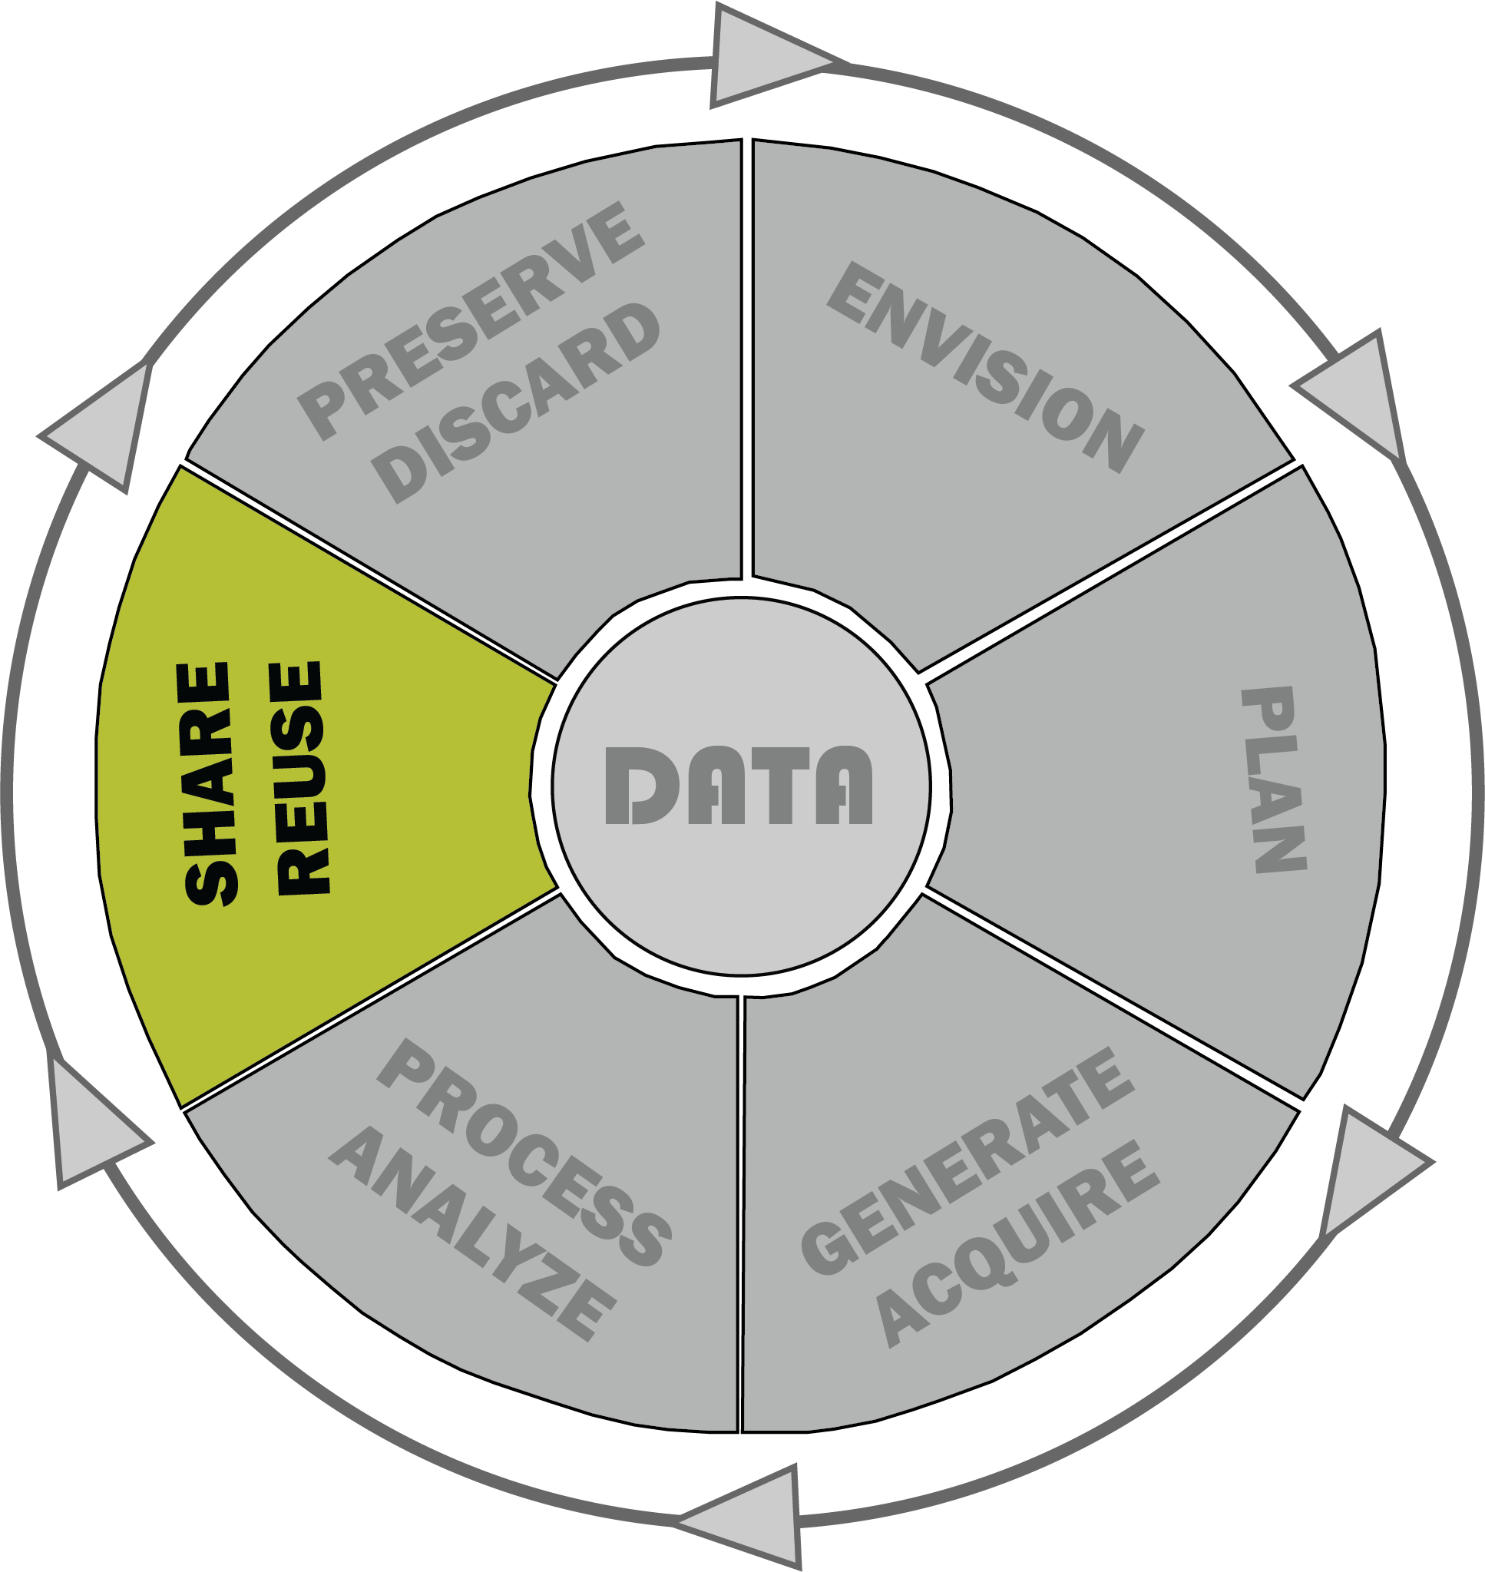
Share / Reuse
Who is your primary audience?
  What level of access do you want to give?
What are the requirements of your grant?
  Open Access policies of your institution?
Discoverability of your data?
  Repositories you’re uploading to?
Accessibility of your data?
  ADA (Americans with Disabilities Act) or WCAG (Web Content Accessibility Guidelines) compliant?

Slide 26
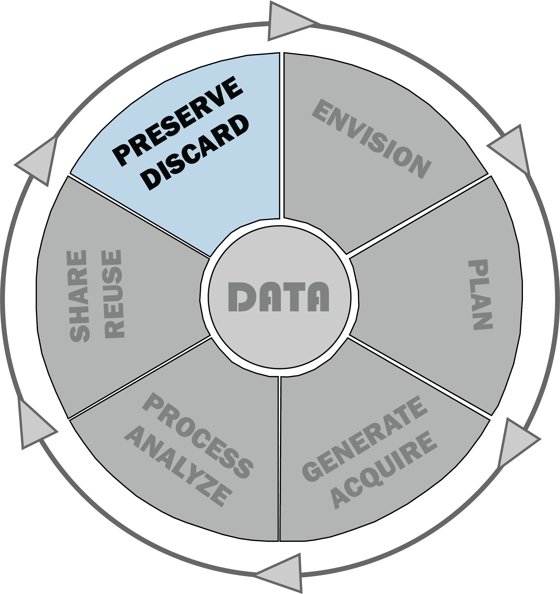
Preserve / Discard
What do you want to do with your data at the end of its life?
  Preserve?
  Destroy?
How much do you want to preserve?
  How much should you preserve (legally, ethically)?
How long does it need to live?
Adapted from NIST RDaF materials​

Slide 27
Research Computing and Data Management
Collaboration Between
  High Performance Computing
  MSU Libraries
  IT Services
  Office of Research Security and Compliance
  Researchers
Goals
  To create a collaborative research ecosystem on our campus.
  Create a 'store-front' at the library to assist faculty and researchers leverage their research compute and data.
  Democratize research compute and data management on our campus.

Slide 28
RCD Strengths
Strengths of Library
  Research data management
    Description
    Visualization
  Service oriented work
  Well-connected on campus
Strengths of HPC
  Data storage
  Computational capability and knowledge
  Systems

Slide 29
RCD Challenges
Challenges
  Siloed departments
  Limited access to software, storage, and compute.
  Limited staff to teach/support researchers
  Recognizing the value of an RCD
Approach
  Build relationships focused on RCD
  Collaborate with researchers on potential uses
  Build systems and support staff capabilities
  Communicate with senior leaders, faculty, and researchers about long-term value of RCD

Slide 30
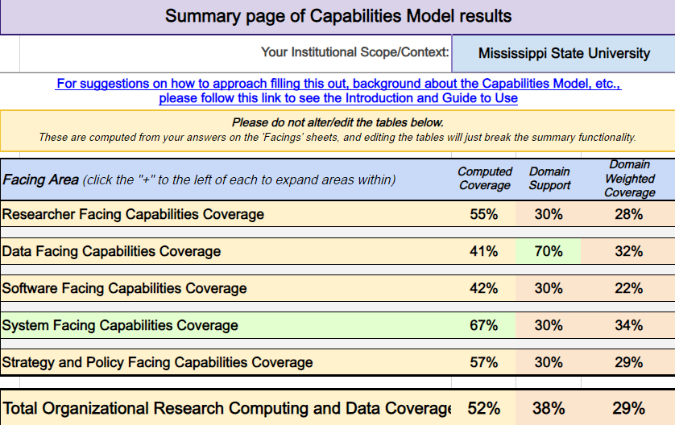
Research Computing and Data – Capabilities Model

Slide 31
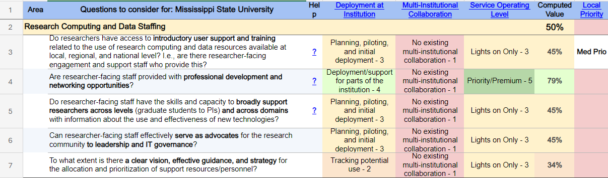
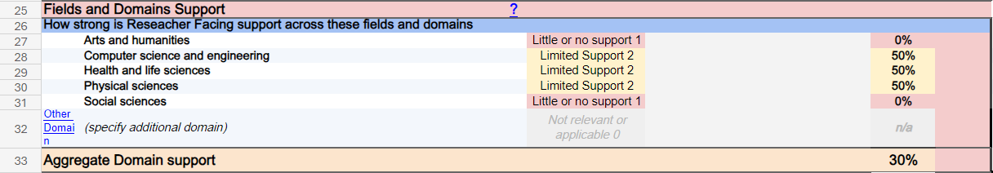
RCD-CM Assessment Questions

Slide 32
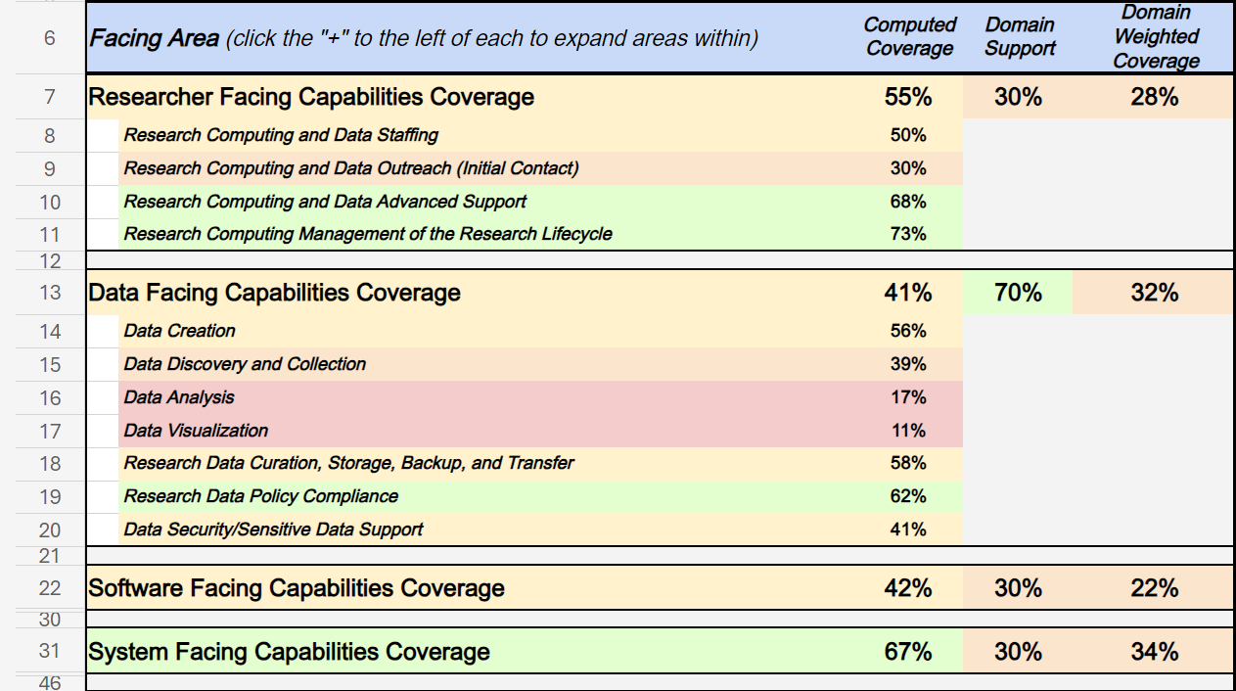
Sub Areas

Slide 33
Research Computing and Data – Capabilities Model

Slide 34
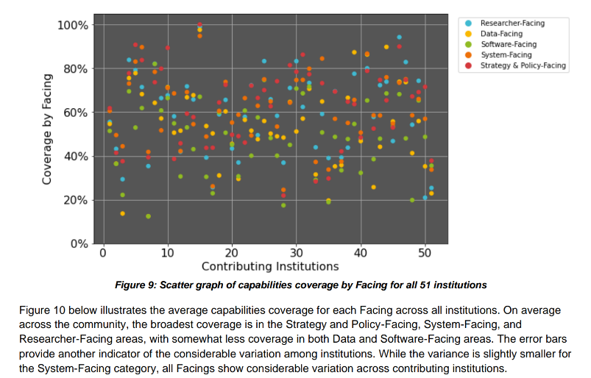
Comparison to Other Universities

Slide 35
Why Use RCD-CM?
Allows more accurate assessment of researcher needs
Help communicate to senior staff gaps in service
Builds collaborative RCD teams
Helps Research Computing and Data Organizations to better vector resources.

Slide 36
Moving Forward
NSF SCIPE grant award
NSF CC* Proposal Submitted
NSF CC* in works
Continue to build capabilities based on RCD-CM assessment

Slide 37
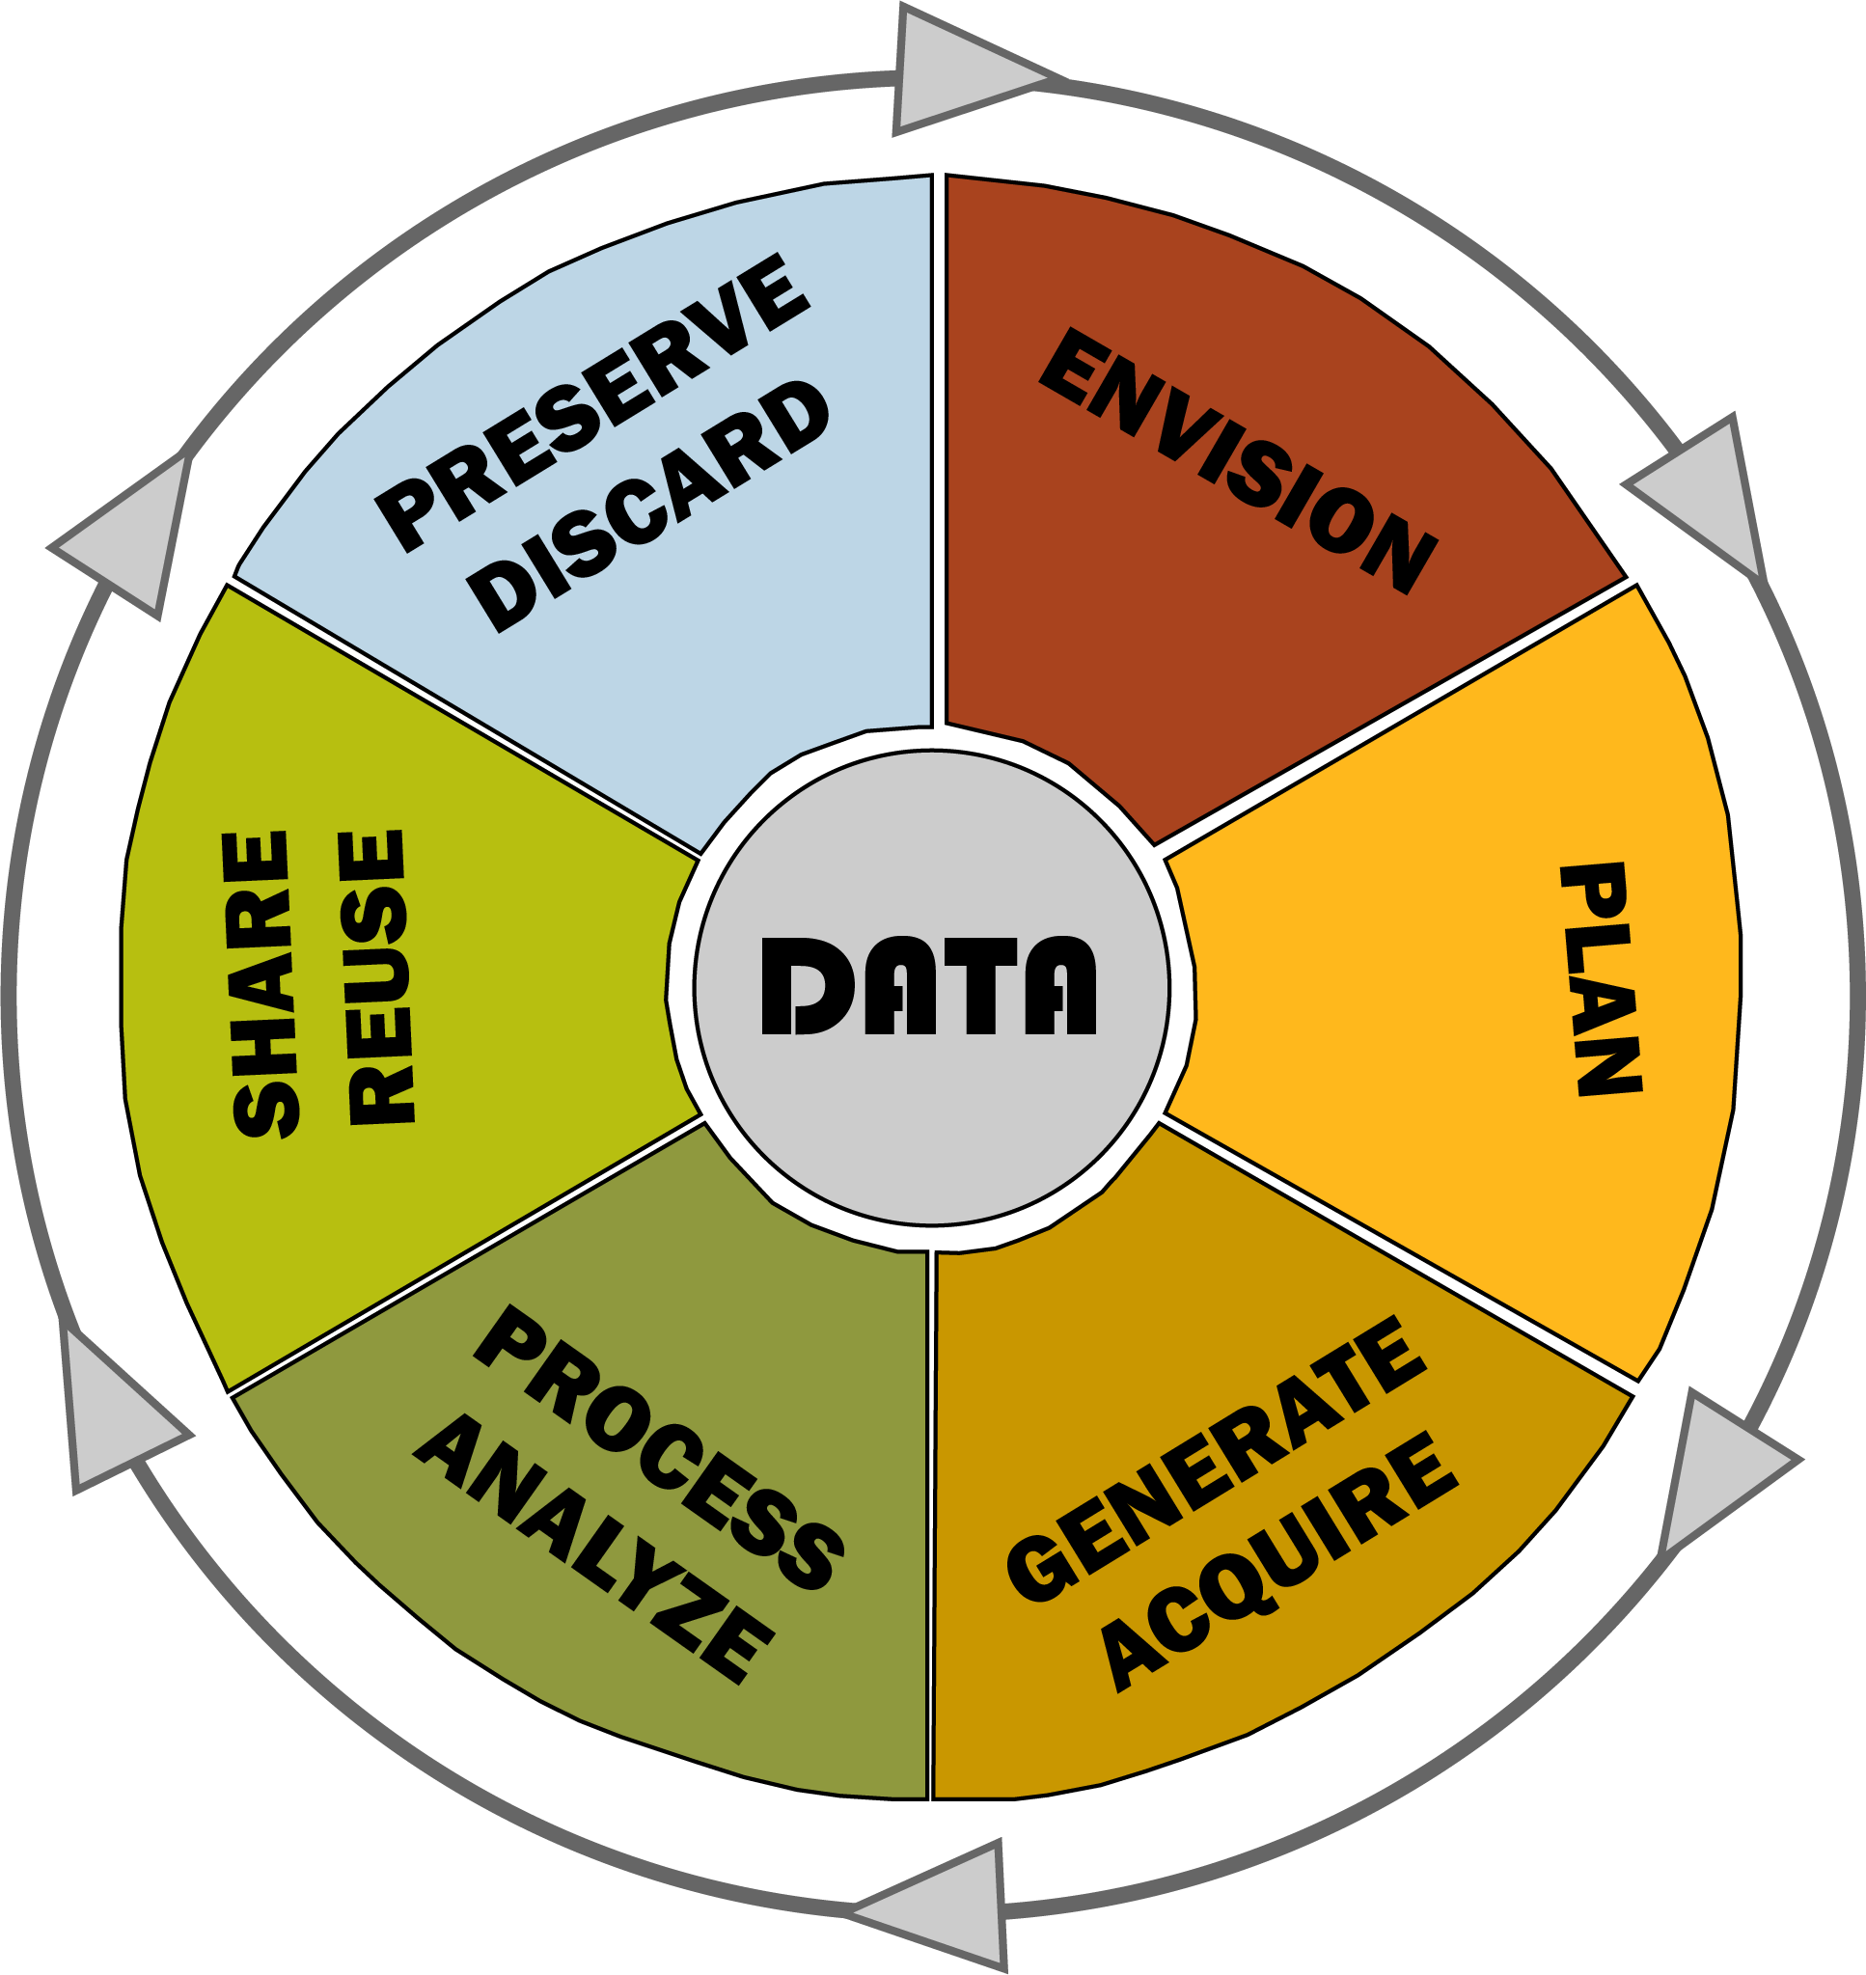
What can we do for you?

Slide 38
What can we do for you?
On the HPC side:
Ptolemy GPU Cluster
  Available for researchers and classes

Slide 39
What can we do for you?
On the Library side:
Data management plans
Metadata standards
Support on data organization during projects
Instruction
Copyright support (mbean@library.msstate.edu)

Slide 40
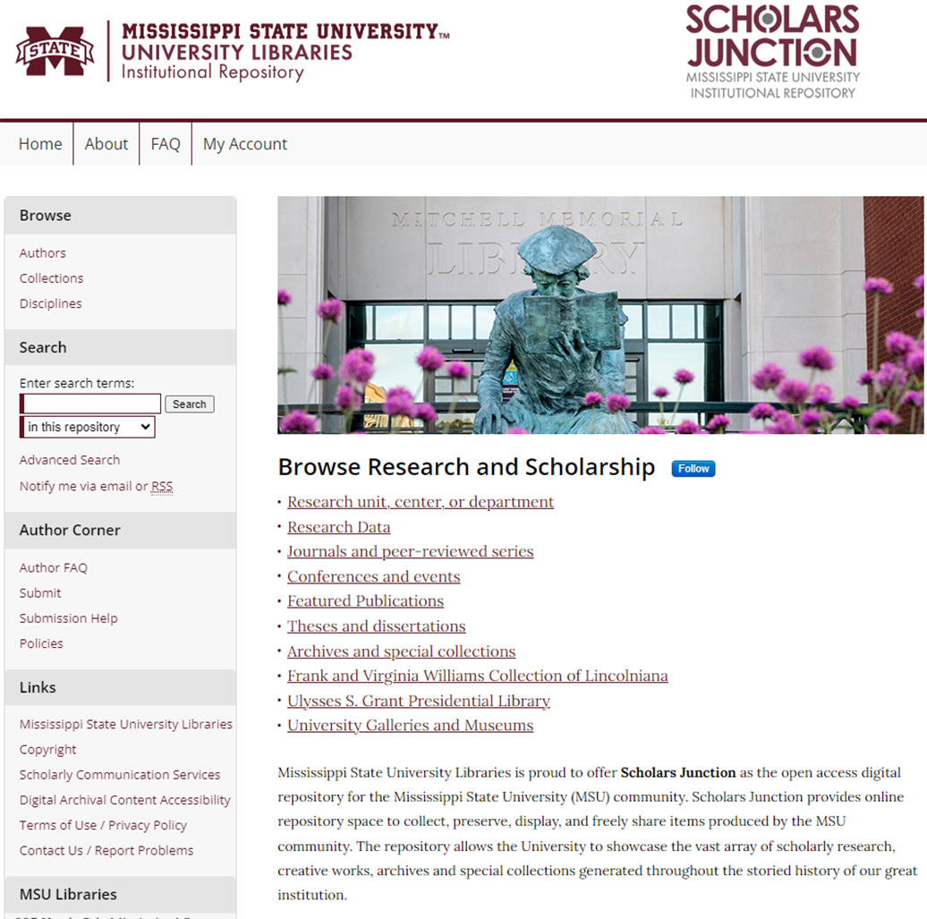
What can we do for you?
On the Library side:
Scholars Junction
  Institutional repository

Slide 41

Contact us:
Carolina Siniscalchi
csiniscalchi@library.msstate.edu
Lauren Geiger
lgeiger@library.msstate.edu
Mike Navicky
navicky@hpc.msstate.edu
Check out Library workshops here!

Slide 42
THANK YOU!!!

Slide 43
What types of data are you/your lab producing?
How much data is it?
Are you using public repositories? Do all your data fit on those?
Do you need temporary data storage (e.g., while the project is ongoing)?
How much thought do you put into data management plans?
Do you have unattended computing needs?
Would you be willing to participate in a focus group about data management?

