Slide 1

Resources
101
Tools, templates, samples & subscriptions
Carmen Arrigo
01/30/2024

Slide 2

Agenda
MSU Tools for Grantseekers developed by ORD
(Website Overview + TOPS)
MSU Subscribed Services
(Hanover, Pivot, Gov.win)
MSU Staff
(ADRs, Grants & Contracts, Business Mgrs., ORD)
Funding Opportunity Announcements & Internal Opps
(OpsWatch, Fuller, International, TOPS, DDD Listserv, Academic Research Funding Strategies, LLC, ORED Opps)
Other MSU Support Units
(SPA, OSP, Graduate School, Provost, General Counsel)

Slide 3


MSU Tools for Grantseekers developed by ORD
We try our best to keep a variety of resources available for faculty use on our website.
Here you can find in-depth information on the services ORD offers, where and how to find funding, toolkits and templates for proposal prep, upcoming education and events, and the ORD staff.

Slide 4

(tops)
Targets of opportunity
Sent out at the beginning of each month, TOPS is a newsletter with curated grants that we think the MSU community might find interest in.
It also contains highlights of staff achievements, upcoming events (institutional and external), entrepreneurship opportunities and pitch competitions, reviewer opportunities, federal and other grant-related webinars, and the contact list for campus Grants and Contracts personnel.

Slide 5

MSU Subscription Services
MSU pays for several services so that they are FREE for you!

Slide 6


Subscribed services
A grant search tool (federal, state, foundation, private)
Can help connect you to collaborators
Can save curated searches to be delivered to email
And more! Kristen is our Pivot Guru.
Hanover Research makes market research accessible to all using the latest research methodologies that deliver outstanding value and measurable impact.
Early Career & Healthcare Deadlines Calendars
Webinars, etc. – just email development@ord.msstate.edu if you’re interested in a topic!

Slide 7
Funding opportunity announcements
TARGETS OF OPPORTUNITY (TOPS)
Sent at the beginning of each month, TOPS contains a few curated funding opportunities along with upcoming federal and institutional professional development events geared for grantseekers, research administrators and adjacent positions.
GRANTWRITING NEWS
Sent monthly, the Academic Funding Strategies, LLC, newsletter contains both articles and links to resources on the web, and includes topics of interest, funding opportunities, and writing tips related to the academic extramural funding landscape.
FULLER GRANT UPDATES
Sent every Wednesday, this resource curated by Dr. Marty Fuller of Federal Solutions provides information about funding opportunities and meetings from various federal agencies of interest to the MSU community.
FULLER INTERNATIONAL FUNDING OPPS
Sent every Friday, this grants update by Dr. Marty Fuller provides information from federal agencies that exclusively relate to the international world. These are not included in the regular fuller grant updates.

Slide 8
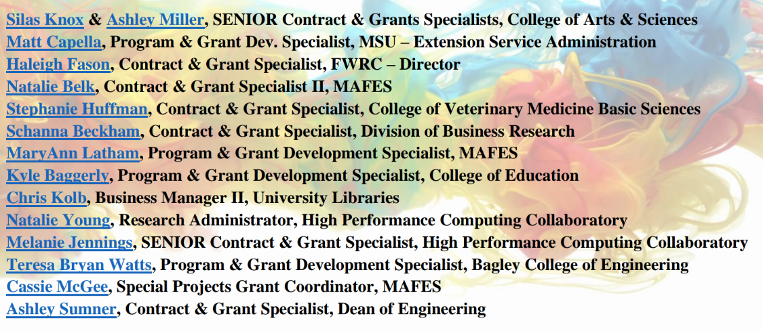
MSU Departmental Staff

Slide 9


Ored support units
Office of Research Development
Office of Sponsored Programs
Sponsored Projects Accounting
Office of Research Compliance & Security
Office of Technology Management
International Institute
Office of Laboratory Animal Resources

Slide 10


Thank you
Carmen Arrigo| carmen@ord.msstate.edu | www.ord.msstate.edu

