Slide 1


Mississippi Department of Education
VISION
MISSION
To create a world-class educational system that gives students the knowledge and skills to be successful in college and the workforce,
and to flourish as parents
and citizens
To provide leadership
through the development of policy and accountability systems so that all students are prepared to compete in
the global community

Slide 2






State Board of Education STRATEGIC PLAN GOALS
ALL Students Proficient
and Showing Growth in All
Assessed Areas
EVERY School Has Effective Teachers and Leaders
1
4
EVERY Student Graduates
from High School and is Ready
for College and Career
EVERY Community Effectively Uses a World-Class Data System to Improve Student Outcomes
2
5
EVERY Child Has Access
to a High-Quality Early
Childhood Program
EVERY School and District is
Rated “C” or Higher
3
6

Slide 3





Mississippi Students and Schools
138
School Districts
835
Schools
436,523
Students
65,307
Students with a Disability
15%
Students with
Disabilities

Slide 4
MDE Support, Services & Oversight to Public Schools
Provide guidance, professional development, and technical assistance in the areas of academics, educator licensure and effectiveness, child nutrition, school finances, and safe and orderly schools, among other areas
Distribute and monitor $2.9 billion in state funds and $1.5 billion in federal funds
Monitor compliance with accreditation standards and state and federal laws
Implement statewide assessment and accountability systems

Slide 5
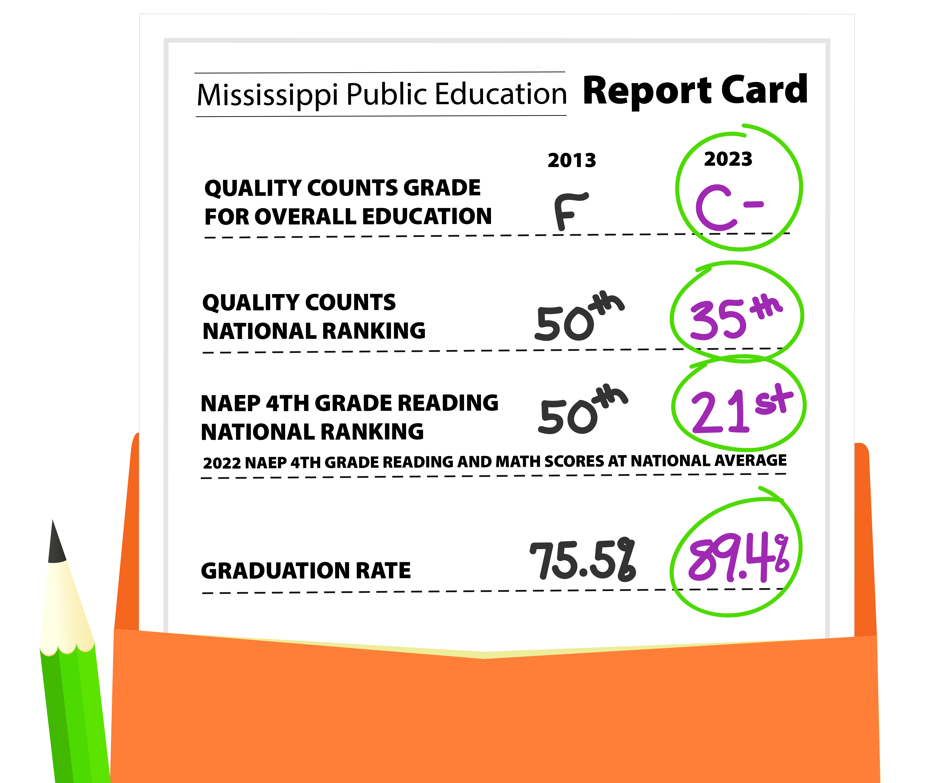
Mississippi Public Education Progress 2013 to 2023
Key strategies for improved outcomes:
Effective State Board Strategic Plan
High expectations for students and educators
Higher academic standards
Strong accountability system for schools and districts
Professional development for educators

Slide 6
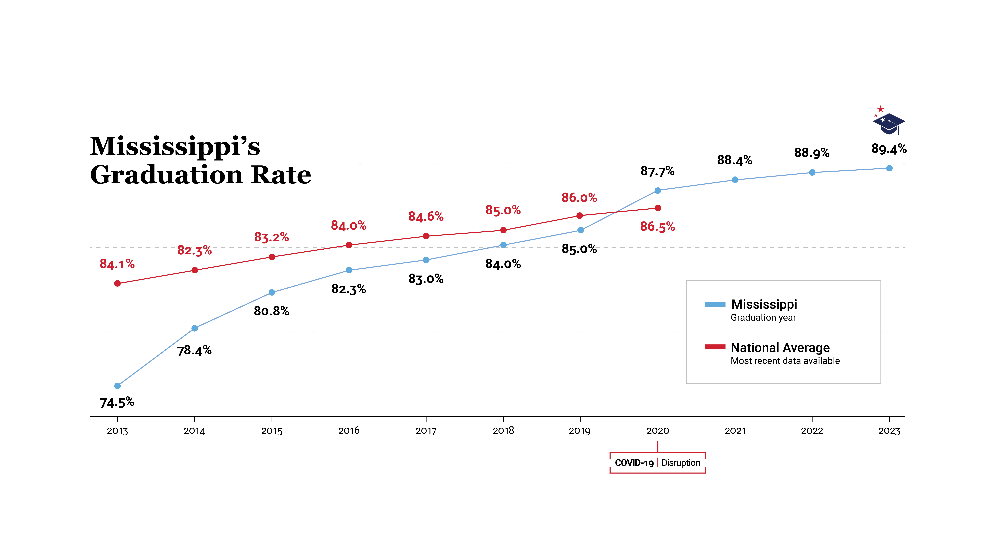
Graduation rate for students with disabilities nearly tripled from 23.2% in 2014 to 70.0% in 2023

Slide 7
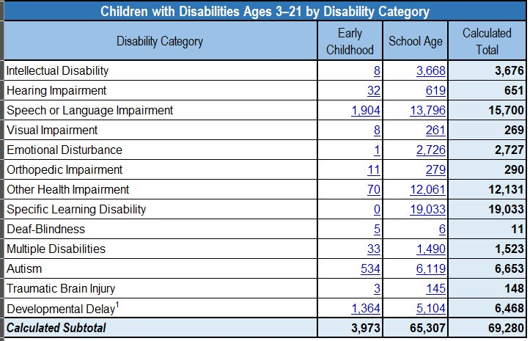
Autism is the fastest growing category among public-school students due to:
Better methods of identification within the fields of education, psychology, and medicine
Early intervention identification

Slide 8
What are the biggest challenge and how can MSU offer support?
Challenges
Limited availability of qualified special education teachers
More training needed for general education teachers to provide high quality
Tier 1 instruction to support diverse learners, including those with special needs
Increased occurrence and severity of behavioral needs among students
Teacher Preparation Support
Include training in successful instructional practices
Provide additional training and instruction in classroom/behavior management (this is the most common reason teachers leave the field; most prep programs only include one course on the topic)
Provide differentiated practicum experiences; include time in a classroom for students with significant needs, a gifted setting, etc.

