Slide 1
Disability Inclusivity & Representation in SCI Research
Learn about the
National Institute on Disability,
Independent Living & Rehabilitation Research
Anjali J. Forber-Pratt, Ph.D.
Director, @anjalifp
Kristi Hill, Ph.D.
Deputy Director
Phillip Beatty, Ph.D.
Director of Office of Research Science
Pimjai Sudsawad, ScD
Associate Director, Office of Research Science
La Vonnia Villanueva
Senior Advisor

Slide 2
NIDILRR’s Mission
To generate new knowledge and to promote its effective use:
To expand society’s capacity to provide full opportunities and accommodations for individuals with disabilities
To improve the abilities of individuals with disabilities to perform activities of their choice in the community

Slide 3
About the Administration for Community Living
The Administration for Community Living was created around the fundamental principle that older adults and people of all ages with disabilities should be able to live where they choose, with the people they choose, and with the ability to participate fully in their communities.
By funding services and supports provided by networks of community-based organizations, and with investments in research, education, and innovation, ACL helps make this principle a reality for millions.

Slide 4
Judy Heumann Quote

Slide 5
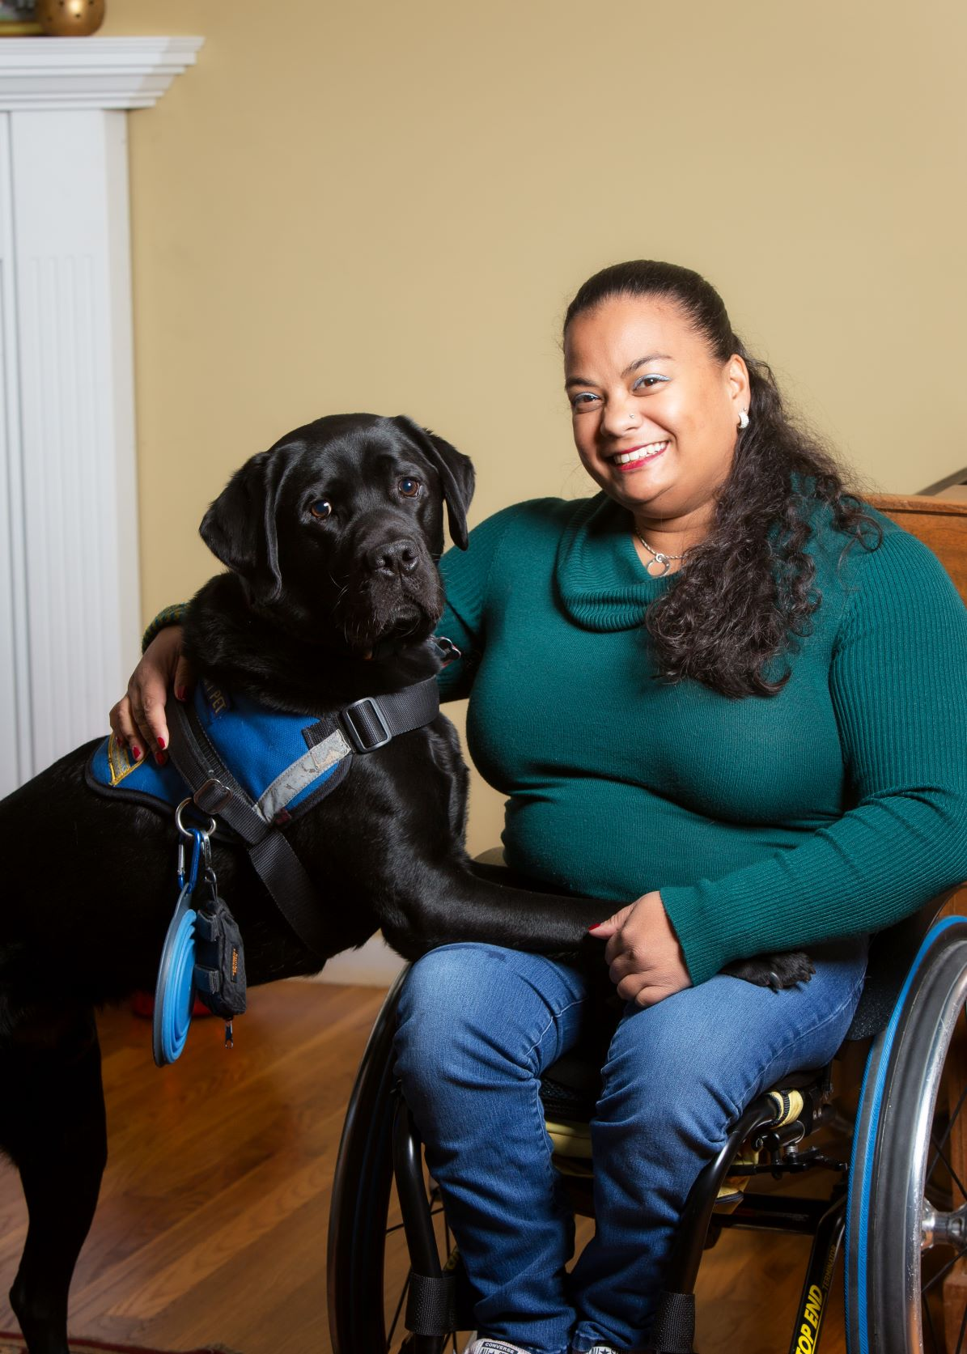
Anjali’s Identities

Slide 6
What We Sponsor (Annual Budget of $119M)
Research & Development
Interventions and products to improve long-term outcomes and community living
Capacity Building
Training young investigators and retraining clinicians to pursue research careers
Knowledge Translation
Promoting the use of R&D findings by people with disabilities, their families, and other stakeholders
Notes:
Health and Function
Employment
Community Living & Participation
Rigor and relevance to the community

Slide 7
Outcome Domains
Health and Function
Employment
Community Living and Participation

Slide 8
Breadth of Responsibility
Populations across the lifespan
Children
All disabilities
Focus on Health and Function, Employment, Community Living and Participation
Justified by the Rehabilitation Act of 1972 as amended most recently in the Workforce Innovation Opportunity Act (WIOA) of 2014
Cross-disability
Transition age
Adults
Aging
Specific programs target SCI, TBI and Burn Injury
Notes:
Populations across the life-span
Children and youth;
Working-age adults; and
Individuals “aging with” lifelong and early-onset disabilities, and those “aging into” disability in mid- to later life.
Cross-disability
Intellectual and developmental disability
Physical disability
Psychiatric disability
Sensory disability
NIDILRR’s program regulations are found at 45 CFR 1330

Slide 9
Director’s Focus
Expansion of Field of Researchers with Disabilities
Relevance of Research to & with Disability Community
Intersectional Systemic Barriers
Equity
Reach Professions Not Currently in Portfolio
Be National & Int’l Resource

Slide 10
Research Inclusivity & Equity
Diverse Researchers
Diverse Study Participants
Diverse Representation in Knowledge Translation Materials
Research Inclusivity & Equity

Slide 11
Data
PWD represent approximately 9% of the scientific workforce (ACD WGD Subgroup on Individuals with Disabilities Report, 2022)
Data from the Women, Minorities, and Persons with Disabilities in Science and Engineering 2021 report indicate that disability representation in the scientific workforce decreases throughout the career path
19% of undergraduate students
9% of doctoral students
8% of postdoctoral students
8% of assistant professors
10% of associate and full professors
8% of department directors, chairs, and chancellors
8% of university presidents and provosts
Just under 5% of medical students (Meeks et al., 2020) and approximately 3% of practicing physicians report disability (Nouri et al., 2021)

Slide 12
Research Enterprise
Project Officers
Peer Reviewers
Investigators
Research Participants
Community Partners
Funders

Slide 13
Funding Priorities
Field-Initiated
Funding opportunity in a general area (typically one of the three major outcome domains)
Agency- Directed
Funding opportunity specifies topic and delineates specific R&D tasks to be accomplished.
E.g.: “Using Robotics and Automation to improve accessible transportation options for people with disabilities.”
Applicants propose specific R&D topic(s). Some administrative elements are required.

Slide 14
Grant Mechanisms
Mary Switzer Research Fellowships
New in FY 24: Doctoral fellowship!
Advanced Rehabilitation Research Training (ARRT)
Field-Initiated Projects (Research and Development) (FIP)
Small Business Innovation Research Grants (SBIR)
Rehabilitation Research and Training Centers (RRTC)
Rehabilitation Engineering Research Centers (RERC)
Disability and Rehabilitation Research Projects (DRRP)
SCI, TBI and Burn Injury Model System Centers (SCIMS, TBIMS,BMS)
ADA National Network
Knowledge Translation Centers

Slide 15
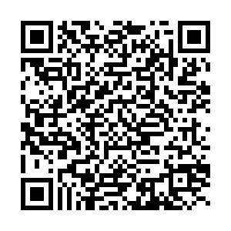
Program Types Funded by NIH & NIDILRR
Program Type: | Research | Career Development | Training | Fellowships
National Institutes of Health | R series | K series | T series | F series
National Institute on Disability, Independent Living, and Rehabilitation Research | DRRP RERC FIP RRTC | ARRT | RRTC | Switzer
TIP: Learn more about federal funding opportunities for disability & rehabilitation research here:

Slide 16
Activities and Accomplishments: Employment
Examination of the moderating role of work limitations in the relationship between job crafting and work performance (University of New Hampshire)
Examination of employment trends affecting individuals who are blind or low vision, AT in the workplace, employers’ attitudes, (Mississippi State University)
Development of an intervention to enable return-to-work by employees who experience brain fog and other cognitive impairments due to Post-Acute Sequelae of COVID-19 (PASC) that negatively impact their ability to function in the workplace (University of Alabama at Birmingham)

Slide 17
Activities and Accomplishments: Health and Function
Evalu8NOW tool was introduced to respectfully monitor depression and anxiety of people with Parkinson’s and other degenerative neurological diseases (CreateAbility Concepts, Inc.)
Investigation of service delivery processes for individuals with disabilities using CRT who have a mobility impairment, while specifically identifying best practices, barriers, and unique features of health delivery policies and practices (University of Pittsburgh)
Conducting of field tests which evaluate measures of trunk function to be used in assigning classifications to athletes in wheelchair basketball competition (Alabama State University)

Slide 18
Activities and Accomplishments: Community Living and Participation
Examination of factors influencing participation in personal and life activities among people aging with long-term physical disability to inform future interventions (Washington University)
Developing and testing an intervention to enhance social connections and feelings of mattering among adults with serious mental illnesses (SMI)
(Temple University)
Quantification of out-of-pocket costs and unmet need for disability-related goods and services with attention to disparities experienced among people with disabilities from underserved backgrounds (Stony Brook)

Slide 19
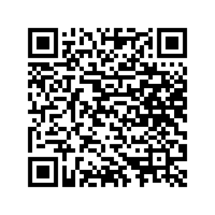
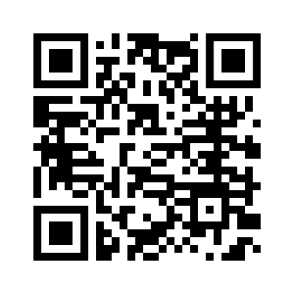
Engage with NIDILRR
Learn about NIDILRR
https://www.acl.gov/about-acl/about-national-institute-disability-independent-living-and-rehabilitation-research
https://acl.gov/news-and-events/announcements/new-nidilrr-long-range-plan
Receive Funding Opportunity Announcements
http://www.naric.com/?q=node/33
Review NIDILRR grant forecast/open grant competitions
https://www.grants.gov/search-grants
TIP: Enter CFDA: 93.433

Slide 20
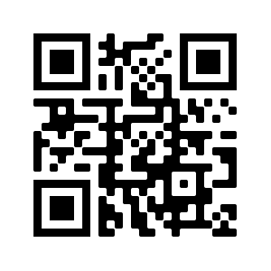
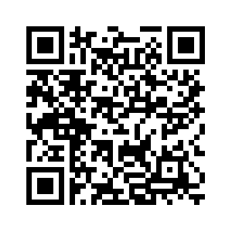
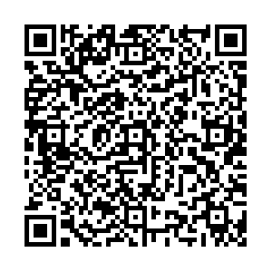
Engage with NIDILRR (cont.)
Search NARIC to learn about NIDILRR-funded research in your topic areas
https://www.naric.com/?q=en/ProgramDatabase
Become a NIDILRR Peer Reviewer
https://rrm.grantsolutions.gov/AgencyPortal/acl.aspx
NIDILRR Match Making Sessions: NIDILRR-Mailbox@acl.hhs.gov
Engage with NIDILRR grantees

Slide 21
NARIC

Slide 22
I hope you are now this excited about NIDILRR…

Slide 23
Contact Information: Anjali J. Forber-Pratt, Ph.D. Director anjali.forber-pratt@acl.hhs.gov Kristi Hill, Ph.D. Deputy Director kristi.hill@acl.hhs.gov Phillip Beatty, Ph.D. Director of Research phillip.beatty@acl.hhs.gov

