Slide 1
SPONSORED PROGRAMS ACCOUNTING
(SPA)
POST AWARD OVERVIEW
Jonathan Tucker
Anna-Marie Nickels
Notes:
JT and AM intro

Slide 2
Topics Covered
SPA Team and Responsibilities
Helpful Banner Screens and Job Submissions for Research Administration
Xtender Demo
SPA Forms and Common Mistakes
Policies Related to Restricted Funds
Question and Answer Session
Notes:
JT

Slide 3
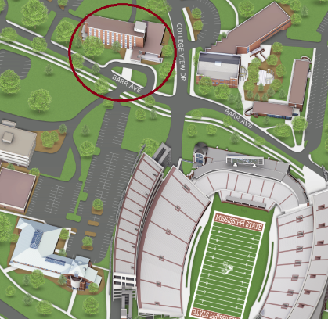
SPA
Post Award Research Administration
Division of Finance - Office of the Controller & Treasurer
McArthur Hall
245 Barr Avenue, 4th Floor
325-1937
spaccounting@controller.msstate.edu
Notes:
JT

Slide 4
SPA Team
Jonathan Tucker – Director, Sponsored Programs Accounting
Jeanette Bailey – Manager, Sponsored Programs Accounting
Anna-Marie Nickels – Interim Manager, Sponsored Programs Accounting
Cully Carpenter – Senior Cost Accountant
Denise Peeples –Accountant (Part Time)
TEAM 1 TEAM 3
Kim Lewis – Senior Accountant Nan Lomax – Senior Accountant
Jakerion Ales – Accountant Stephanie Parrish – Accountant
Jade Eubank– Accountant Haley Williams– Accountant
TEAM 2 TEAM 4
Kristen Odom – Senior Accountant Webb Jennings – Senior Accountant
Casey Watts – Accountant Mallory Hough – Sr. Sponsored Program Asst.
Ashley Collins – Accountant Sharon Liles – Sr. Sponsored Program Asst.
Notes:
JT

Slide 5
SPA RESPONSIBILITIES
SPA SENIOR ACCOUNTANTS
Process Awards/Mods
  Review, bookmark & highlight pertinent information within the agreements
  Assign the fund(s)
  Update the appropriate Banner Forms
  Load the restricted budget
  Create the Indirect Cost (IC) distribution template
  Email fund notification to respective department
Subcontracts
  Review, bookmark & highlight pertinent information within the sub agreements
  Create payment spreadsheet
  Email notification to respective department
Team Leader
  Train and mentor team members
  Review respective team member’s invoices, financial reports, journal entries
  Provide departmental support as needed
Establish Scholarship Funds
Notes:
JT

Slide 6
SPA RESPONSIBILITIES
SPA ACCOUNTANTS
Generate and submit monthly invoices & financial reports
Facilitate closeout process for final invoices & financial reports
Review subcontract invoices for payment
Create journal entries
Review & approve departmental journal vouchers (JVs)
Perform high level cost share review
Review & work to resolve outstanding sponsor payments
Review & approve NSF Queue entries
Provide departmental support as needed
SPA SENIOR SPONSORED PROGRAM ASSISTANTS
Generate and submit monthly invoices & financial reports
Facilitate the processing of monthly invoices & financial reports
Process check and wire payments
Key journal entries
Upload and index documents to SPA Xtender applications
Monitor central emails and route to staff accordingly
Review & correct fund, org, program errors as needed
Notes:
JT

Slide 7

controller.msstate.edu/sponsoredprograms
Notes:
JT

Slide 8
FIND YOUR SPA ACCOUNTANT
TEAM 1 | TEAM 2 | TEAM 3 | TEAM 4
Kim Lewis Senior Sponsored Programs Accountant | Kristen Odom Senior Sponsored Programs Accountant | Nan Lomax Senior Sponsored Programs Accountant | Webb Jennings Senior Sponsored Programs Accountant
Haley Williams Accountant Responsible for Orgs: 01 (remaining) | Ashley Collins Accountant Responsible for Orgs: 010300, 012200, 03, 18, & 19 (remaining), 464500 | Stephanie Parrish Accountant Responsible for Orgs: 02, 04, 05 (remaining), 08, 09, 192500, 192501, 2, 3, 4 (remaining), 5 | Mallory Hough Sr. Sponsored Programs Assistant
Jakerion Ales Accountant Responsible for Orgs: 011100, 011900, 190500, 191000, 191001, 193000, 193002, 193700 | Casey Watts Accountant Responsible for Orgs: 015900, 015901, 051700, 060500, 060502, 194000, 194100, 440900 | Jade Eubank Accountant Responsible for Orgs: 06 (remaining) | Sharon Liles Sr. Sponsored Programs Assistant
Notes:
JT (NEXT SLIDE AM)

Slide 9
BANNER SCREENS
and JOB SUBMISSIONS
FRAGRNT - Grant Maintenance
FGIDOCR - Document Retrieval Inquiry
FOAAINP – Document Approval
FGIBAVL – Budget Availability Status
FGITBSR - Trial Balance Summary
FGITRND - Detail Transaction Activity
FWREXSA - Sponsor Budget Available
FWREXCS - Cost Share Fund Report by Org
Notes:
AM
To kick off our training session, let’s talk about common banner screens and job submissions to help you provide your department with top-notch grant administration service.

Slide 10
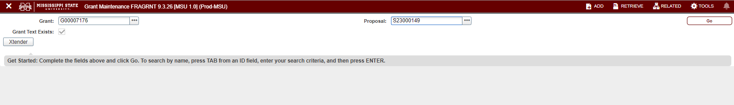
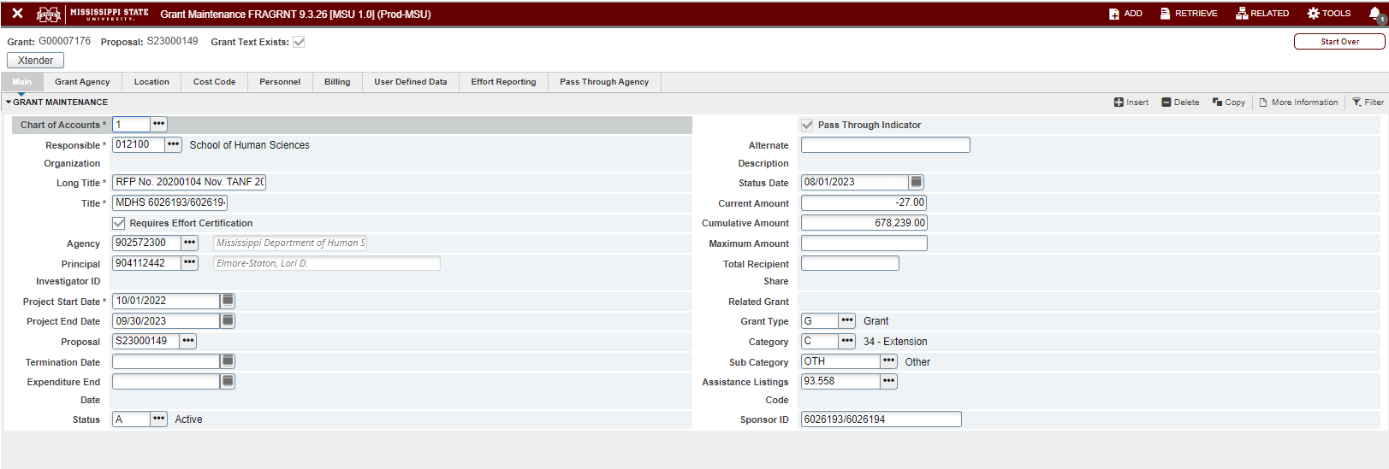
FRAGRNT - Grant Maintenance
Notes:
AM
The most frequently talked about Banner Screen is like likely FRAGRNT. By searching with your grant number in the top left corner and selecting go, you will have a plethora of information at your disposal. On the main screen you will find the responsible fiscal unit, agency name and number, PI name, start and end date, current and cumulative award amounts, and pass-through indicators. Through the tabs on the top portion of the screen, you can flip through agency information and other details on the project. Using the related button in the top right corner, you can select FOATEXT and view current status related to the grant number.

Slide 11
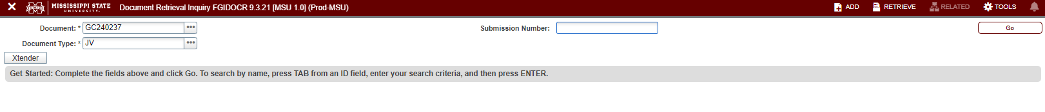
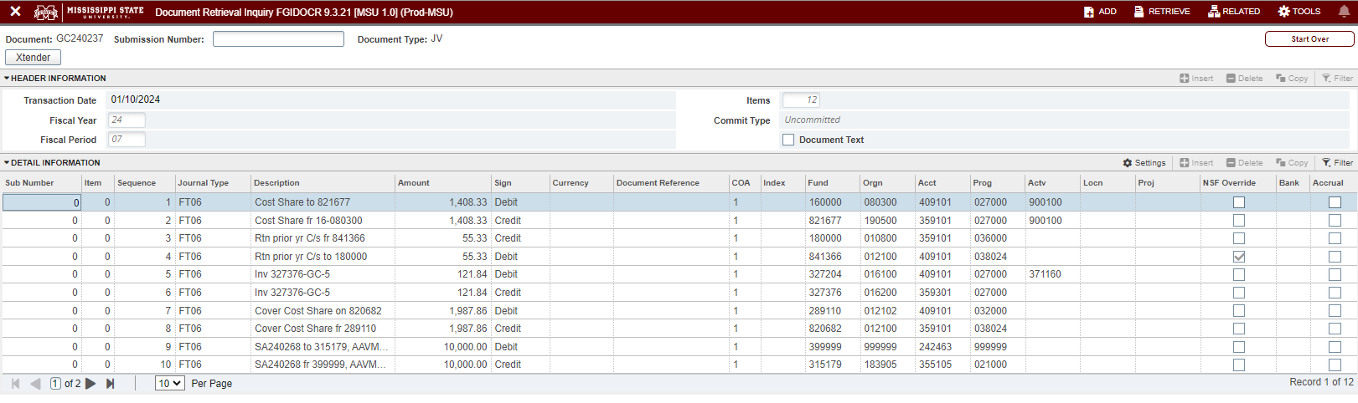
FGIDOCR - Document Retrieval Inquiry
Notes:
AM
As a grant administrator, you might find yourself needing to review a JV that SPA initiated or approved. You can find these details in FGIOCR by searching the document number and selecting go. For long journal entries, you will need to use the arrows to view multiple pages.

Slide 12
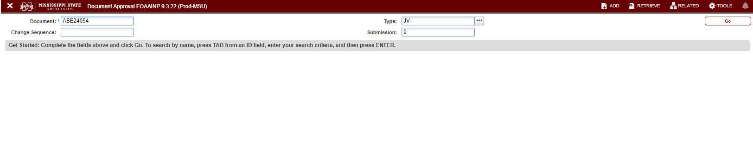
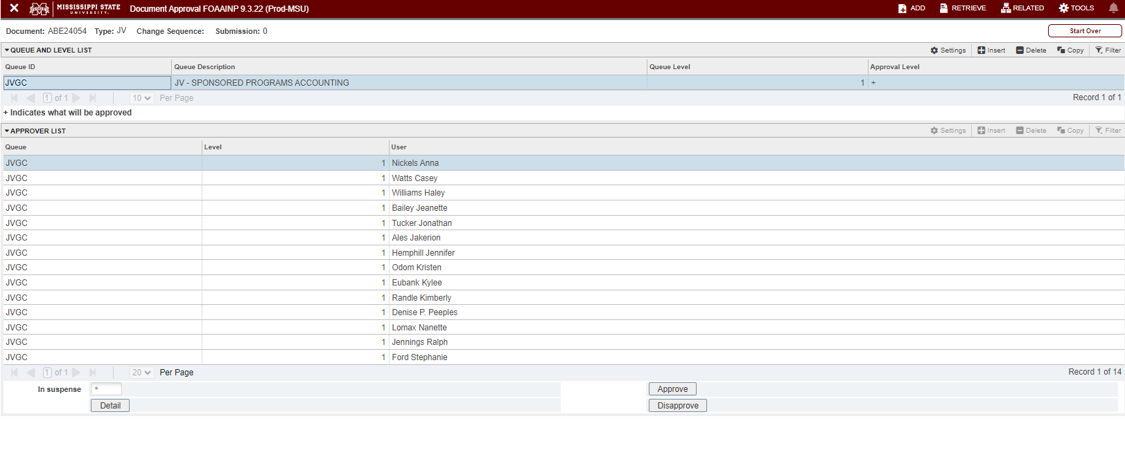
FOAAINP – Document Approval
Notes:
AM
If you feel that a journal voucher may have bottle-necked in someone’s approval queue, you can search your document number in FOAAINP and select go. Here you will be able to view the queue levels and have confirmation of who you need to get in contact with.

Slide 13
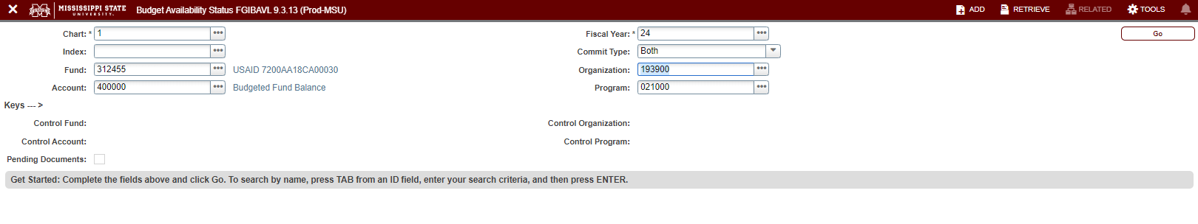
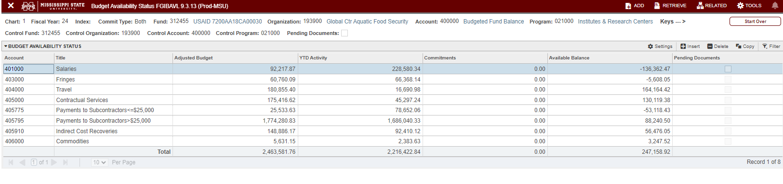
FGIBAVL – Budget Availability Status
Notes:
AM
By using FGIBAVL, you can get a quick screenshot of the available balance of your fund. You will enter your fund number and account code 400,000 to include the expense accounts.

Slide 14
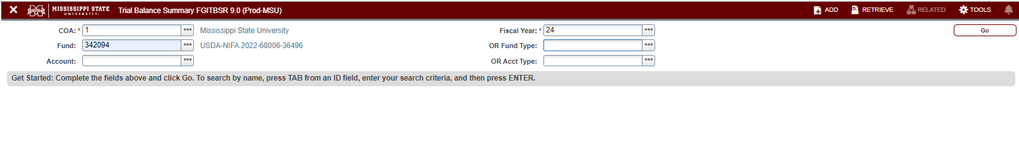
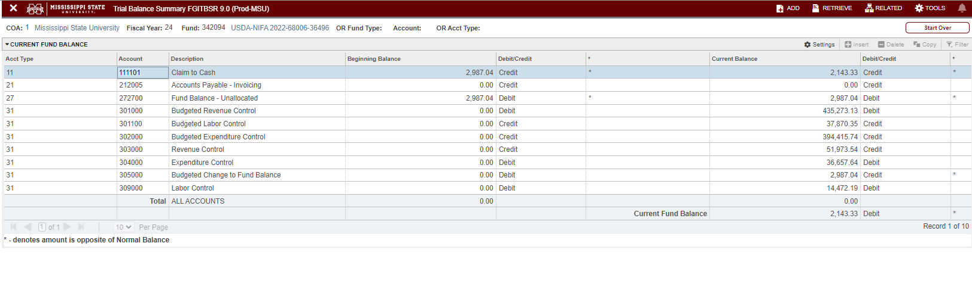
FGITBSR - Trial Balance Summary
Notes:
AM
To check that your credits and debits are balanced within a fund, you can run FGITBSR. A trial balance summarizes the transations of a fund and proves the arithmetical accuracy of the books.

Slide 15
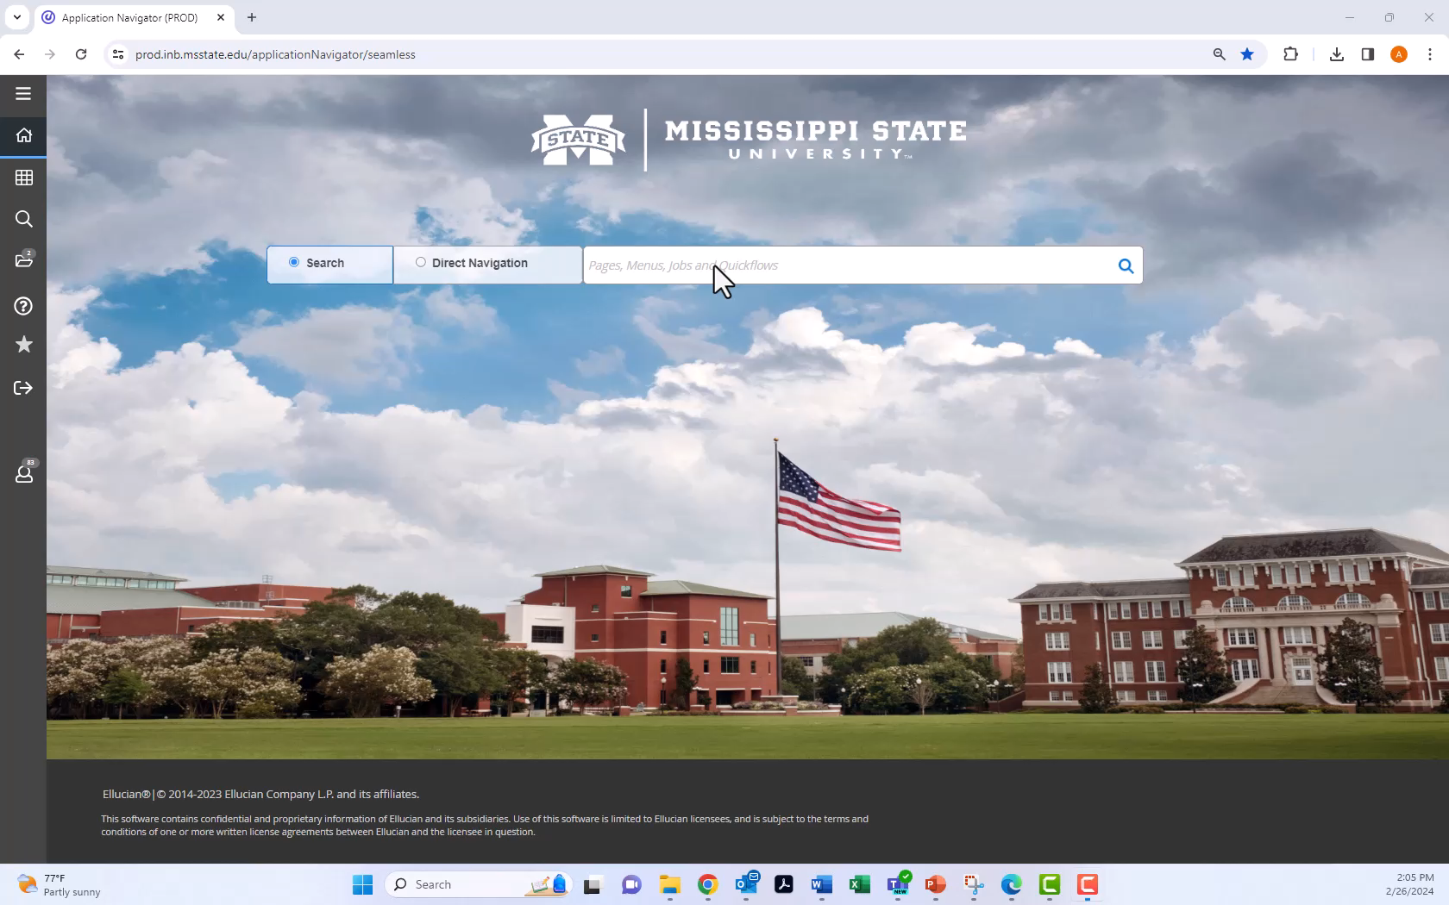
FGITRND - Detail Transaction Activity
Notes:
AM (next slide is JT)
Many of you find yourselves managing large awards. At times, it may be easier for you to sort your general ledger in an Excel file rather than using a PDF version. In this video demonstration, you will see the benefits of using FGITRND. You will search with your fund number but be sure to exclude the org and prog so you will capture all activity related to the fund. You will be able to query by account type seen here by filtering using the revenue prefix of 35 and the % sign as your wildcard. Hit F8 to search. You can see that only revenue-related entries populate. If you need to filter further, hit F7, delete your old filter, enter your new filter, and hit F8. By using YTD in your field box, you will only capture the debits and credits of your fund and not the budget entries. Using the tools button in the top right corner, you can choose to export the data to an Excel file for further data manipulation.

Slide 16
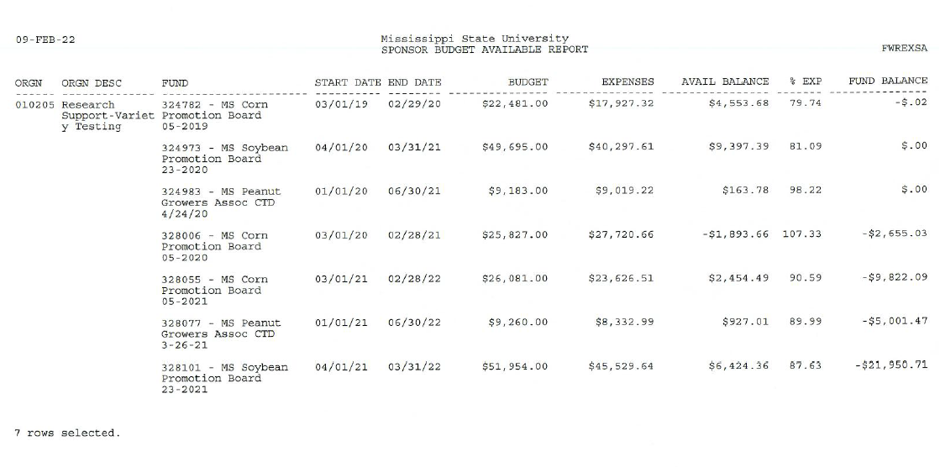
Job Submission FWREXSA – Sponsor Budget Available
Use to quickly view available cumulative expense
& available balances on all restricted funds within your org
Notes:
JT

Slide 17
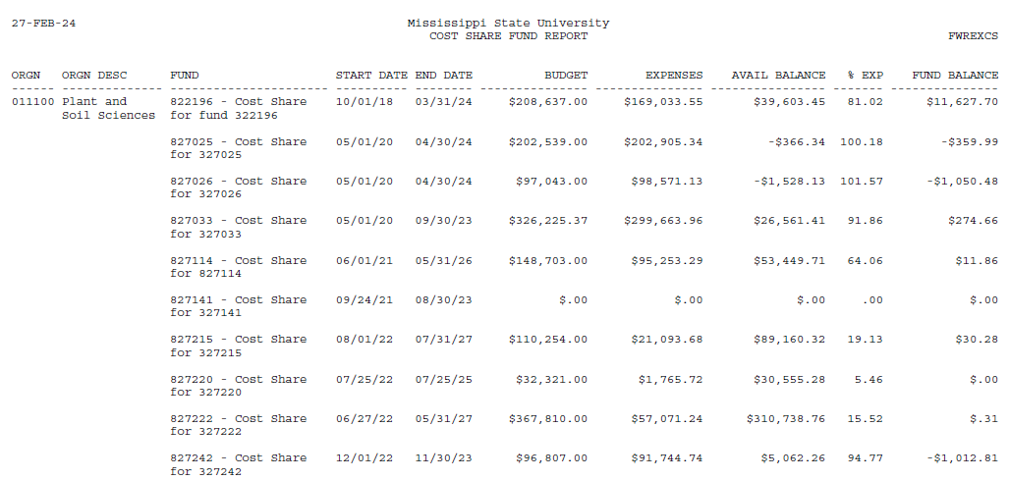
Job Submission FWREXCS – Cost Share Fund Report
Use to quickly view available cumulative expense
& available balances on all cost share funds within your org
Notes:
JT

Slide 18
WHAT IS XTENDER?
Xtender is an electronic document filing system.
Notes:
JT

Slide 19
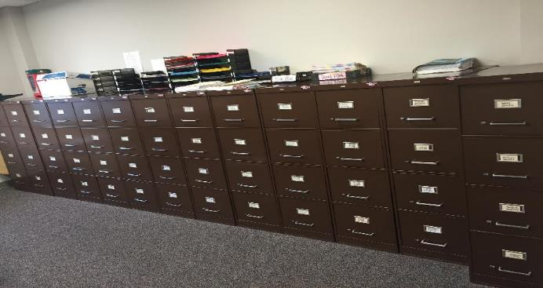
Xtender has helped our office transfer this….
Notes:
JT

Slide 20

To this
Notes:
JT (next slide is AM)

Slide 21
How to access Xtender?
BANNER FORMS
  FRAGRNT
    Award agreements
    Subcontract agreements
    Invoices submitted to our sponsors
    Subcontract invoices received from our subrecipients
  FGIDOCR
    Journal Vouchers w/ backup documentation
  **All SPA documents can be exported in pdf format**
Notes:
AM
Xtender can be accessed from two different Banner screens depending on what information you are wanting to extract. Using FRAGRNT, you have access to award and subaward agreements and invoices. Using FGIOCR, you have access to journal vouchers and backup documentation. These documents can be exported in PDF format.

Slide 22

Xtender via FRAGRNT
Notes:
AM
In Banner, this video demo walks you through accessing Xtender through FRAGRNT. Enter your grant number in the top left corner and click the Xtender button just below. You can sort by document type by clicking on the top ribbon. If you are searching on a large award, you might want to use the breadcrumbs to further tease out the information you need. Using the dropdown box, select the document type you are researching and click search. This will further narrow down the documents you need.

Slide 23
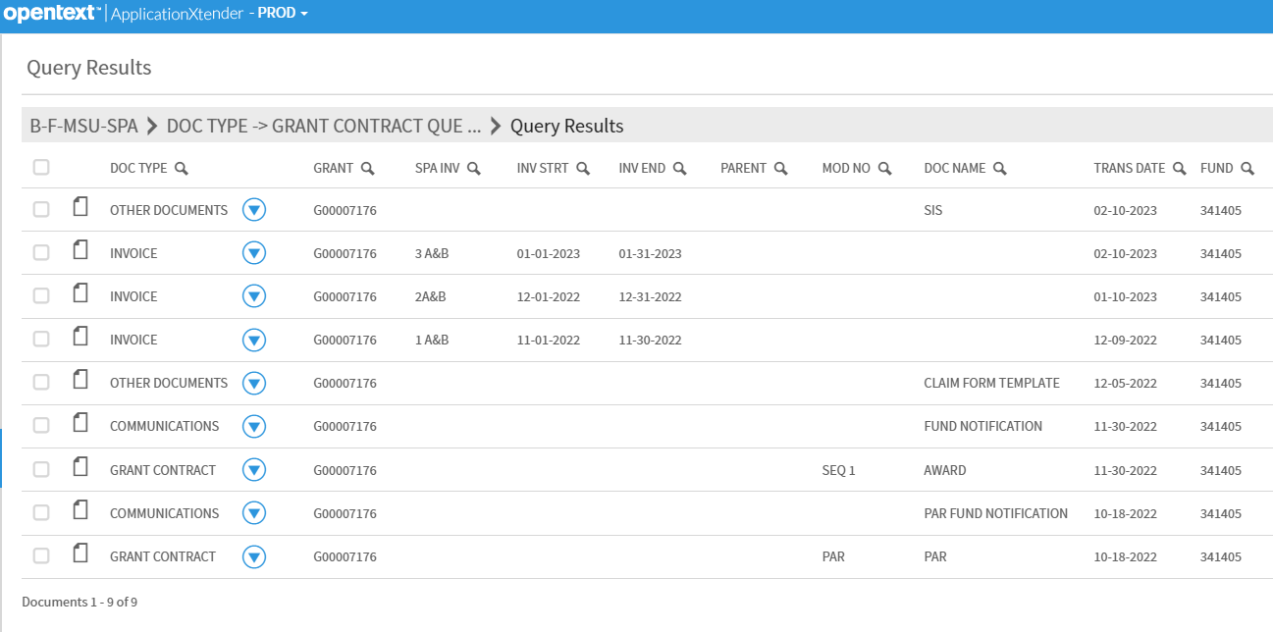
XTENDER – AWARD ACCESS
Notes:
AM
Award agreements can be found under the grant contract document type. For G7176, that document is third from the bottom. By clicking the document icon, you can view the document within Xtender.

Slide 24
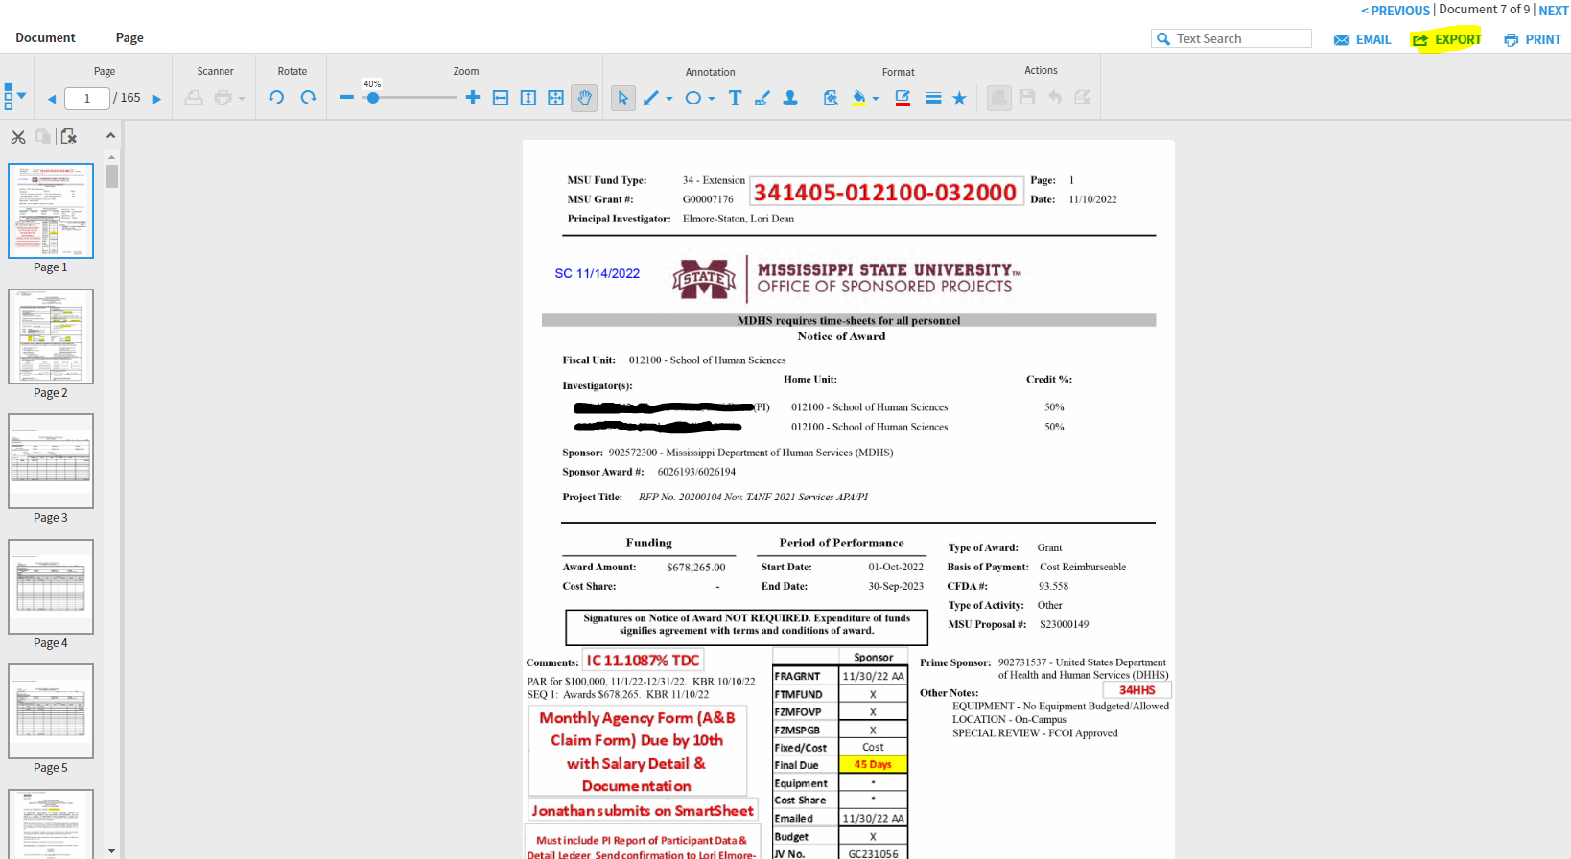
XTENDER – AWARD ACCESS
Notes:
AM
To open the document in Adobe, click the export button on the top right corner.

Slide 25
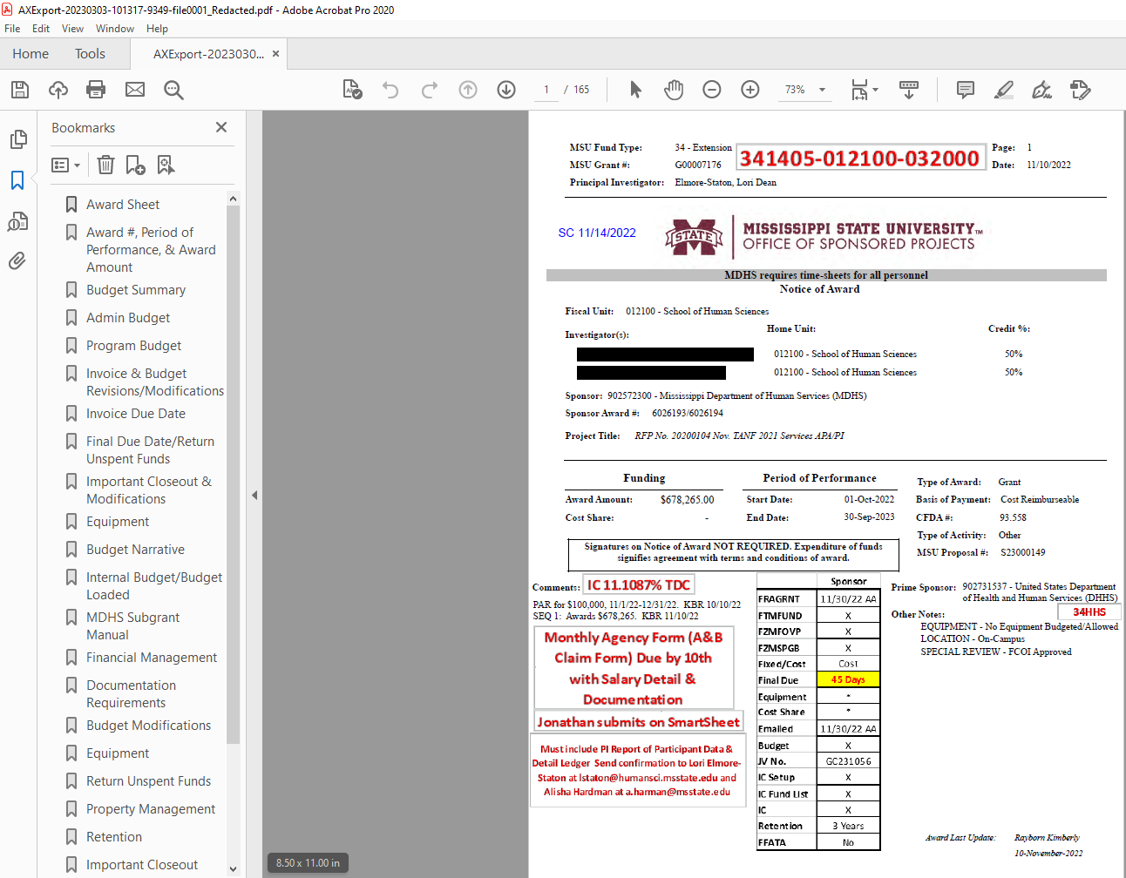
XTENDER – AWARD ACCESS
Notes:
AM
Depending on how you are viewing the document, this setup may look a little different. You can use the bookmark functions to easily identify pertinent information that our seniors noted such as the budget narrative, equipment stipulations, and invoicing requirements.

Slide 26

Xtender via FOIDOCR
Notes:
AM (next slide is JT)
You can also access journal vouchers and supporting documentation through FOIDOCR. Search by document number and hit the Xtender button below in the left-hand screen. To open the document in Adobe, click the export button on the top right corner. Depending on how you are viewing the document, this setup may look a little different. You can use the bookmark functions to sort through supporting documents.

Slide 27
MOST COMMONLY USED SPA FORMS
THE TYPE OF ENTRY BEING COMPLETED DETERMINES WHICH FORM TO USE
INTERDEPARTMENTAL JOURNAL VOUCHER – Used for interdepartmental transactions, to correct ORG and/or Program errors, or to reclassify account codes
COST TRANSFER FORMS – Used to transfer an expense from one fund to another (i.e., 2 or more fund must be involved with this entry)
BUDGET TRANSFER REQUEST – Used to transfer budget and/or revenue from one fund to another (Cost Share, Tuition, overruns, etc.)
RESTRICTED FUND BUDGET REVISION – Used to revise restricted budgets; to reallocate funds between budget line items (Sponsor Approval May Be Required)
Notes:
JT

Slide 28
MOST COMMONLY USED SPA FORMS
COMMON MISTAKES
INTERDEPARTMENTAL JOURNAL VOUCHER
  Lack of supporting backup
  Debits / Credits backwards
BUDGET TRANSFER REQUEST
  Incorrect transfer codes
Is the entry related to cost share?
Is the entry between fund types or within fund types?
Notes:
JT

Slide 29
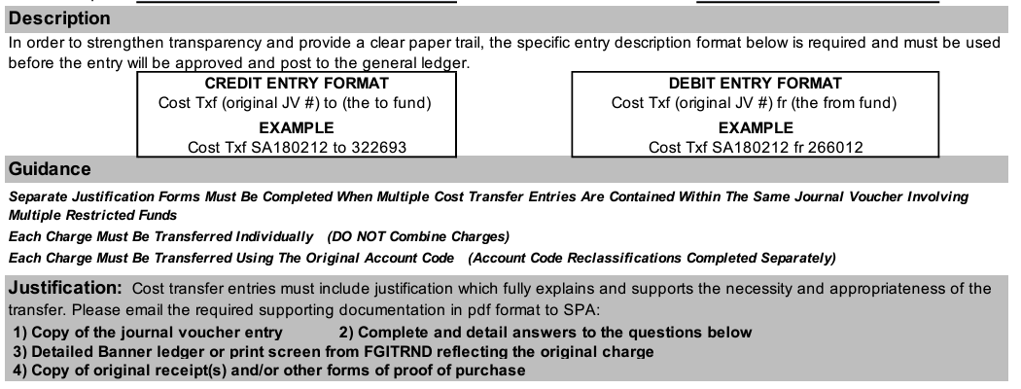
MOST COMMONLY USED SPA FORMS
COMMON MISTAKES
JUSTIFICATION FOR SPONSORED PROJECT COST TRANSFER
  Incorrect description format
  Lack of required supporting documentation
  Insufficient answers to questions
Notes:
JT (next slide is AM)

Slide 30
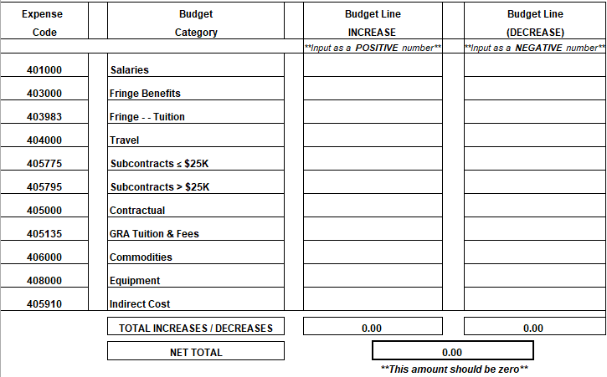
MOST COMMONLY USED SPA FORMS
COMMON MISTAKES
RESTRICTED FUND BUDGET REVISION
  Increase / Decrease columns must balance (Net Total must equal $0)
  Incorrect IC
Notes:
AM
Many of you are familiar with our restricted fund budget revision form. The two most common errors we see are the increase and decrease columns are not balanced and the IC calculation being incorrect.

Slide 31
Indirect (Facilities & Administrative (F&A)) Costs
§200.56 Indirect (F&A) costs means those costs incurred for a common or joint purpose benefitting more than one cost objective, and not readily assignable to the cost objectives specifically benefitted, without effort disproportionate to the results achieved.
Expenditure types not subject to F&A
Tuition
Equipment
Subcontract expenses in excess of $25K
Lease, Utilities & Maintenance - LUM
Participant Costs
Notes:
AM
Uniform Guidance or 2 CFR section 200.56 is written to provide the framework on how grants should be managed financially. Indirect costs are costs that are incurred for a common or joint purpose benefitting more than one cost objective, and not readily assignable to the cost objectives specifically benefitted. You will hear this called IC, Indirect Costs, Facilities and Administration, and F&A. All are interchangeable. The most common expenditures that are not subject to IC are Tuition, Equipment, Subcontract expenses above $25K,
Lease, Utilities & Maintenance – LUM, and Participant Costs.

Slide 32
CALCULATING INDIRECT COST
Example #1 – Re-budgeting $1000 from Contractual to Equipment
$ 1,000 | / | 1.455 | = | $ 687.29 | Direct Cost
$ 1,000 | - | $687.29 | = | $ 312.71 | Indirect Cost
CONTRACTUAL | $ (687.29)
INDIRECT COSTS | $ (312.71)
EQUIPMENT | $ 1,000.00
Notes:
AM
I mentioned two slides earlier that we commonly see IC calculation errors when we are doing a budget revision between one fund. Let’s look at an example. In this first example, we are moving $1000 from contractual to equipment. Are we increasing or decreasing IC? Decreasing, correct! To calculate how much IC will need to move is a two-step process. We will take our re-budgeting amount of $1000 and divide by 1. IC RATE to find our direct cost. We will take our re-budgeting amount of $1000 and subtract the direct cost to find our indirect cost. On the bottom of the screen, you have an example of what your entry would be on the restricted fund budget revision form.

Slide 33
CALCULATING INDIRECT COST
Example #2 – Re-budgeting $1000 from Equipment to Commodities
$ 1,000 | / | 1.455 | = | $ 687.29 | Direct Cost
$ 1,000 | - | $687.29 | = | $ 312.71 | Indirect Cost
COMMODITIES | $ 687.29
INDIRECT COSTS | $ 312.71
EQUIPMENT | $ (1,000.00)
Notes:
AM
In this second example, we are moving $1000 from equipment to commodities. Are we increasing or decreasing IC? Increasing, correct! To calculate how much IC will need to move is a two-step process. We will take our re-budgeting amount of $1000 and divide by 1. IC RATE to find our direct cost. We will take our re-budgeting amount of $1000 and subtract the direct cost to find our indirect cost. On the bottom of the screen, you have an example of what your entry would be on the restricted fund budget revision form.

Slide 34
Policies Related to Restricted Funds
OP 61.05 – FIXED PRICE AND RESIDUAL BALANCE
OP 61.06 – COST TRANSFER
OP 70.08 - TIME AND EFFORT REPORTING
Notes:
AM
If you thought a few math problems were all the excitement you were going to experience today, do I have news for you. Let’s talk about everyone’s topic, POLICY!

Slide 35
OP 61.05 – FIXED PRICE AND RESIDUAL BALANCE
Fixed Price projects are characterized by payments of predetermined amounts by a sponsor to support a project.
Payment for a Fixed Price project is based on successfully providing the goods or services agreed to in the contract.
The contract amount is not adjusted when it actually costs more or costs less to complete the project than the price initially agreed upon.
Such agreements are subject to the same policies and procedures that apply to all sponsored projects.
Fixed Price terms do not eliminate the need to follow cost accounting principles.
As with all other types of sponsored projects, all direct costs incurred as a result of performing the Scope of Work must be expensed directly to the project
Notes:
AM
When you hear fixed price, you should think predetermined payment amounts. These payment amounts are linked to a good or service that we are providing as stated in the award agreement.

Slide 36
OP 61.05 – FIXED PRICE AND RESIDUAL BALANCE
A residual balance is a result of money remaining in a fund after a Fixed Price project has been completed, all bills have been paid, and all payments have been received from the sponsor.
If the project has not been completed by the expiration date, a no-cost extension should be requested by the department’s Office of Sponsored Projects Administrator.
A no-cost extension may also be requested to provide additional research services to the sponsor using the remaining residual funds.
Notes:
AM
Residual balances are the sum of funding remaining after all deliverables from the fixed price agreement have been met. If you are in that a residual balance, it is often best to work with OSP to request a no-cost extension.

Slide 37
OP 61.05 – FIXED PRICE AND RESIDUAL BALANCE
In the event a residual balance exists at the end of the project, Sponsored Programs Accounting will recover 100% of the Facilities and Administrative (F&A) costs up to the federally negotiated rate, based on the budgeted direct costs
If a residual balance still exists after the F&A recovery is posted, Sponsored Programs Accounting will contact the Budget Manager and/or PI to certify total expenditures and to identify the fund to which the residual balance should be transferred by completion of a Certification of Expenditures form (COE).
If a fund is not identified within 45 calendar days of Sponsored Programs Accounting’s COE request, a second request will be sent.
If a fund is not identified within 90 calendar days of Sponsored Programs Accounting’s initial COE request, the residual balance may be appropriated by the university and used for other institutional needs.
Notes:
AM
If you can’t get an NCE and are left with a residual balance, then SPA is going to recover 100% of the Facilities and Administrative (F&A) costs up to the federally negotiated rate, based on the budgeted direct costs. If any funds should remain, we will contact the budget manager to complete a certification of expenditures. Please have this signed COE back to us within 90 days.

Slide 38
OP 61.05 – FIXED PRICE AND RESIDUAL BALANCE
If the residual balance, after the F&A has been recovered up to the federally negotiated rate, is greater than 25% of the award amount at the end of the project, the PI must provide Sponsored Programs Accounting written justification that has been approved by the appropriate Vice President.
Any residual balance greater than 25% that cannot be adequately justified is subject to having the excess over 25% being transferred to the appropriate Vice President.
In the event of cost overruns, such costs will be assumed by the department.
Notes:
AM (NEXT SLIDE JT)

Slide 39
OP 61.06 – COST TRANSFER
A Cost Transfer is the reassignment (transfer) of a previous expense from one fund to another. Cost Transfers can include salary and non-salary expenditures. Examples include, but are not limited to the following:
Transfer of pre-award costs (Request a PAR when applicable)
Correction of clerical errors
Reallocation of effort and other non-labor expenses where multiple projects benefited
Routine allocation of shared services
Notes:
JT

Slide 40
OP 61.06 – COST TRANSFER
Types of Cost Transfers Not Allowable
Cost transfers to other sponsored projects for the purpose of eliminating budget overruns and avoiding restrictions. Such cost overruns must be transferred to an appropriate fund to assure that the expenditures are properly recorded for facilities and administrative (F&A) cost development.
Cost transfers to a fund for the sole purpose of expending the remaining balance.
Notes:
JT

Slide 41
OP 61.06 – COST TRANSFER
The manager (department head, Institute or Center Director, etc.) of the organization responsible for the sponsored project fund where the cost or expenditure is being transferred TO is responsible for establishing internal control procedures to ensure the following:
The costs are an appropriate and allowable use of such funds and have a direct benefit to the project
The cost transfer has adequate documentation and justification
The cost transfers are approved by a designated authorized approver for the organization’s funds
The cost transfer is made on a timely basis, i.e., within ninety (90) days, after the initial charge was recorded, and in all cases 30 days prior to the date the final report is due to the sponsor
Notes:
JT

Slide 42
OP 61.06 – COST TRANSFER
The cost transfer has been made in consultation with and has been authorized by the Principal Investigator
Cost Transfer Requests completed to distribute costs must be directly allocable to the project
Notes:
JT

Slide 43
OP 61.06 – COST TRANSFER
All cost transfers must be accompanied by written documentation indicating why the transfer is a necessary and appropriate charge to the project. A detailed explanation is required. An explanation merely stating that the transfer was made “to correct error” or “to transfer to correct project” is not sufficient. If the transfer is more than ninety (90) days since the original posting date or after effort certification, the following additional written documentation is required:
Why the transfer was not submitted in a timelier fashion and what steps will be taken to prevent this type of error from reoccurring in the future.
How does the charge directly benefit the project and is the expense an allocable and allowable cost for this project.
Documentation that changes have been discussed with and authorized by the principal investigator.
Notes:
JT

Slide 44
OP 61.06 – COST TRANSFER
Constant or frequent transfers raise serious questions about their propriety as well as the overall reliability of the accounting system and internal controls. Departments are encouraged to perform a thorough review of expenditures prior to the last 30 days of the project end date. Departments completing an excessive number of cost transfers on a consistent basis may be recommended for a process/internal control review by Internal Audit.
The department with which the charge is affiliated is responsible for appropriately funding any cost transfer that is disallowable due to failure to meet requirements stated above. The department will be held financially responsible if any cost transfer is later disallowed during an audit.
Notes:
JT (NEXT SLIDE IS AM)

Slide 45
OP 80.13 – COST SHARE
Cost share refers to the resources contributed or allocated by the University (including third-party resources) to a sponsored project over and above the support provided by the sponsor of that project.
Restricted Fund = 327376, then Cost Share Fund = 827376
Cost share is a two-prong approach
  Charge expense
  Transfer in revenue to cover the expenses
Cost Share must be timely, proportional, and covered by FY end close
Notes:
AM (next slide is JT)
Cost share refers to the resources contributed or allocated by MSU (including in-kind) to a sponsored project over and above the support provided by the sponsor of that project. Cost share funds are linked to their appropriate restricted fund by beginning with an 8 and sharing the same last 5 digits as the fund number. There is a common misconception that you just add expenses to the cost share fund, but you will need to transfer revenue into the cost share to cover the expenses. Cost share must be timely, proportional to the restricted fund as outlined in the award agreement, and covered by the fiscal year-end close. We do not want to see balances owed at the end of the year.

Slide 46
OP 70.08 - TIME AND EFFORT REPORTING
Types of Funds on Report
All sponsored restricted funds and cost share funds (funds starting with a 3 or 8)
MAFES funds that start with 16 and has a federal criss (activity) code
FWRC funds that start with 17 and has a federal criss (activity) code
MSU-Extension funds that start with 18 and use program codes starting 032, 033, 034, 037 and 038
Frequency and Due Dates
Three times a year for 9 month employee and twice a year for 12 month employees
9 Month Employees
  Fall Semester (Aug 16th – Dec 31st) – Reports Due March 31st
  Spring Semester (Jan 1st – May 15^{th)} – Reports Due August 31st
  Summer Semester (May 16th – August 15th) – Reports November 31st
12 Month Employees
  July 1st – Dec 31st – Reports Due March 31st
  January 1st – June 30th – Reports Due September 28th
Notes:
JT

Slide 47
OP 70.08 - TIME AND EFFORT REPORTING
SPA will send email reminders advising departments when to run the report
Each department should assign a T&E Coordinator to facilitate this process
It is strongly encouraged that the individual employee certify their own effort
If the employee is no longer available, the PI or responsible official with first-hand knowledge of the work performed will review and certify
The departmental T&E Coordinator should gather all reports and send a scanned version to spaccounting@controller.misstate.edu by the specific due date
Intermittent, hourly retiree, and students are not included on the T&E Report; however, departments are required to keep time sheets for these employees
See Time & Effort Quick Reference Guide in Training Resources section of SPA website
Notes:
JT

Slide 48
OP 70.08 - TIME AND EFFORT REPORTING
The University shall require all Time and Effort Reports to be certified within 90 calendar days of the close of the reporting period.
The completed Time and Effort Report should be submitted to the Sponsored Programs Accounting Office within this time frame.
Effort not certified within 90 days may result in reversal of the charges on the award, jeopardize submission of future proposals, cause a current proposal to be withdrawn, and/or jeopardize the acceptance of future awards.
Notes:
JT

Slide 49
OP 70.08 - TIME AND EFFORT REPORTING
Actual effort should be monitored, and significant changes to estimated effort calculations should be made as soon as they become known.
If at the end of a certification period, the effort percentages reflected on the certification are not a reasonable reflection (5% or less variation from actual) of the employee’s effort, a payroll redistribution should be submitted promptly to the appropriate office.
Once the employee’s effort is correct, the department should reprint the updated Time and Effort Report for certification and include with the department’s report within the 90 day period.
Notes:
JT

Slide 50
OP 70.08 - TIME AND EFFORT REPORTING
In the rare instance it becomes necessary to correct a Time and Effort Report that has already been certified, the departmental administrator must submit the Job Labor Redistribution Form along with a Justification Form explaining the reason for the change and the delay in making the correction.
In addition to the Department Head and Principal Investigator, the Justification Form must also be acknowledged by the appropriate Dean/Director and Vice President and then submitted to the Director of Sponsored Programs Accounting for review and approval.
Once the Job Labor Redistribution Form has been approved and posted in Banner, a new Time and Effort Report for the employee should be produced, certified and sent to spaccounting@controller.misstate.edu
Notes:
JT

Slide 51
OP 70.08 - TIME AND EFFORT REPORTING
Constant or frequent submission of late Time and Effort Reports and Job Labor Redistribution Forms after the Time and Effort Report is certified could raise serious questions about their propriety as well as the overall reliability of the accounting system and internal controls.
A list of departments with late reports or frequent JLRF after effort is certified will be provided to the appropriate Vice President’s Office and Internal Audit
Notes:
JT

Slide 52
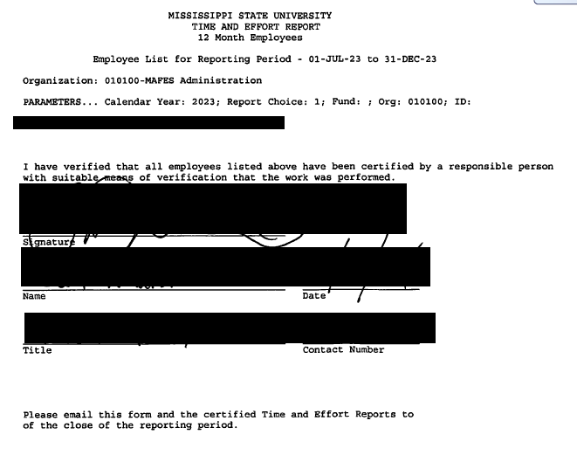
OP 70.08 - TIME AND EFFORT REPORTING
Notes:
JT

Slide 53
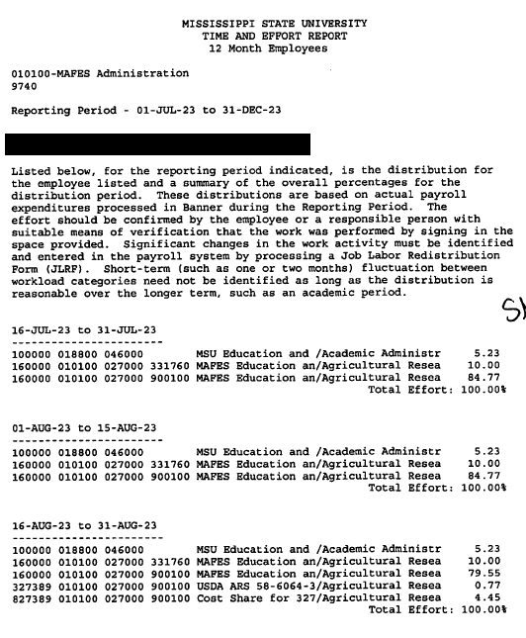
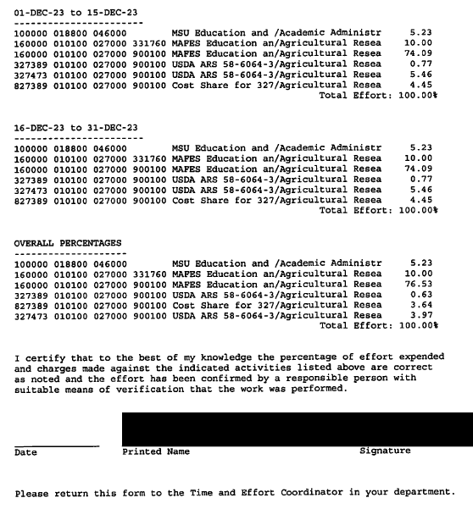
OP 70.08 - TIME AND EFFORT REPORTING
Notes:
JT

Slide 54
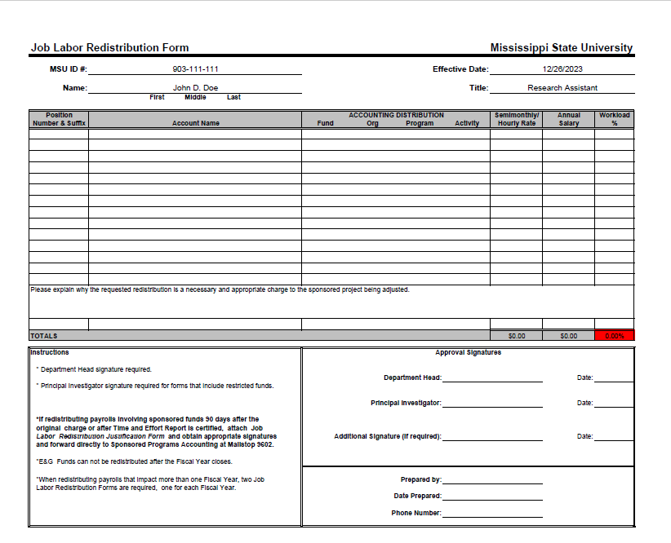
OP 70.08 - TIME AND EFFORT REPORTING
Job Labor Redistribution Form (JLRFs)
JLRF and Justification are required if the effective date is more than 90 days past
Notes:
JT
Please explain why the requested redistribution is a necessary and appropriate charge to the sponsored project being adjusted.

Slide 55
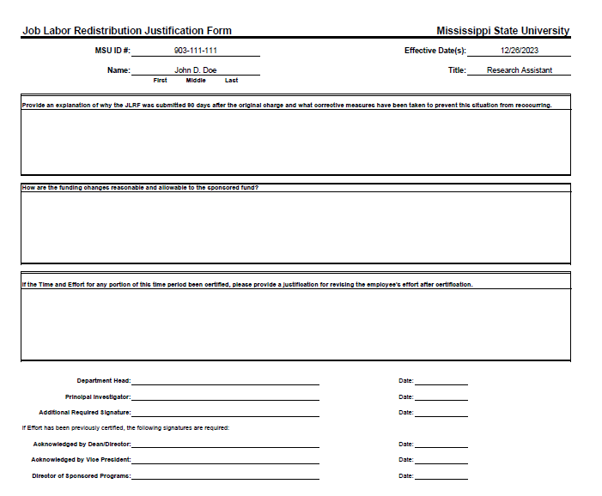
OP 70.08 - TIME AND EFFORT REPORTING
Job Labor Redistribution Form (JLRFs)
JLRF and Justification are required if the effective date is more than 90 days past
Notes:
JT
1) WHY WAS THE JLR SUBMITTED 90 AFTER ORIGINAL CHARGE AND WHAT HAVE YOU IMPLEMENTED TO PREVENT THIS FROMREOCCURRING
2) HOW ARE THE CHANGES REASONABLE AND ALLOWABLE TO THE SPONSORED FUND
3) IF THE ORIGINAL EFFORT HAS BEEN CERTIFIED, PROVIDE A JUSTIFICATION FOR REVISING THE EFFORT
4) DEAN AND VP ACKNOWLEDGMENT

Slide 56

QUESTIONS??

Slide 57
Contact Information
Jonathan Tucker
Phone: 325-1930
Email: jtucker@controller.msstate.edu
Office: 531 McArthur Hall
Anna-Marie Nickels
Phone: 325-6802
Email: anickels@controller.msstate.edu
Office: 431 McArthur Hall

