Slide 1
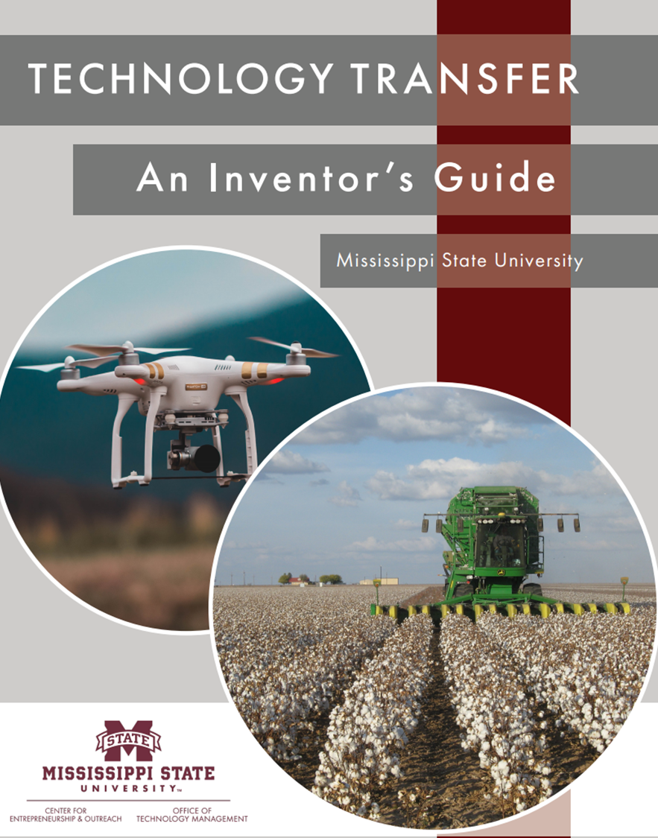
Working With OTM and What to Expect “An Odyssey Into the Unknown”
Sophia Barnett & Austin Check
Office of Technology Management
03/25/2024

Slide 2
Purpose
Overview
MSU Services and Support for Technology Transfer
Business Development and Licensing
Notes:
Increase awareness

Slide 3
Technology Transfer at MSU
Office of Technology Management
Known as “OTM”
Assist with handling intellectual property and licensing at MSU
Center for Entrepreneurship & Outreach
Known as “E-Center”
Assist startups at MSU

Slide 4
Intellectual Property
“a work or invention that is the result of creativity, such as a manuscript or a design, to which one has rights and for which one may apply for a patent, copyright, trademark, etc.”

Slide 5
Qualifications for IP Protection
Copyrights – (1) originality (2) expression (3) fixation
Trademarks – (1) must be in use in commerce or there is a real intent to use (2) must be distinctive
Patents – (1) patentable subject matter (2) utility (3) novelty (4) nonobviousness (5) enablement
Notes:
Originality. The term “originality” refers to the originating source of the work, not to any specific standard of value. For a work to be deemed original, its expression must have originated with the author. It also cannot be copied from any other source.
Expression. The term “expression” is used to limit what is copyrightable as opposed to expanding on it. The Copyright Act specifically states that it protects actual expressions, not the ideas, concepts or procedures that go into these expressions. Therefore, copyright protection only extends to the unique, tangible elements that the author has contributed to the work.
Fixation. The last term “fixation” requires any copyrightable work to be “fixed in a tangible medium of expression.” This means that the work must be in a tangible, permanent state that would allow it to be reproduced or communicated.
Patentable subject matter - defined as any process, machine, manufacture, composition of matter or improvement of matter.
Utility - Patents must be for inventions that are useful. This means the item being patented has a credible, specific and substantial purpose.
Novelty - Novelty means the invention was not known or used by others; that is, it must be new.
Nonobvious - A patent claim is nonobvious if the improvement goes beyond the predictable use of prior art according to its established functions.
Enablement - To meet the enablement requirement, the patent application must include a written description of the item being patented, including the manner and process of making and using it.

Slide 6
Technology Transfer at MSU
Overview of the Technology Transfer Process at MSU
IP Exists

Slide 7
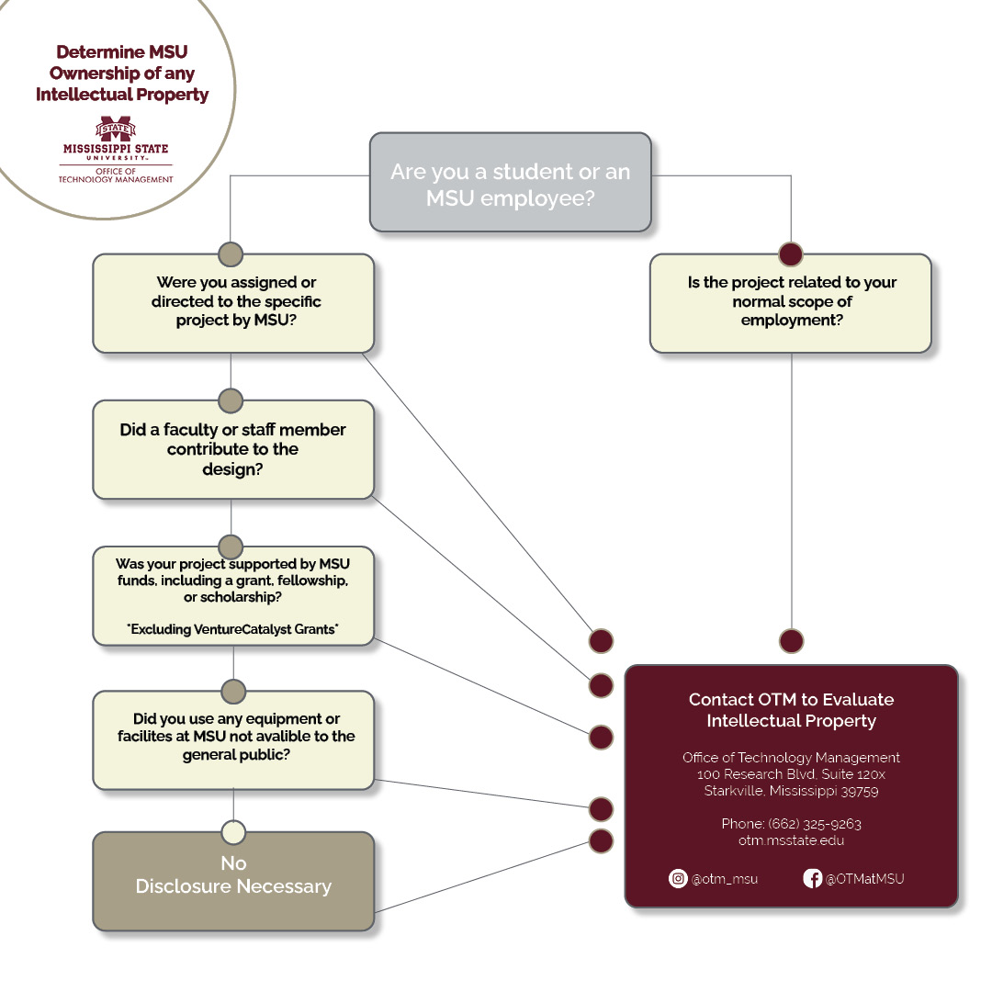
Determining Ownership

Slide 8
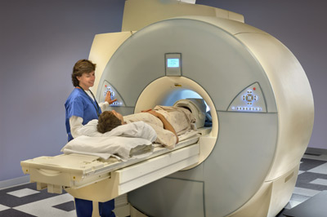
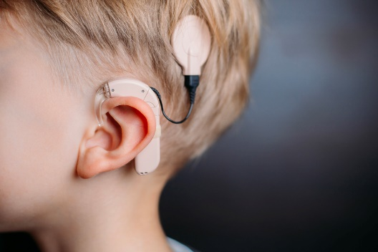
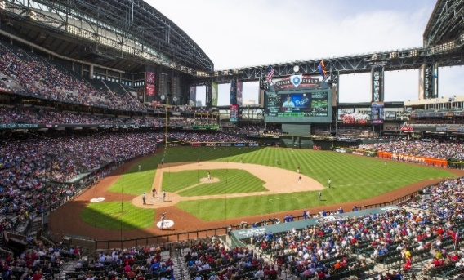
What We Do
Technology Transfer Economic Development
Tech Transfer Services:
Assist with IP Reporting
Federal Bayh-Dole compliance
MSU IP Policy compliance
Assist with IP Protection
Patents
Copyrights
Trademarks
Assist with Collaborations
Material Transfer
Sharing Confidential IP
Assist with Commercialization
Licensing
Start-ups/MURA
5. Other Duties as Assigned
Trying to bring value however we can!!
Notes:
Bayh-Dole Act 1980
Federally sponsored IP
uniform federal IP policy
universities can elect title to federally funded inventions
universities must meet due diligence or risk losing funding
Must share royalties

Slide 9
So, what have we done lately?
New Techs Disclosed: 20 (FY 23)
OTM New Agreements: 58 (so that’s where my time went) (includes licenses, MTAs, NDAs, IP mgt agreements, etc., none are cookie cutter)
Patents filed: 17 (FY 23)
Patents Issued: 13 (FY 23)
Patent expenditures: $173k (FY 23)
Patent reimbursements: $125k (FY 23)
Income: $260k (FY 23)
Other Income/Research $340k (FY 23)

Slide 10
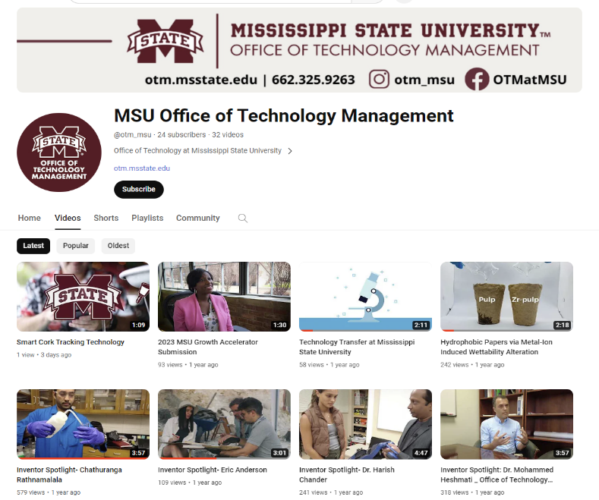
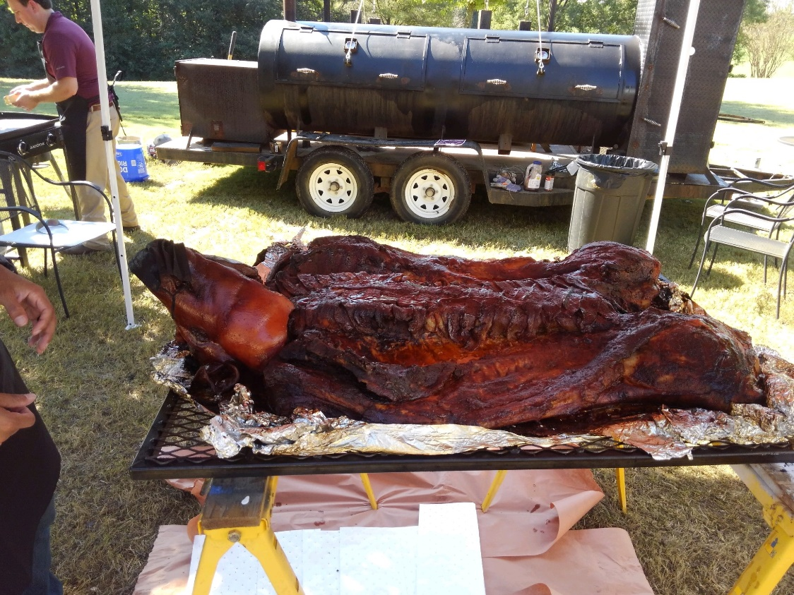
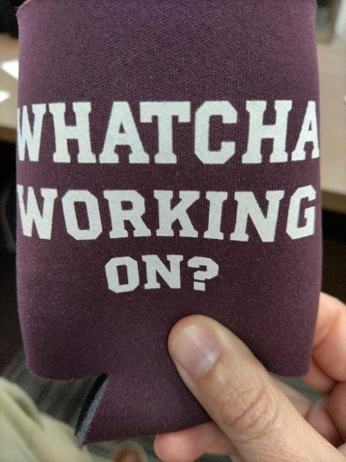
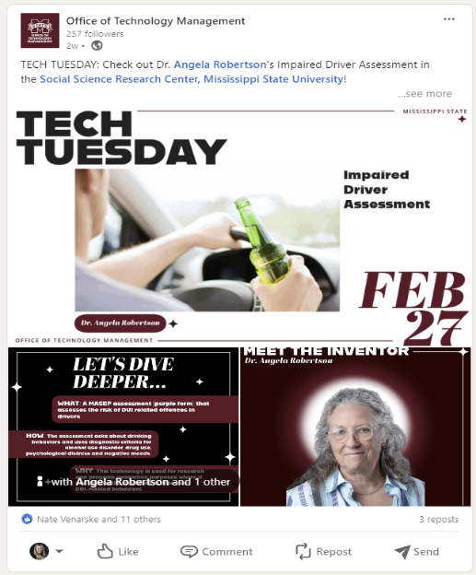
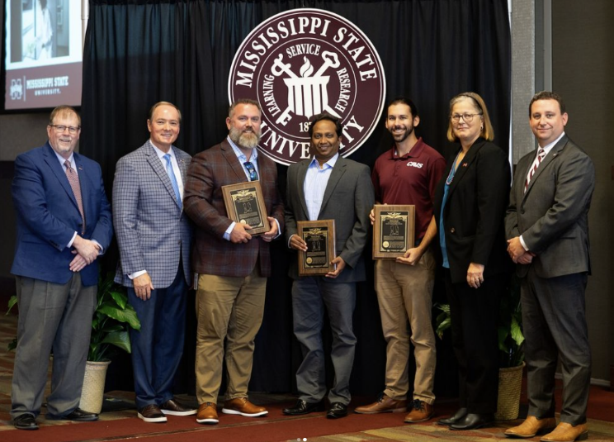
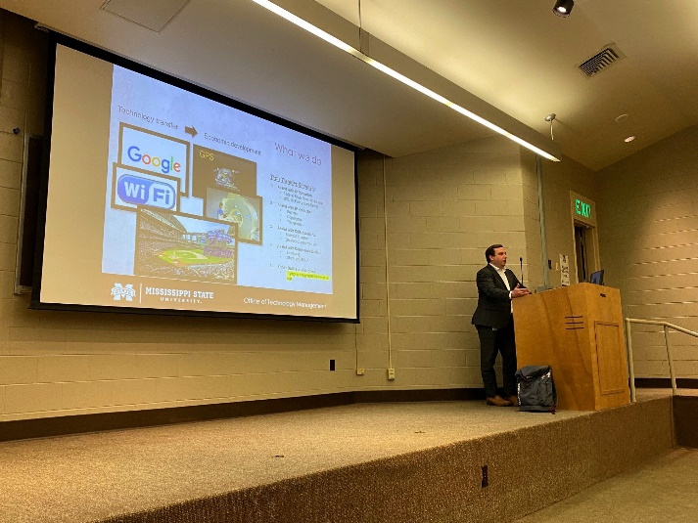
Major Initiatives FY 24
Internal Marketing/In Reach
Notes:
-OTM social media:
> YouTube: Inventor Spotlight, Technology Spotlights
> LinkedIn/Instagram: Tech Tuesdays
-OTM Annual Pig Pickin’
-OTM Merch (Koozies)
-Patent Plaques for our inventors with issued patents
-Internal seminars, classes, and events teaching more about IP

Slide 11
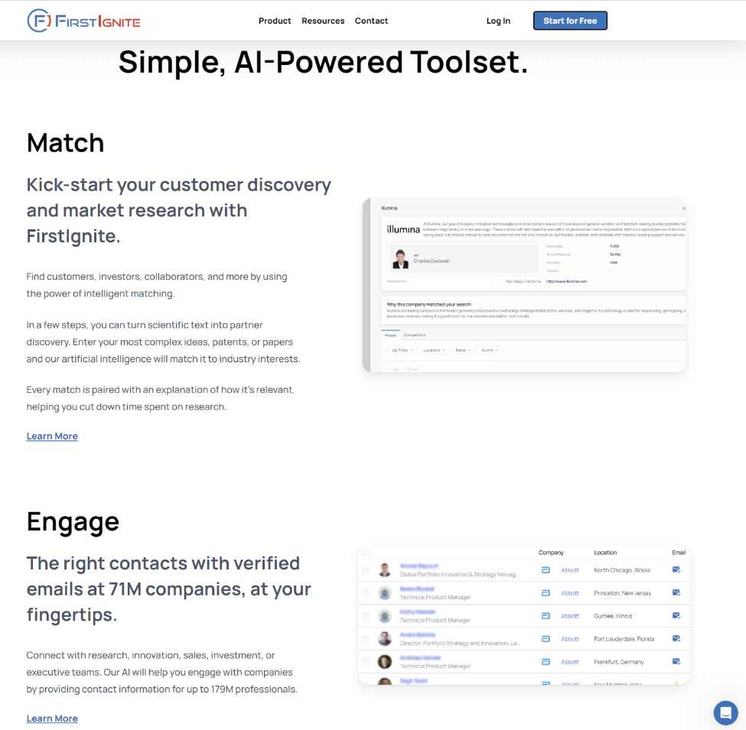
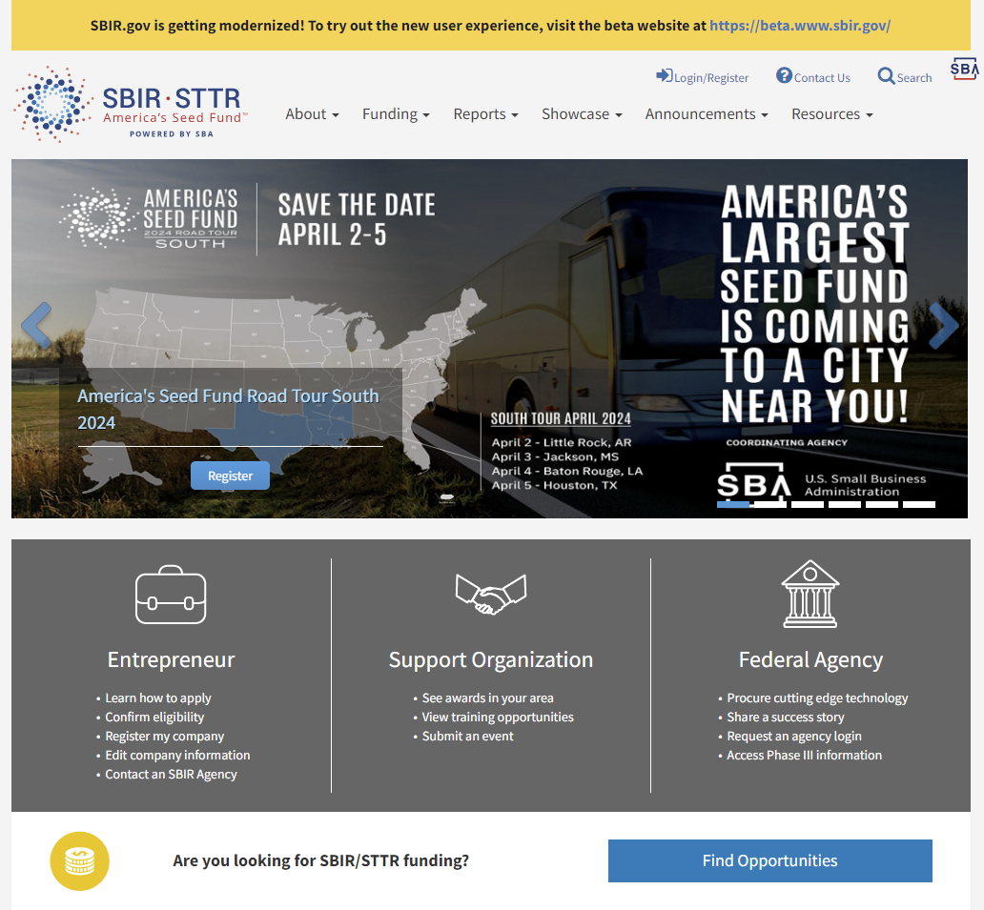
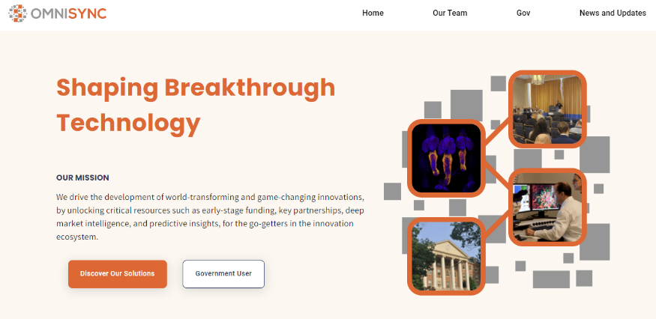
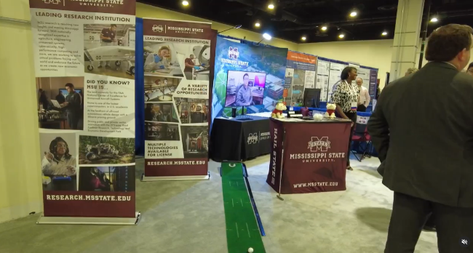
Major Initiatives FY 24
External Marketing/Outreach
Notes:
-FirstIgnite campaigns
-Networking events (connecting MSU employees with industry)
-Omnisync/turboinnovate

Slide 12
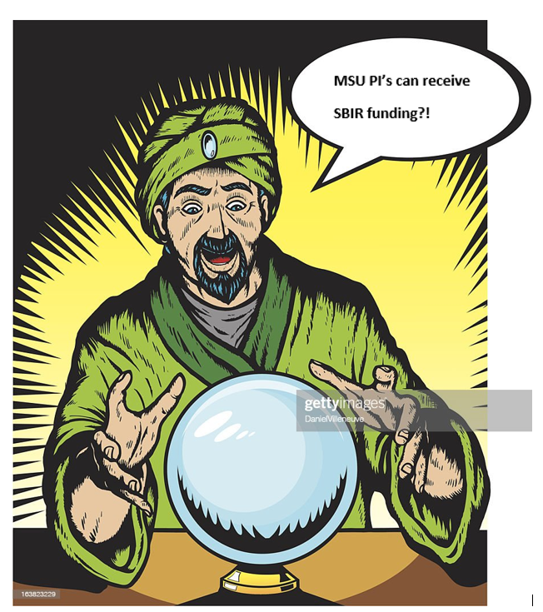
Major Initiatives FY 24
Demystifying SBIR, STTR, and other commercialization funding
ORD, E-Center

Slide 13
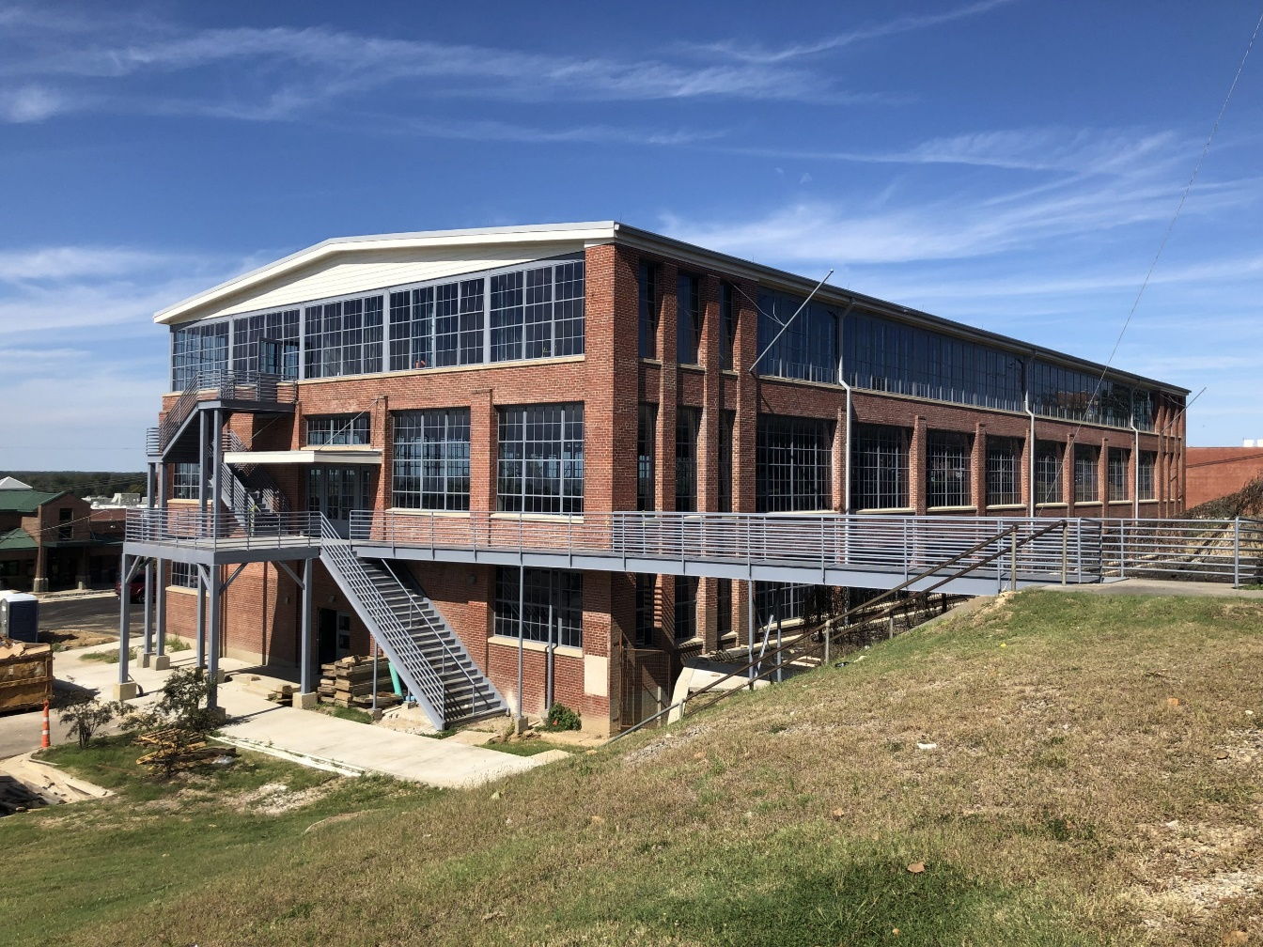
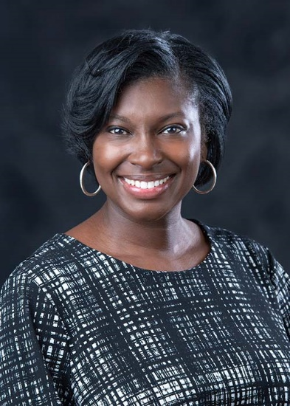
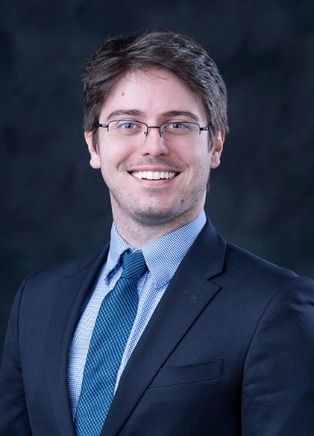
Major Initiatives FY 24
Tasha Bibb
Senior Program Manager
Office of Technology Management
Ryan Gilbrech
Senior Program Manager
Center for Entrepreneurship and Outreach
MCITy/Vicksburg funding
Notes:
-helping grow the city’s technology and start-up sector (growing entrepreneurship presence)

Slide 14
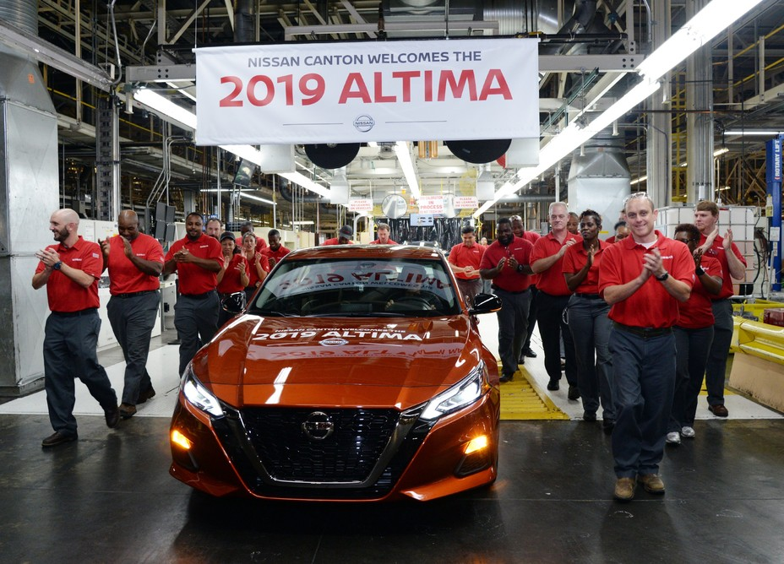
What’s the point of all this?
Stewardship—try to explain value of
basic research to public/political
leaders. . . We need tangible impact
Make a difference in MS—give young people other options to slow brain drain and grow economy

Slide 15
Why should you care?
Researchers participating in tech. transfer and entrepreneurship gain access to funding streams for commercialization– can result in research expenditures that are multiples of original award.

Slide 16
OTM Challenges
Creating a campus culture that values academic entrepreneurship!
Increases research funding for existing faculty
Attracts new faculty
This is slowly changing for the better (rate increasing?)
Statewide efforts with MDA also (hopefully) moving broader culture in a positive direction
Notes:
Bayh-Dole Act 1980
Federally sponsored IP
uniform federal IP policy
universities can elect title to federally funded inventions
universities must meet due diligence or risk losing funding
Must share royalties

Slide 17
How Does OTM Identify Potential Licensees?
Researcher Knowledge
Past Relationships
Passive Marketing
Active Marketing

Slide 18
Meeting with Industry (What to Expect??)
It’s a Buyers Market
What’s the Value vs Current Trends?
Testing and Validation Methods.
Tech Support (Researcher & MSU).
What is the Ask?

Slide 19
Being Prepared
Be Humble
Be Honest
Be Punctual
Accept Feedback (Positive & Negative)
Openness to Pivot
Walking vs Running
Know MSU Supports You!

Slide 20
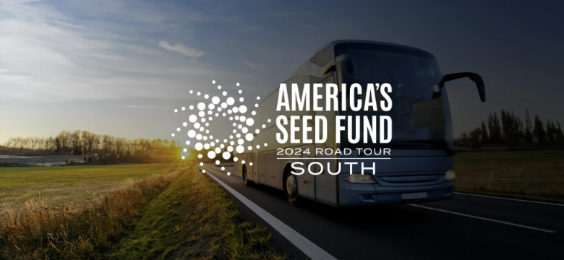
Upcoming Events
April 3, 2024
8:00 AM – 2:00 PM
Located at Jackson State University
****COMPLETELY FREE (lunch included)
America's Seed Fund Road Tour is a national outreach effort to connect innovators and entrepreneurs to non-dilutive, technology funding opportunities provided through the Small Business Innovation Research (SBIR) and Small Business Technology Transfer (STTR) programs, known as "America's Seed Fund". Federal Agency representatives will meet with companies attending the event to help attendees navigate over $4 billion in early-stage funding opportunities available through America's Seed Fund. Register to attend the event to learn more about SBIR/STTR programs from experts!
The agenda will include:
· Overview of America's Seed Fund
· Reverse Pitches from Federal Agency Representatives
· Panels & Presentations (Examples of potential panels include - SBIR/STTR Agency specific panels, proposal support resources & programs, entrepreneur success stories, resources available through STATE FAST and the STATE SBTDC, SBIR/STTR grant matching opportunities, proposal tips and strategies, among other potential topics)
· Opportunity to meet with entrepreneurial support organizations
· One-on-one meetings with Federal Agency Representatives
OTM is providing transportation
Notes:
NOTE: You do not need a small business or small business partner to attend.

Slide 21
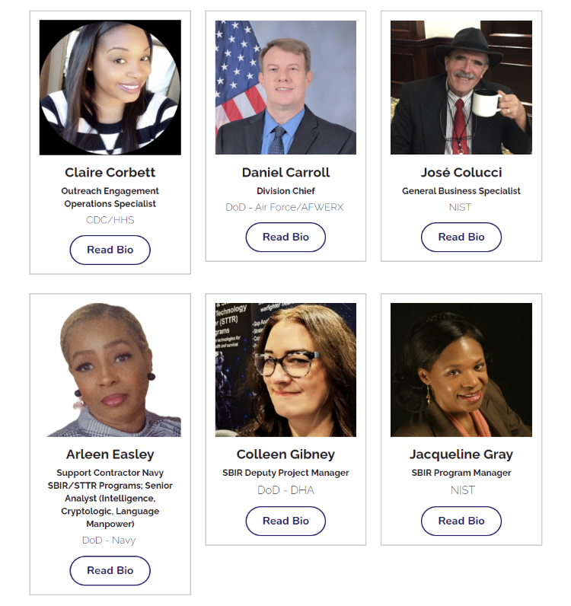
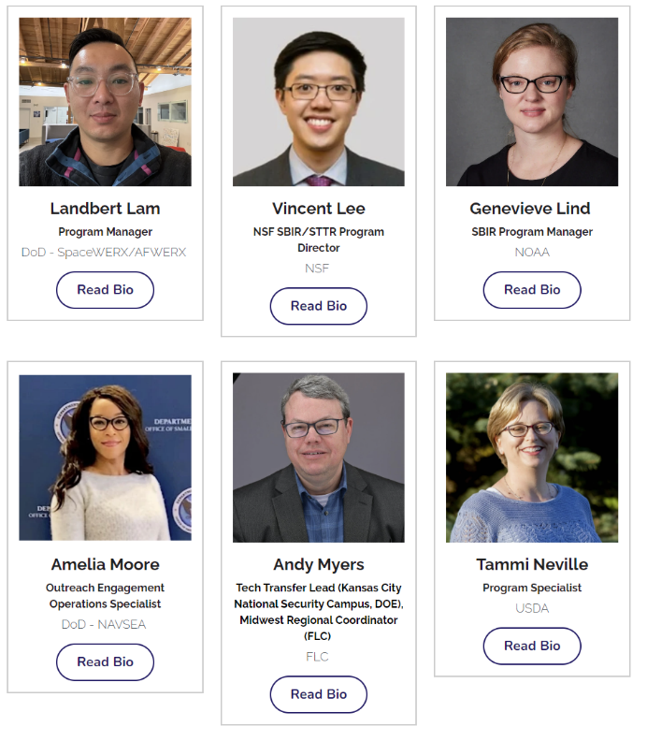
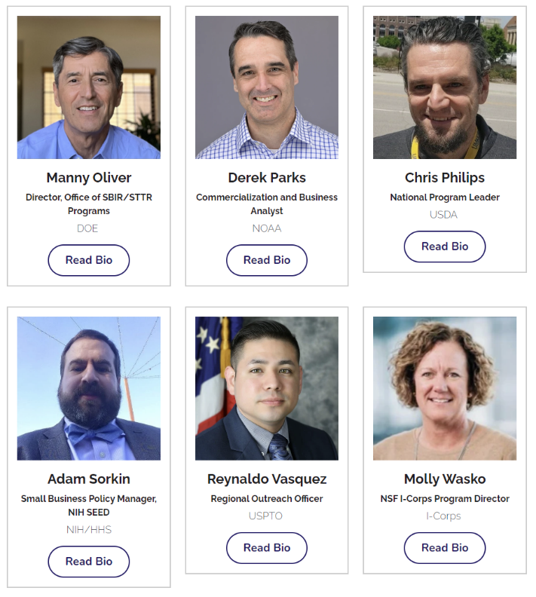
FEDERAL AGENCIES ATTENDING APRIL 3RD EVENT

Slide 22
Any Questions?
Phone: 662-325-9263
Email: office@otm.msstate.edu
Website: otm.msstate.edu
Thank You!!

