Slide 1
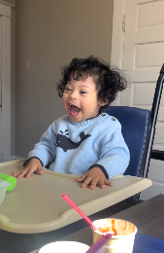
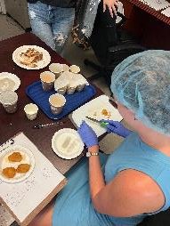
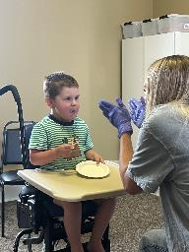
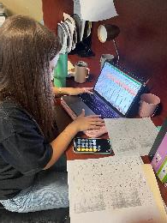
Pediatric Feeding Disorders Lab at Mississippi State University
Hallie M. Smith, Ph.D., BCBA-D, LP

Slide 2
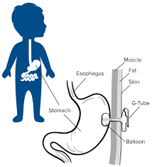
Brief Background on PFD’s

Slide 3
Brief Background on PFD’s
Upwards of 90% of children with Autism Spectrum Disorder (ASD) have feeding problems; majority of those children have food selectivity
Negative medical and social outcomes associated with PFD if not treated

Slide 4
Mission of the Lab
To provide clinical services for individuals with pediatric feeding disorders while generating and disseminating research to further improve outcomes for individuals with pediatric feeding disorders and their families.
Research
Training
Clinical Service to Community

Slide 5
Lab Directors
Dr. Hallie Smith and Dr. Hailey Ripple

Slide 6
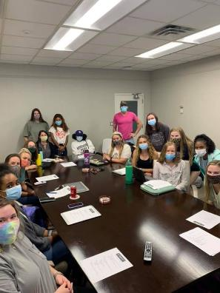
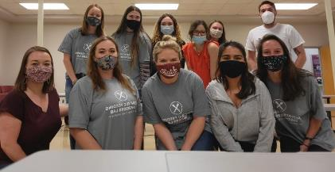
BRIEF History Lesson
Notes:
Total of 58 students have been trained or involved in the lab since January 2021

Slide 7
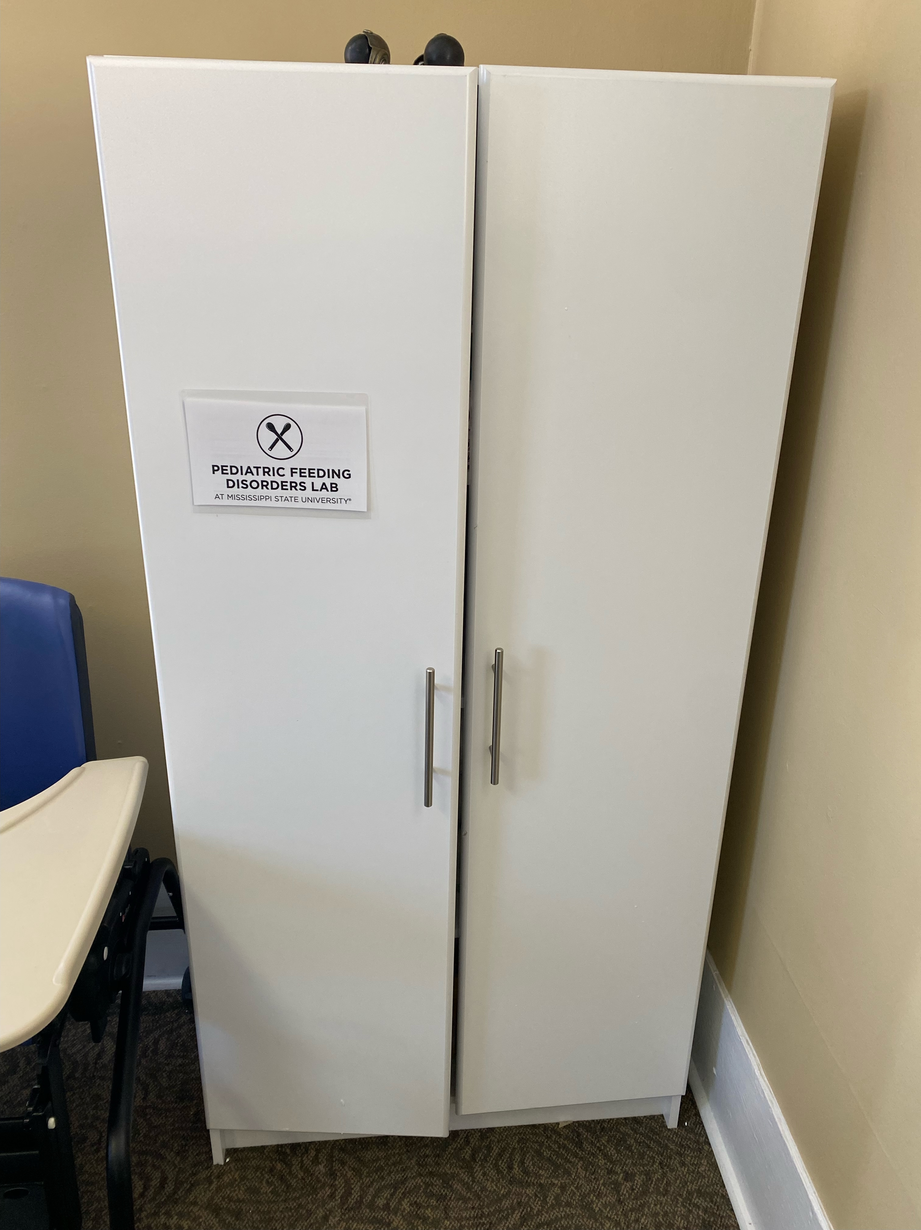
BRIEF History Lesson
Notes:
Total of 58 students have been trained or involved in the lab since January 2021

Slide 8
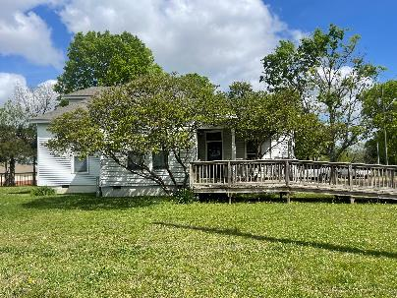
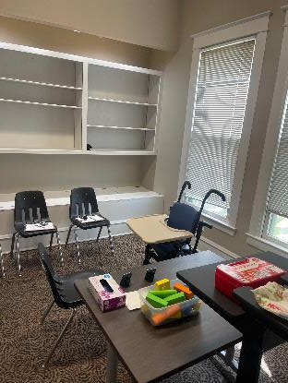
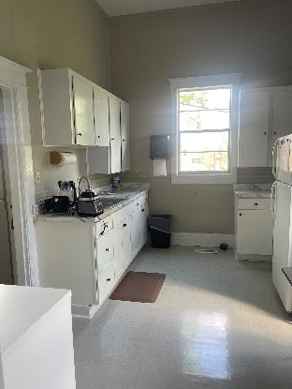
BRIEF History Lesson
Notes:
Total of 58 students have been trained or involved in the lab since January 2021

Slide 9
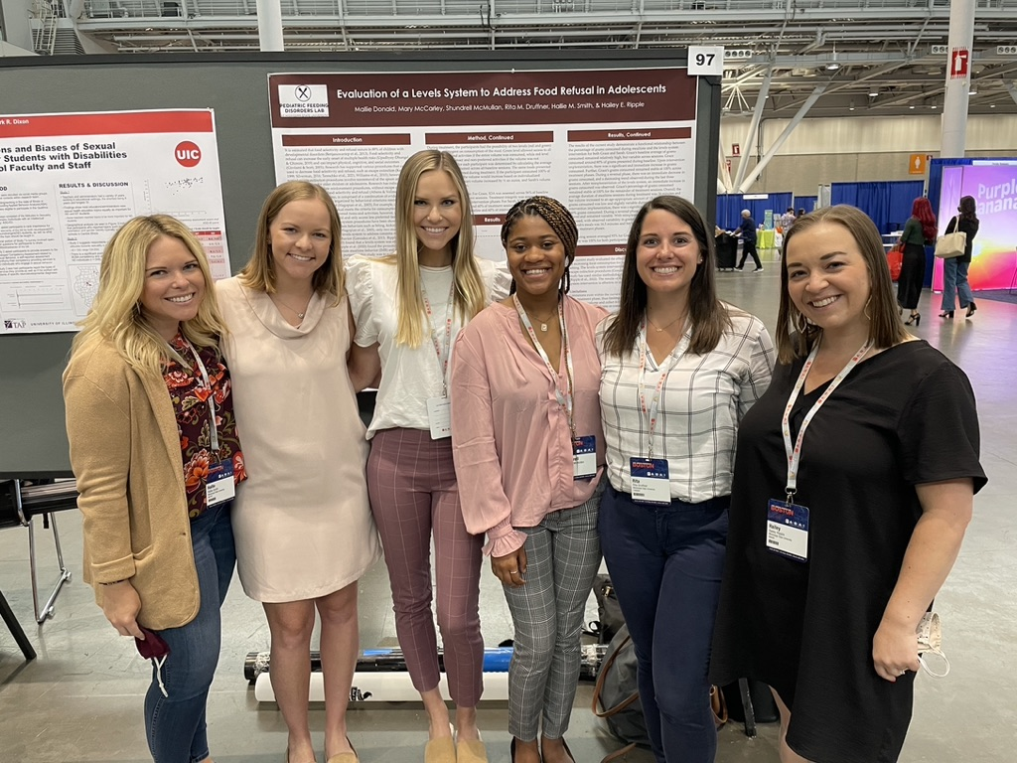
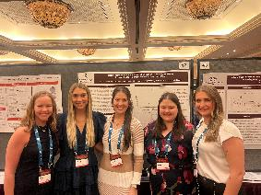
Research Agenda
Evaluate and develop novel approaches to the assessment and treatment of pediatric feeding disorders
Ask questions, get answers, share outcomes
Use of single case design methodology
7 different projects (questions) in the lab
2 dissertations
16 presentations at local, national, and international conferences
Production of 4 different manuscripts for publication

Slide 10
Research Agenda
Increasing Efficiency of Treatment Identification for Pediatric Feeding Problems Through the Development of a Rapid Assessment Tool]
Pilot project funded ($40,000) funded by MCCTR

Slide 11
Training Experiences
Lab consists of undergraduate students as well as graduate students from MSU’s ABA and School Psychology Programs
Current lab membership: 11 graduate students, 5 undergraduate students
Notes:
Total of 58 students have been trained or involved in the lab since January 2021

Slide 12
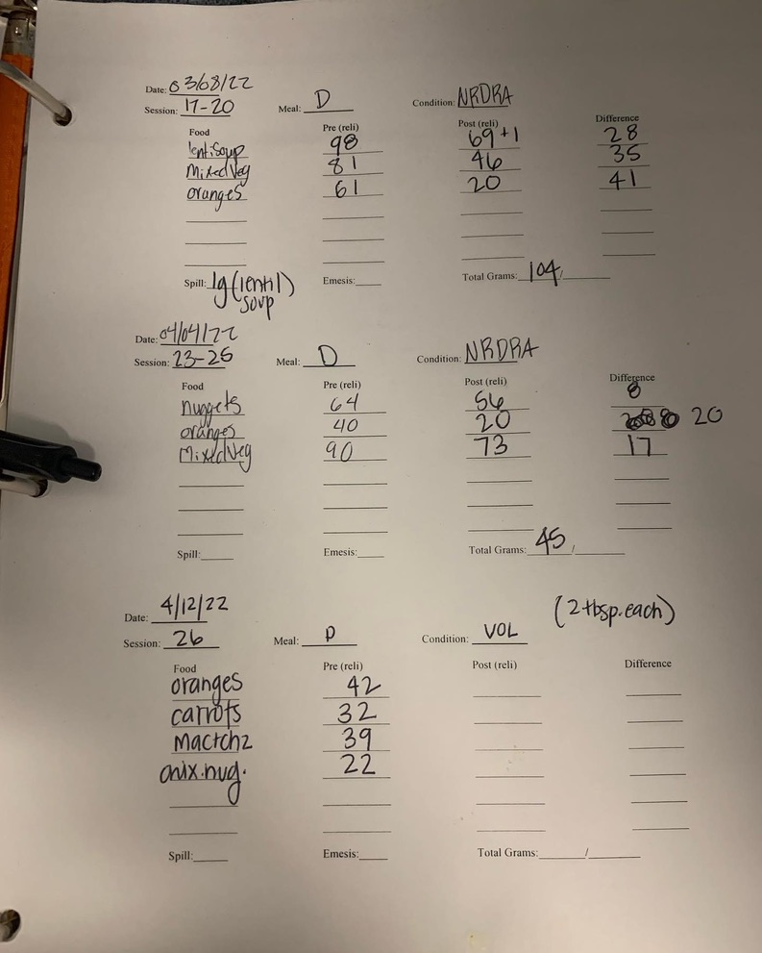
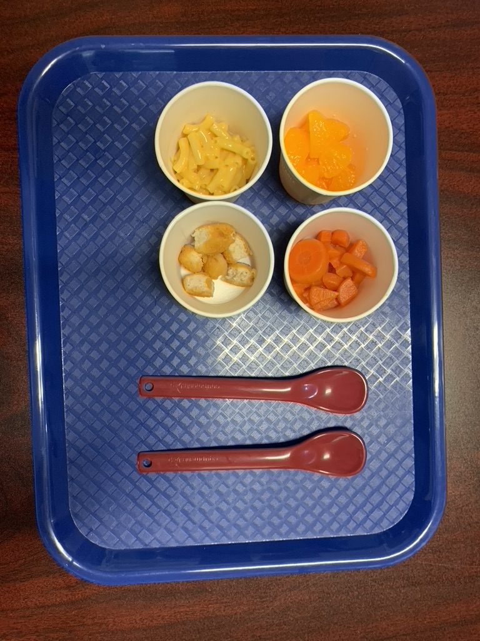
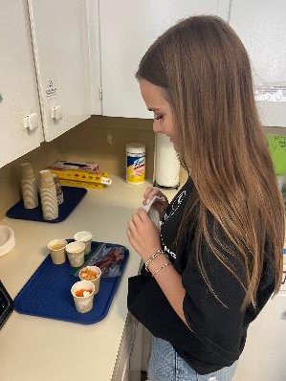
Training Experiences

Slide 13
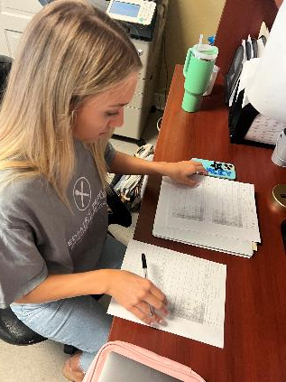
Training Experiences

Slide 14
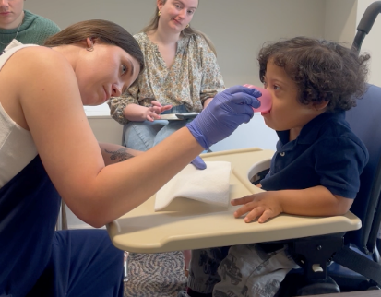
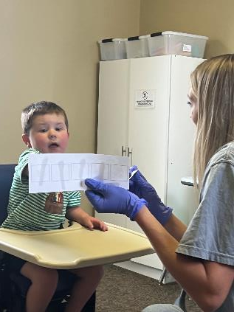
Training Experiences

Slide 15
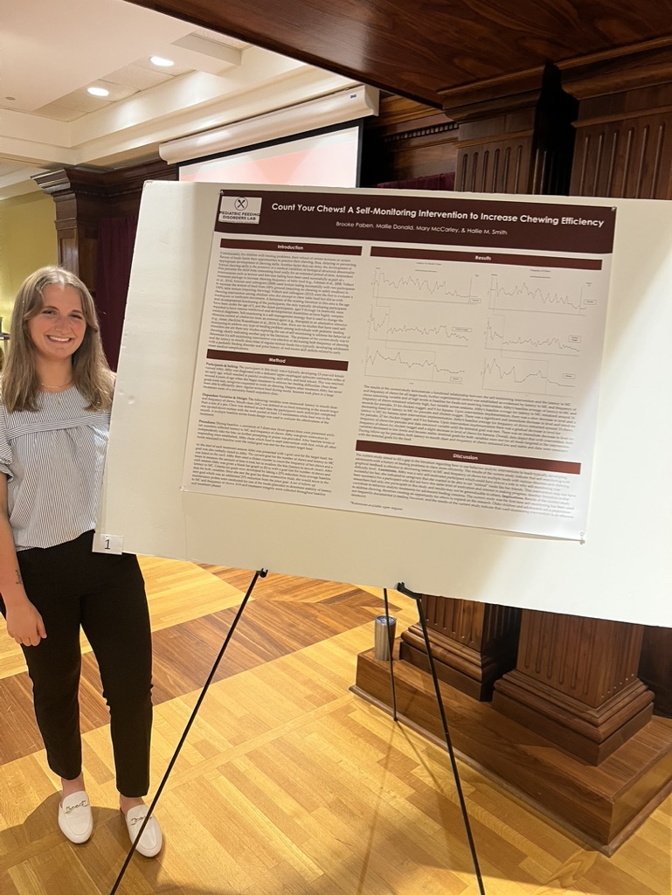
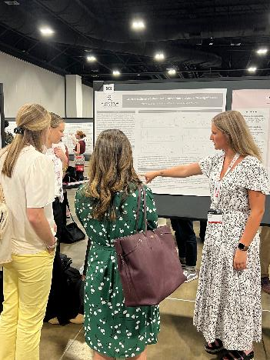
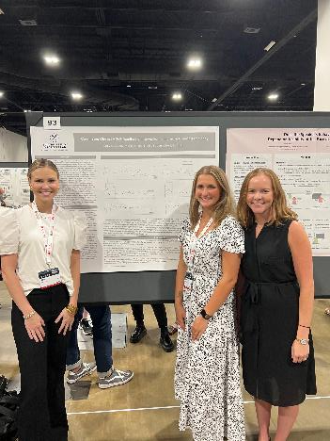
Training Experiences

Slide 16
Hierarchy of Lab Positions
Feeding Aide
Feeding Technician
Feeding Specialist
Feeding Behavior Analyst

Slide 17
Clinical Service to Community
Provided individualized outpatient or intensive outpatient services to 28 different children ranging in age from 2 to 16 years old
Parent Training
Participants have had a variety of diagnoses
ASD
ADHD
Developmental Delay
Down Syndrome

Slide 18
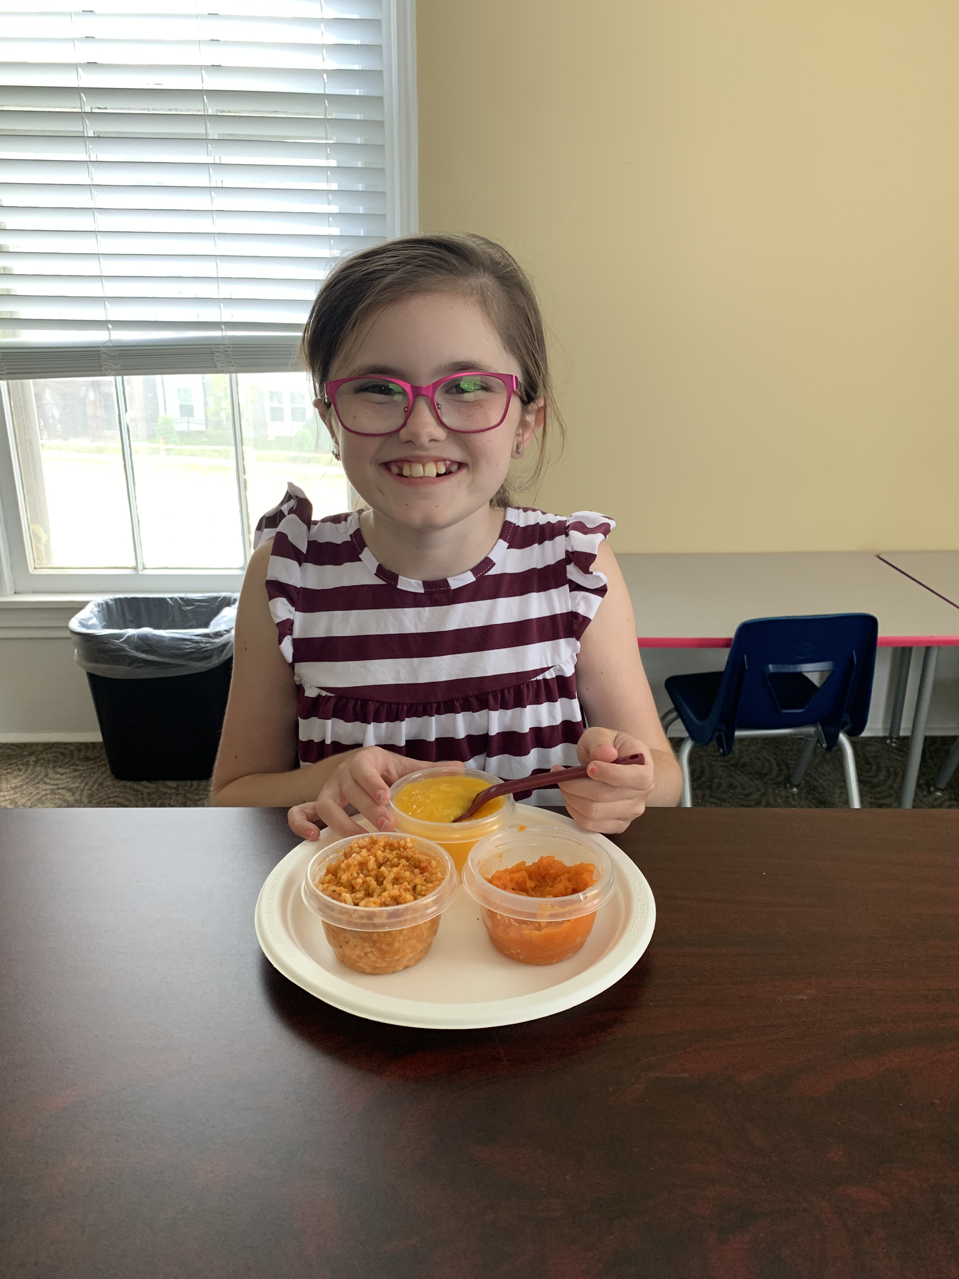
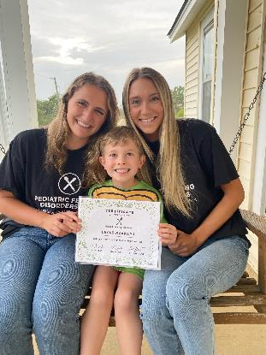
Clinical Service to Community
850 hours of direct service delivery to children and adolescents since January 2021
Funding ($60,000) from Mississippi Council on Developmental Disabilities in April of 2021 to provide clinical services to area of need

Slide 19
Funding Support for Lab
Supportive Department!
Start-Up funds for Tenure Track faculty
GA Support
Mississippi Council on Developmental Disabilities
$60,000
Mississippi Center for Clinical and Translational Research
$40,000
MSU Office of Research & Development
$4,000 for support of undergraduate research
CEU Workshop
$4,000 from revenue

