Slide 2
Mission
To improve the assessment and intervention process for students with developmental disabilities who engage in severe behavior in public-school settings.
Notes:
LEAPS is an acronym that stands for “Lending Expert Assistance to Partnership Schools”. Our mission is to improve the assessment and intervention process for students with developmental disabilities who engage in severe behavior in public-school settings, and we’ve received funding for the past several years from the MS Council on Developmental Disabilities to help accomplish that mission.

Slide 3
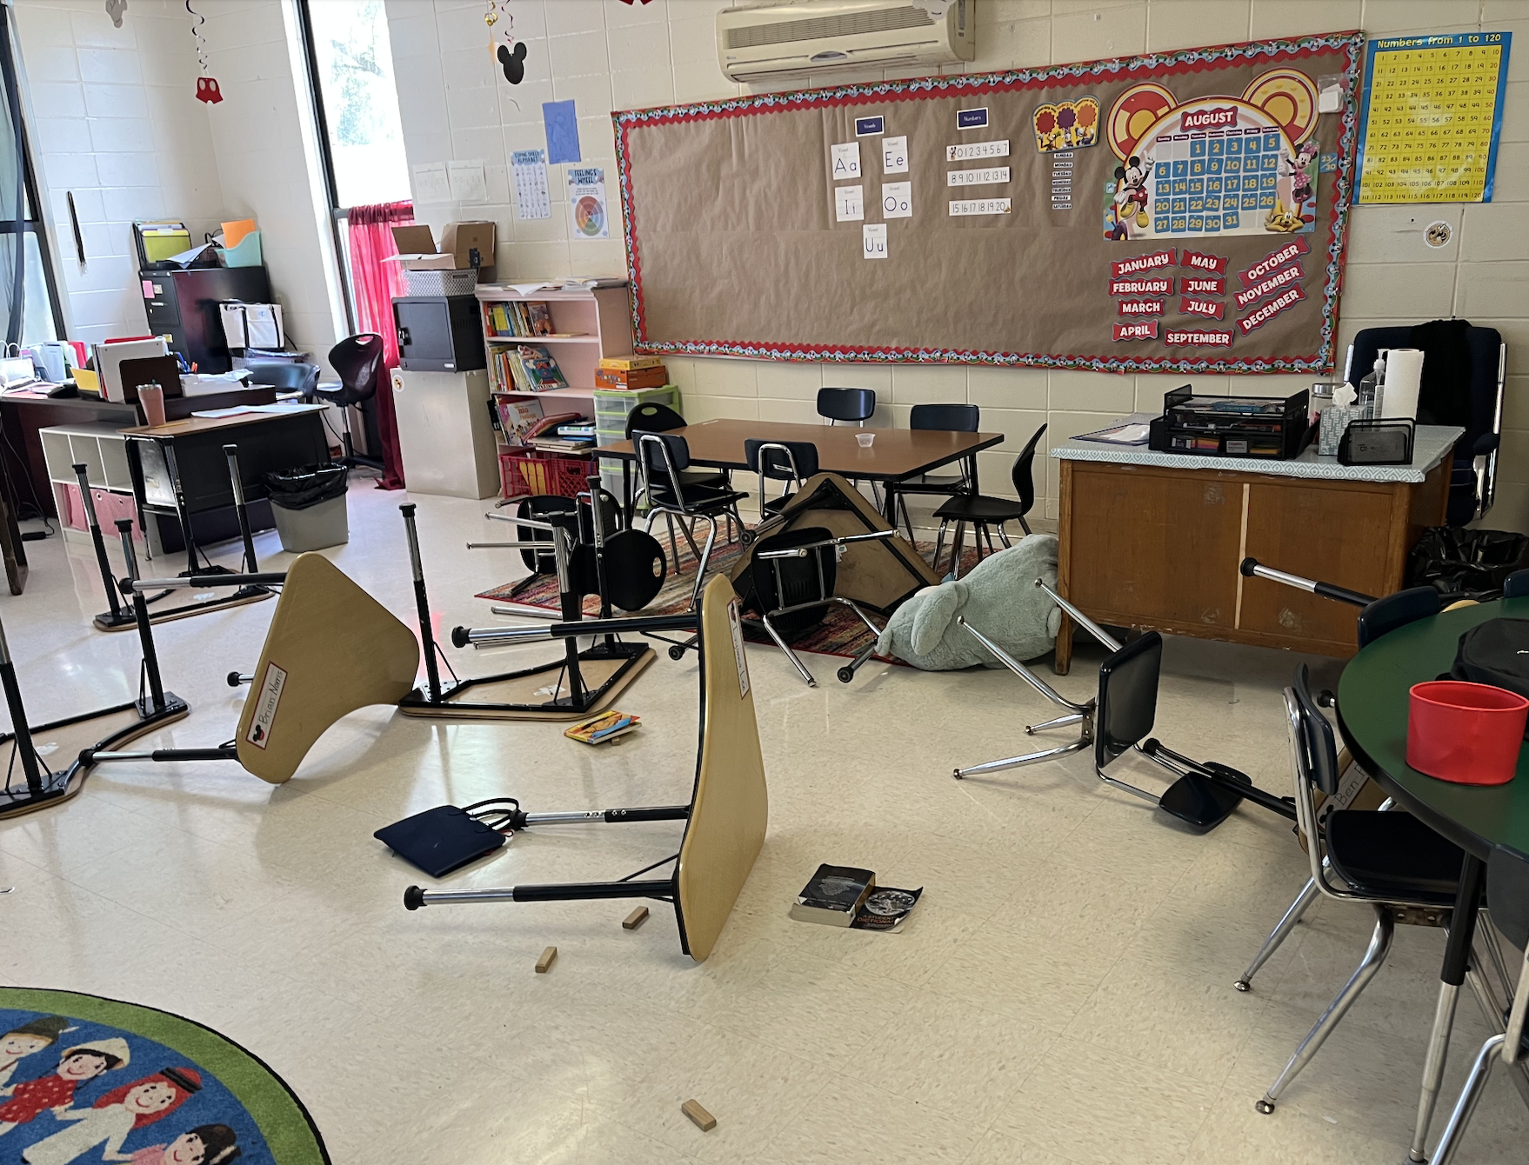
What is ‘severe behavior’?
Dangerous behavior
Aggression, self-injury, property destruction
Extremely disruptive behavior
Screaming, disrobing, spitting
Notes:
What do I mean when I say severe behavior? I’m really referring to 2 categories of behavior– dangerous behavior that could result in physical harm, like aggression or self-injury, and extremely disruptive behavior, like screaming or disrobing, which interferes with learning for everyone present. This is a picture from one of our students’ classrooms, and you can see he flipped tables and threw things like chairs and tablets all around the room.

Slide 4
Prevalence & Impact
5-10% of individuals with developmental disabilities
ASD, intellectual disability, fragile X syndrome, fetal alcohol spectrum disorder
Limits access to naturalistic settings
Stressful for caregivers
May result in injuries
Notes:
Research tells us that 5-10% of individuals with developmental disabilities engage in these complex and challenging behaviors. The students we serve have diagnoses like ASD, ID, fragile X syndrome, and fetal alcohol spectrum disorder. Unfortunately, the presence of severe behavior often limits these individuals’ access to naturalistic settings, it can be stressful for parents and teachers, and may even result in injuries.

Slide 5
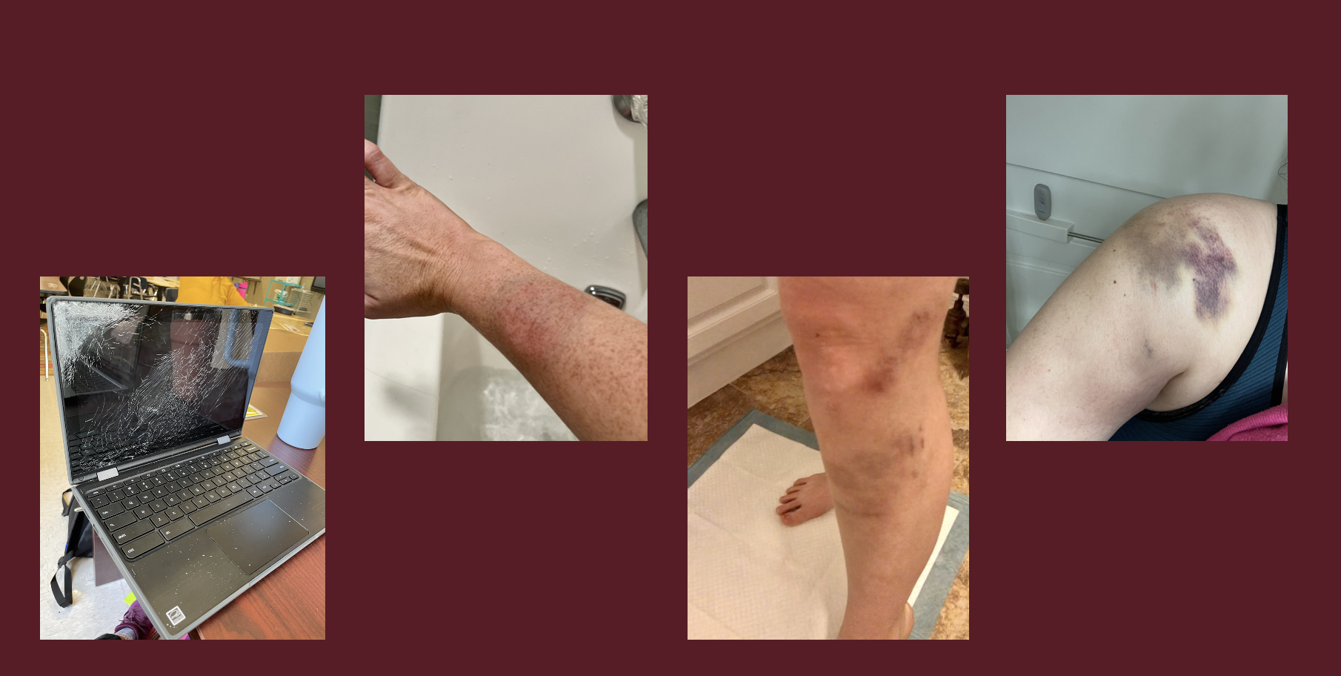
Notes:
These aren’t stock images…. There are real images shared by some of the folks we’ve worked with. You can see one of many destroyed computers, severe bruises resulting from bites and kicks, and one teacher even suffered a separated AC joint in her shoulder, which I’m sure was incredibly painful.

Slide 6
Our Program
1) Training for educators and mental health professionals
Best practices for assessment, intervention, and crisis management
2) Consultation
Short-term assistance and feedback
3) Intensive support
15-35 hours per week of support with implementation of intervention plan
Notes:
The LEAPS program provides 3 types of behavioral services this year. First, we provide training for educators and clinicians who support individuals with developmental disabilities. Second, we provide short term consultative support, where we observe, provide feedback and suggests, and conduct additional training as needed. And third, we provide intensive, hand-on support for students who we feel will need ongoing assessments and assistance with implementation for safety reasons.

Slide 7
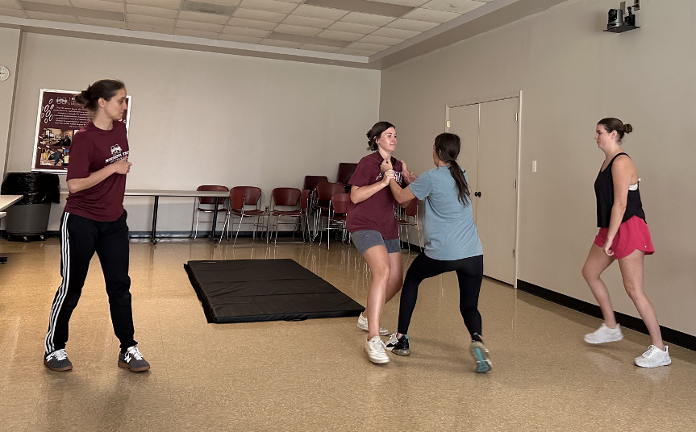
Our Program
Entirely community based
Prioritize capacity building
What will help now AND in the future?
Notes:
We provide all of our services within the student’s normal school setting to ensure we’re designing and developing solutions that are well suited for the child’s usual environment. We also really focus on capacity building, so people we work with develop the skills they definitely need now but also skills they might need later. Here, you can see me giving feedback during one of our crisis management trainings.

Slide 8
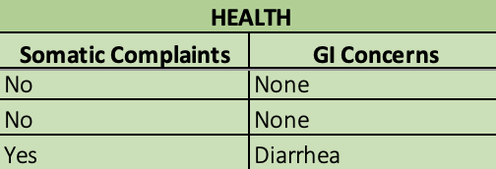
Our Approach
Collect and evaluate LOTS of data
Learn everything about child and school supports/challenges
Include and work closely with parents
Focus on increasing functional communication, teaching socially important skills
Match demands to child’s abilities
Notes:
So how do our actual interventions work? Well, we start by collecting and examining mountains of data. We interview teachers and parents, we observe across many days. Then we work with teachers and caregivers to find strategies they feel good about trying based on what we’ve learned. Our interventions use simple behavioral principles. We teach and prompt students to communicate instead of using challenging behavior to get what they want, and once they are communicating reliably, we teach them other skills like waiting and following instructions.

Slide 9
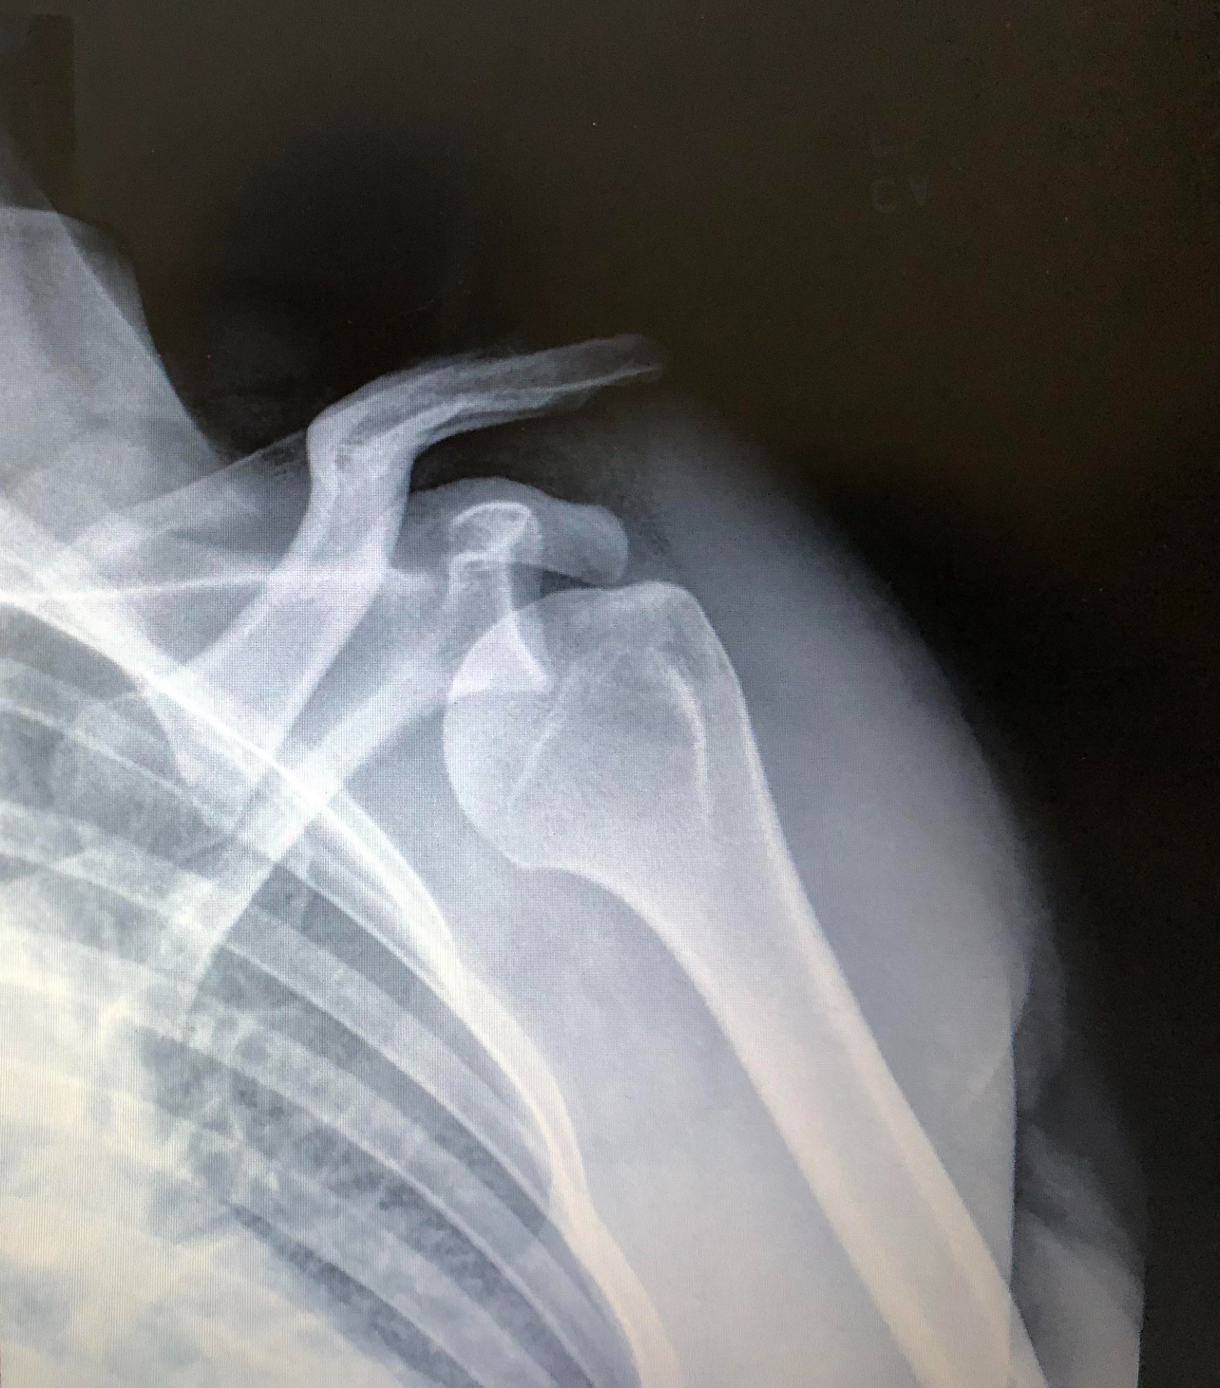
Case Example: Jacob
5-year-old boy diagnosed with ASD, some language delays
Referred for aggression towards peers and teachers, intense tantrums
Disrobing, throwing and destroying items, self-injury
Immediate risk of alternative placement
Notes:
To illustrate our approach, I will share a case example. Jacob was a 5-year-old boy with autism and some language delays. He had just started kindergarten, and he was referred to our program for aggression in the form of headbutting, which was directed at peers and teachers. He also had very intense tantrums, which would include behaviors like undressing, property destruction, and self—injury. During one tantrum, he headbutted a teacher and dislocated her shoulder, which required surgery. The school was interested in pursuing an alternative placement at a private facility.

Slide 10
Case Example: Jacob
Assessment
Predictors of challenging behavior: periods of low attention-- restricted access to preferred items-- challenging academic demands-- hunger-- poor sleep or health
Treatment
Phase 1) Teach and honor a single phrase (“I don’t like that”) to use instead of engaging in challenging behavior
Phase 2) Gradually increase tolerance of non-preferred contexts, shape language to be context-specific
Notes:
We conducted many assessments with Jacob and learned that there were many things he didn’t like about school, but also some reliable tells that he was about to engage in challenging behavior. Our treatment first focused on teaching him to use one simple phrase “I don’t like that” when he was becoming upset, and we initially honored that phrase every time by undoing whatever had upset Jacob. In the next phase of treatment, we taught him to tolerate increasingly long periods of things he did like, such as waiting for a teacher or toy. We also taught him other ways of communicating, like “I need help”.

Slide 11
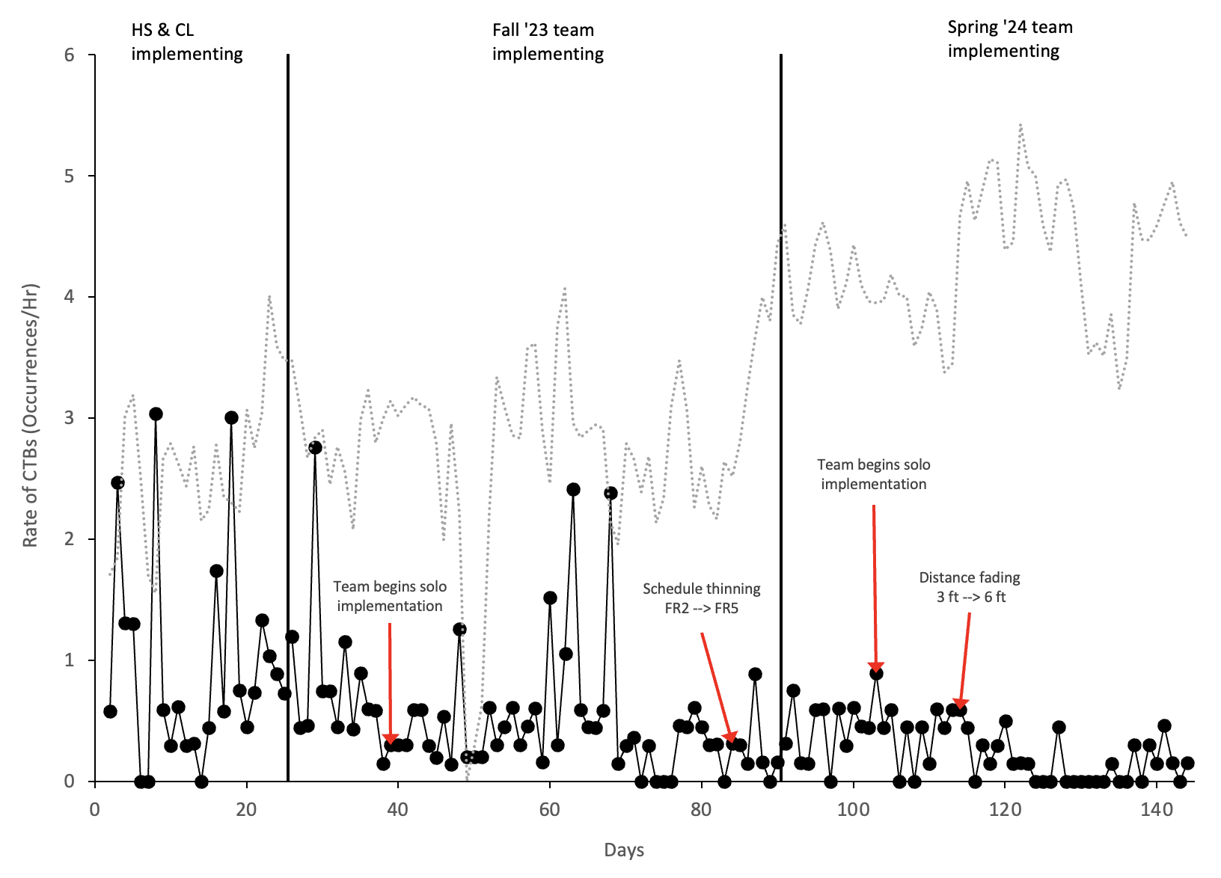
Case Example: Jacob
Time around peers: 0 minutes per day → 5 hours per day
Target behaviors: 93/hr (9/22) → .15/hr (3/24)
99.8% reduction without a change in setting
Notes:
18 months later, Jacob has gone from spending 0 minutes per day around his peers to around 5 hours per day. His target behaviors, which were occurring about 93 times per hour pre-treatment, are now occurring once or twice per day. This represents a 99.8% reduction in target behaviors without a change in educational placement.

Slide 12
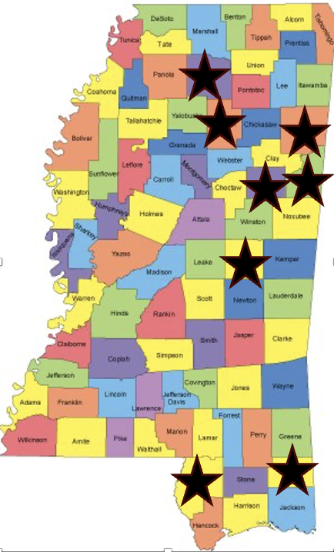
Program Outcomes
Provide over 100 service hours per week
Includes services to students and educators across the state
Have trained nearly 150 current and future educational, mental health professionals
Notes:
In terms of program outcomes, we’ve nearly double our service provision since last year. We’re currently providing over 100 no-cost service hours per week, and we have provided support in a number of counties across the state. To expand our reach even further, we’ve also provided in-depth and hands on trainings for nearly 150 educators and mental health professionals.

Slide 13
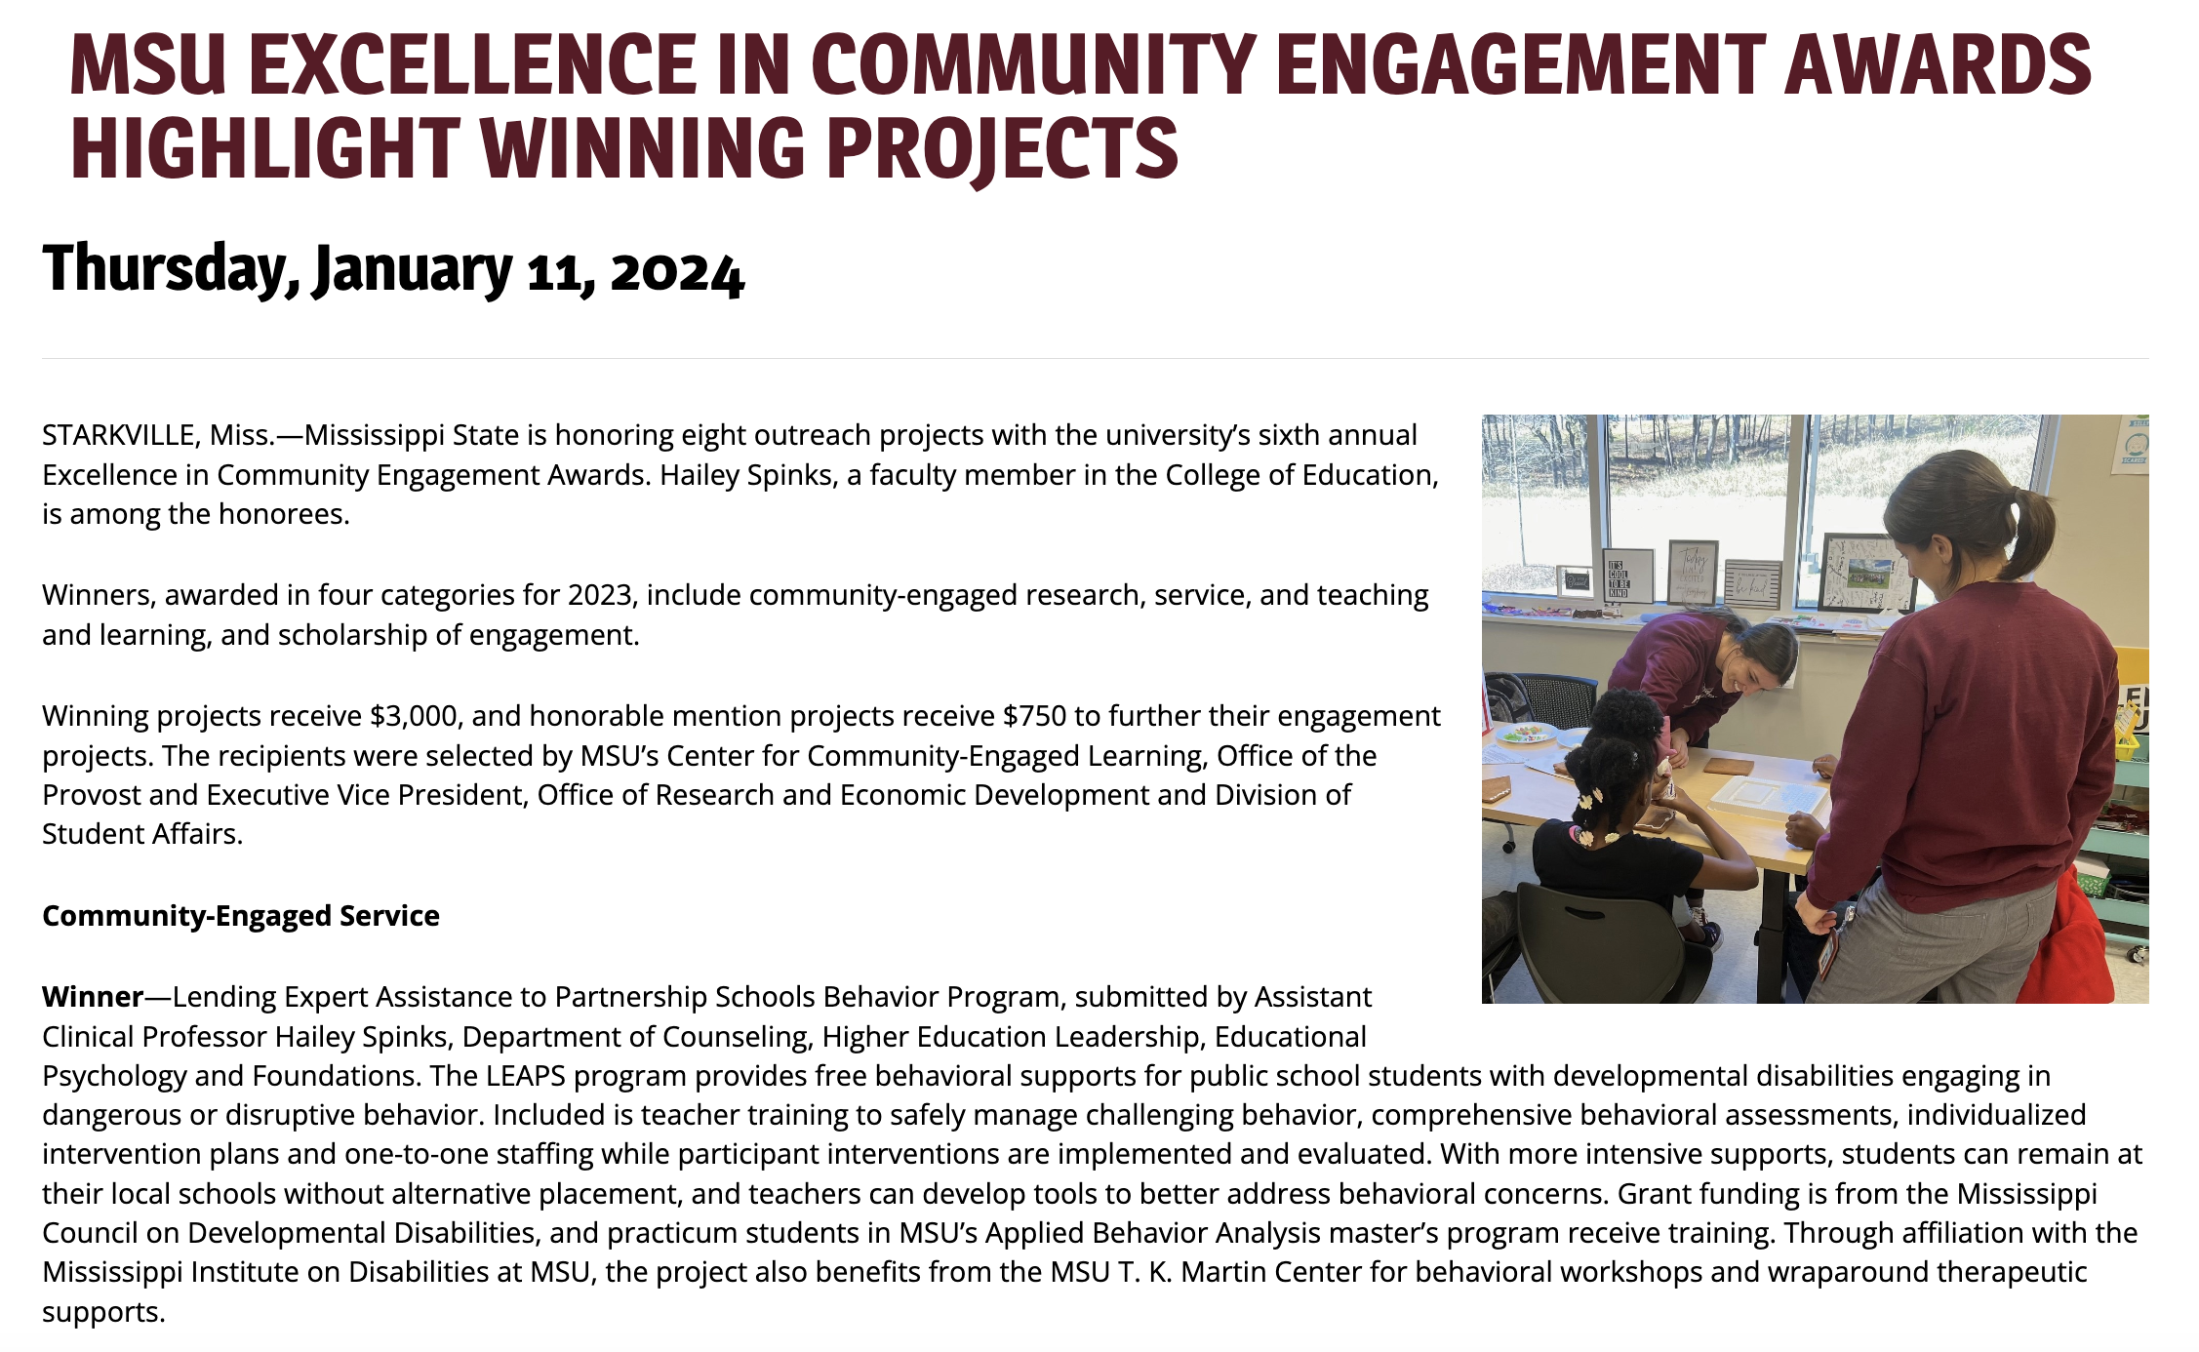
Program Outcomes
Notes:
Despite the notable growth in our program from year 1 to year 2, we’ve worked hard to maintain or improve the quality of services we are providing. This year, we won MSU’s Excellence in Community Engaged Service award. You can see me and another staff member here working with a student in her classroom.

Slide 14
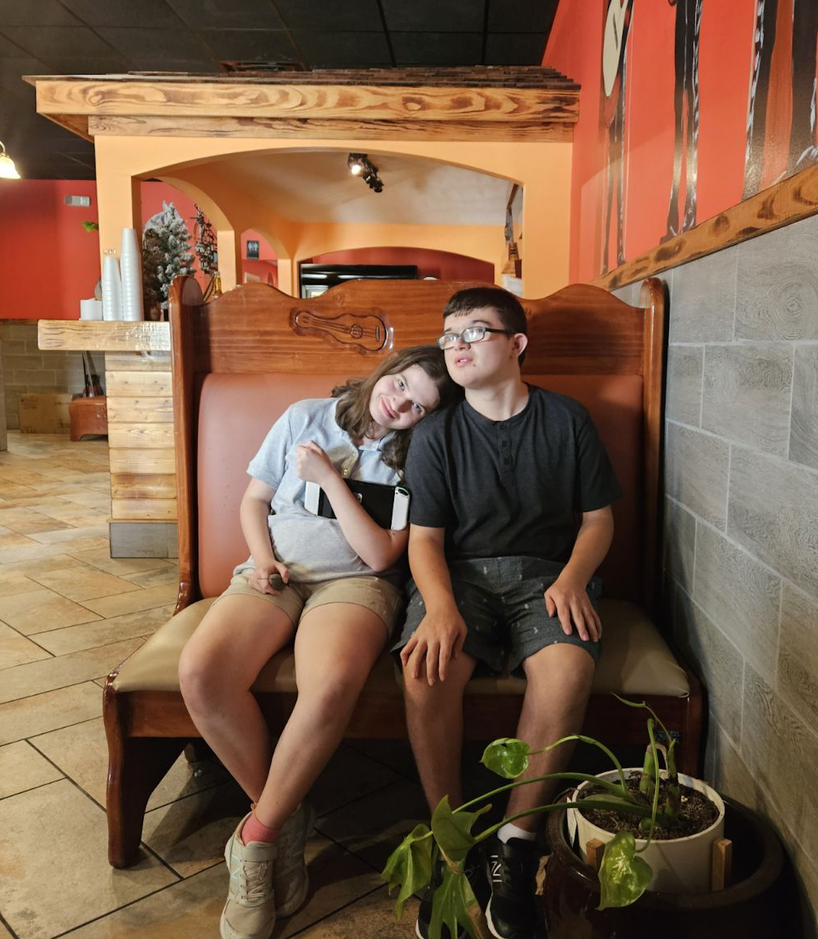
Resonant Impact
Students spend more time around peers and in less restrictive environments
Teachers feel calmer, better supported, and more skilled to work with students with severe behavior
Parents are more involved and feel more positive about their child’s school experience
Notes:
We believe that the impact of our program will be long-lasting for the students, educators, and families we are working with. Our data indicate that the student we work with spend more time around their peers and can participate in less restrictive environments, like inclusion classroom and community events. The teachers we work with report feeling much more able to manage their students with our support and feel more skills to work with these students in the future. Lastly, the parents and families we work with are more involved in their child’s educational planning and feel more positive about their student’s experiences at school.

